Slide 1
Employee Behavior Monitoring System Using Machine Learning
Project Members:-
Shweta Kadgi Sakib Patel
Akanksha Tathe Mayuri Rathod
Nikhil Katte Vrushali Relekar
Juveriya Shaikh
Name of industry – PiSyst India Pvt. Ltd.
Stipend provided - No
Name of industry mentor – Mandar Sonawane
Placement opportunity - No

Slide 2
Problem Statement Description
Predicting employee behavior
Reduced manual calculations
Easy way for employee appraisals

Slide 3
Why Selected Problem?
Why it is essential?
Project Idea

Slide 4
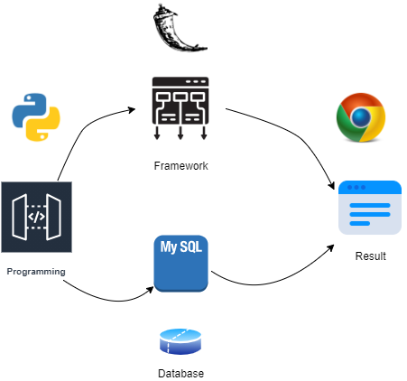
Technology Stack
Python
Flask Framework
MySql Database

Slide 5
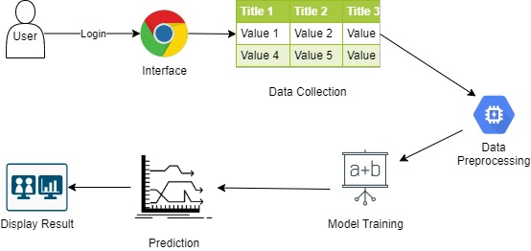
Implementation

Slide 6
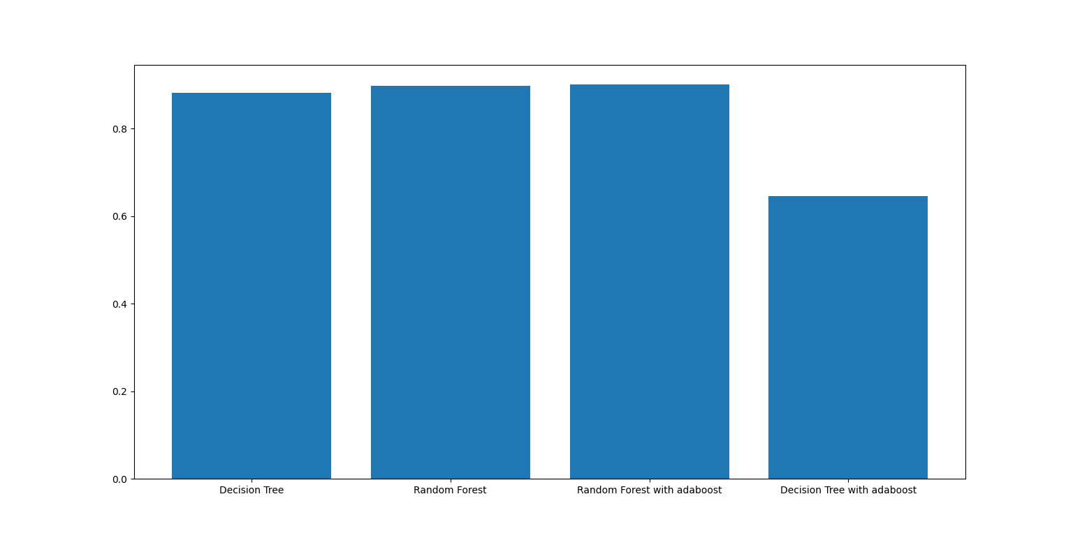
Algorithms Used
Linear Regression
Logistic Regression
Decision Tree
Random Forest
Decision Tree with Adaboost
Random Forest with Adaboost
Using Random Forest with Adaboost algorithm,
model gives best prediction with accuracy of 93.25%
88.22 89.74 93.25 64.61

Slide 7
Major Findings
Employee Behavior in organization.
Helps to monitor performance of employee.

Slide 8
Applications
Improve Workforce Management Efficiencies
Employee Engagement
Security Employee Information
HR data analytics and metrics

Slide 9
Thank you!

