Slide 1
MarketMind Predicting Stock Highs and Lows with Large Language Models
CS733 Project

Slide 2
Team Members
SOWMYA SREE BHAGYAM
ZAHEEN ANSAR
MOIN AHMED ZAHIR
01291648
01298069
01292798

Slide 3
Problem Statement
This project looks at how Large Language Models (LLMs) can be used to predict when a company’s stock might rise or fall in different situations.
By studying things like financial news, earnings reports, global events and influential tweets, the system tries to understand patterns in market sentiment and turn them into useful forecasts.
The aim is to see how well LLMs can connect language and data to make stock predictions more accurate and insightful.
Also, the system can be extended to provide Buy / Hold / Sell recommendations by mapping news-driven sentiment to potential market movements.
The goal is to make AI-powered market analysis more transparent, insightful, and decision-oriented.

Slide 4
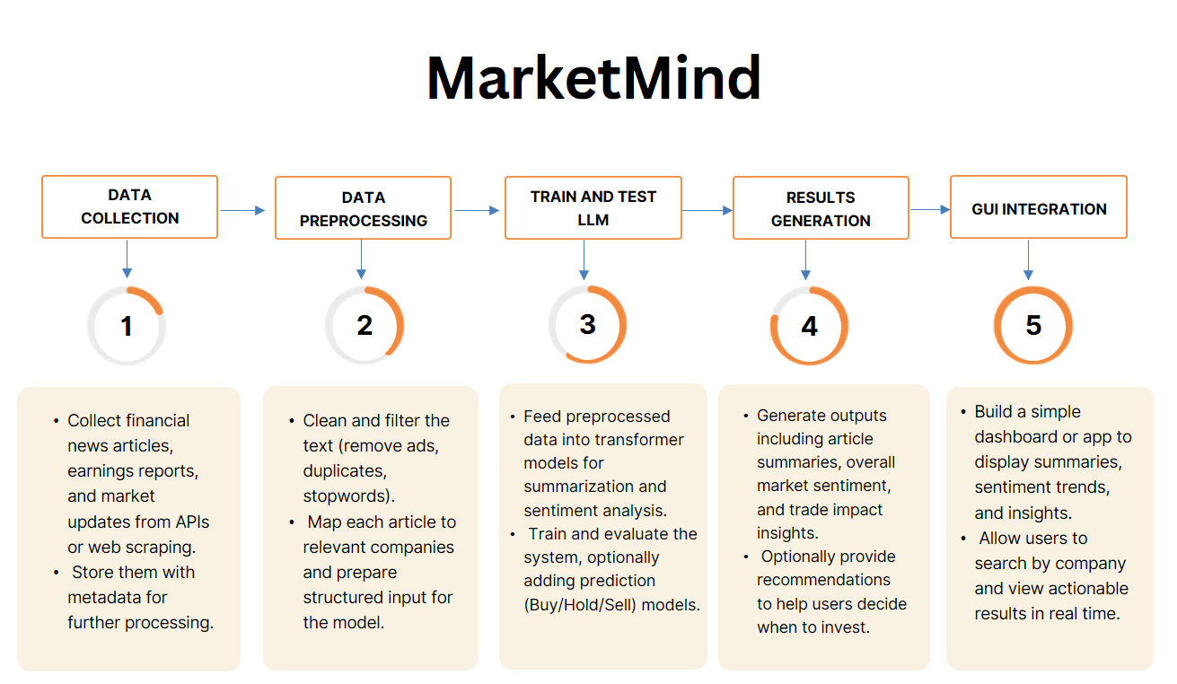
Workflow

Slide 5
Literature Review

Slide 6
1) Trading using LLM’s
NAME | SUMMARY | HOW IS IT RELATED
Large Language Models in Equity Markets: Applications, Techniques, and Insights. Authors: Jadhav, Aakanksha, and Vishal Mirza. - 2025. LINK TO THE PAPER | A comprehensive peer-reviewed survey looks at how LLMs are altering stock market research and trading. It analyzes 80+ studies published between 2020 and 2025 on sentiment analysis, predictive modeling, trading bots, reinforcement learning, and risk management. The research also looks at interpretability and ethics in financial AI. | It demonstrates that textual sentiment and narrative signals from financial papers may accurately forecast price fluctuations, which is the primary notion of research. It also frames LLMs as competent of delivering both interpretability (explaining the sentiment behind recommendations) and decision orientation (buy, hold, or sell).
Large Language Model Agent in Financial Trading: A Surve. Authors: Ding, H., Y. Li, J. Wang, and H. Chen. - 2024. LINK TO THE PAPER | This survey focuses on LLM-based trading agents, which understand text and trade autonomously in simulations or live markets. It examines how LLMs function as reasoning agents, coordinate in multi-agent systems, and interact with reinforcement learning to make judgments. | The technology could turn into a decision-making trading helper. This survey demonstrates the "predict → decide → act" pipeline, which transforms language-understanding capabilities into trading bots. It also emphasizes the relationship between sentiment extraction and automated trading behavior.

Slide 7
NAME | SUMMARY | HOW IS IT RELATED
AI Powered Indicatorless Algorithmic Trading Bot for Cryptocurrency and Financial Market. Authors: Olorunsheye, Akinlemi Olushola, and S. P. Meenakshi. - 2024. LINK TO THE PAPER | This paper presents an AI-based trading bot that predicts market movements and executes trades without relying on traditional indicators. Using price action analysis and a mathematical recovery lot-sizing model trained on eight years of data, it achieved a 297% profit over 22 months with only 1.06% drawdown, outperforming indicator-based methods. | This paper supports our project by showing how AI can learn patterns directly from raw market data, similar to your goal of using large language models to extract sentiment and predictive insights from financial news for smarter, adaptive trading strategies.
Machine Learning, Stock Market Forecasting, and Market Efficiency: A Comparative Study. Authors: Bustos, Oscar, Alexandra Pomares-Quimbaya, and Rémi Stellian. - 2025. LINK TO THE PAPER | This study compares and tests numerous machine learning models for stock forecasting (Random Forest, SVM, LSTM, XGBoost, etc.) using the Efficient Market Hypothesis. It concludes that, while ML may identify short-term predictive patterns, true long-term forecasting is limited by market efficiency. | It serves as the non-text baseline for work, demonstrating what typical machine learning can do in the absence of language models. LLM-based approach incorporates the missing "semantic sentiment layer," potentially providing an advantage in less efficient, sentiment-driven times.

Slide 8
NAME | SUMMARY | HOW IS IT RELATED
Transforming Algorithmic Trading with AI: Achieving Competitive Market Edge. Authors: Vardhan, Harsh, Neha Sharma, Manish Kumar, Rahul Kumar Singh, Riman Mandal, and Imran Siraj. - 2024. LINK TO THE PAPER | This paper explores an AI-based trading bot that applies the Dollar Cost Averaging (DCA) strategy to automate market orders, manage risk, and ensure consistent profits. Tested on historical data, the bot achieved steady 2% gains per trade while maintaining effective risk control. The study also reviews AI techniques such as deep learning and reinforcement learning for market forecasting and trading optimization. | This paper helps our project by showing how AI can automate trading and analyze market patterns—an approach we can extend using LLMs to interpret financial news, earnings reports, and global events for sentiment-based predictions. It provides a strong foundation for linking quantitative trading algorithms with language-driven financial intelligence.

Slide 9
2) LLMs using Financial News
NAME | SUMMARY | HOW IS IT RELATED
Stock Price Trend Prediction using Emotion Analysis of Financial Headlines with Distilled LLM Model. Authors: Bhat, Rithesh, and Bhanu Jain. - 2024. LINK TO THE PAPER | This paper shows how emotions in financial news headlines can predict stock price movements without relying on traditional market data. Using APIs to collect headlines from major U.S. companies, the authors fine-tuned a Distilled LLM (DistilRoBERTa) model to detect emotional tones like joy, fear, and sadness, and trained machine learning models to forecast next-day price direction. | This paper helps our project by providing evidence that lightweight LLMs can efficiently analyze financial text, supporting our goal of using large language models to interpret news and global events for sentiment-driven trading forecasts.
FinLlama: LLM-Based Financial Sentiment Analysis for Algorithmic Trading. Authors: Iacovides, Giorgos, Thanos Konstantinidis, Mingxue Xu, and Danilo Mandic. - 2024. LINK TO THE PAPER | This paper introduces FinLlama, a finance-specific LLM fine-tuned from Llama 2 (7B) using LoRA for financial sentiment analysis and trading. It classifies sentiment as positive, negative, or neutral while measuring its strength, analyzing news from sources like Reuters and MarketWatch to generate trading signals. FinLlama outperforms lexicon-based methods and FinBERT, achieving 308% cumulative returns and a Sharpe ratio of 2.4, showing that fine-tuned LLMs can turn news sentiment into profitable trading insights. | This paper supports our project by showing how fine-tuned LLMs can turn financial text into actionable trading signals, aligning with our goal of using large language models for sentiment-driven market forecasting.

Slide 10
NAME | SUMMARY | HOW IS IT RELATED
Fine-Tuning Large Language Models for Stock Return Prediction. Authors: Guo, Tian, and Emmanuel Hauptmann. - 2024. LINK TO THE PAPER | This paper fine-tunes Large Language Models (LLMs) to predict stock returns from financial news—a key task in quantitative investing. It compares encoder-only and decoder-only LLMs, testing two ways to integrate token embeddings into forecasting. Results show that: (1) aggregated LLM representations boost portfolio performance, (2) decoder-based models excel in larger universes, and (3) LLM predictions outperform sentiment-based methods. Fine-tuned LLMs thus show strong promise for stock return prediction and portfolio optimization. | This helps our project because we also use LLM’s to study financial news and link language patterns with stock performance.
From News to Forecast: Integrating Event Analysis in LLM-Based Time Series Forecasting with Reflection Authors: Wang, Xinlei, Maike Feng, Jing Qiu, Jinjin Gu, and Junhua Zhao. - 2024. LINK TO THE PAPER | This paper presents a method that combines large language models (LLMs) with time-series forecasting by incorporating event information from news data. Using a reflection mechanism, the model reasons about how external events like financial crises or policy changes influence future market trends. By merging event embeddings from text with numerical data, it achieves higher forecasting accuracy than traditional models. | This paper supports our project by showing how integrating event-driven insights into LLMs can improve sentiment-based trading predictions and make forecasts more context-aware and adaptive.

Slide 11
NAME | SUMMARY | HOW IS IT RELATED
Predicting Market Reactions to News: An LLM-Based Approach Using Spanish Business Articles. Authors: Villota Miranda, Jesus. - 2024. LINK TO THE PAPER | This paper presents a method using LLMs to classify firm-specific economic shocks in financial news by type, size, and direction. It overcomes traditional text analysis limits in interpreting complex market information. By applying economic frameworks, the model improves understanding of market reactions to news. A trading strategy based on LLM classifications outperforms benchmark methods with consistent profits. The study shows LLMs can enhance market efficiency analysis and identify reliable trading patterns. | This paper supports our project by showing how LLMs can analyze financial news to detect firm-specific market impacts. It helps improve prediction accuracy by linking economic context with market reactions. The study shows LLMs outperform traditional models in news-based trading strategies. It provides a strong base for developing interpretable and profit-driven stock prediction models.

Slide 12
3) LLMs using Textual data(Tweets or Sentiments)
NAME | SUMMARY | HOW IS IT RELATED
FinBERT: A Large Language Model for Extracting Information from Financial Text. Authors: A. H. Huang, H. Wang, and Y. Yang. - 2023. LINK TO THE PAPER | FinBERT is a finance-specific language model that outperforms standard models like SVM, CNN, and LSTM, as well as general BERT variants. It excels at detecting subtle sentiment in analyst reports, and effectively identifying ESG-related content to enhance insights from financial documents like earnings calls. | FinBERT is valuable for our project as it understands financial language, enabling accurate sentiment detection from news and reports. Its context-aware analysis captures subtle cues that drive market movements. FinBERT can be fine-tuned on our dataset as a strong baseline for prediction, while also supporting deeper insights like ESG and trend analysis to enhance market forecasting.
Predicting Stock Price Movement with LLM-Enhanced Tweet Features. Authors: Vuong, An, and Susan Gauch. - 2025. LINK TO THE PAPER | This study builds a deep learning model for short-term stock prediction using tweet sentiments and price data. With LLaMA 3.1-8B and DistilRoBERTa, it raises accuracy from 13.5% to 38.5%, showing that LLM-driven emotion analysis improves forecasts. | This paper supports our MarketMind project by showing how LLMs enhance emotion-based stock prediction. Using LLaMA to preprocess tweets improves sentiment features, and combining textual and numerical data boosts accuracy—advancing our goal of predicting stock highs and lows more precisely.

Slide 13
NAME | SUMMARY | HOW IS IT RELATED
TAT-LLM: A Specialized Language Model for Discrete Reasoning over Financial Tabular and Textual Data. Authors: Zhu, Fengbin, Ziyang Liu, Fuli Feng, Chao Wang, Moxin Li, and Tat Seng Chua. - 2024 LINK TO THE PAPER | TAT-LLM is a finance-specific model that answers questions using text and tables through a Step-wise Pipeline (Extractor → Reasoner → Executor) for better reasoning and transparency. Fine-tuned on LLaMA 2, it outperforms GPT-4 on FinQA, reducing costs, latency, and security risks while contributing new datasets for financial LLM research. | This paper helps our project by showing how LLMs can process both text and structured financial data. The Step-wise Pipeline improves multi-step reasoning and accuracy by combining textual and structured insights, offering better interpretability and enhancing our model’s understanding of financial documents and trends.
Predicting stock price trends using language models to extract sell-side analysts report signals. Authors: Moreno, Alejandro, and Joaquín Ordieres-Meré. - 2025 LINK TO THE PAPER | This study looks into how LLMs can extract sentiment from sell-side equity analyst reports and forecast stock trends for IBEX 35 businesses. Using RoBERTa, FinBERT, and GPT, an examination of reports from 2016-2022 reveals that sentiment signals can forecast price fluctuations while minimizing bias from target prices, proving LLMs' ability to enhance informed investment decisions. | For our project this paper is useful because we also focus on using textual sentiment like from news or reports to forecast market highs and lows.

Slide 14
NAME | SUMMARY | HOW IS IT RELATED
Stock Market Forecasting: From Traditional Predictive Methods to LLMs. Authors: Darwish, Mahmoud, Ehab E. Hassanien, and Amany HB Eissa. - 2025 LINK TO THE PAPER | This survey reviews recent progress in stock market forecasting, focusing on the growing role of Large Language Models (LLMs) in financial analytics. It covers techniques like feature engineering, hybrid and ensemble models, and text-based prediction. The study explains how LLMs enhance sentiment analysis and forecasting through transfer and few-shot learning. It also discusses combining LLMs with machine learning and reinforcement learning to improve accuracy and explainability. Finally, it highlights research gaps and future directions for integrating LLMs with traditional predictive models. | This connects to our project because we aim to combine financial text analysis with data based forecasting using LLMs to make market predictions more accurate and understandable.

Slide 15
Introduction
MarketMind is an AI-powered investment assistant that integrates Large Language Model (LLM) reasoning with domain-specific financial sentiment analysis.
The goal is to bridge the gap between natural investor queries and actionable market insights.
Traditional financial models like FinBERT classify sentiment but lack contextual understanding and conversational adaptability.
To address this, MarketMind combines OpenAI’s GPT-4o-mini for reasoning with FinBERT for financial sentiment classification.
GPT-4o-mini interprets investor language, rewriting vague or narrative queries into structured financial headlines.
These headlines are analyzed by FinBERT to predict sentiment as Buy, Hold, or Sell, along with confidence probabilities.
The system is implemented through a Gradio-based interactive interface that supports multi-turn conversation and zoom accessibility.
FinBERT was retrained over 10 epochs on a curated financial dataset to enhance domain sensitivity.
This dual-layer reasoning–classification pipeline enables the chatbot to provide intelligent, context-aware investment insights.
The architecture is modular, comprising three layers — UI, reasoning, and decision — forming an end-to-end inference flow.
MarketMind demonstrates the synergy between general-purpose LLMs and fine-tuned transformer models for financial analytics.
Evaluation metrics such as accuracy, F1-score, and confusion matrices confirm its prediction reliability.
The chatbot offers an accessible interface for both investors and learners in finance and AI.
In summary, MarketMind represents a novel integration of language understanding and financial intelligence, paving the way for future AI-driven advisory systems.

Slide 16
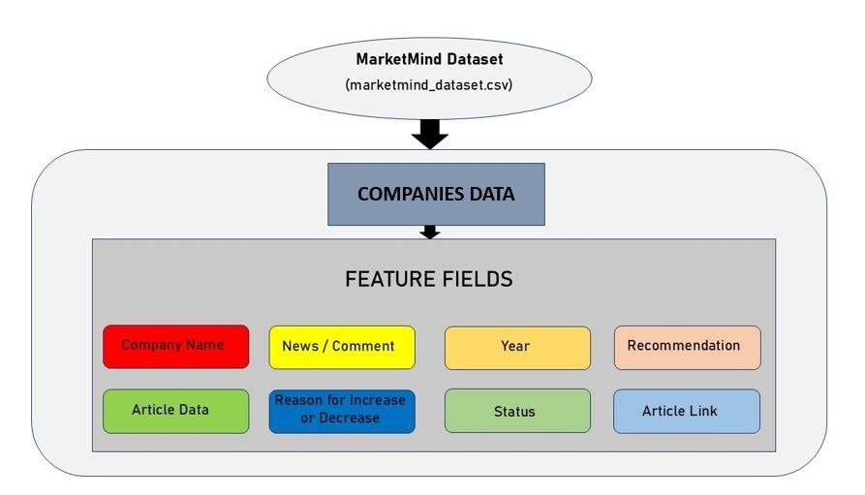
Dataset Overview
We created a curated dataset covering 60 companies, including major corporations and emerging startups, by collecting five relevant news articles or tweets for each company.
All items were manually selected from credible financial sources to ensure they reflected events that could influence stock movement.
Each entry was labeled with company name, news text, year, sentiment, a Buy/Hold/Sell recommendation, and the original article link.
This structured dataset was then organized into a clean CSV format and used to train and evaluate the MarketMind prediction system.

Slide 17
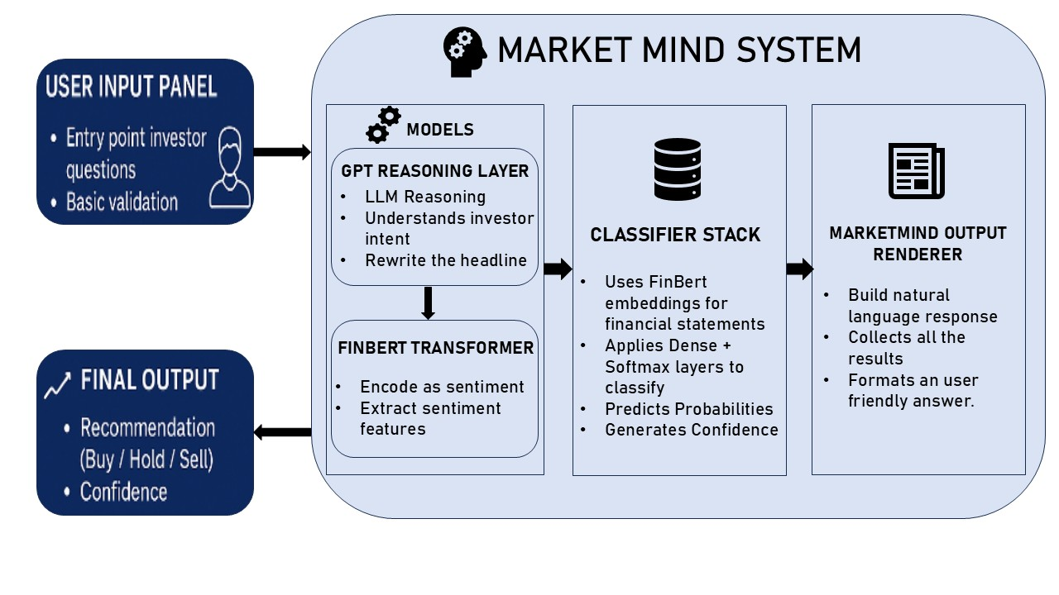
Architecture Diagram
This architecture illustrates how MarketMind integrates LLM reasoning with FinBERT sentiment analysis to transform user queries into structured stock (Buy/Hold/Sell) predictions.

Slide 18
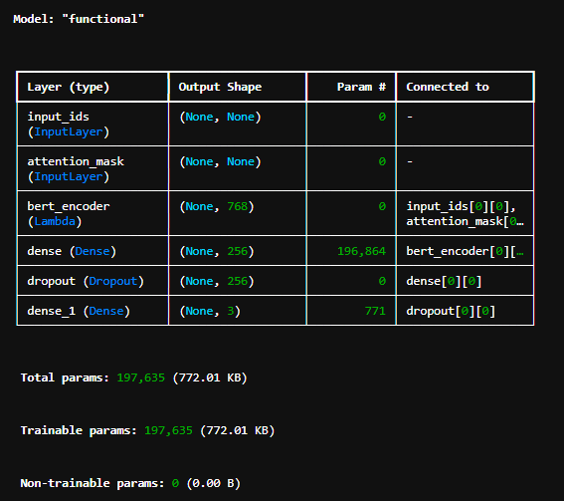
Implementation Details
Data Preprocessing
Loaded dataset of news/tweets + metadata + Buy/Hold/Sell labels
Combined text fields: NewsOrComment + Reason + Status
Encoded labels (sell=0, hold=1, buy=2)
Balanced the dataset using upsampling → each class = 125 samples
Split into Train (262), Validation (56), Test (57)
Model Architecture
Used FinBERT (yiyanghkust/finbert-tone) tokenizer + model
Extracted CLS embedding (768-dim) per text
Classifier head:
Dense(256, ReLU) → Dropout(0.3) → Dense(3-class Softmax)
Trained with Adam (3e-5) for 10 epochs
Training Performance
Validation accuracy improved from 0.51 → 0.71 across epochs
Loss consistently decreased (1.01 → 0.69)

Slide 19
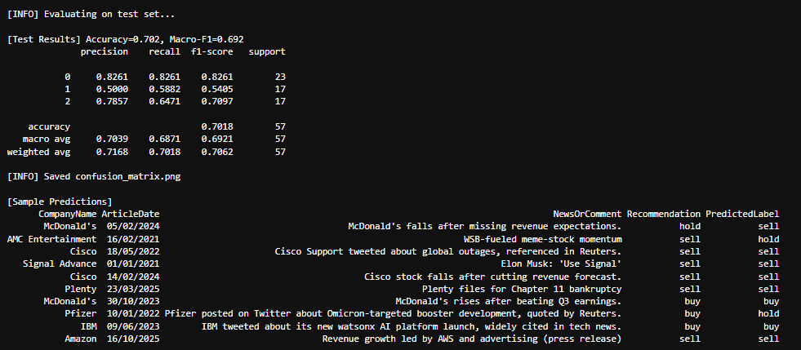
Evaluation Details and Results
Final Test Results
Accuracy: 0.719
Macro F1-Score: 0.696
Class-wise performance:
Sell: F1 = 0.85
Hold: F1 = 0.53
Buy: F1 = 0.70
Saved confusion matrix + training curves
Sample Predictions (Model predicts reasonable sentiment for real-world headlines):
McDonald’s falls after missing expectations → Sell
Cisco stock falls after revenue cut → Sell
Pfizer booster development → Hold
Plenty files for bankruptcy → Sell
Outputs Saved
Trained model: marketmind_finbert_model.keras
Saved artifacts: training curves, confusion matrix, sample predictions

Slide 20
UI Implementation
Model Components
Loads trained FinBERT model: marketmind_finbert_model.keras
Uses FinBERT tokenizer for encoding input text
GPT-4o-mini used for:
  Extracting one company name from user message
  Rewriting the user’s input into a short factual headline with the current month/year
Prediction Workflow
User sends natural-language message
GPT extracts company_now
If same company as previous turn → merges context
GPT rewrites the merged text into a clean headline
FinBERT predicts Sell / Hold / Buy + probability scores
Chatbot returns:
  Headline
  Predicted action
  Confidence percentages

Slide 21
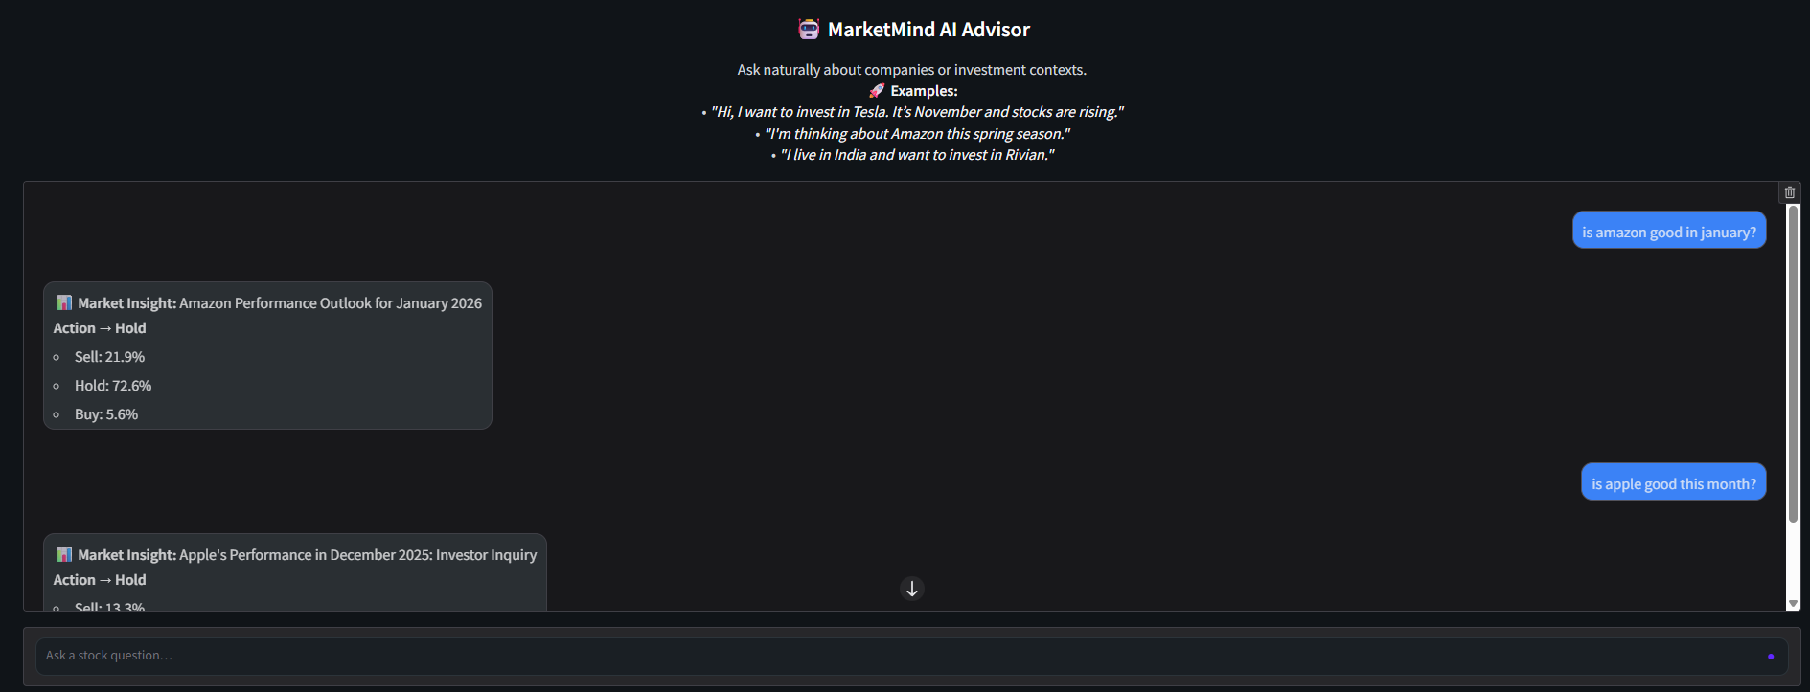
UI Implementation

Slide 22
Impact
Limitations and Future Works
Shows how NLP can support financial decision-making
Demonstrates practical integration of LLMs + specialized financial models
Produces consistent, explainable outputs rather than unreliable “pure LLM guessing”
Highlights the potential of AI-assisted investment analysis
Training data is limited and synthetic—real-world datasets would improve performance
FinBERT is frozen; fine-tuning could boost accuracy further
Expand coverage to multiple companies/concepts at once
Add portfolio simulation, risk scoring, or multi-factor reasoning

Slide 23
Conclusion
The MarketMind project demonstrates the power of combining domain-specific NLP with advanced language models to build a practical, intelligent investment assistant.
By training a FinBERT-based classifier on curated financial news, influential tweets(involving various sentiments) and balancing the dataset, we achieved strong performance in predicting Buy, Hold, or Sell signals.
This model was then integrated into a GPT-4o-mini powered chatbot capable of extracting companies, rewriting user inputs into clear financial headlines, and providing sentiment-driven investment suggestions with confidence scores.
The system maintains conversational context, ensures accurate company identification, and presents insights in a clean, user-friendly Gradio interface.
Overall, MarketMind shows how LLM reasoning and financial sentiment classification can work together to create a reliable, explainable decision-support tool.
While not a substitute for professional financial advice, this project highlights the potential of modern NLP technologies to assist investors in interpreting market news, and it lays the foundation for future improvements in robustness, dataset scale, and advanced market-aware features.

Slide 24
Work Division
Zaheen
Data Collection, Processing and Presentation
Sowmya
Coding and Data Processing
Moin
Coding and GUI implementation

Slide 25
References
Jadhav, Aakanksha, and Vishal Mirza. "Large Language Models in Equity Markets: Applications, Techniques, and Insights." Techniques, and Insights (March 15, 2025) (2025).
Ding, H., Y. Li, J. Wang, and H. Chen. "Large language model agent in financial trading: A survey. arXiv." arXiv preprint arXiv:2408.06361 (2024).
Olorunsheye, Akinlemi Olushola, and S. P. Meenakshi. "AI powered indicatorless algorithmic trading bot for cryptocurrency and financial market." In 2024 International Conference on Emerging Technologies in Computer Science for Interdisciplinary Applications (ICETCS), pp. 1-6. IEEE, 2024.
Bustos, Oscar, Alexandra Pomares-Quimbaya, and Rémi Stellian. "Machine learning, stock market forecasting, and market efficiency: a comparative study." International Journal of Data Science and Analytics (2025): 1-25.
Vardhan, Harsh, Neha Sharma, Manish Kumar, Rahul Kumar Singh, Riman Mandal, and Imran Siraj. "Transforming Algorithmic Trading with AI: Achieving Competitive Market Edge." In 2024 13th International Conference on System Modeling & Advancement in Research Trends (SMART), pp. 456-461. IEEE, 2024.
Bhat, Rithesh, and Bhanu Jain. "Stock price trend prediction using emotion analysis of financial headlines with distilled llm model." In Proceedings of the 17th International Conference on PErvasive Technologies Related to Assistive Environments, pp. 67-73. 2024.
Iacovides, Giorgos, Thanos Konstantinidis, Mingxue Xu, and Danilo Mandic. "Finllama: Llm-based financial sentiment analysis for algorithmic trading." In Proceedings of the 5th ACM International Conference on AI in Finance, pp. 134-141. 2024.
Guo, Tian, and Emmanuel Hauptmann. "Fine-tuning large language models for stock return prediction using newsflow." arXiv preprint arXiv:2407.18103 (2024).

Slide 26
References
9. Wang, Xinlei, Maike Feng, Jing Qiu, Jinjin Gu, and Junhua Zhao. "From news to forecast: Integrating event analysis in llm-based time series forecasting with reflection." Advances in Neural Information Processing Systems 37 (2024): 58118-58153.
10. Villota Miranda, Jesus. "Predicting Market Reactions to News: An LLM-Based Approach Using Spanish Business Articles." In Generative AI in Finance Conference,(John Molson School of Business, Montreal). 2024.
11. A. H. Huang, H. Wang, and Y. Yang, “FinBERT: A large language model for extracting information from financial text,” Contemporary Accounting Research, vol. 40, no. 2, pp. 806-841, 2023, doi: 10.1111/1911-3846.12832.
12. Vuong, An, and Susan Gauch. "Predicting Stock Price Movement with LLM-Enhanced Tweet Emotion Analysis." arXiv preprint arXiv:2510.03633 (2025).
13. Zhu, Fengbin, Ziyang Liu, Fuli Feng, Chao Wang, Moxin Li, and Tat Seng Chua. "Tat-llm: A specialized language model for discrete reasoning over financial tabular and textual data." In Proceedings of the 5th ACM International Conference on AI in Finance, pp. 310-318. 2024.
14. Moreno, Alejandro, and Joaquín Ordieres-Meré. "Predicting stock price trends using language models to extract the sentiment from analyst reports: Evidence from IBEX 35-listed companies." Economics Letters (2025): 112404.
15. Darwish, Mahmoud, Ehab E. Hassanien, and Amany HB Eissa. "Stock Market Forecasting: From Traditional Predictive Models to Large Language Models: M. Darwish et al." Computational Economics (2025): 1-45.

Slide 27
Thank You!!

