Slide 1
Secure And Reliable Data Forwarding Against Blackhole And Wormhole Attacks In Mobile Ad Hoc Networks
by
Mazharul Islam
Roll : 1807102
Supervised by
Professor Dr. Kazi Md. Rokibul Alam
Professor
Dept. of CSE, KUET

Slide 2
Outlines
Introduction
Related Works
Objectives
Contributions
Tools
Methodology
Proposed scheme
Result Analysis
Performance Evaluation
Base paper: Elbasher et al. “Secure and reliable data forwarding using homomorphic encryption against blackhole attacks based on mobile ad hoc network”. JISA, 2020, 51, 102425

Slide 3
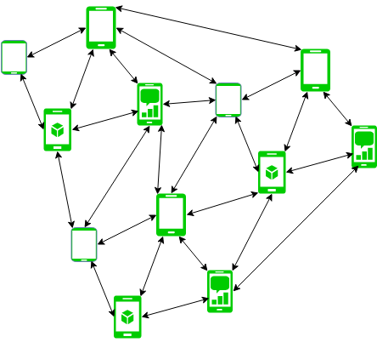
Introduction
Mobile Ad-hoc Network(MANET)
Wireless network with no fixed infrastructure with mobile devices as nodes
Known for their highly mobility, self-configuring
and self-organizing
MANETs are constructed with dynamic nodes so they allow frequent moves in the network
This flexibility is critical for communication during disaster and military operations
Fig 1. Mobile Ad hoc Network

Slide 4
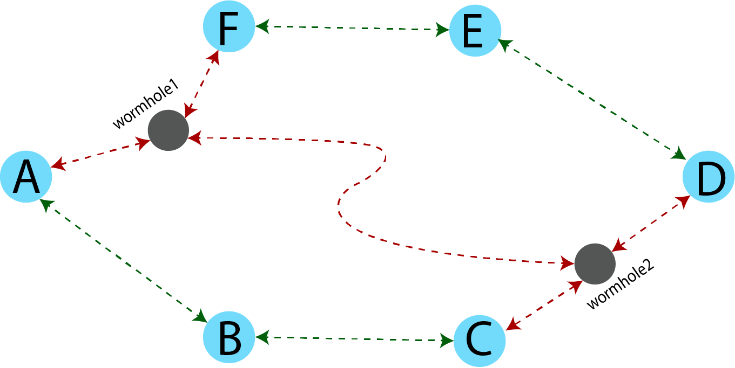
Problem Statement
MANET security challenges
Highly decentralized, expose to unauthorized access
Multipath Routing and Malicious Nodes
Results in data loss while forwarding control packets
Blackhole and Wormhole Attacks in AOMDV
Blackhole nodes can mislead traffic onto fabricated paths,
disrupting communication by dropping packets
Wormhole can bypass the important data packet to another route.
Fig 2: Wormhole attack

Slide 5
Table 1: Comparison between the related works and the proposed scheme
Related Works
work | Key focus | Approach and Features | Overhead | Packet loss | Security Constrained | End-to-end delay
1 | End-to-end secure trans-mission In MANET | Utilizes multipath routing for resilience and adaptability | yes | yes | yes | yes
2 | Data confidentiality enhancement in MANETs | Secret sharing, safeguard against compromised nodes. | yes | no | no | yes
3 | Detection and prevention of attacker nodes in WSNs | Divide WSNs in clusters with powerful nodes. | no | yes | yes | yes
4 | Route selection security enhancement in MANETs | Adds route reliability to routing table | yes | yes | no | yes
5 | Self-organized Network-layer security in MANETs | Detects malicious nodes, shields routing and forwarding. | yes | no | no | yes
Proposed | High reliability security in data transmission | Using Homomorphic cryptosystem with AOMDV protocol | no | no | no | yes

Slide 6
Research Gap
Both reliability and security for routing protocol for data transmission
is missing.
Lack of security in message transmission.
Routing protocol with more overhead and less throughput.
Vulnerable to Blackhole, Wormhole attacks etc.

Slide 7
Objectives
To provide a reliable and secure AOMDV routing protocol for data transmission
Discover available secure route by efficient authentication scheme
To make AOMDV routing protocol more efficient
Secure data packets from Blackhole and Wormhole attacks.

Slide 8
Contributions
Leverages the AOMDV protocol to establish multiple paths and transmits securely with these paths
Encrypted by Enhanced Homomorphic Cryptosystem (EHC)
Make the AOMDV Protocol of intrusion avoidance from intrusion detection
Counters the malicious nodes – The Blackholes and The Wormholes
Ensures the transmission of entire message without modifications from Blackhole attacks and Wormhole attacks.

Slide 9
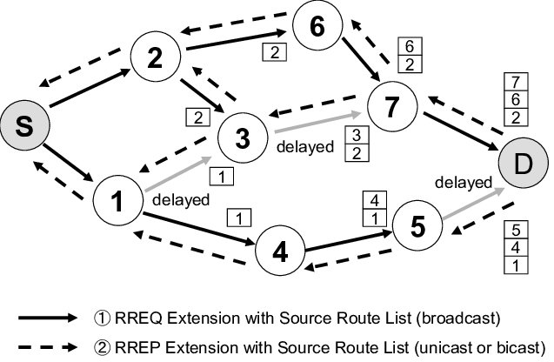
Ad hoc On-demand Distance Vector( AODV)
Tools
AODV is a routing protocol derived from the DSDV algorithm
Functions reactively, establishing routes when needed
It guarantees a single, loop-free path for data transmission
Initiates a Route Request (RREQ) to uncover un-
familiar route
Destination route send back a Route Reply (RREP) message to the source
Fig 3. Basic AODV routing
Tools cont’d….

Slide 10
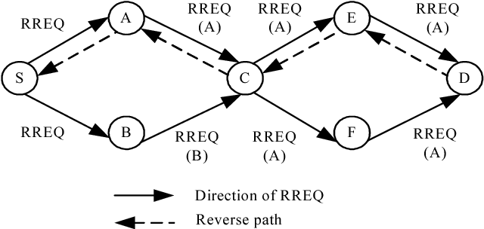
Ad hoc On-demand Multipath Distance Vector (AOMDV)
Tools
AOMDV is akin to AODV in many aspects
Employs multipaths instead of single routes using distance vector methodology
Shares nodes to find destination instead of initiating route from start
Efficient node switching is the key feature
Effectively concern about link failure
Fig 4. Basic AOMDV routing

Slide 11
Tools
Enhanced Homomorphic Encryption (EHC)
Additive homomorphic strategy, introduced by Gorti[3]
Encryption involves a large number m derived from primes p and q, where p serves as the secret key
Incorporates random numbers for enhanced security, strengthening the cryptosystem's resilience
Scheme revolves around key generation, encryption, and decryption as its fundamental principles
Tools cont’d….

Slide 12
Methodology
Secure Route Discovery
Secure and Reliable Data Communication
Methodology cont’d….

Slide 13
Secure Route Discovery
Methodology cont’d….

Slide 14
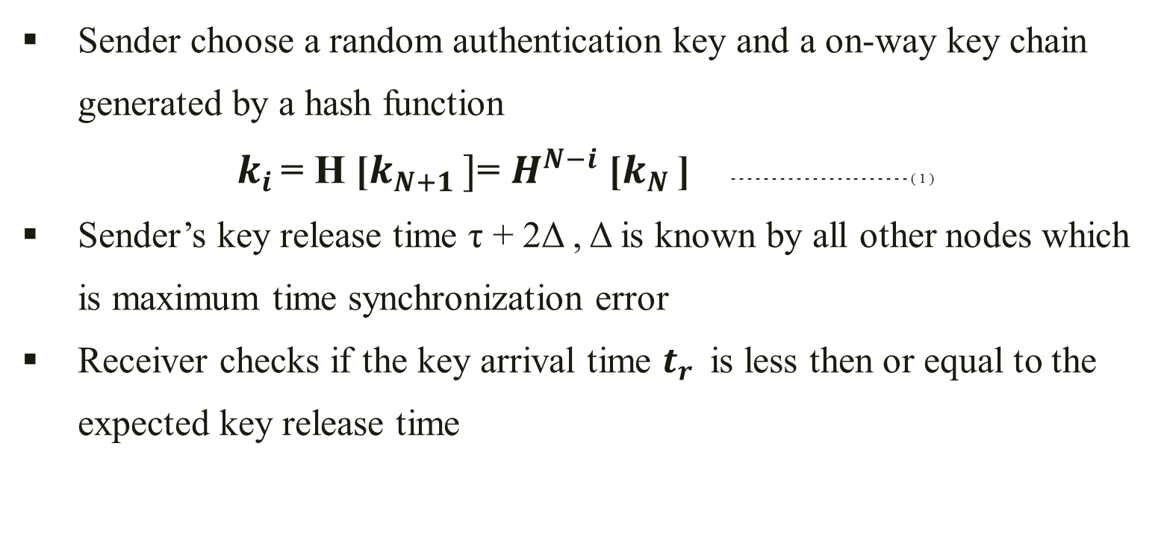
Methodology
Sender choose a random authentication key and a on-way key chain generated by a hash function
$k_{i }$= H [$k_{N+1 }]$= $H^{N−i}$ [$k_{N }$] - - - - - - - - - - - - - - - - - - - - - - ( 1 )
Sender’s key release time τ + 2Δ , Δ is known by all other nodes which
is maximum time synchronization error
Receiver checks if the key arrival time $t_{r }$ is less then or equal to the expected key release time
Methodology cont’d….

Slide 15
Secure and Reliable Data Communication
Methodology cont’d….

Slide 16
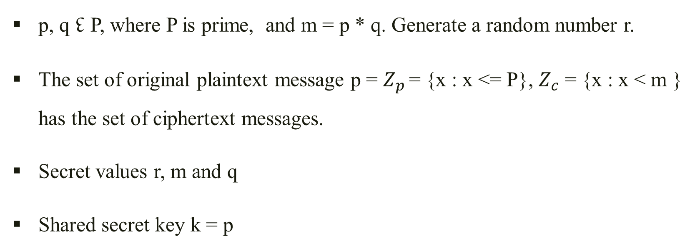
Methodology
Secret Key Generation
p, q ↋ P, where P is prime, and m = p * q. Generate a random number r.
The set of original plaintext message p = $Z_{p }$= {x : x <= P}, $Z_{c}$ = {x : x < m } has the set of ciphertext messages.
Secret values r, m and q
Shared secret key k = p
Methodology cont’d….

Slide 17
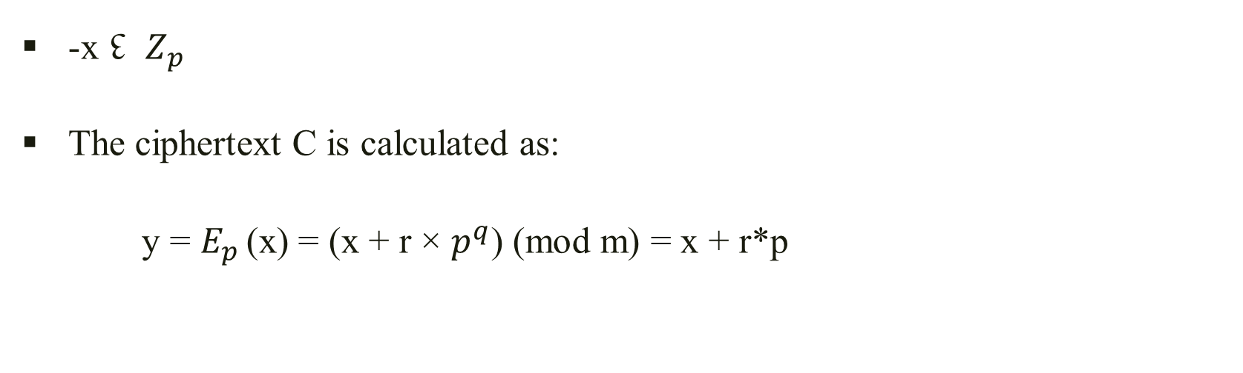
Methodology
Encryption
-x ↋ $Z_{p }$
The ciphertext C is calculated as:
y = $E_{p }$(x) = (x + r × $p^{q}$) (mod m) = x + r*p
Methodology cont’d….

Slide 18
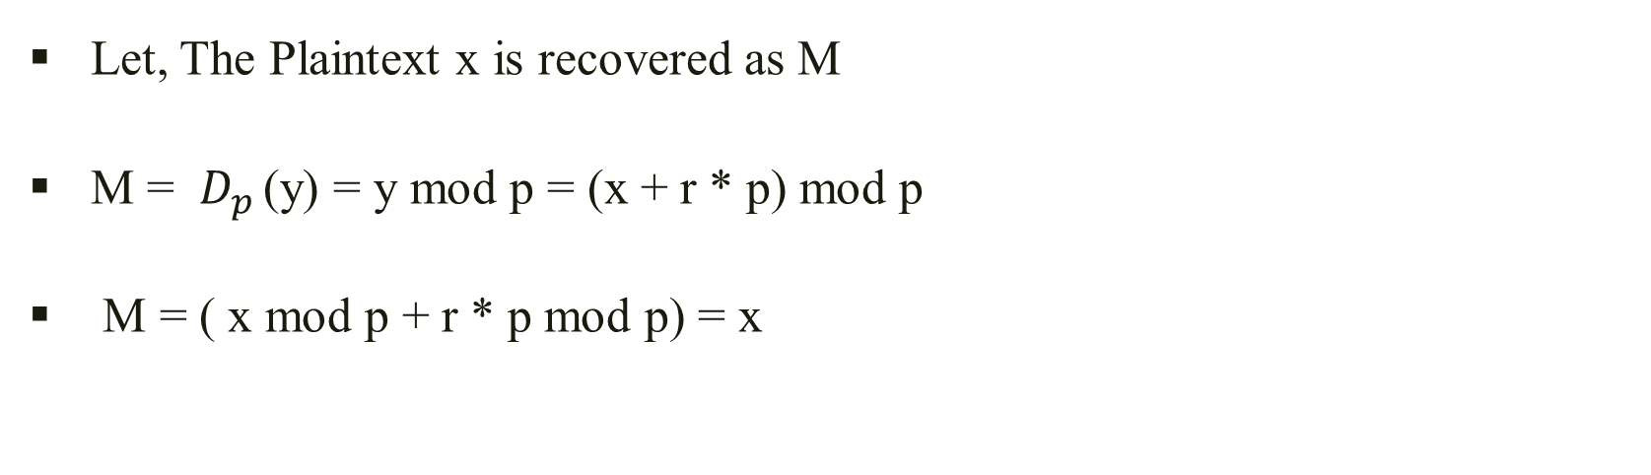
Methodology
Decryption
Let, The Plaintext x is recovered as M
M = $D_{p }$(y) = y mod p = (x + r * p) mod p
M = ( x mod p + r * p mod p) = x
Methodology cont’d….

Slide 19
Proposed Scheme
Establishing operational routes
Grouping paths into G
Message fragmentation and identification
Sender-side homomorphic encryption
Receiver-side decryption
Proposed scheme cont’d….

Slide 20
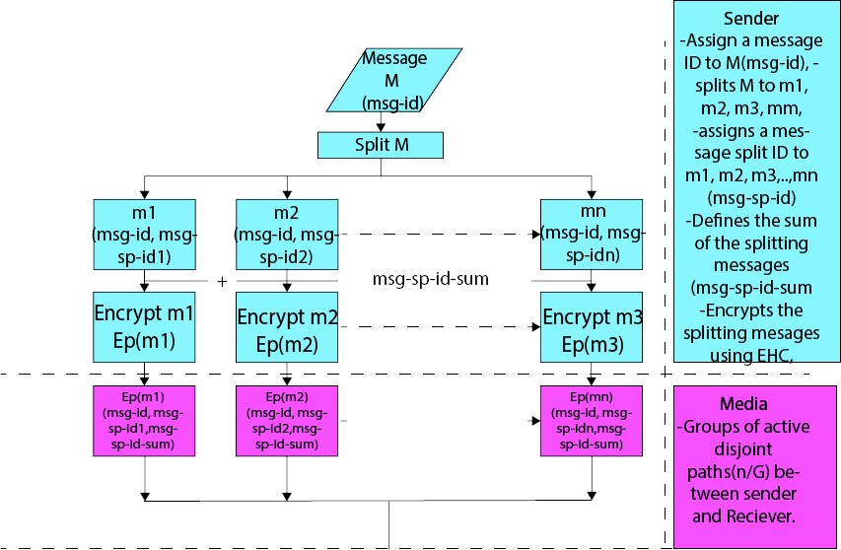
Proposed Scheme - Flowchart
Fig 4. Flowchart of the proposed scheme
Proposed scheme cont’d….

Slide 21
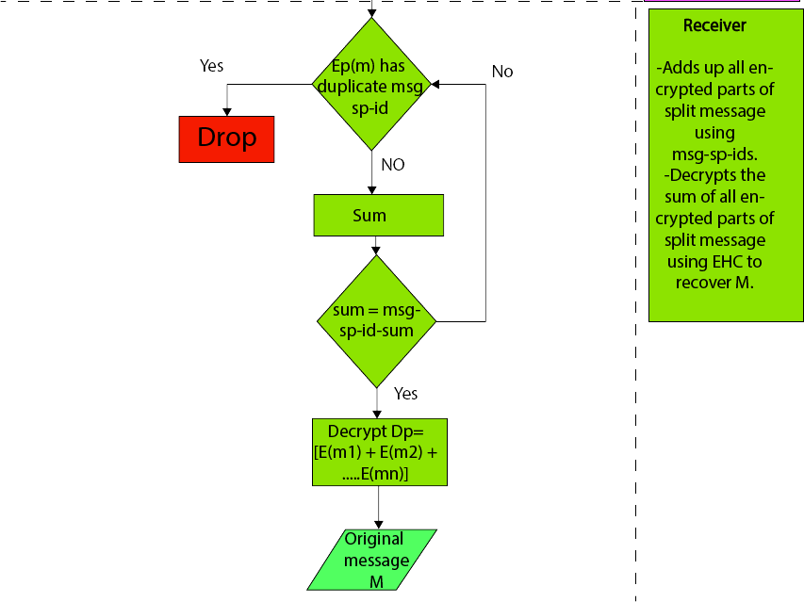
Proposed Scheme - Flowchart
Fig 5. Flowchart of the proposed scheme
Proposed scheme cont’d….

Slide 22
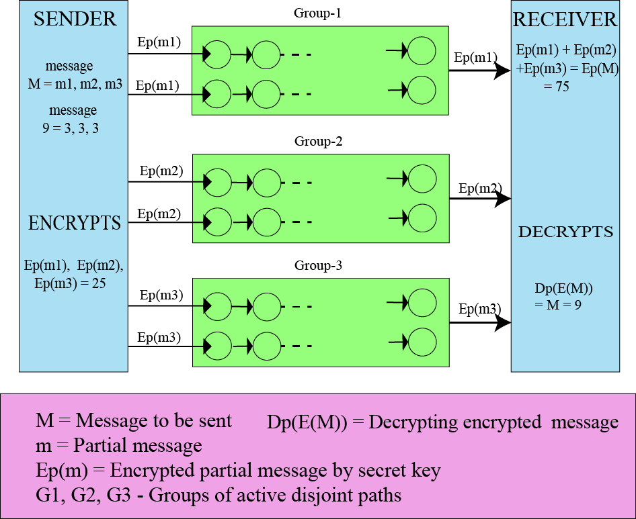
Proposed Scheme(Example)
Fig 6. Example of the Scheme

Slide 23
Result Analysis
Table 2: Comparison of time complexity between proposed scheme and the AOMDV scheme
Scheme | Memory | Encryption | Decryption | Computation | Communication
Proposed | θ(n) + θ(G) | T × θ(G) | T × θ(1) | T × θ(G) | θ(n)
AOMDV | - | - | - | θ(1) | 0(n)
Result Analysis cont’d….

Slide 24
Performance Evaluation
Table 2: Encryption process time (ms) of different cryptosystems when key size is 512 bits
Message size in bits | Elgamal cryptosystem | Mixed Multiplicative Homomorphic | Enhanced Homomorphic Encryption system
250 | 89 | 21 | 9
500 | 105 | 21 | 11
1000 | 142 | 22 | 8
Result Analysis cont’d….

Slide 25
Performance Evaluation
Table 3: Encryption process time(ms) of different cryptosystems when key size is 1024 bits
Message size in bits | Elgamal cryptosystem | Mixed Multiplicative Homomorphic | Enhanced Homomorphic Encryption system
100 | 72 | 11 | 7
250 | 76 | 11 | 7
500 | 87 | 11 | 7
Result Analysis cont’d….

Slide 26
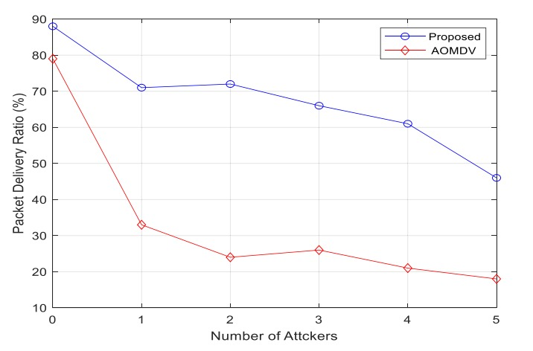
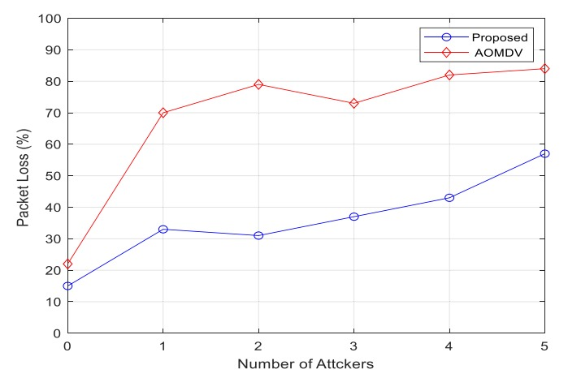
Performance Evaluation
Fig 7. Packet delivery ratio(%)
Fig 8. Packet loss(%)
Performance Evaluation cont’d….

Slide 27
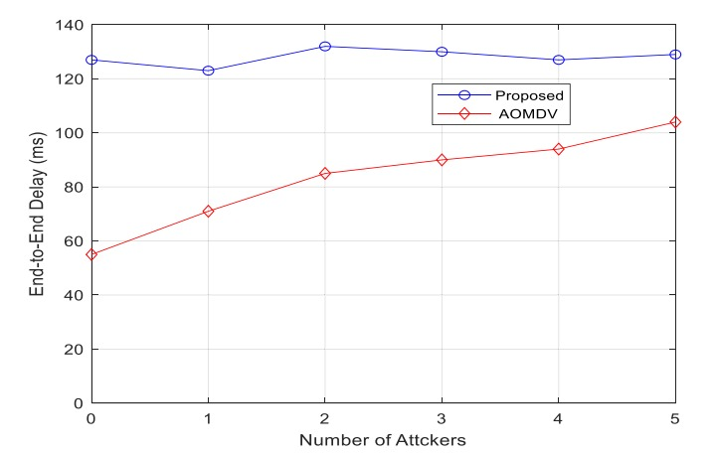
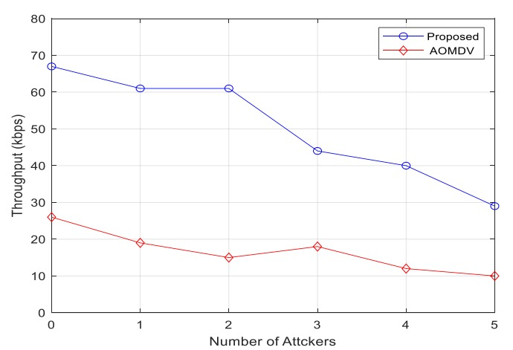
Performance Evaluation
Fig 9. End-to-end delay(ms)
Fig 10. Throughput(kbps)

Slide 28
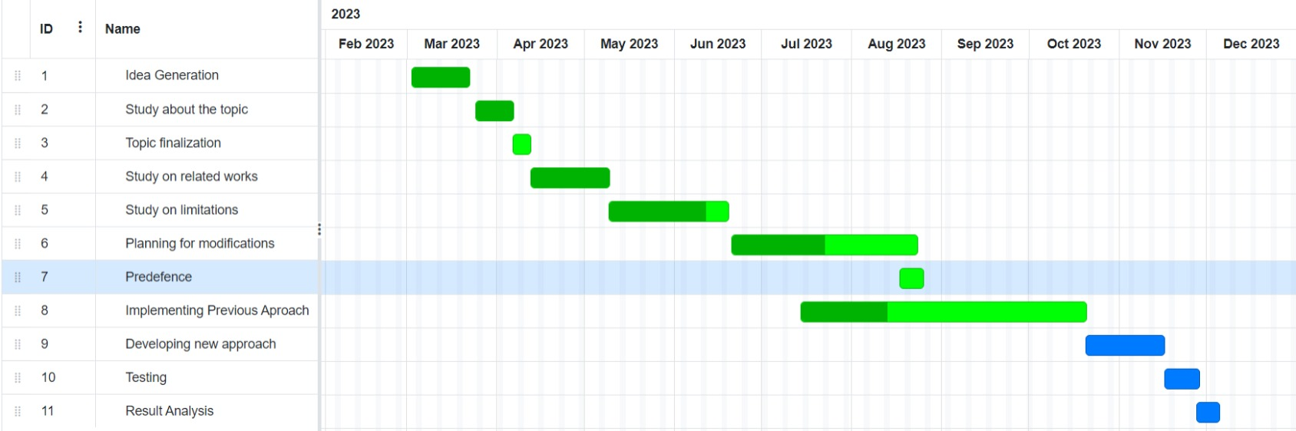
Gantt Chart
Fig 11– Work plan shows in Gantt chart

Slide 29
Conclusion
Enhanced AOMDV Scheme
Node Authentication for Route Discovery
Distributed Message Components
Entire message can’t be revealed, a node get only a part of the message
High Success rate

Slide 30
Future work
End-to-End Delay Reduction
Emergency Application Implementation for real life simulation.

Slide 31
Reference
https://www.researchgate.net/publication/4183879_AODV_multipath_extension_using_source_route_lists_with_optimized_route_establishment
An Optimized Ad-hoc On-demand Multipath Distance Vector(AOMDV) Routing Protocol | Semantic Scholar
Papadimitratos P, Haas ZJ. Secure message transmission in mobile ad hoc networks. Ad Hoc Netw 2003;1:193–209. doi:10.1016/S1570-8705(03)00018-0.
Lou W, Liu W, Fang Y. SPREAD: enhancing data confidentiality in mobile ad hoc networks. Proc IEEE INFOCOM 2004;4:2404–13. doi:10.1109/INFCOM.2004. 1354662.
Wazid M, Kumar A. An efficient hybrid anomaly detection scheme using K-means clustering for wireless sensor networks. Wirel Pers Commun 2016;90:1971–2000. doi:10.1007/s11277-016-3433-3.
J. P. T. V. Satav P, “Secure route selection mechanism in the presence of blackhole attack with aomdv routing algorithm,” fourth international conference on computing communication control and automation., 2018.

Slide 32
Thank You

