Slide 1

Project Title : “Secure Mailbox”
Presented By
Md. Mazharul Islam
Id : 171-35-1798
Supervised By
Afsana Begum
Senior Lecturer, Department of SWE
Daffodil International University

Slide 2
Content of Project
Motivation
Objective
Feasibility Study
Features
Stakeholders
Requirements
Use Case
Activity
Tools and Technologies
Future Work
Github link
Referances

Slide 3
Motivation
Everyday we use many application to send e-mail. So, that I think to develop a web based e-mail application which name is “SecureMailbox”. Where user can use some extra features that’s haven’t in other e-mail application.
Encrypt File Process
Decrypt File Process and
Live Chat

Slide 4

Project Objective
Before, sending the mail user can encrypt their files also they can communicate each other with live chat using live chat features.
When user get an encrypted files which was encrypt using “Secure Mailbox” then user can decrypt their encrypted files with encryption key.
User will be able to use this system with free of cost.

Slide 5

Feasibility Study
This project is possible to implement technically
Between the implementation time it’s possible to implement.
It’s my undergraduate academic project. So, budget not issue here.

Slide 6
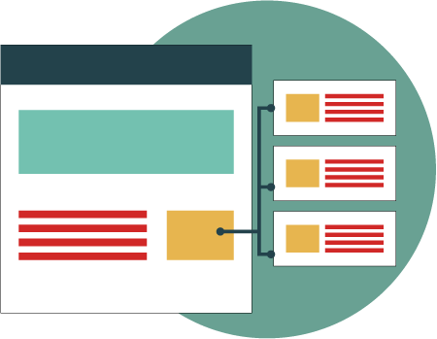
System Features
Registration
LogIn
Compose Mail
Encrypt File
Decrypt File
Inbox
Sendbox
Live Chat
Technical Support
Logout

Slide 7

Stakeholders
Admin
User
Project Owner

Slide 8
Requirements
Functional
User Login & Registration
File Encryption Process
File Decryption Process
Live Chat
Compose Mail
User Inbox list
User Sending list
Logout
Non functional
UI Design
Database Capacity
System maintenance

Slide 9
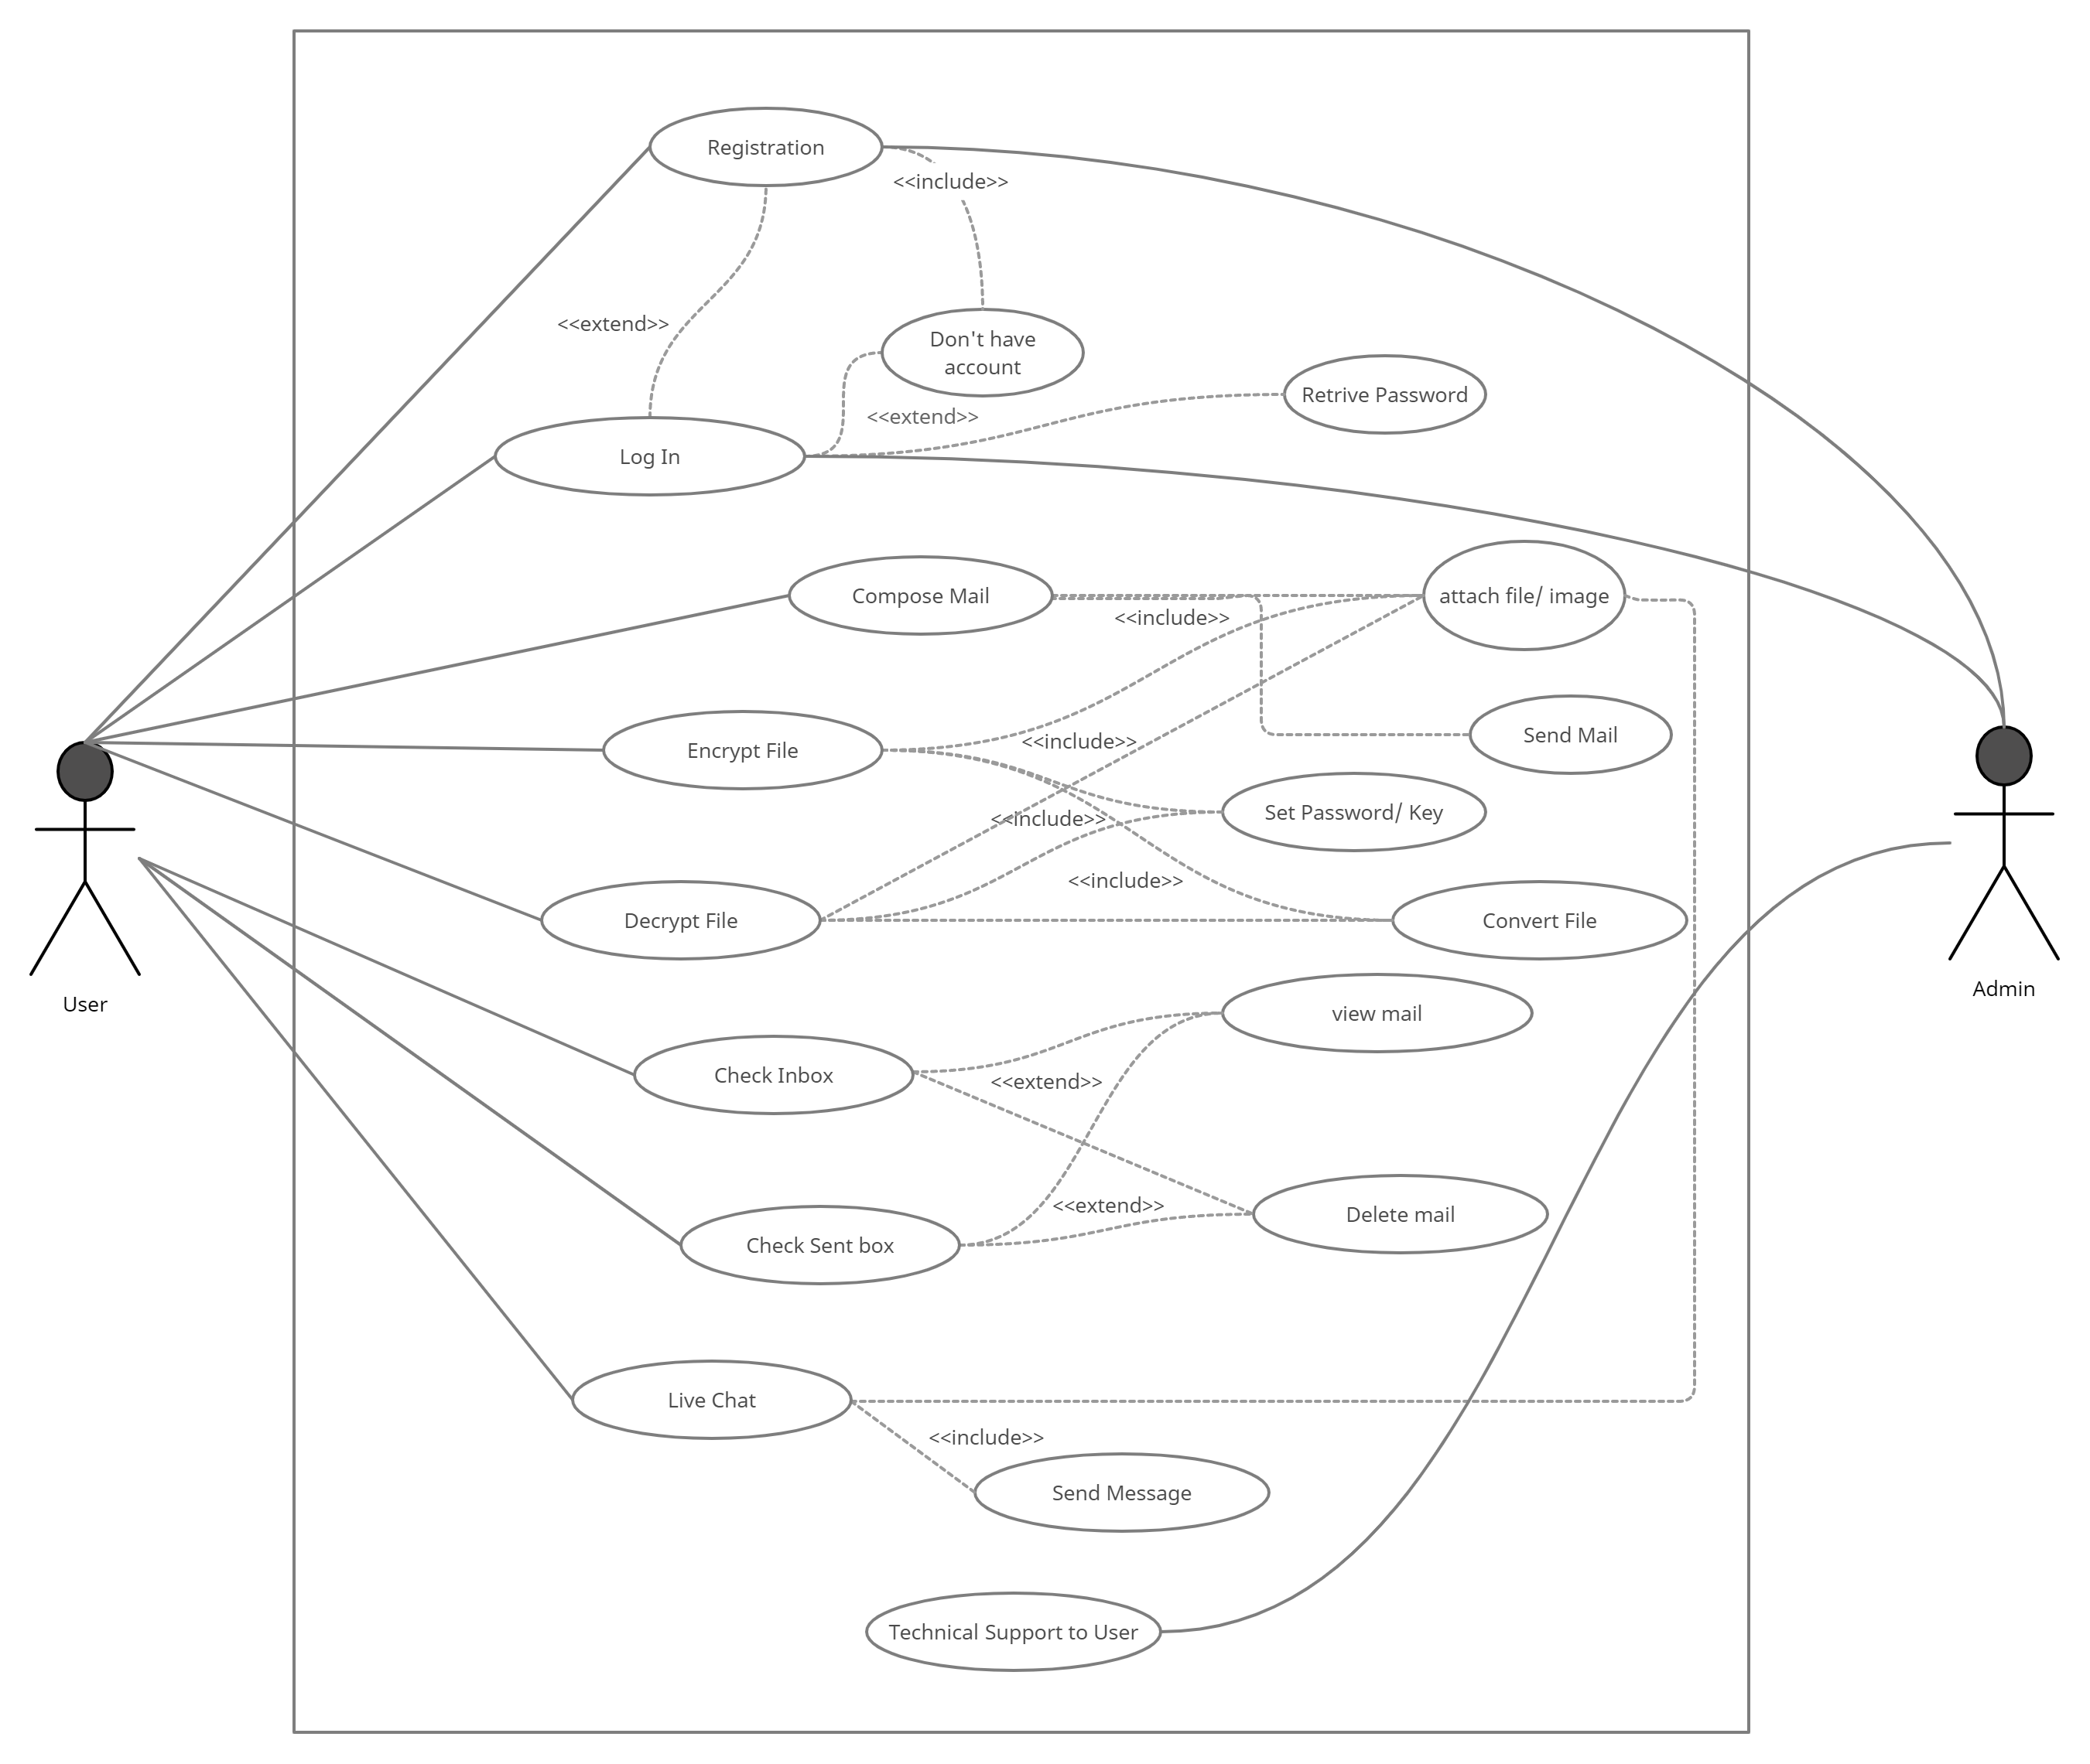
Use Case Diagram

Slide 10
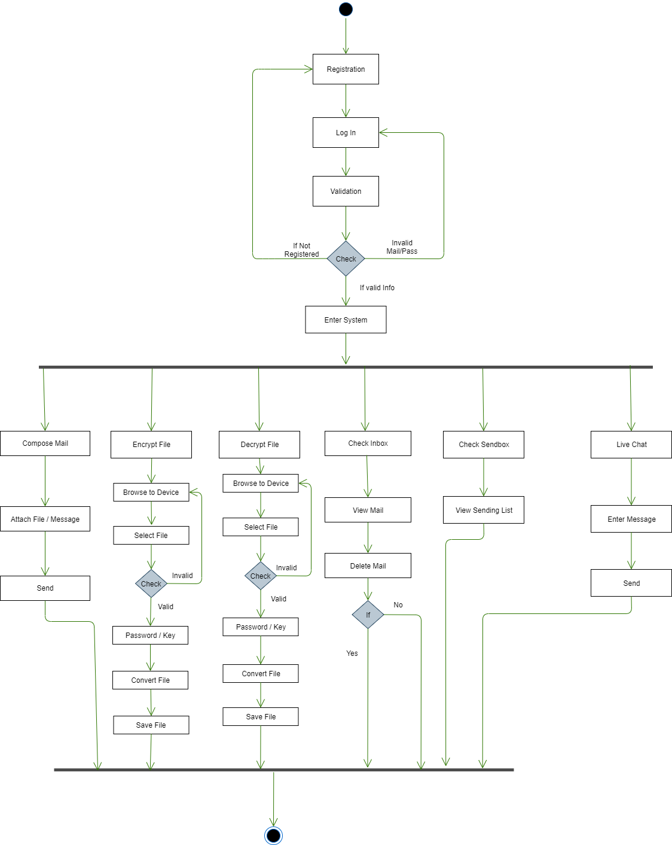
User Activity Diagram

Slide 11
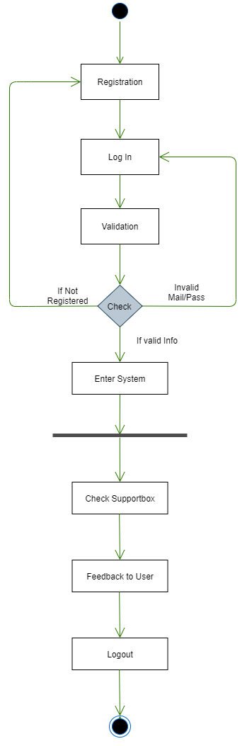
Admin Activity Diagram

Slide 12
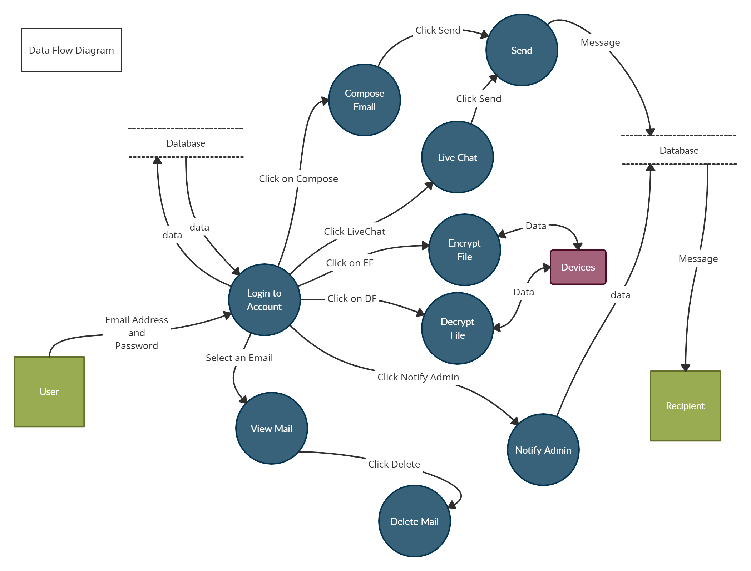
DFD(Data Flow Diagram)

Slide 13

Tools and Technologies
Tools :
1. Visual Studio 2017/2019
2. SQL Server 2014, Firebase
3. Browser(any browser)
Programming Languages & Frameworks
1. HTML, CSS, Bootstrap, JQuery, C#
2. ASP. Net Core 3.1
3. SQL

Slide 14

Future Works
I will create some paid feature which can use paid user only.
System support will include for user after build the paid features.

Slide 15

GitHub Link
https://github.com/SHOWROV11981/SecureMailbox

Slide 16
References
IEEE Xplore : 1.https://ieeexplore.ieee.org/document/7406040?arnumber=7406040&queryText=image%20aes&newsearch=true
2.https://ieeexplore.ieee.org/document/5734951?arnumber=5734951&
queryText=image%20aes&newsearch=true
Protonmail : https://protonmail.com/
Encryption Process : Advanced Encryption Standard process – Wikipedia
AES Security Process : https://proprivacy.com/guides/

