Slide 1
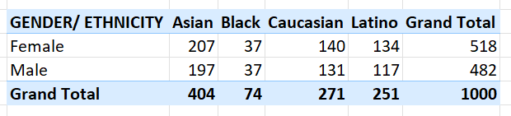
1: Gender and Ethnicity distribution
The Female to Male ratio indicates that there are more Female employees
The Ethnical Distribution shows that there are more Asian employees

Slide 2
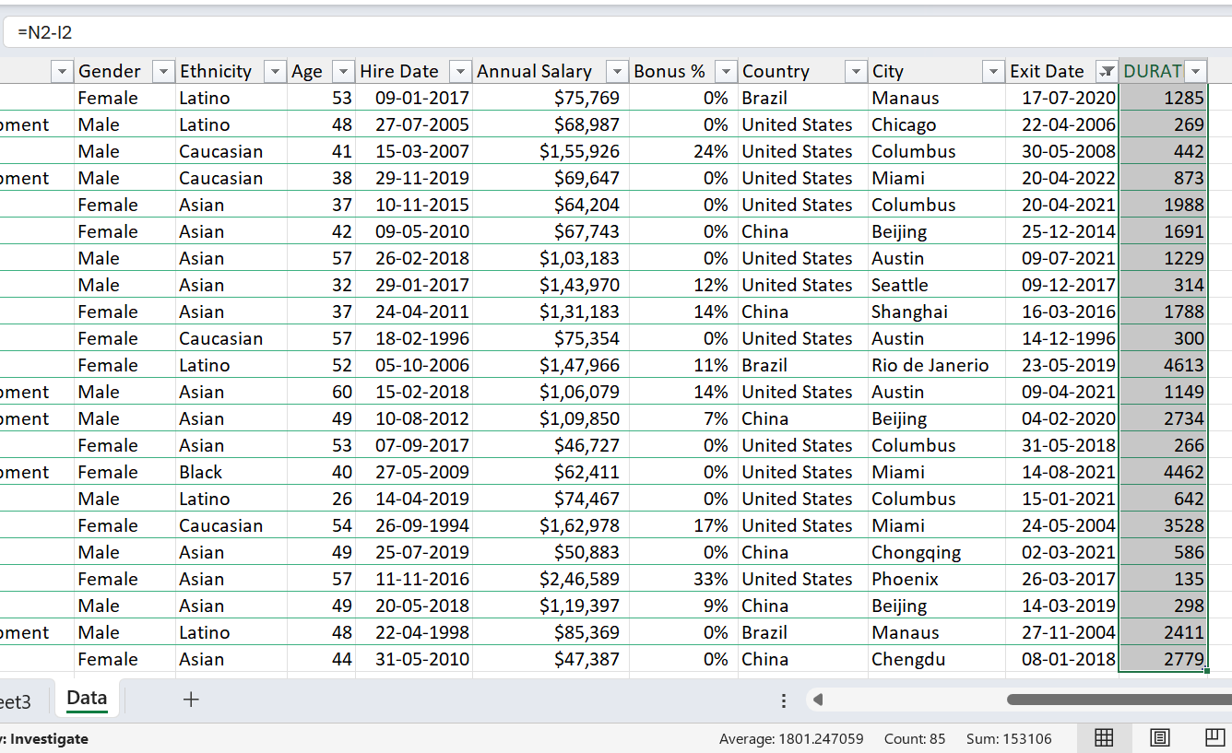
2: Average Length of Stay, of Exiting employees
A new duration column was created and the Exit Date was subtracted from the Joining Date to give the duration, then the average of the duration was taken

Slide 3
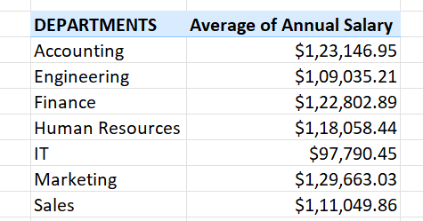
3: Average Salaries between different departments
The IT Dept has the lowest Average Salary

Slide 4
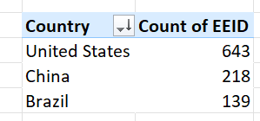

4: Country with the highest number of employees
United States has the most number of employees

Slide 5
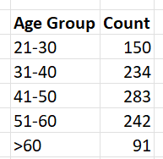
5: Most common age range
The most common age range is the 40s

Slide 6
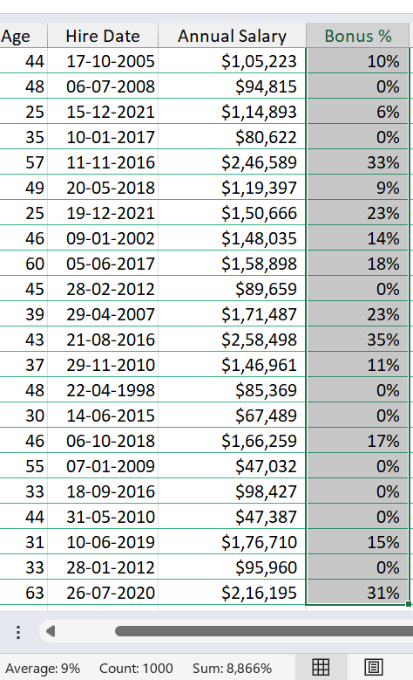
6: Average Bonus %
The average of the bonus % column was taken to show the average bonus %

Slide 7

7: Most frequently occurring job title
A pivot chart was plotted b/w job title and count of EEID which returned Directors as the most frequent job title

Slide 8
8: Primary Reason for Exiting
No specific reasoning was given by the employee on exiting the company

Slide 9
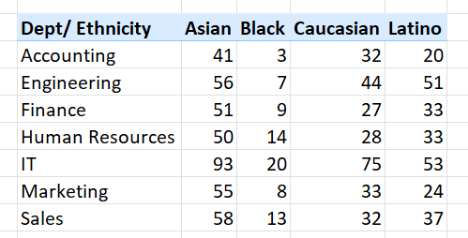
9: Ethnical Diversity in Departments

Slide 10
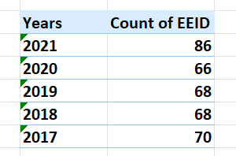
10: Change in Number of Hires over the years
There was a spike of 20 in the last year of hiring

