Slide 1


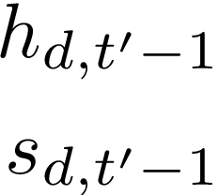


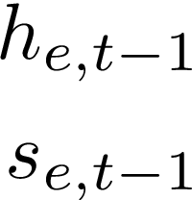



Output
Tempo
Attn
Mid
Spatial
Attn
Input

