Slide 1
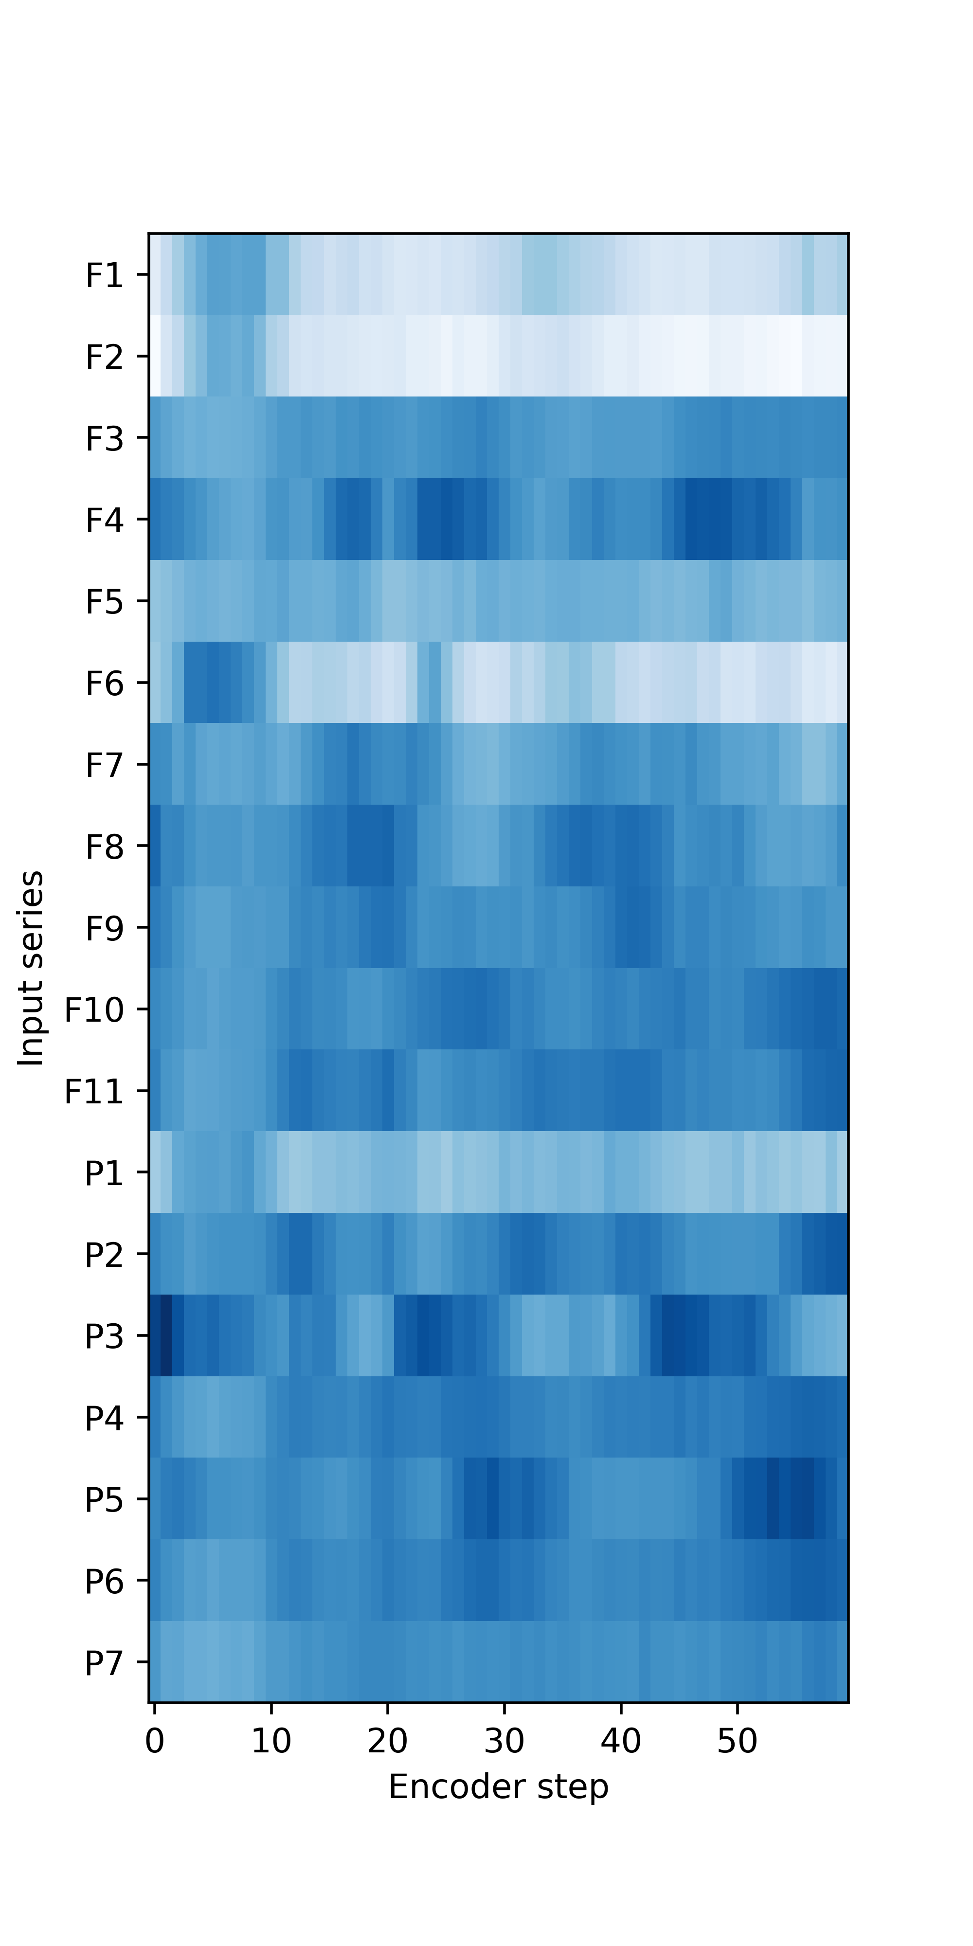
Remote BS
Near BS
Near Sensor
Target
Remote BS
Near BS

