Slide 1








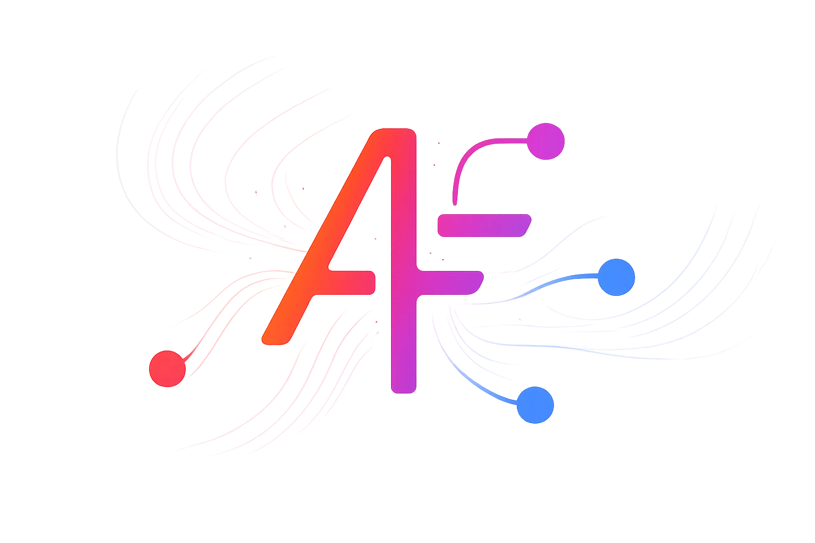
















Agent Fabric
A2A-T Runtime
Phase III
C26.0.910
Agents that understand telecom.
Trusted autonomy for production.

