Slide 1
A2A-T Runtime for Autonomous Networks – Phase III
Cross-Domain Fault Resolution Scenario
Catalyst URN.C26.0.910

Slide 2
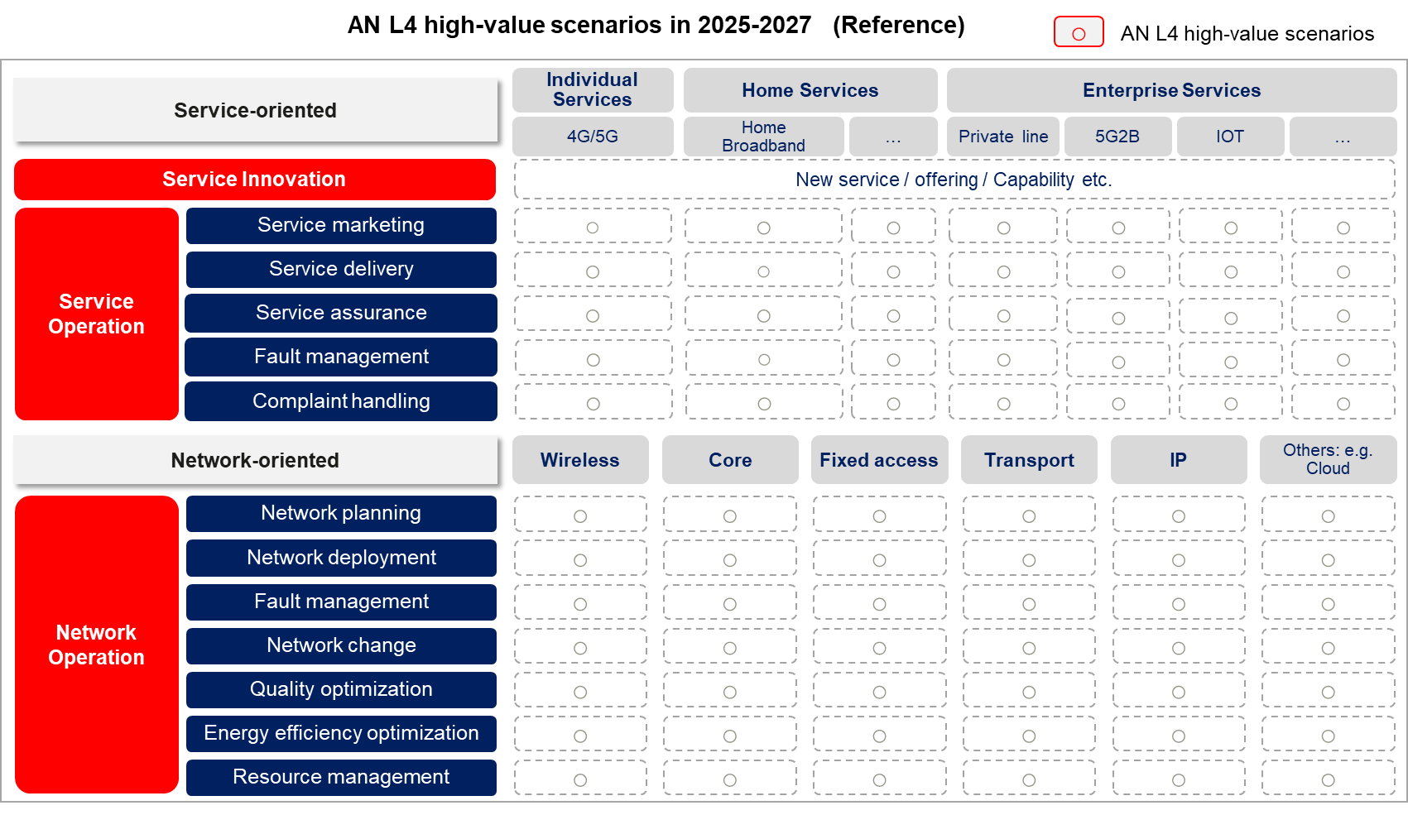
L4 High Value Scenarios Mapping (IG1339)

Slide 3
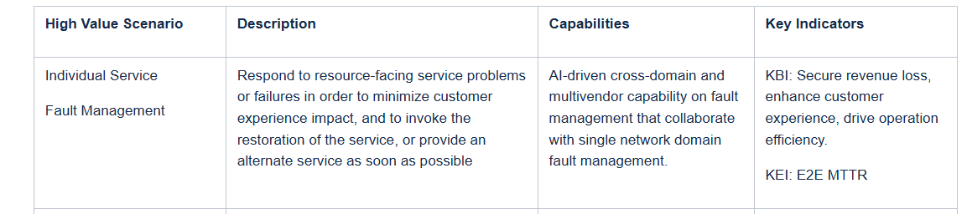
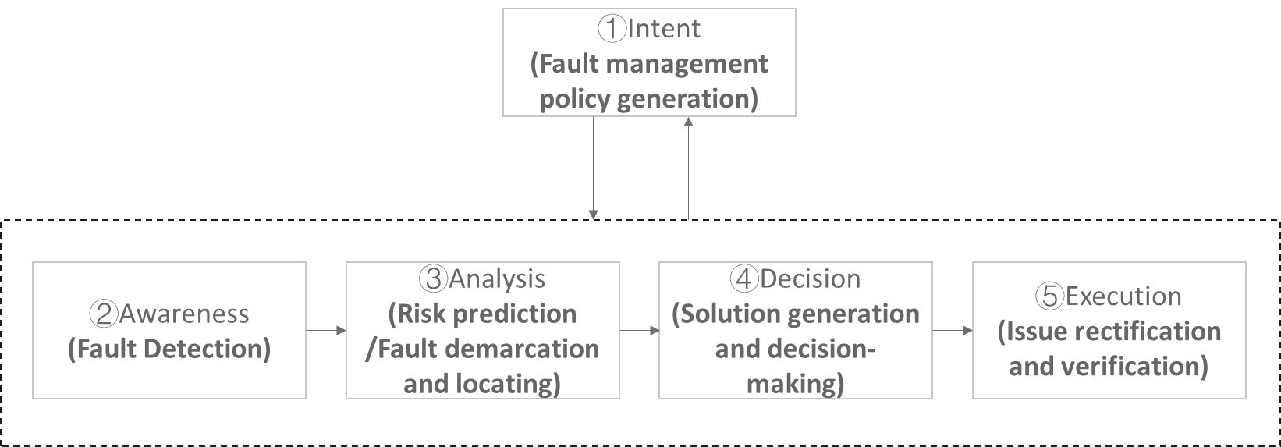
Cross-Domain Service Fault Management (IG1339)

Slide 4



Cross-Domain Service Fault Management
High level Agents View
OSS Operations
Prioritization Agent
Customer Experience Agent
Recommendation Agent
Remediation Agent
Operational Digital Twin
Topology Agent
RCA Agent
Service Impact Agent
Customer Business Impact Agent
Network & OSS
IP network domain
Core network domain
RAN network domain
IP ADN System Agent
Core ADN System Agent
RAN ADN System Agent

Slide 5

Cross-Domain Service Fault Management
Agents Data & Flow - Operational Digital Twin
Operational Digital Twin
Outputs (Northbound)
Topology for consumers
Impacting Business Problems
RCA Outputs
Impact Outputs
What-If queries
Others
Topology Agent
1
2
3
RCA Agent
Service Impact Agent
Customer Business Impact Agent
Topology Model
Network & OSS Data Sources
IP network domain
Core network domain
RAN network domain
Customer Experience
Topology Data
Network Alarms & KPIs
Topology Data
Network Alarms & KPIs
Topology Data
Network Alarms & KPIs
KPIs & Insights
Anomalies

Slide 6

Cross-Domain Service Fault Management
OSS Operations – Data & Flow
Operational Digital Twin
OSS Operations
Impacting Problems
1
2
4
Topology Agent
Prioritization Agent
Customer Experience Agent
3
Recommendation Agent
Remediation Agent
Digital Twin repositories
5
Network & OSS
IP network domain
Core network domain
RAN network domain
IP ADN System Agent
Core ADN System Agent
RAN ADN System Agent

Slide 7
Cross-Domain Service Fault Management
Identified A2A-T Interactions
Amdocs Impact Analysis – RADCOM Customer Business Impact Analysis
  Goal: Improve visibility into which customers are affected.
  The Amdocs Service Impact Agent sends the RADCOM Customer Business Analysis Agent a faulty network element ID, geographical location, and/or time window.
  The Customer Business Analysis Agent returns a list of additional impacted accounts, including detailed context for each account.
Amdocs Prioritization – RADCOM Customer Experience
  Goal: Determine the customer’s potential priority based on real experience indicators.
  The Amdocs Prioritization Agent sends the Customer Experience Agent an enterprise ID or a consumer IMSI.
  The Customer Experience Agent provides a natural‑language summary of the customer’s recent experience for that enterprise or consumer.
Amdocs Remediation – (?) RAN Domain Executer
  Goal: Execute targeted, intent‑based remediation actions.
  The Amdocs Remediation Agent sends a request describing the desired remediation intent.
  The RAN Domain Executor translates the remediation intent into concrete, network‑level commands and executes them.

Slide 8
Thank you
Contact Us via email:
kevin.mcdonnell@huawei.com

Slide 9
Problem Resolution (Fault)
Business layer
ID Verification Provider
External Agent
A2A-T
Service layer
Agent
Registry
Center
Fiber Wholesaler
Resource & Service Operations
Registration
External Agent
Prioritization
Recommendation
Complaint Handling
Publication
A2A-T
Digital Twin
Authorization
…
Topology
RCA
Impact
Agent Card
Customer
Experience
A2A-T
Network layer
IP network domain
RAN network domain
IP ADN
System Agent
…
Transport ADN
System Agent
Fault
Agent
Optimization
Agent
Energy Saving
Agent
Fault
Agent
Optimization
Agent
Energy Saving
Agent
NE
NE
NE
NE
NE
NE
Site Intelligence
Site Intelligence

