Slide 1





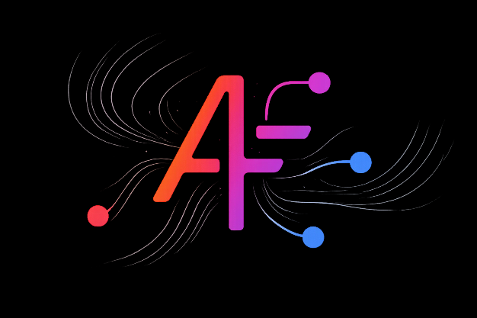







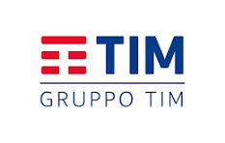








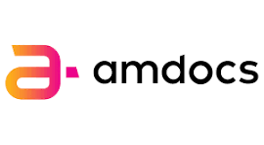
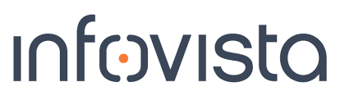

Agent Fabric
A2A-T Runtime
Phase III
C26.0.910
Agents that understand telecom.
Trusted autonomy for production.

Slide 2
The Challenge
L4 is achievable. Keeping it there is the unsolved problem.
SEMANTIC ACCURACY
DETERMINISTIC EXECUTION
GOVERNED AUTONOMY
Agents do not share meaning
Ambiguity deferred is ambiguity compounded
Autonomy without accountability is not deployable
LF A2A gives agents a way to talk. Without A2A-T they have no shared telecom meaning when they do. A Task-T issued by one vendor's agent must be interpreted identically by the next — that requires a structured, versioned semantic anchor at the protocol level, not natural language alone.
Other agentic frameworks defer ambiguity to natural-language clarification at runtime. At carrier scale this produces re-escalation chains and non-deterministic outcomes. Negotiation-T resolves target, feasibility, and information gaps before Task-T commits.
At L4, agent actions are consequential and may be irreversible. Operators must know what evidence drove a decision, what constraint was honoured, and what authority authorised the action. Without a governance fabric, production L4 stays aspirational.
Pedro Garcia Parra, Director of Autonomous Networks, Telefónica: "The unsolved challenge in Autonomous Networks is not building individual agents — it is keeping them working together safely, at scale."
© 2026 TM Forum
C26.0.910 Agent Fabric: A2A-T Runtime Phase III
June 2026
2

Slide 3
Problem Statement
Five questions every operator asks before trusting an agent with the network.
INDUSTRY DATA · Dataiku / Harris Poll 2025 (n=800 data leaders)
1
Can any agent talk to any other?
86%
run agents in daily operations — none share a common protocol
Every integration is bespoke. Every payload is a snowflake.
2
Does the agent understand what I mean?
70%
weight AI suggestions over human ones — yet semantic drift goes unmeasured
Messages pass. Meaning drifts. One vendor's 'fault' isn't another's.
3
Can I add agents I've never used before?
45%
replaced an agent last year — swapping should not be a re-integration project
Multi-vendor means multi-integration. A new agent is a new project.
4
Does every agent follow my rules?
80%
say an accurate but unexplainable decision is more dangerous than a traceable error
Agents that follow vendor defaults run their workshop — not your network.
5
Can I prove it did the right thing?
95%
could not trace an AI decision end-to-end for a regulator. Today. In production.
Plausible is not provable. Auditors and regulators need more than vibes.
The rest of this presentation answers all five — in order, because each depends on the one before.
© 2026 TM Forum
C26.0.910 Agent Fabric: A2A-T Runtime Phase III
June 2026
3

Slide 4
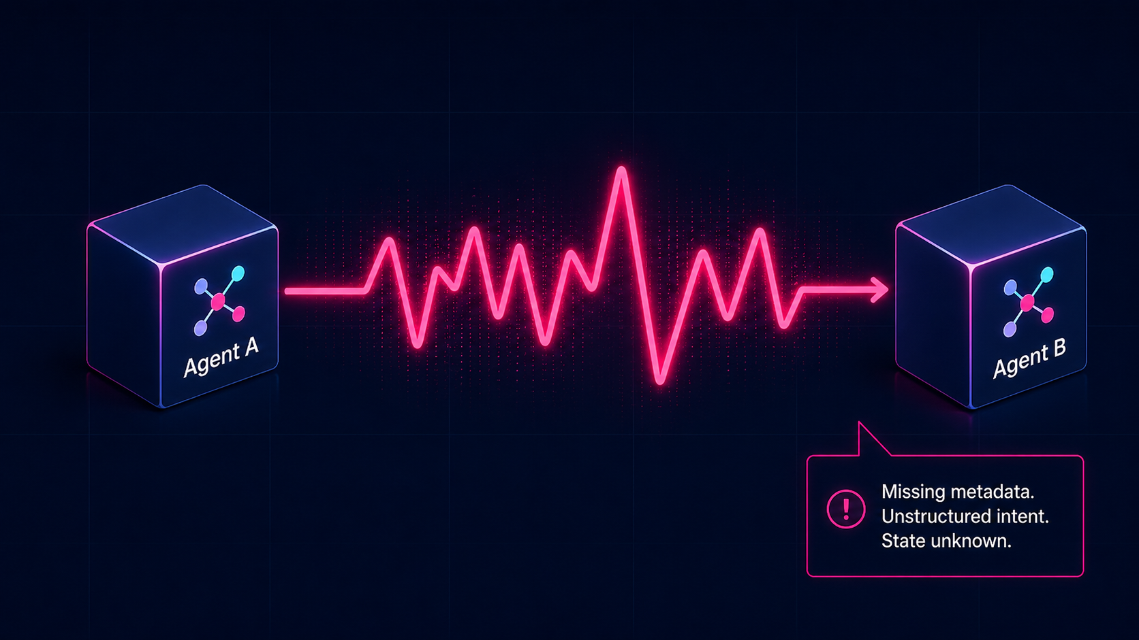
Standard A2A leaves agents guessing.
Natural-language protocols rely on interpretation — chattiness, unverified intent, execution failure.
Natural Language
© 2026 TM Forum
C26.0.910 Agent Fabric: A2A-T Runtime Phase III
June 2026
4

Slide 5
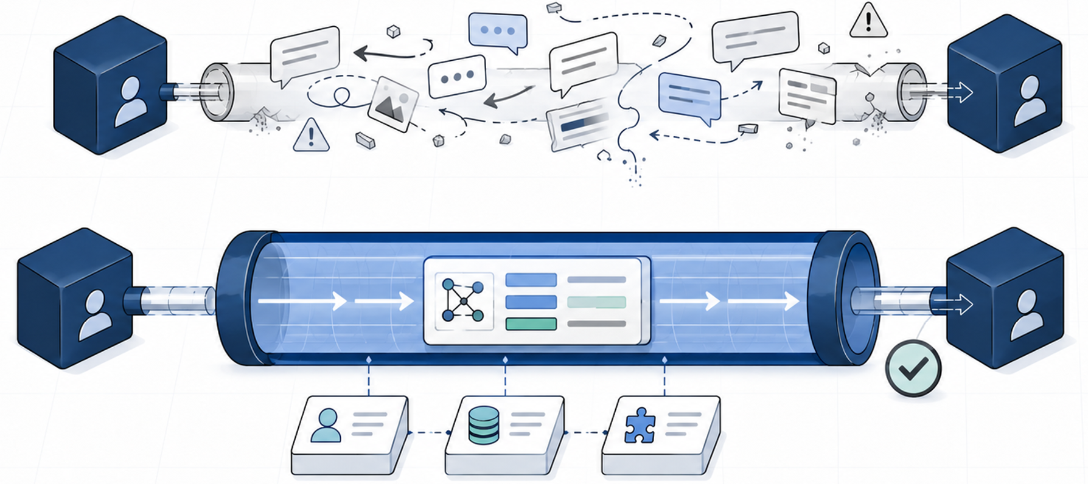
Agents that Talk vs Agents that Understand… Telecom
Natural-language protocols rely on interpretation — chattiness, unverified intent, execution failure.
Agent
A
Agent
B
ERROR · REWORK · ESCALATION
LF A2A standardizes the channel. Each agent interprets differently.
Ambiguity causes retries, misrouting, and failed execution.
Fewer messages · typed intent · first-time execution
Agent
A
Agent
B
A2A-T
✓ Executed first time
Precision comes from:
HVS-1 · Slice QoS Degradation
TargetType: FAULT_MANAGEMENT | Domain: TRANSPORT
Priority: HIGH | SLA remaining: 18 min | Action: re-route via backup LSP
TMF AN HVS Sub-Scenarios
SID
IG1453 “A2A-T” Spec
© 2026 TM Forum
C26.0.910 Agent Fabric: A2A-T Runtime Phase III
June 2026
5

Slide 6
From Protocol to Trusted Autonomy
Each layer answers: why isn't the previous one enough?
01
Protocol
A2A-T extends LF A2A
Agents can pass messages… but do the messages mean anything?
02
Semantics
Meaning, not just structure
Agents understand the task… but can they find who can execute it?
03
Cooperation
Any agent, any vendor
Agents coordinate… but do they follow your rules?
04
Governance
Operator playbook applied
Agents comply… but can you prove it?
05
Trust
Autonomy you can prove
Trusted autonomy. In production.
Each layer unlocks a new capability. Each capability is demonstrated live at DTW 2026.
© 2026 TM Forum
C26.0.910 Agent Fabric: A2A-T Runtime Phase III
June 2026
6

Slide 7
A2A-T: Telecom Extension of LF A2A
Extension, not fork. Full implementation of TMF guidance in IG1453.
Trusted Flow | Secure Passport (TG)
Task-T
DETERMINISTIC TASK ASSIGNMENT
Structured, typed payload in message metadata. Binds task to HVS scenario, CSP-approved prompt, 3GPP schema. Receiving agent reads telecom intent before calling its LLM. Deprecated prompt versions rejected at runtime.
CONTENT
Task-T (structured prompt)
TMF IG1453
A2A-T Extensions
Negotiation-T | Event-T
Negotiation-T
AMBIGUITY RESOLUTION BEFORE EXECUTION
Three types: TARGET (objective unclear), FEASIBILITY (task not possible as stated), INFORMATION (executor missing data). Resolves before Task-T commits — not during. Zero downstream re-clarification across all HVS demo runs.
MESSAGE
Agent Card
Task · Message · Part · Artifact
LF A2A Base
Event-T
DOMAIN-CENTRIC PUBLISH / SUBSCRIBE
INTERACTION
POST/GET | Notification
Explicit subscription contract spanning multiple tasks across domains. Fires for any matching telecom event regardless of originating task. Standard A2A is task-centric; Event-T is domain-centric — the gap matters at carrier scale.
TRANSPORT
JSON-RPC · gRPC · HTTP+REST
Lifecycle:
Task
→
Negotiate
→
Event
© 2026 TM Forum
C26.0.910 Agent Fabric: A2A-T Runtime Phase III
June 2026
7

Slide 8
Three Layers. One Production System.
Agent Fabric (The Production System)
OpenAN + Trusted Data Gateway + Governance Agent + Audit + Eval + XAI
OpenAN (The Open-Source Core)
Registry Center + Orchestration Center + Knowledge Graph.
Any operator can run it, contribute to it.
A2A-T (The Protocol)
Telecom extension of LF A2A.
What agents say to each other —
and what it means.
The Catalyst = Agent Fabric + 7 vendor agents + 3 live HVS scenarios.
© 2026 TM Forum
C26.0.910 Agent Fabric: A2A-T Runtime Phase III
June 2026
8

Slide 9
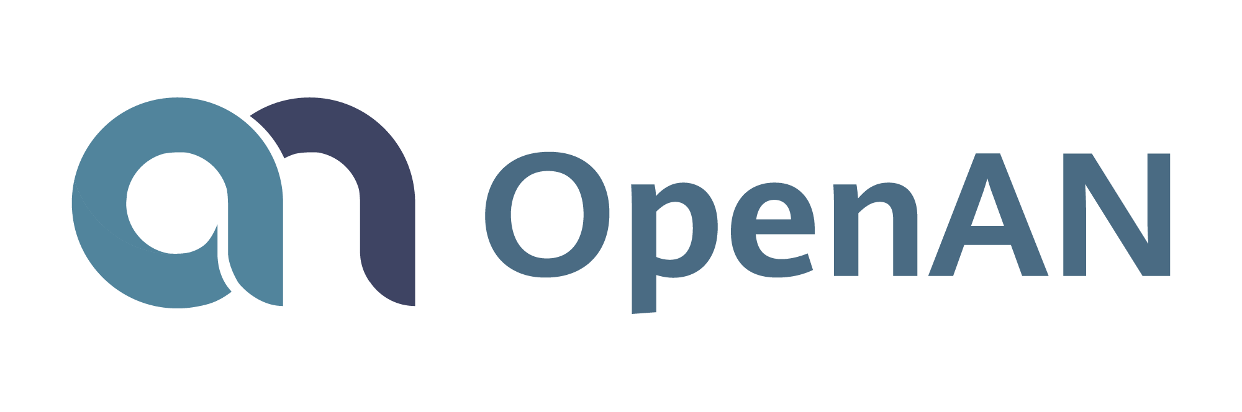


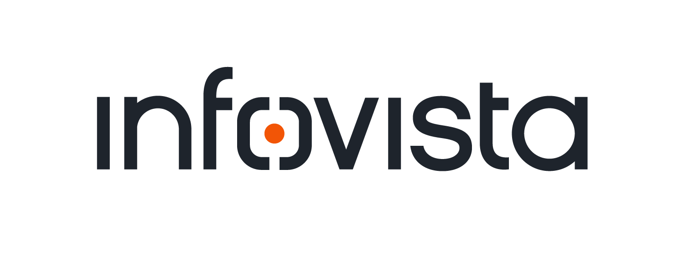






Agent Fabric Catalyst Architecture Where the agents live
.
BUSINESS LAYER
Business Management
Billing Agent
Customer Relationship Agent
HelpDesk Engineer Copilot
End User Copilot
…
TRUSTED DATA GATEWAY
AGENT REGISTRY · OpenAN
SERVICE LAYER
· Orchestration + Registries
M x Service Centers
Digital Twin
Layer
Registration – Authorization – Agent Cards
Private Line
Service Agent
Enterprise
Service Agent
…
…
Registry Center
A2A-T
SDK
PROMPT REGISTRY
Task-T · HVS semantics · versioned
Amdocs · RADCOM · Infovista
N x Operation Centers
Orchestration
Center
Fabric
Knowledge
Graph
Fault Center
Agent
Optimization
Center Agent
Complaint
Center Agent
Service Orchestration
Agent
Trust &
Observability
KNOWLEDGE GRAPH
Playbooks
SID · BPMN corpus
Task-T history
NETWORK LAYER
Wireless / RAN Domain Huawei
IP / Transport Domain Infosys
RAN System Agent
IP System Agent
AGENT EVAL (DESIGN TIME)
Fault
Agent
Optimization
Agent
Energy Saving
Agent
Fault
Agent
Optimization
Agent
Energy Saving
Agent
Aligned to TMF AN L4 Target Architecture (IG1251C)
GOVERNANCE AGENT
© 2026 TM Forum
C26.0.910 Agent Fabric: A2A-T Runtime Phase III
June 2026
9

Slide 10
Agent Fabric: How It Works
Agent A
(Initiator)
A2A-T
Task-T · Event-T · Negotiation-T
LF A2A Extension · IG1453 · SDK
Agent B
(Executor)
Seven vendors. One runtime. No bespoke integrations.
Trusted Data Gateway (TDG) · Secure Passport -MEF.DEV · All traffic goes through the fabric
Registry Center · OpenAN
Orchestration Center · OpenAN
Trust & Observability
Agent Registry
CSP Playbook
Audit Log
Agent Cards · capabilities · skills
Operator policy
Full trace · replayable
Tool Registry
BPMN Workflows ★
Design-time Eval ★
Tool endpoints · schemas
MEF.DEV Process → Task-T
Iquall · pre-deployment validation
Resource Registry
HVS Task Corpus
Runtime Eval ★
Network resources · domains
IG1453 template-based
Arize Phoenix
Prompt Registry ★
Knowledge Graph ★
XAI ★
TMF-semantics · versioned · HVS-scoped
SID · TIO · BPMN · Task-T history
Infosys · per-decision explainability
Governance Agent · observes all fabric components · flags policy violations · acts within authority thresholds -RADCOM
Trust Score
★ New in Phase III
© 2026 TM Forum
C26.0.910 Agent Fabric: A2A-T Runtime Phase III
June 2026
10

Slide 11
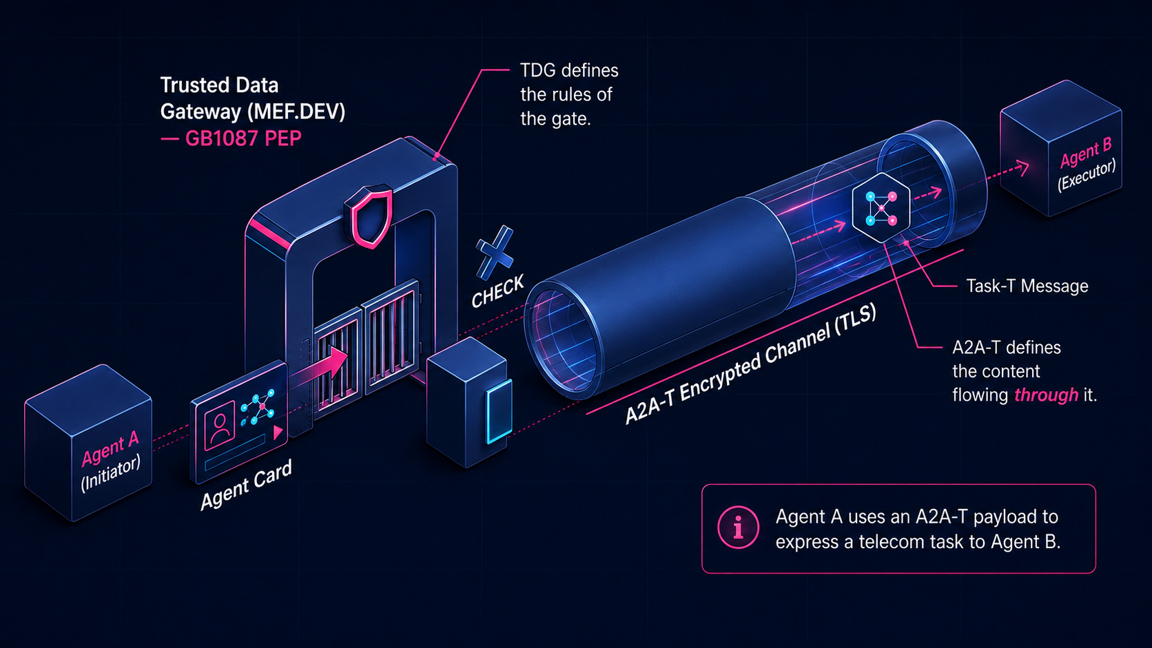
How A2A-T works inside the Fabric
TDG enforces the rules of the gate (GB1087). A2A-T defines the payload and protocol flowing through it.
© 2026 TM Forum
C26.0.910 Agent Fabric: A2A-T Runtime Phase III
June 2026
11

Slide 12
With / Without A2A-T
Same agents. Same conversation. Different outcome.
WITHOUT A2A-T · Standard LF A2A
WITH A2A-T · IG1453 Extensions Active
WITHOUT A2A-T · Standard LF A2A
✕ Natural language only
✓ Task-T structured payload
LLM on receiving end interprets — or guesses
Telecom intent in metadata — read before LLM call
✕ No structured intent
✓ Prompt Registry grounding
Agent cannot pre-route or validate before LLM call
Versioned, CSP-approved; same input = same execution
✕ Ambiguity deferred
✓ Negotiation-T pre-execution
Clarification loops at runtime — tokens, latency
Ambiguity, feasibility, missing info resolved first
✕ 40–70% token overhead
✓ 40–70% token reduction
Per task vs A2A-T equivalent, measured on wire
Measured on wire — same scenario, toggle
✕ Non-deterministic output
✓ Deterministic output
Same prompt, different state, different result
Versioned prompt + structured payload = reproducible
✕ No cross-vendor audit trail
✓ 100% audit coverage
Actions recorded per-agent, not across the chain
Every Task-T dispatch with constraint attestation
Demonstrated live at DTW. Raw message payload visible. Toggle on request.
© 2026 TM Forum
C26.0.910 Agent Fabric: A2A-T Runtime Phase III
June 2026
12

Slide 13
HVS1: Service Fault Management
Cross-domain autonomous fault resolution. RAN + Transport. Zero human handoffs.
Anomaly
Detection
Problem ID
& Diagnostics
Impact
Analysis
Prioritise
& Resolve
RADCOM
→
Amdocs
→
Amdocs
→
Huawei RAN /
Infosys Transport
ML over RAN + Transport telemetry
Digital Twin substrate query
SID KG dependency graph
Task-T dispatch to domain agent
Protocol: Event-T (anomaly feed) → Task-T (chain dispatch) → Audit Log (every step)
< 1 hr
80%
60–70%
70% → 90%
MTTR
MTTR compression
NOC FTE reduction
Fault demarcation
from 3+ hrs
vs manual baseline
per cross-domain fault
accuracy improvement
Validated proxy metrics — calibrated against comparable production deployments at IOH, AIS, and MTN.
© 2026 TM Forum
C26.0.910 Agent Fabric: A2A-T Runtime Phase III
June 2026
13

Slide 14
Outcomes: Measured Against Production Baselines
Validated proxy metrics, calibrated against comparable deployments at IOH, AIS, MTN. IG1501-aligned ROI model.
PROTOCOL
OPERATIONS
TRUST
40–70%
< 1 hr
100%
Token reduction per task
Cross-domain MTTR
Audit coverage
A2A-T vs standard LF A2A, on wire
From 3+ hr manual baseline (HVS1)
Every cross-vendor Task-T
Zero
60–70%
100%
Downstream re-clarification
NOC FTE reduction
Trust verification
Negotiation-T resolves before commit
Per cross-domain fault
Cryptographic via MEF.DEV TDG
100%
70% → 90%
Per-decision
Task determinism
Fault demarcation accuracy
XAI coverage
Same prompt → same behaviour
ML anomaly + Digital Twin (HVS1)
Infosys: EXPLAIN on every response
Commercial: > 3× ROI by Year 3 · benefits in 12–18 months · zero replatforming · deployable within existing budget cycles
© 2026 TM Forum
C26.0.910 Agent Fabric: A2A-T Runtime Phase III
June 2026
14

Slide 15
Scale and Results
3 HVS scenarios · 7 vendors · 18 CSP champions · end-to-end, no human handoffs.
HVS
Scenario
Multi-Vendor Agent Chain
KCI · KEI · KBI Result
HVS1
Cross-Domain Fault Management
(RAN + Transport)
RADCOM · Amdocs · Huawei RAN · Infosys Transport
AN Level: L3 → L4
MTTR: 3+ hrs → < 1 hr
Manpower: 60–70% FTE ↓
Demarcation: 70% → 90%
HVS2
Enterprise Service
Complaint Handling
Infovista · Amdocs · Huawei · Infosys · Digital Twin
Complaint→credit: no human ticket
SLA validation: real-time
Credit issuance: autonomous
Cross-org coordination: A2A-T
HVS3
Enterprise Service
Fulfilment
Infosys · Huawei · Amdocs · Infovista · External agents
Fulfilment: weeks → hours
Provisioning A/T/S: autonomous
3rd-party integration: A2A-T standard
Multi-party cost: reduced
KCI: Key Capability · KEI: Key Effectiveness · KBI: Key Business Indicators · Validated proxy metrics (IOH, AIS, MTN) · Contributed to TM Forum AN White Paper 8.0 , DTW26
© 2026 TM Forum
C26.0.910 Agent Fabric: A2A-T Runtime Phase III
June 2026
15

Slide 16
Open Source Contributions
OpenAN and A2A-T to LFN
LF A2A CONTRIBUTION
AGNTCY RELATIONSHIP
IG1453 v2.1
A2A-T and the AGNTCY Agent Gateway Protocol operate at different layers — complementary, not competing. A2A-T closes the telecom semantic accuracy gap LF A2A leaves open. AGNTCY operates at the gateway and routing layer. Both are required for full carrier-grade interoperability.
A2A-T specification — Task-T, Event-T, Negotiation-T
Issues #1796
Formal upstream extension proposals to LF A2A
experimental-ext-telecom
Telecom profile repo under a2aproject org — running
WHAT IS OPEN
— IG1453 specification (TMF governed)
OpenAN runtime
— OpenAN: Registration + Orchestration + Knowledge Graph
Registry, Prompt Registry, Orchestration, KG — open via LF
— A2A-T SDK — reference implementation
Endorsements
— Audit Log schema and Fabric UI
— Contributed as TM Forum asset + LF A2A telecom profile
DT · Vodafone · Telefónica · TIM · China Mobile · Huawei
© 2026 TM Forum
C26.0.910 Agent Fabric: A2A-T Runtime Phase III
June 2026
16

Slide 17
Why This Catalyst Matters
85% of CIOs say explainability gaps have already blocked AI from production.
For CSPs
For VENDORs
For SIs/Consultants
Defensible autonomy at last
Open protocol ends the integration tax
A framework clients can buy and deploy
Operators are under board pressure to prove AI ROI with regulators requiring traceability within 12 months. A2A-T gives operators their own processes as the executable contract —workflows compiled into agent tasks. Every decision produces an evidence chain.
74% of CIOs regret at least one AI vendor selection in the past 18 months. The root cause is lock-in. A2A-T, governed in Linux Foundation open source, means any vendor's agent registers once and interoperates across the entire fabric.
82% of CIOs say agents are built faster than IT can govern them. Consultants need a standards-backed governance blueprint deployable as an overlay on existing OSS/BSS — no replatforming.
MTTR cut 80% · NOC FTE reduced 60–70% · Provable, not asserted.
7 partners. One protocol. New agents integrated in days, not quarters.
IG1453 + IG1501 ROI model. Validated by 20 operators. 3× ROI by Year 3.
70% of CIOs: AI audit mandates within 12 months
74% regret their AI vendor choice — open wins
3× ROI by Year 3 · No replatforming required
80%
60–70%
Weeks → Hours
18 operators
MTTR reduction · 3+ hrs → <1 hr, zero handoffs
NOC FTE per fault · verified vs IOH production
Enterprise fulfilment · access, transport, 3rd-party
7 vendors · 1 open protocol · 0 bespoke integrations
The industry's greatest fear in 2026: not that AI will be wrong — but that AI will be ungoverned. A2A-T and Agent Fabric give telecom one open protocol, one open runtime, one governance fabric. Level 4 stops being a target. It becomes production reality.

Slide 18
Agent Fabric: A Three-Phase Evolution
Phase III builds on two prior Catalysts.
PHASE I
PHASE II
PHASE III
Incident Copilot
Agent Fabric
Agent Fabric: A2A-T Runtime
Copilots and Agents · AN Level 3+
Cross-domain Collaboration · AN Level 4
Open protocol + open fabric · L4 sustained
— AI recommends — NOC engineer decides
— Multi-vendor, multi-agent (MVMA)
— A2A-T extends LF A2A · IG1453-aligned
Task-T · Event-T · Negotiation-T
— RAN L4 autonomous agents with copilot above
— SOC + NOC unified, cross-domain
— Protocol, Semantics, Coordination, Governance, Trust
— 4–8 hrs → minutes, single engineer
— Agents cooperate without human handoffs
— 7-vendor fabric · 18 operator champions
— Human-in-the-loop: verify, approve
— A2A, ACP, MCP runtime · TMF939/735 APIs
— 3 HVS proven live
trusted, governed
L4 is achievable. The unsolved problem is keeping it there — safely, trusted, business-focused. Phase III solves that.
© 2026 TM Forum
C26.0.910 Agent Fabric: A2A-T Runtime Phase III
June 2026
18

