Slide 1
C# File IO

Slide 2
A file is a collection of data stored in a disk with a specific name and a directory path.
When a file is opened for reading or writing, it becomes a stream.
The stream is basically the sequence of bytes passing through the communication path.

Slide 3
There are two main streams: the input stream and the output stream.
The input stream is used for reading data from file (read operation) and the output stream is used for writing into the file (write operation).

Slide 4
C# IO Classes
The System.IO namespace has various classes that are used for performing numerous operations with files, such as creating and deleting files, reading from or writing to a file, closing a file etc.

Slide 5
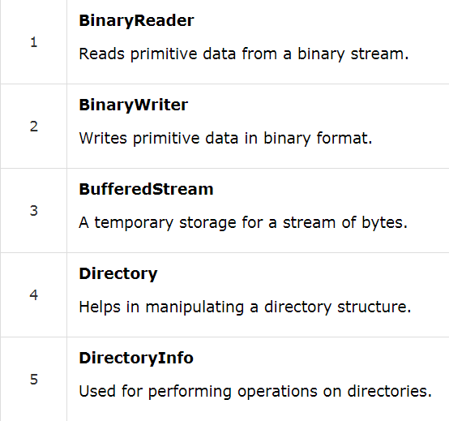
some commonly used non-abstract classes in the System.IO namespace

Slide 6
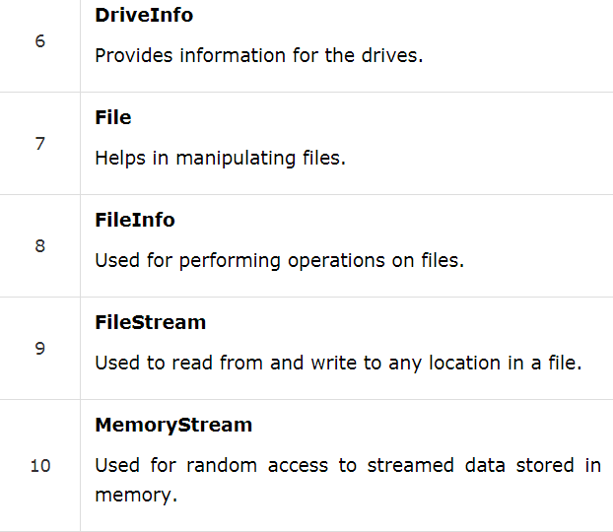
Cont.

Slide 7
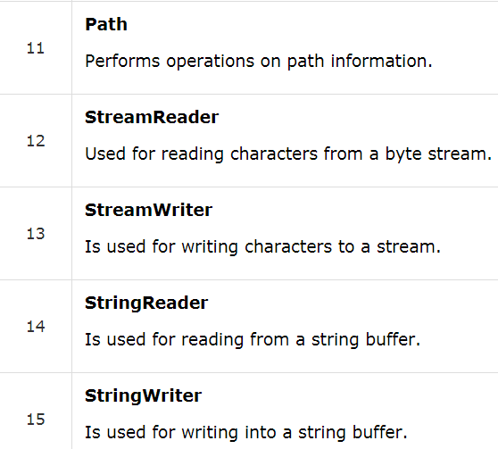
Cont

Slide 8
FileStream Class
The FileStream class in the System.IO namespace helps in reading from, writing to and closing files. This class derives from the abstract class Stream.

Slide 9
FileMode
Append
Create
Open
Truncate

Slide 10
FileAccess
Read
ReadWrite
Write

Slide 11
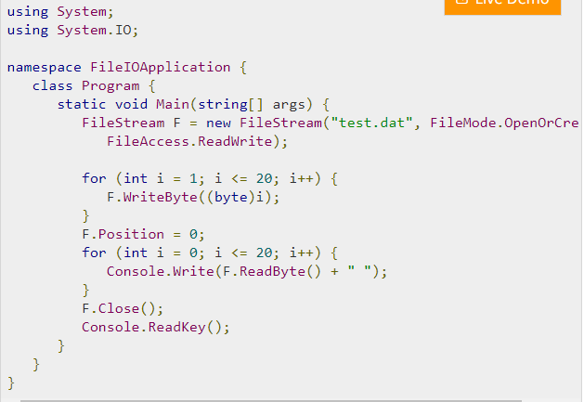
Example

Slide 12
Text File Read / Write
The StreamReader and StreamWriter classes are used for reading from and writing data to text files.
The StreamReader class also inherits from the abstract base class TextReader that represents a reader for reading series of characters.

Slide 13
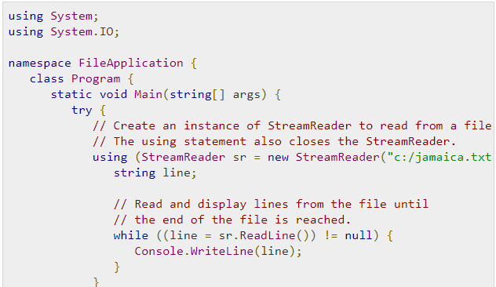
Example-Read

Slide 14
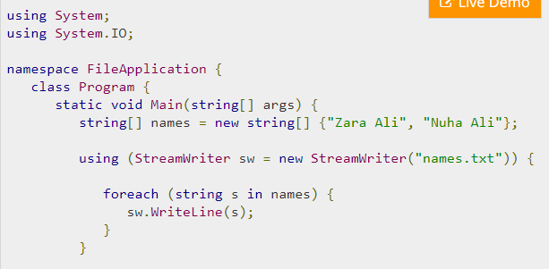
Example Write

Slide 15
Windows File System
C# allows you to work with the directories and files using various directory and file related classes such as the DirectoryInfoclass and the FileInfo class.

Slide 16
DirectoryInfo
The DirectoryInfo class is derived from the FileSystemInfoclass. It has various methods for creating, moving, and browsing through directories and subdirectories.

Slide 17
DirectoryInfo Attributes
Attributes
Creationtime
Exists
FullName
LastAccessTime

Slide 18
Methods
Create
Delete
GetDirectories
GetFiles

Slide 19
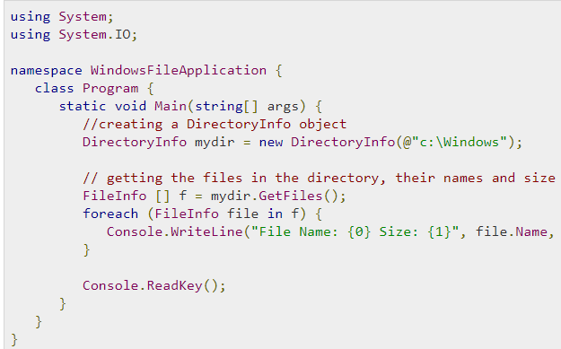
Example

