Slide 1
ASP.net Security

Slide 2
Introduction
Security is an essential part of web applications and should be taken into consideration from the first stage of the development process.
security is all about protecting your assets from unauthorized actions.

Slide 3
The ASP.NET security framework includes classes for authenticating and authorizing users as well as for dealing with authenticated users in your applications.

Slide 4
Understanding Potential Threats
You can’t create secure software if you don’t know who has access to your application and where possible points of attack might be.
The most important factor for creating a secure application architecture and design lies in a good understanding of environmental factors such as users, entry points, and potential possible threats with points of attack.

Slide 5
Cont.
Threat modelling is a structured way of analyzing your application’s environment for possible threats, ranking those threats, and then deciding about mitigation techniques based on those threats.

Slide 6
Understanding Gatekeepers
A good way to increase the security of your application is to have many components in place that enforce security.
Gatekeepers are a conceptual pattern that apply a pipelining model to a security infrastructure. This model helps you tighten your security.

Slide 7
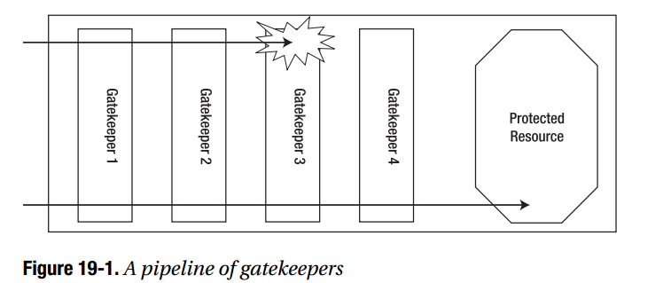
Understanding Gatekeepers

Slide 8
Levels of Security
Authentication
Authorization
Confidentiality
Integrity

Slide 9
Authentication
First, you have to authenticate users. Authentication asks the question, who goes here?
It determines who is working with your application on the other end.

Slide 10
Authorization
Second, as soon as you know who is working with your application, your application has to decide which operations the user may execute and which resources the user may access. In other words, authorization asks the question, what is your clearance level?

Slide 11
Confidentiality
While the user is working with the application, you have to ensure that nobody else is able to view sensitive data processed by the user.
Therefore, you have to encrypt the channel between the client’s browser and the web server.

Slide 12
Integrity
Finally, you have to make sure data transmitted between the client and the server is not changed by unauthorized actors.

Slide 13
Authentication
Authentication is the process of discovering a user’s identity and ensuring the authenticity of this identity.
Once your identity is established, your token identifies you so that everywhere you go within a particular area, your identity is known.

Slide 14
Ways of Authentication
• Windows authentication
• Forms authentication
• Passport authentication
• A custom authentication process

Slide 15
Authentication
In each of these, the user provides credentials when logging in. The user’s identity is tracked in different ways depending on the type of authentication.
All authentication does is allow the application to identify who a user is on each request. This works well for personalization and customization.

Slide 16
Authorization
In a web application, different types of authorization happen at different levels.
For example, at the topmost level, your code can examine the user identity and decide whether to continue with a given operation.
lower level, you can configure ASP.NET to deny access to specific web pages or directories for certain users or roles.

Slide 17
Impersonation
Impersonation is the process of executing code in the context (or on behalf) of another user identity.
By default, all ASP.NET code is executed using a fixed machine-specific account.
To execute code using another identity, you can use the built-in impersonation capabilities of ASP.NET.

Slide 18
Impersonation
To give each web application different permissions.
To use existing Windows user permissions.

Slide 19
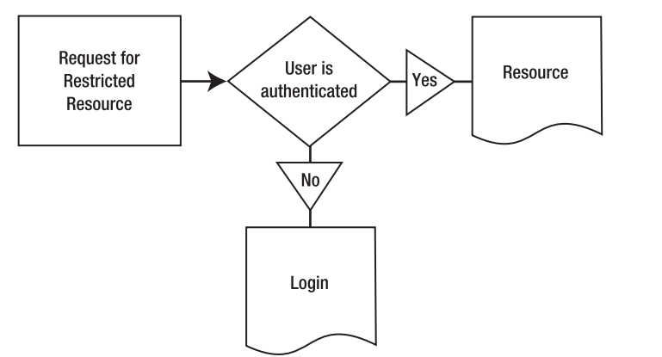
Scenario in case of Authentication

Slide 20
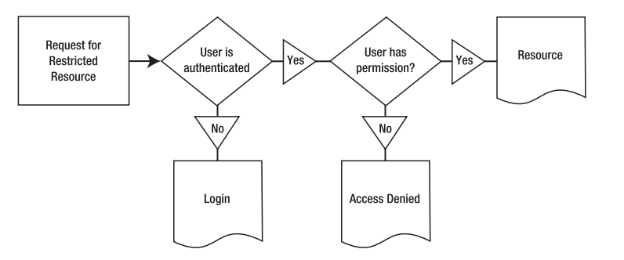
Authentication and Authorization

Slide 21
ASP.NET Security Architecture
the user must be authenticated and authorized at the beginning of each request.
ASP.NET handles this by firing global application events. Authentication modules can handle these events to perform user authentication.

Slide 22
Important Events
The AuthenticateRequest event is raised by the HttpApplication object when a request requires authentication.
the next step is to make sure the user identity information is readily available for the rest of the page-processing cycle.
create a new object with user information and attach it to the User property of the current HttpContext.

Slide 23
Important Events
The AuthorizeRequest event is raised after the user has been authenticated in the AuthenticateRequest event.
Authorization modules use AuthorizeRequest to check whether the user is authorized for the resource they are requesting

Slide 24
Authentication
• FormsAuthenticationModule
• WindowsAuthenticationModule
• PassportAuthenticationModule

Slide 25
Form Authentication
The Forms Authentication Module uses forms authentication, which allows you to design your own login pages, write your own authentication logic.
<authentication mode="Forms" />

Slide 26
Windows Authentication
The Windows Authentication Module works in conjunction with IIS to perform Windows authentication.
<authentication mode="Windows" />

Slide 27
Passport Authentication
The Passport Authentication Module provides a wrapper for Microsoft’s Passport authentication service.
The advantage of Passport is that you can use existing user credentials (such as an e-mail address and password), without forcing users to go through a separate registration process.

Slide 28
Authorization
UrlAuthorization
  The UrlAuthorization module works basedon the content of the <authorization> configuration in the web.config files of different directories of your web application. It can restrict access to both directories and files, based on the user’s name or the roles assigned to the user.

Slide 29
Authorization
FileAuthorization
  When using Windows authentication in intranets, ASP.NET automatically uses the FileAuthorization module for authorizing Windows users against files accessed by ASP.NET.

Slide 30
Membership API
The membership API is a complete user management system. It helps you create, edit, and delete users, and it includes functionality for password recovery.
you can use the ASP.NET web configuration tool for the graphical administration of your users.

Slide 31
Roles API
In many cases authorization is performed on groups of users called roles.
One role can contain many users, and a user can be assigned to many roles.

Slide 32
The Security Context
Regardless of the authentication system, ASP.NET uses the same underlying model to represent user and role information.
Users who log in to a web application are granted a principal and an identity based on the credentials they have provided.

Slide 33
Iprincipal Interface
When you access the User property of the current web page (System.Web.UI.Page) or from the current HTTP context (HttpContext.Current), you’re accessing an IPrincipal object that represents the security context of the current user.
if (HttpContext.Current.User.IsInRole("Admin"))
{
// (Do something.)
}

Slide 34
Iidentity Interface
The IIdentity interface defines the basic information needed to represent the current user.
this includes the following three read-only properties:
  AuthenticationType
  IsAuthenticated
  Name

Slide 35
Thank you

