Slide 1
Python level 1
VS Code Installation Guide
Alexandra Oliveira
September 1

Slide 2
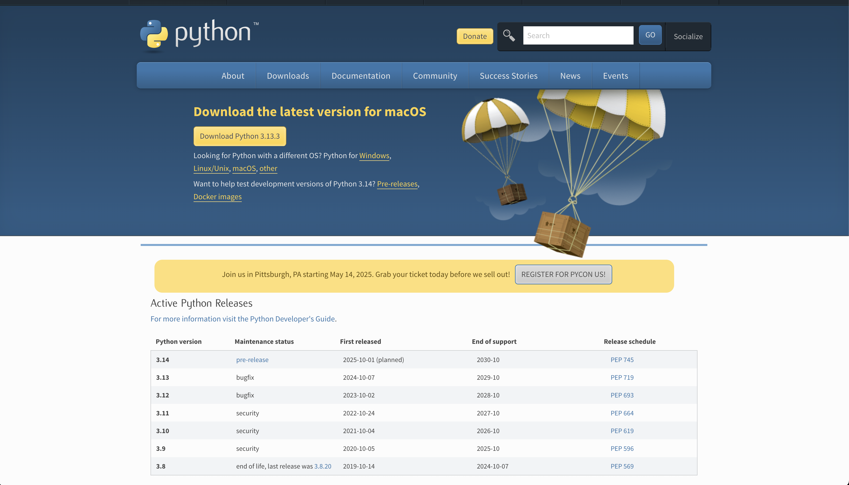
Installing Python
Download a Python:
Visit the official Python website: Python Downloads (https://www.python.org/downloads/);
Click on the "Downloads" tab and select the version suitable for your operating system (Windows, macOS, or Linux);
Install the latest Python version.

Slide 3
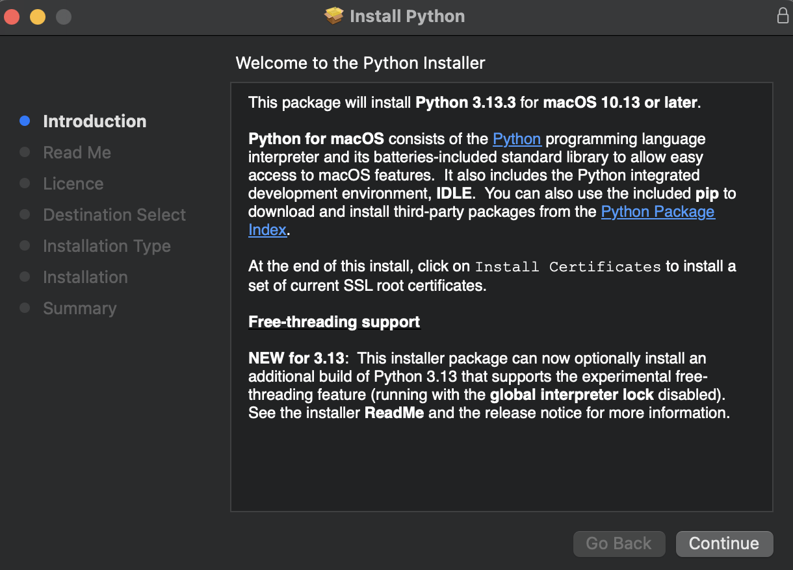
Installing Python
Run the Installer:
For Windows: Double-click the downloaded installer (.exe) and follow the installation wizard;
For macOS: Double-click the downloaded installer (.pkg) and follow the installation instructions;
For Linux: Open a terminal and navigate to the directory where you downloaded the installer. Run the command: sudo dpkg -i <installer_filename>.

Slide 4
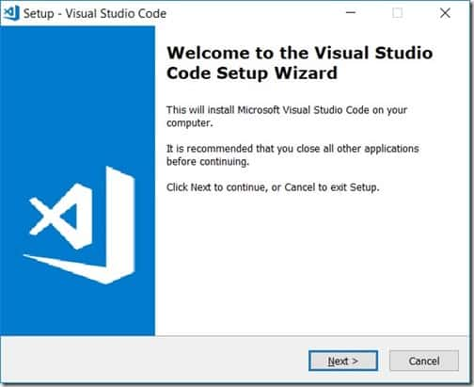
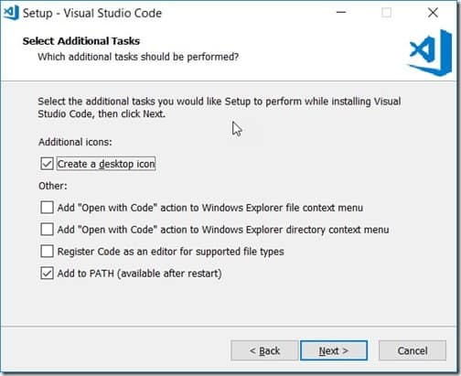
Installing VS Code on Windows
Install VS Code
For windows
Run the downloaded .exe installer.
Accept the license agreement.
Choose the installation location (default is fine for most users).
Recommended: Check the following options during setup:
Add "Open with Code" to context menu
Register Code as editor for supported file types.
Click Install.

Slide 5
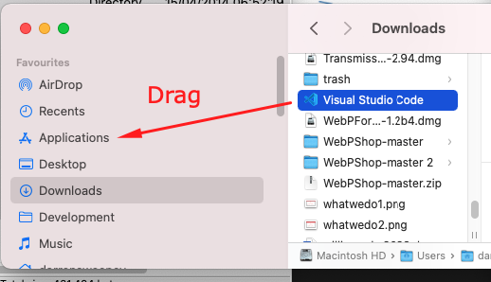
Installing VS Code on MAC
Install VS Code
For MAC
Open the downloaded .zip file.
Drag the Visual Studio Code app into your Applications folder.
You can optionally add VS Code to your Dock for easy access.

Slide 6
VS Code essentials
Set up a virtual environment
Create the virtual environment: In the terminal and insider your project folder type.
Activate the virtual environment.
After activation, your terminal will show the environment name at the beginning, like.
cd path-to-your-project-folder python –m venv venv
terminal
Windows
.\venv\Scripts\Activate.ps1
MAC/Linux
source venv/bin/activate
(venv) your-computer-name:your-project-folder username$
terminal

Slide 7
Virtual Environments
A virtual environment is like a special, isolated space on your computer where you can install Python packages just for one project, without messing with other projects or your system’s Python.
Think of it like:
📦 A "project box" that keeps everything you need inside.
🛡️ It protects your project from problems like version conflicts (different projects needing different versions of the same package).
Example:
Project A needs Pandas 3.2.
Project B needs Pandas 4.
If you use a virtual environment, each project can have its own Pandas version, no problems!
Without a virtual environment, everything would install globally, and projects could easily break each other.

Slide 8
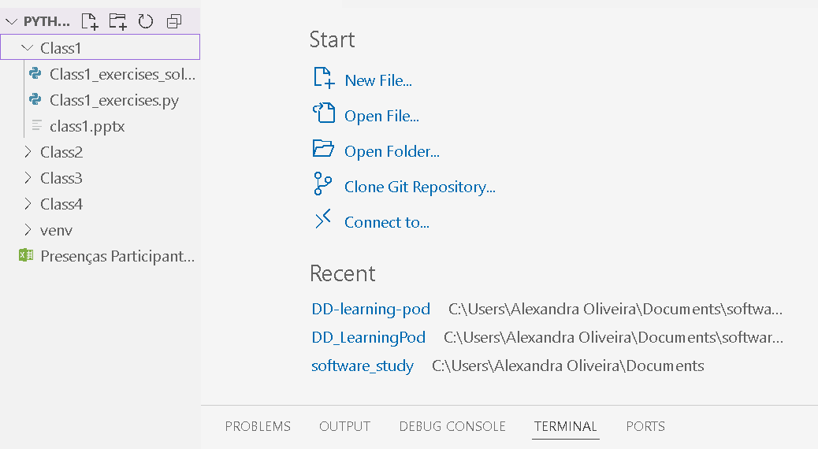
Virtual Environments
An integrated development environment (IDE) is a software application that helps programmers develop software code efficiently. It increases developer productivity by combining capabilities such as software editing, building, testing, and packaging in an easy-to-use application. Just as writers use text editors and accountants use spreadsheets, software developers use IDEs to make their job easier.
VS Code is one of the best IDEs for programming in Python

Slide 9
Alexandra Oliveira
m.alexandra.ro@gmail.com

