Slide 1



--Linked
Get linked with projects and collaborators
Team Hatchlings
Mohammad A, Sania S, Uzair M, Mateja M, Aarham W

Slide 2
Problem
SOLUTION
GitHub: Look at projects and collaborate but there is no social aspect to it
LinkedIn: Connect with people but no direct access/ matching with their projects
GitHub X LinkedIn: The best of both worlds
Get recommended projects and collaborators and make social + professional connections with people of similar interests

Slide 3
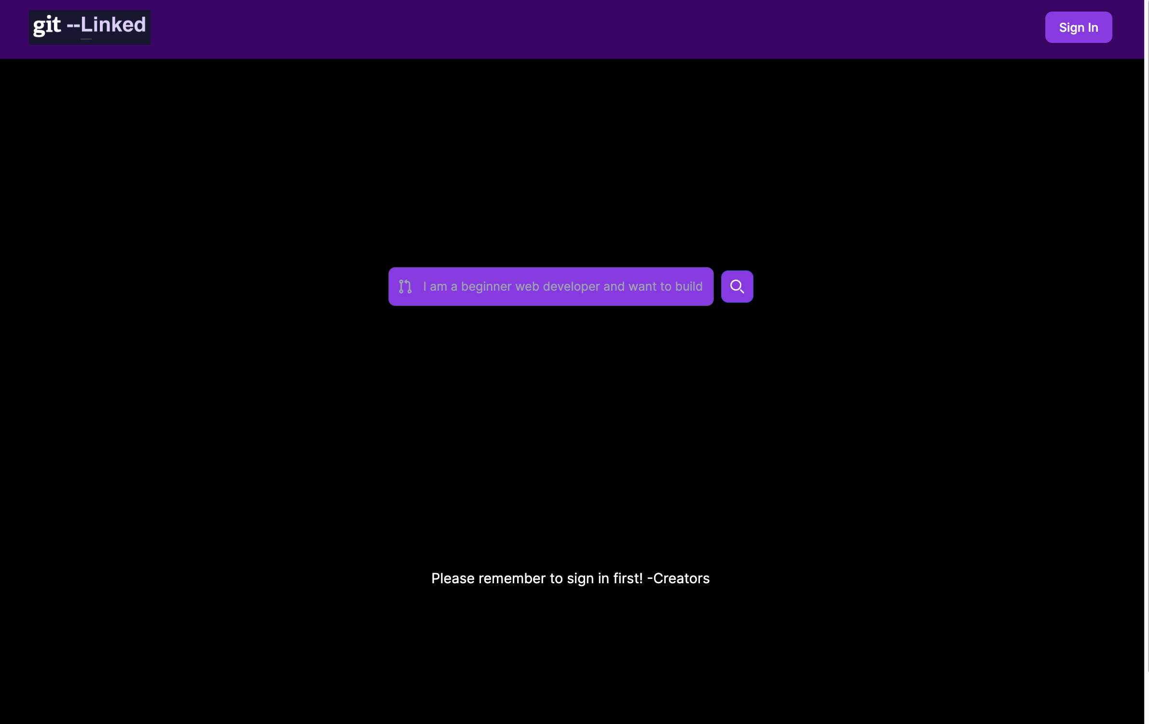
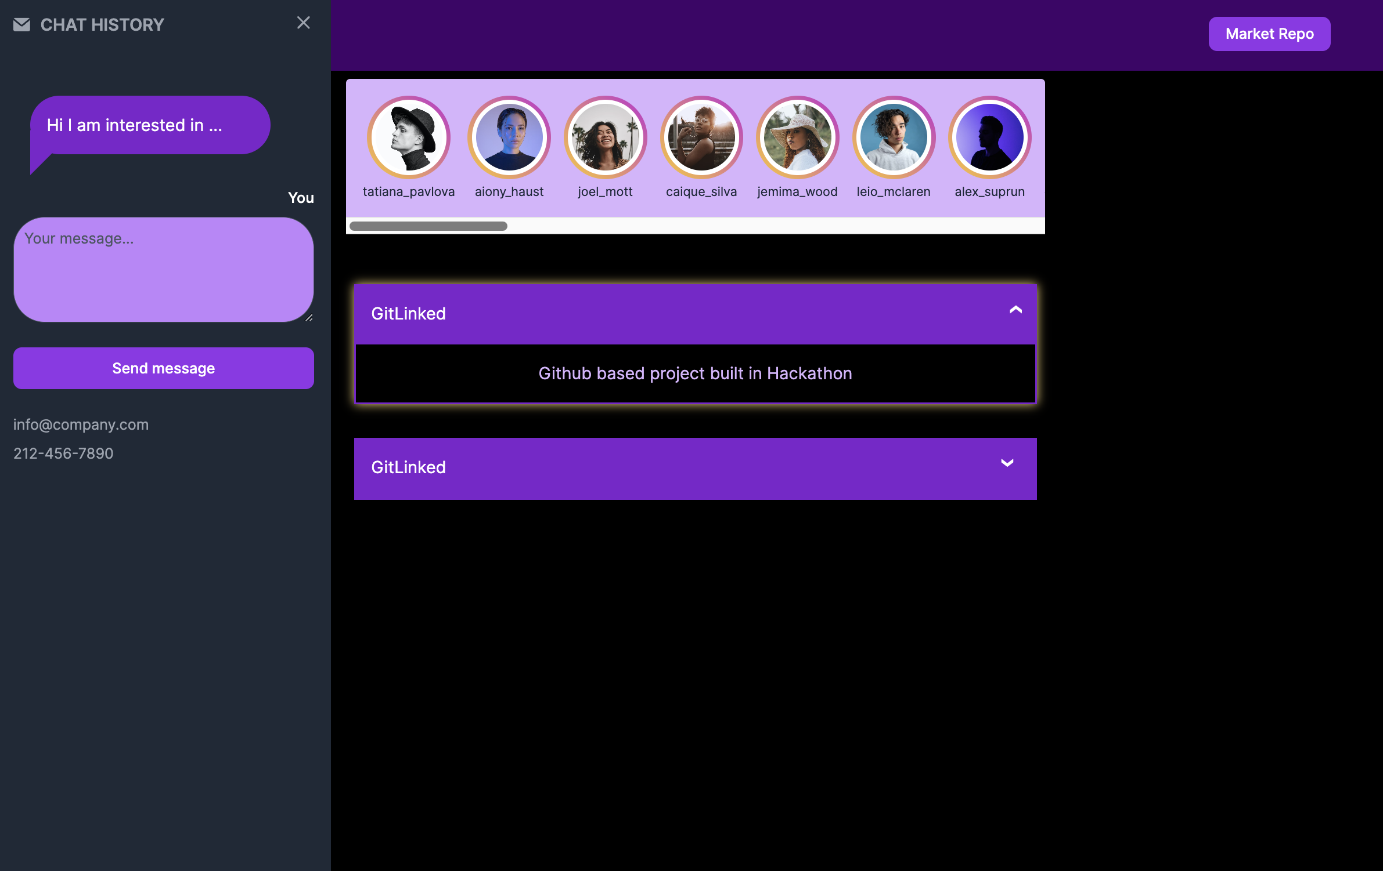
FEATURES
Sign in to access our features
Market your repository to look for collaborators
Sign In
Recommended Users: Click to chat
Search for projects and collaborators based on your interests or skills
Chat with users by clicking on their icon
Recommended Repositories: Click to expand details

Slide 4
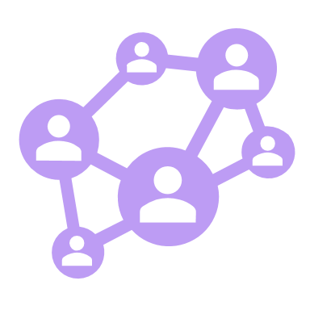




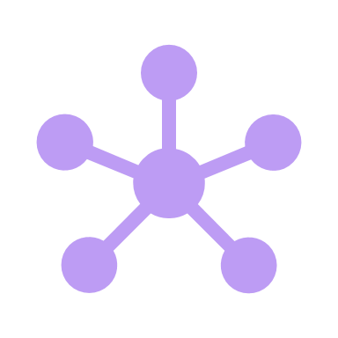

Our Recommendation System
Uses a Hybrid of Graph and NLP methods to match repositories to developers
Social Network
Of repositories and developers
Interests,
Languages
Technologies
Skills
Cosine similarity search
Extracted from README and profiles
Node2Vec
Train an embedding model using a biased random walk
Match scores
Unique Space Lab
Embedded Graph
That represents items in the same latent space
2. ISS Radiation
Link Prediction Algorithm
Suggests potential connections based on contribution activity and mutual connections
...
Recommend open-source repositories for the user to engage with

Slide 5





TECH SCHEMA
Sign in
Format parsing
Input Prompt
Recommendation System
Gitlinked.co
User
Chat
Database
Projects & Collaborators

Slide 6
impact
Best of different worlds
social media and project collaboration
Friends and projects
Connecting people with similar tech interests
Giving developers new ideas and connections
Connect non-tech project builders or researchers with tech resources
Make science and technology a "trend" to a younger audience
Expand global interest in science
Help people get linked!

Slide 7
FEATURE EXPANSION
Personalized dashboard with stats
Market repositories as looking for collaborators synced with dashboard
Leaderboard based on categories
The new social media for developers..... and everyone else!
Post projects that show up as featured based on interests and user connections
Integration with other project management tools such as Trello, Notion

