Slide 1

(A)
Data Acquisition
Near-Real Time
Data Acquisition using Twitter API
Tweets Storage
PFA-User Location Lookup Table
Pre-processing: Removal of URL, Duplicates, etc.
Monthly-Geocoded Tweets
Time Step t
(B)
Opinion Analytics
Randomization testing
Sentiment Lexicon
Observed Sentiment Document (OSD) (Policing-COVID-19 pandemic p)
Expected Sentiment Document (ESD)
(Policing p)
Geocoded Tweets
Tidy text
P-values
Exploration of Tweets
(C)
Sequential Visualization
Radar Chart
Likert Chart
Sequential Geospatial map

Slide 2
Observed sentiment documents (OSD)
‘Type 1’ tweets
‘Type 2’ tweets
Retrieve the mean probabilities (p) of each sentiment type
Assign p
Tweets containing ‘policing’ related keywords only.
Tweets containing ‘police-’ and ‘pandemic-’ related keywords.
Tweets with sentiments probabilities as ‘Type 1’
Randomised sentiment assignment
‘Expected’ sentiment documents (ESD)
Notes:
Pseudocode…
Control for region variance.
Page 33 of ‘Sentiment analysis of twitter data.pdf’
Of note, the Twitter API rate limits the number of requests sent to it. The
API allows for 15 calls every 15 minutes [11]. This analysis collected tweets based
on #hashtags. The rst script requested 1,000 tweets for 11 dierent #hashtags,
without being rate limited because 11 calls were made to the API. Immediately after
the rst script was run a second script would request 1,000 tweets for 10 dierent
#hashtags, this request would be rate limited and delayed for 15 minutes because the
API had received 21 requests within the allotted 15 minute API window.

Slide 3
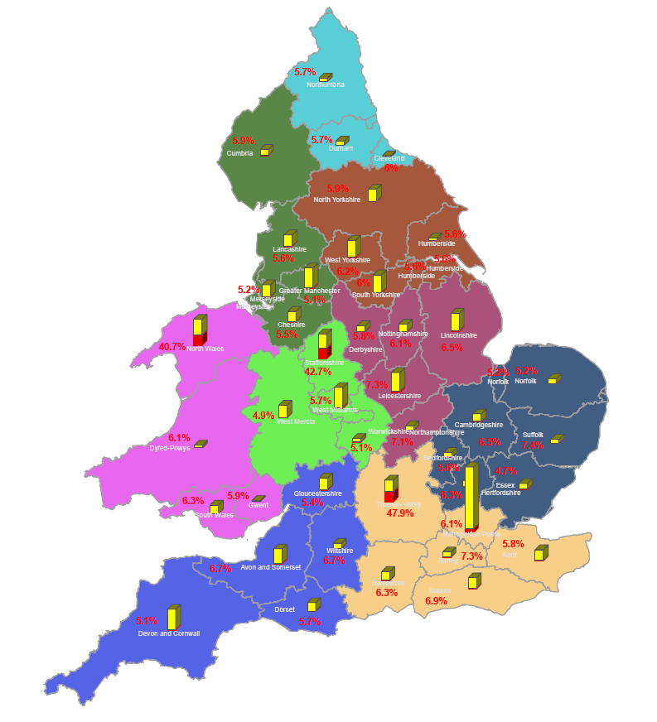
Keys
11,000
No. of tweets with ‘policing’ keywords
No. of tweets with ‘policing’ & ‘pandemic’ keywords
Regions
Notes:
https://fullfact.org/finder/crime_law/police/
https://assets.publishing.service.gov.uk/government/uploads/system/uploads/attachment_data/file/567535/police_and_public_health_overview.pdf
On your first example; when forwarding your interpretation, you could say that the article was mostly associated with sadnessand disgust, nothing wrong with that. You could also add that the article was least associated wtih joyand anger.

Slide 4
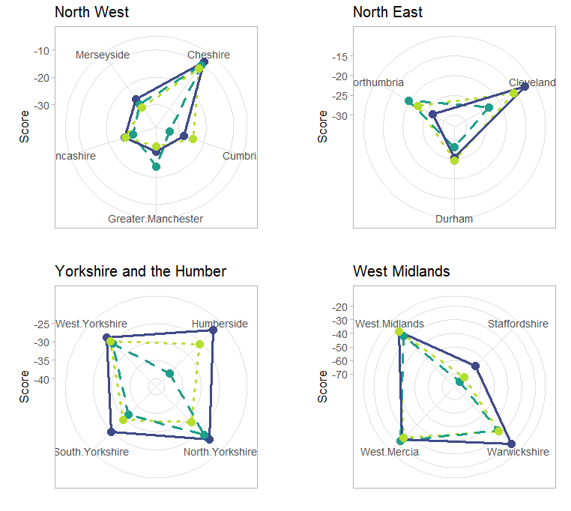
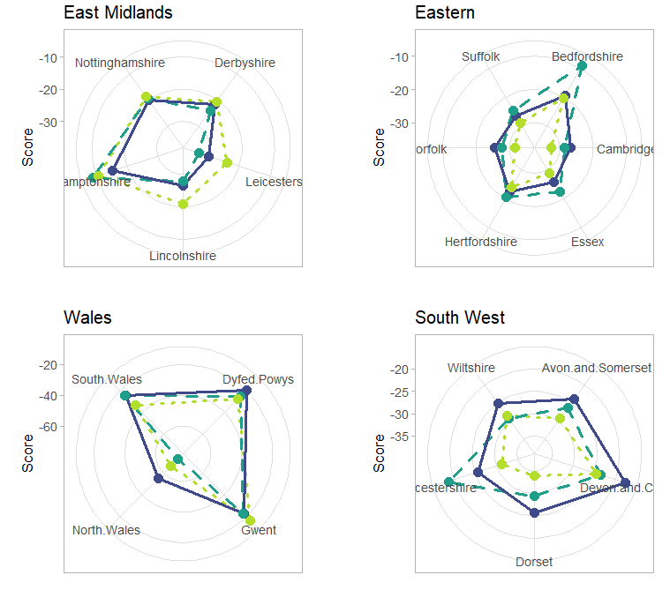
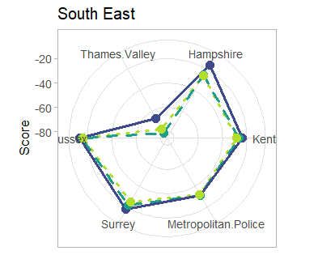

Key
Time step 1
Time step 2
Time step 3
Notes:
https://fullfact.org/finder/crime_law/police/
https://assets.publishing.service.gov.uk/government/uploads/system/uploads/attachment_data/file/567535/police_and_public_health_overview.pdf

Slide 5
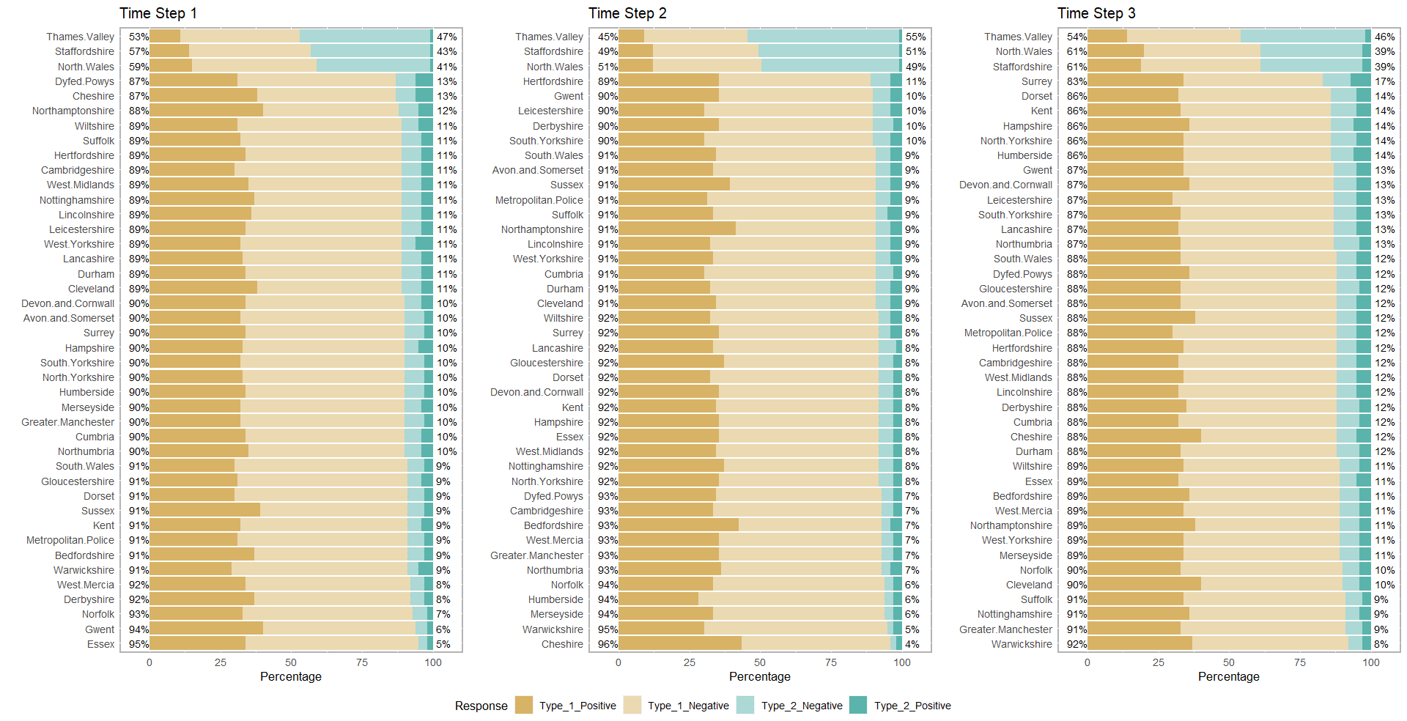
Key
Notes:
https://fullfact.org/finder/crime_law/police/
https://assets.publishing.service.gov.uk/government/uploads/system/uploads/attachment_data/file/567535/police_and_public_health_overview.pdf

Slide 6
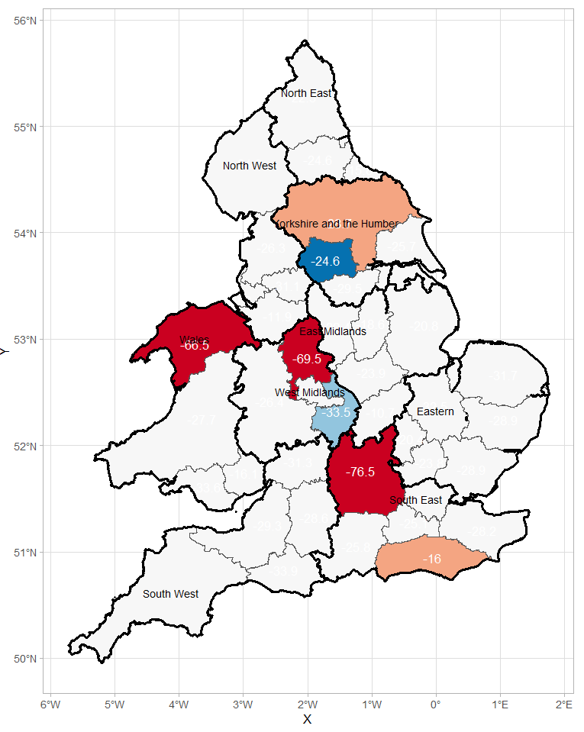
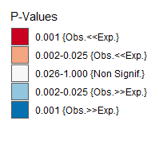
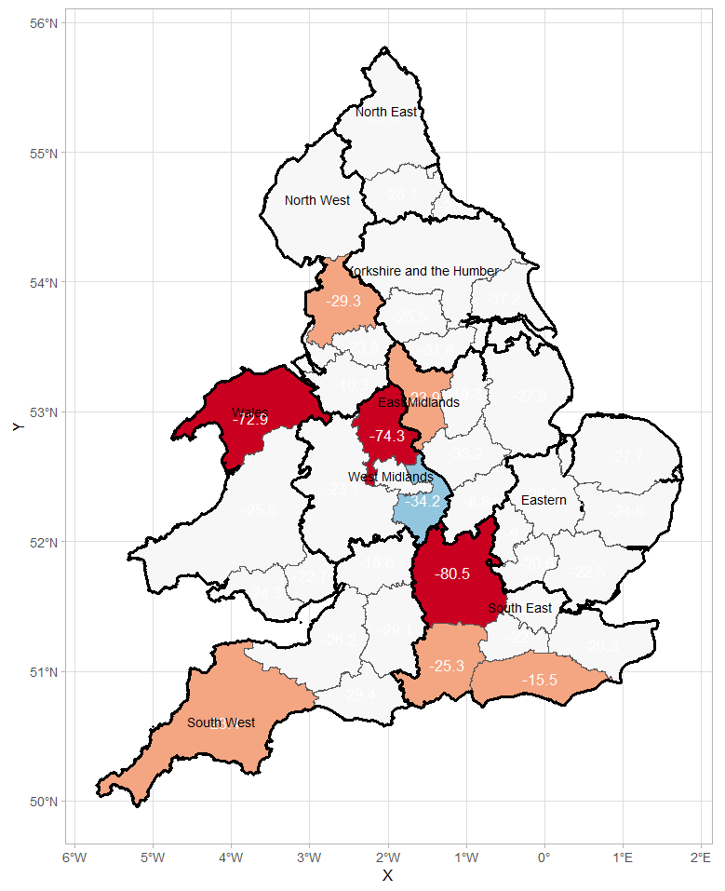
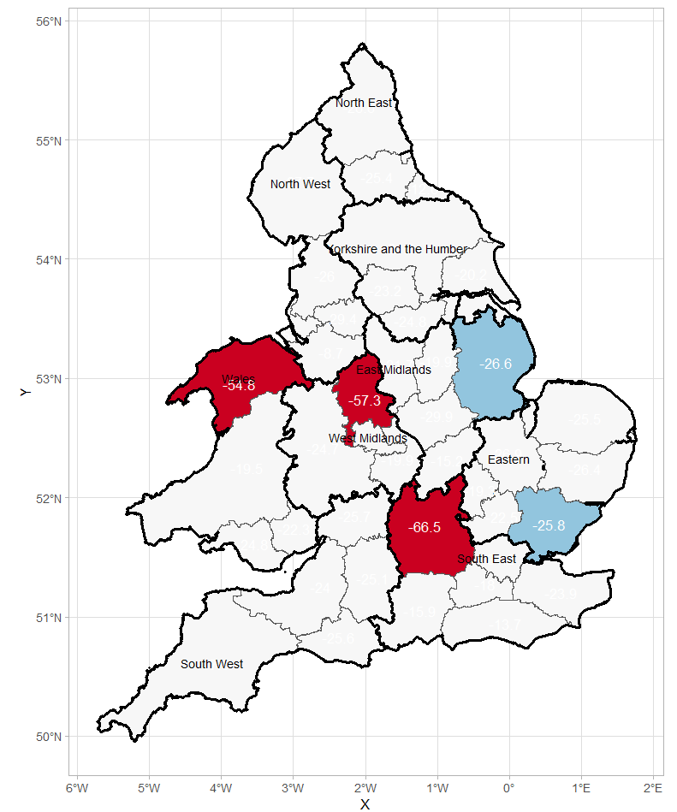
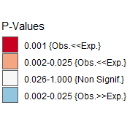
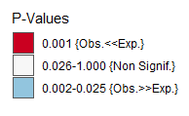
(a) Time Step 1
(b) Time Step 2
(a) Time Step 1
(b) Time Step 2
(c) Time Step 3
OR
(c) Time Step 3
Notes:
https://fullfact.org/finder/crime_law/police/
https://assets.publishing.service.gov.uk/government/uploads/system/uploads/attachment_data/file/567535/police_and_public_health_overview.pdf

