Slide 1
% tweets referencing pandemic vs. % tweets not referencing pandemic (by Police Force).
SN | Region | Police Force | Pandemic reference | Non-Pandemic reference
1 | North East | Cleveland | 16 | 194
2 |  | Durham | 48 | 629
3 |  | Northumbria | 37 | 522
 |  | Total (%) | 101 (6.98%) | 1345 (93.02)
4 | North West | Cheshire | 126 | 1480
5 |  | Cumbria | 66 | 940
6 |  | Greater Manchester | 213 | 3134
7 |  | Lancashire | 131 | 1710
8 |  | Merseyside | 132 | 1827
 |  | Total (%) | 668 (6.84%) | 9091 (93.16%)
9 | Yorkshire and the Humber | Humberside | 28 | 371
10 |  | North Yorkshire | 126 | 1909
11 |  | South Yorkshire | 173 | 2863
12 |  | West Yorkshire | 200 | 2602
 |  | Total (%) | 527 (6.37%) | 7745 (93.63%)
13 | West Midlands | Staffordshire | 1357 | 2228
14 |  | Warwickshire | 20 | 429
15 |  | West Mercia | 119 | 2040
16 |  | West Midlands | 234 | 3123
 |  | Total (%) | 1730 (18.12%) | 7820 (81.88%)
17 | East Midlands | Derbyshire | 50 | 903
18 |  | Leicestershire | 263 | 2700
19 |  | Lincolnshire | 182 | 2531
20 |  | Northamptonshire | 50 | 633
21 |  | Nottinghamshire | 93 | 1176
 |  | Total (%) | 638 (7.44%) | 7943 (92.56%)
22 | Eastern | Bedfordshire | 45 | 668
23 |  | Cambridgeshire | 90 | 1182
24 |  | Essex | 40 | 928
25 |  | Hertfordshire | 60 | 873
26 |  | Norfolk | 49 | 825
27 |  | Suffolk | 58 | 644
 |  | Total (%) | 342 (6.26%) | 5120 (93.74%)
28 | Wales | Dyfed-Powys | 34 | 362
29 |  | Gwent | 6 | 151
30 |  | North Wales | 1350 | 2463
31 |  | South Wales | 90 | 1440
 |  | Total (%) | 1480 (25.10%) | 4416 (74.90%)
32 | South West | Avon and Somerset | 170 | 2515
33 |  | Devon and Cornwall | 186 | 3211
34 |  | Dorset | 90 | 1505
35 |  | Gloucestershire | 145 | 2088
36 |  | Wiltshire | 69 | 859
 |  | Total (%) | 660 (6.09%) | 10178 (93.91%)
37 | South East | Metropolitan Police | 1393 | 21676
38 |  | Hampshire | 96 | 1357
39 |  | Kent | 94 | 1596
40 |  | Surrey | 69 | 774
41 |  | Sussex | 134 | 1774
42 |  | Thames Valley | 1301 | 1786
 |  | Total (%) | 3087 (9.63%) | 28963 (90.37%)

Slide 2
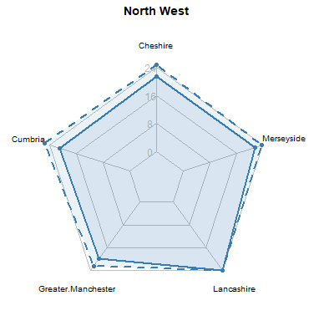
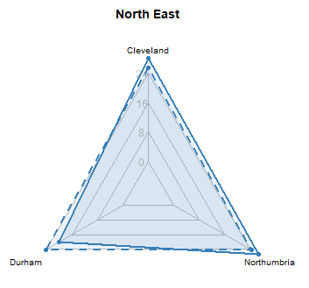
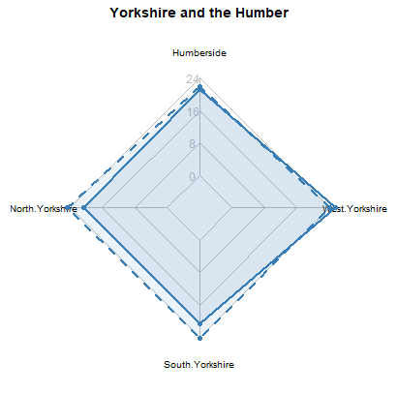
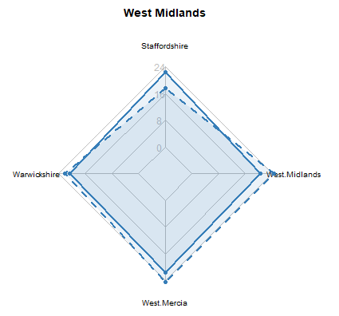
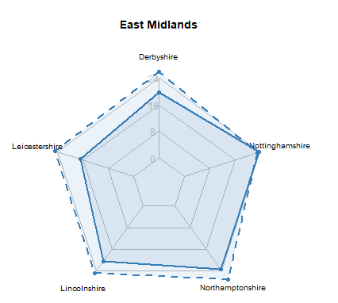
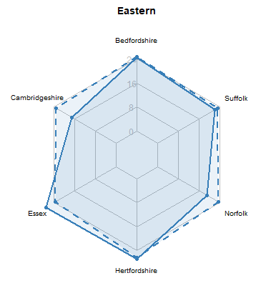
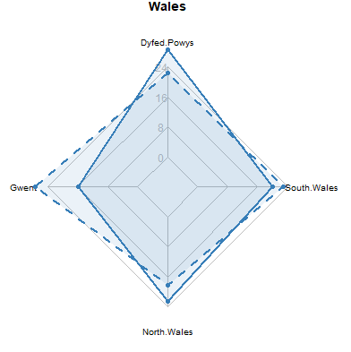
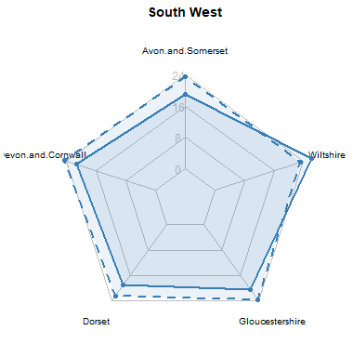
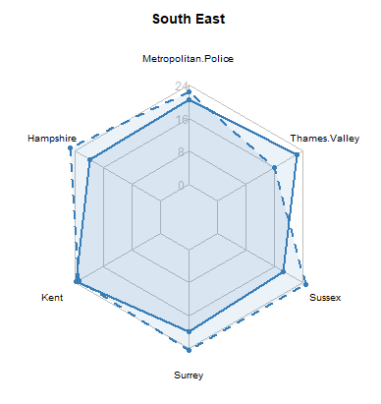
% polarity of opinion in tweets (Pandemic-referenced vs. Non-pandemic referenced) .
Pandemic-referenced
Non-Pandemic-referenced

Slide 3
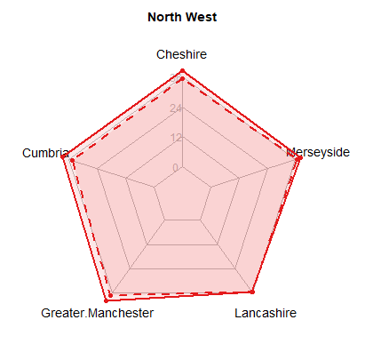
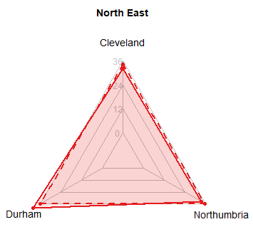
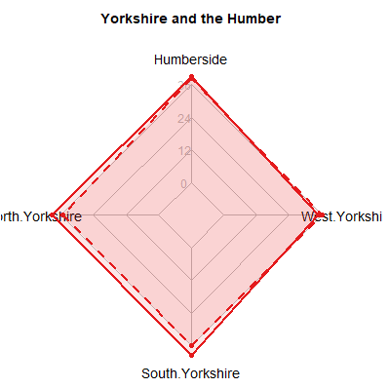
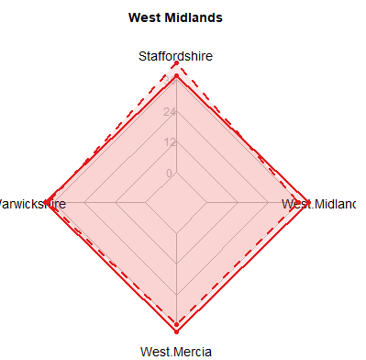
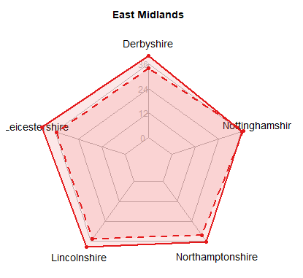
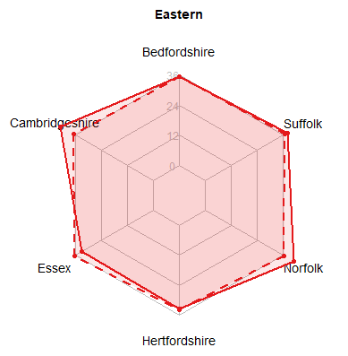
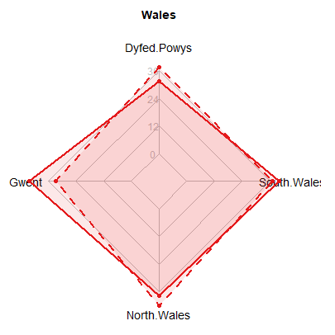
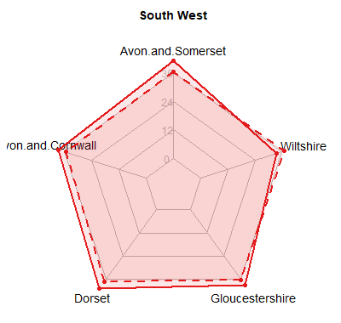
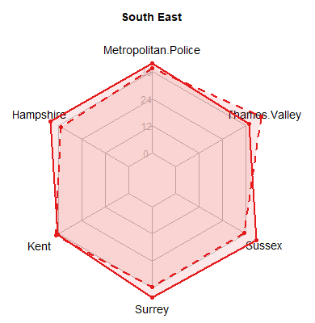
% polarity of opinion in tweets (Pandemic-referenced vs. Non-pandemic referenced) .
Pandemic-referenced
Non-Pandemic-referenced

Slide 4
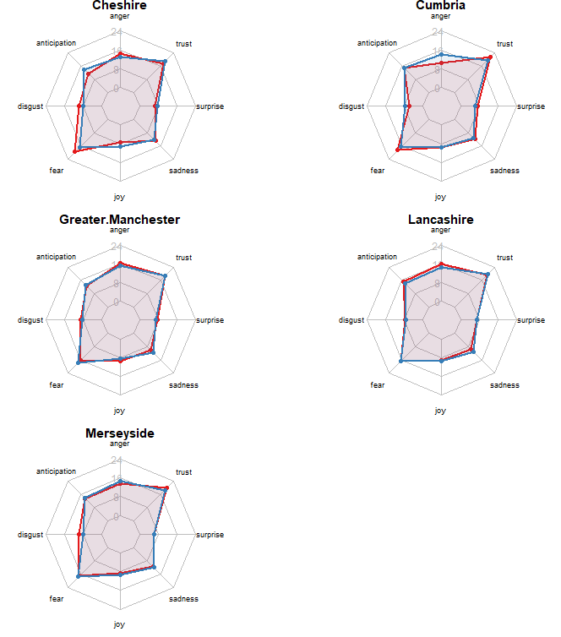
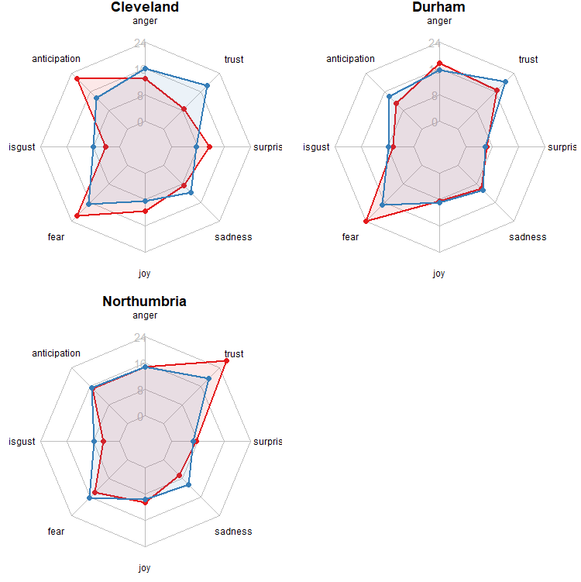
Mapping range of emotions expressed in tweet (pandemic vs. non-pandemic referenced)
North West
North East

Slide 5
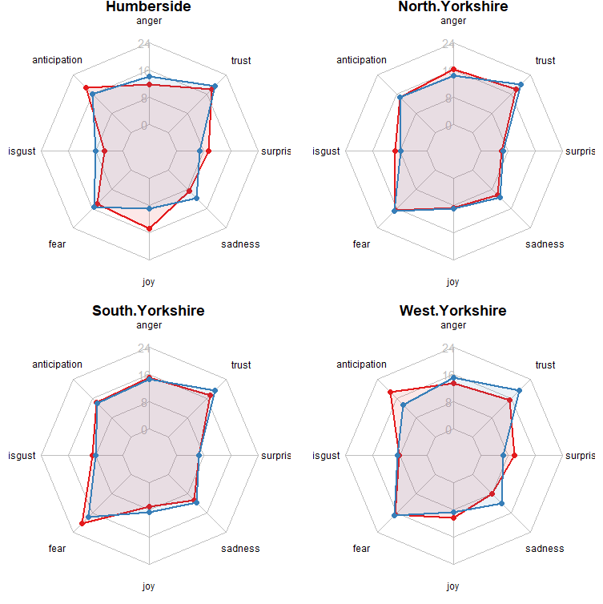
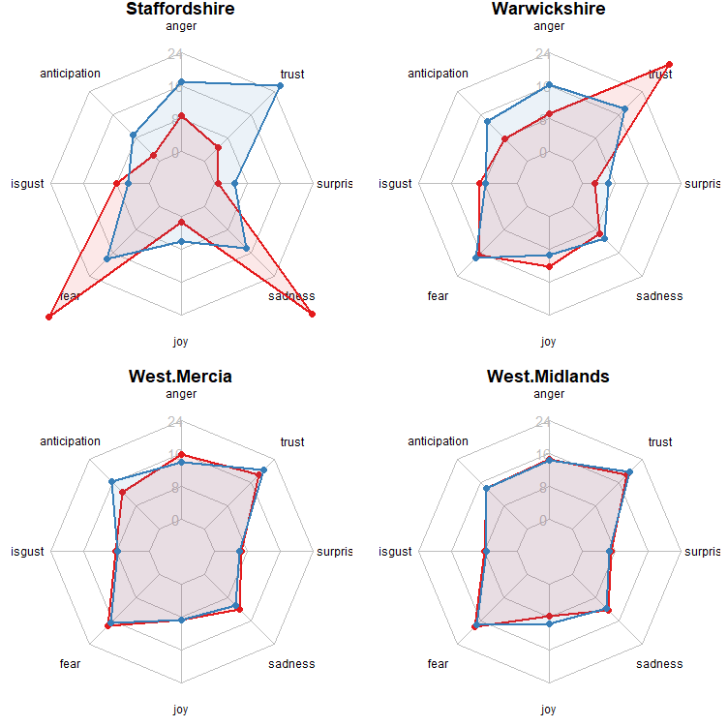
Mapping range of emotions in tweet (pandemic vs. non-pandemic referenced)
Yorkshire and the Humber
West Midland

Slide 6
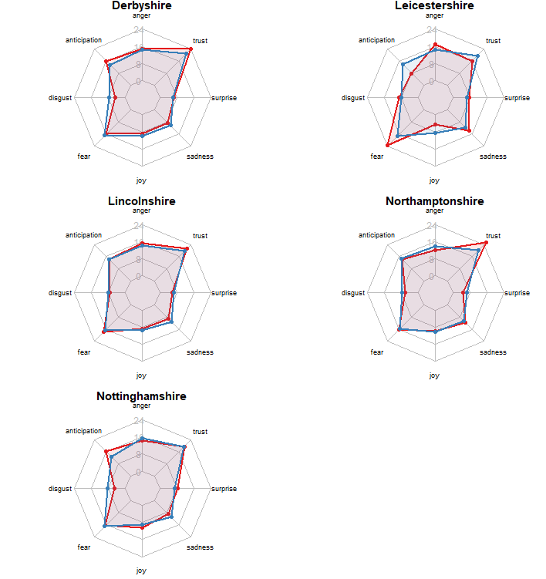
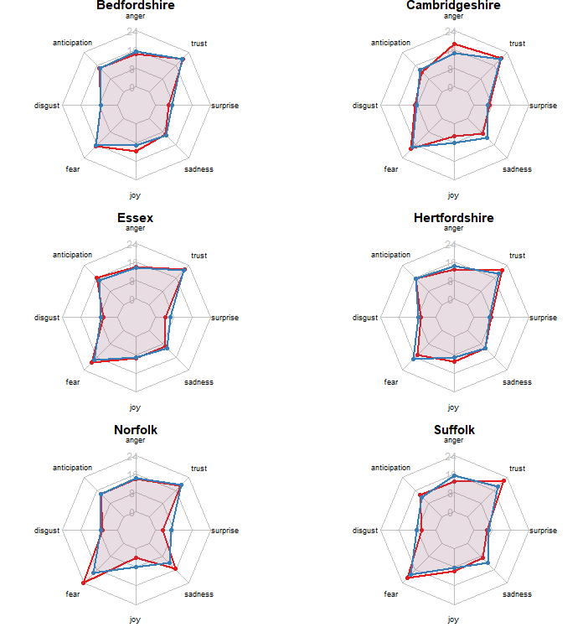
East Midlands
Eastern

Slide 7
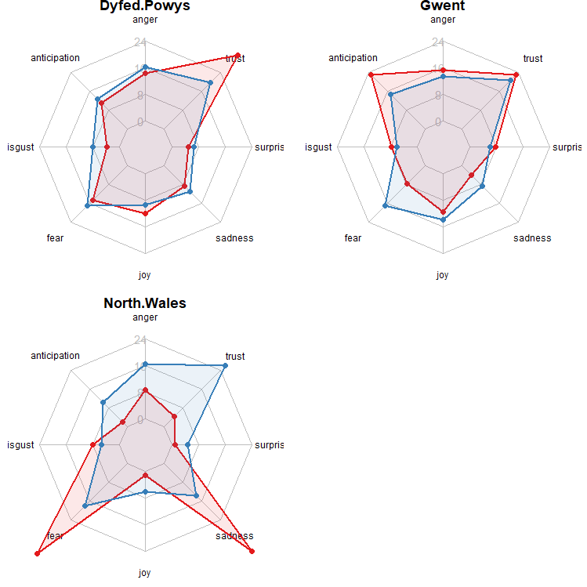
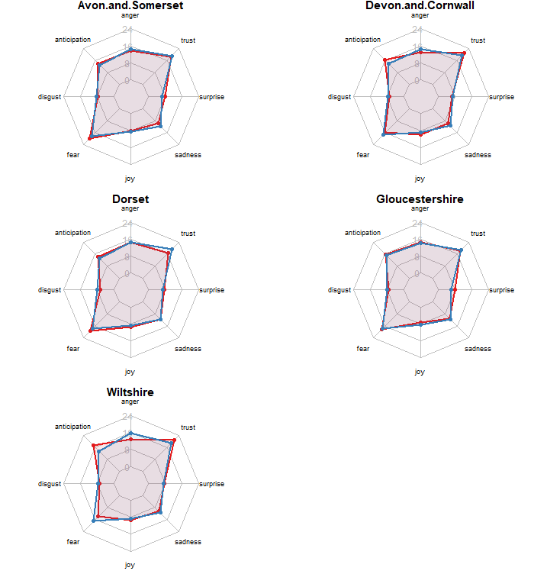
Wales
South Western

Slide 8
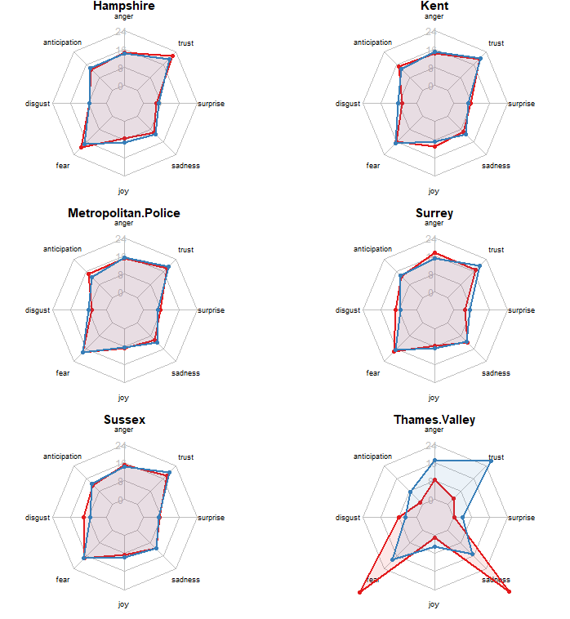
South Eastern

