Slide 1
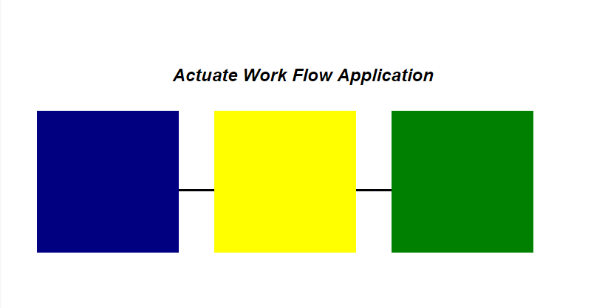

Slide 2
Work Flow Application
This application employs various techniques and functionality to enable the iHub to be used as a simple workflow application.
Content within the iHub can be inserted into the workflow which is then reviewed and approved by different users who provide their commentary about the content going through each step of the workflow.
The non-admin users are part of separate user groups in the security setup, these groups help the application identify which role and the appropriate functionality they can use such as setting a disposition of “Approved”.
The administrator is able to manually insert and delete content, they are also able to delete specific steps making it possible to “roll back” the content’s progression through the workflow.
Note, content such as MS Office file types may open in their respective applications instead of within the browser, however, the commentary and disposition will still be access via the browser.

Slide 3
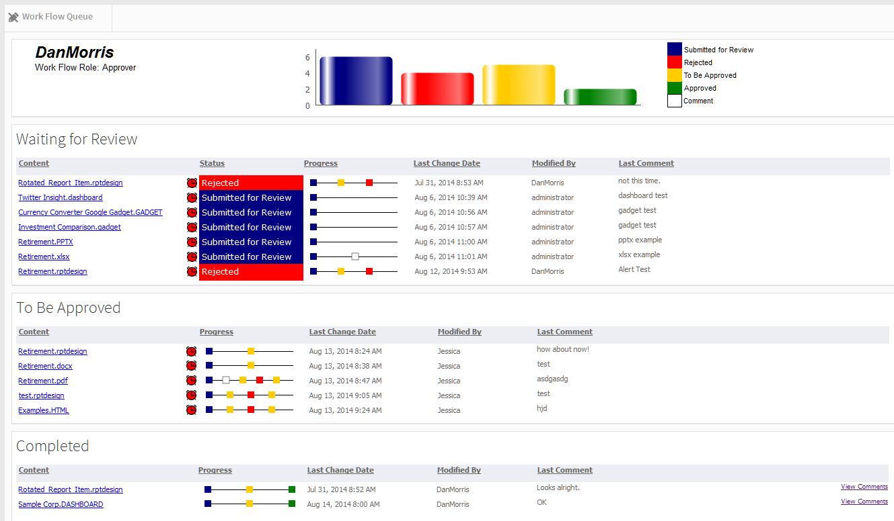
Work Flow Application – Sample Screen Shot

Slide 4
Work Flow Application - Disposition and Queue Diagram
User Role
System / Admin |  | Reviewer | Approver
 | Queue: | Waiting for Review | To Be Approved | Completed
Insert an item into the work flow
Submitted for Review
Review Item
Rejected
Disposition
To Be Approved
Review Item
Content Specific Process
Approved
Add Comments

Slide 5
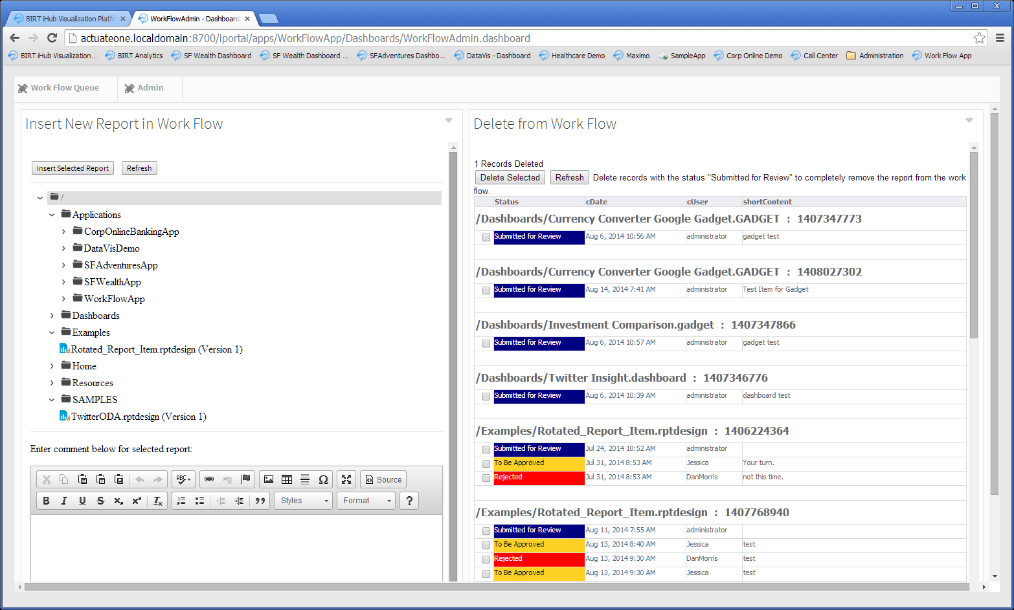
Work Flow Application – Admin Controls

Slide 6
Work Flow Application - Administrator
System / Admin
Most content in a volume can be inserted into the Work Flow.
The Manual process permits an administrator to select content and insert into the Work Flow, comments are optional in this step only.
Process can be automated:
  Example: report documents are created on a scheduled basis. A routine inserts a record into the work flow db table for each rptdocument created.
Integration points:
  The Insert Info Work Flow screen uses JSAPI to display a filtered list of content from the current volume using the credentials of the user.
  An HTML Gadget displays the web page which is residing in the current volume, not on the file system.
  The Comments Editor is an open source component “dropped” into the iConsole server on the file system which provides the ability to stylize the text.
  The insert is performed with a report containing the SQL Write Back plug-in.
  The Delete from Work Flow is a Reportlet Gadget and makes use of the SQL Write Back plug-in to delete selected records.
Insert an item into the work flow
Submitted for Review

Slide 7
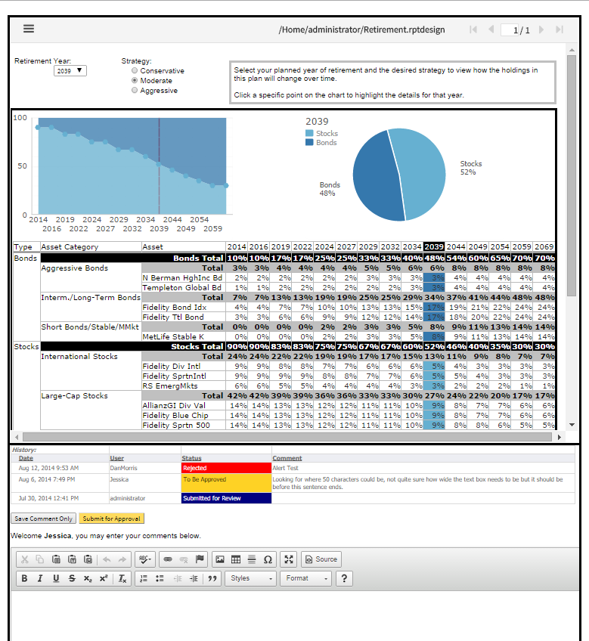
Reviewer’s view of
an item
Content / Report Section
Past Comments and Disposition
Workflow Actions for Reviewer
Comments Editor

Slide 8
Work Flow Application - Reviewer
Reviewer
Waiting for Review
Reviewer role can add a comment to an item in the queue or Submit for Approval.
A Comment Only action does not move (change disposition of) the item in the work flow, it is informational only and visible in the history for the item.
Submitting for Approval requires a comment and changes the disposition of the item.
Items overdue in their current step have a yellow clock, twice the overdue time have a red clock. Duration for overdue can be set at the bottom of the screen to demonstrate the use of parameters in a dashboard and logic with graphical indicators.
Progress is a graphical representation of all the steps the items has been through in the Work Flow. This helps identify items that have been “rejected” a few times.
Integration Points:
  The Queues are from a single report displayed in Reportlet Gadgets with a refresh interval.
  Tracking the viewing of items can be accomplished with the server’s Usage Logging.
  An item is displayed in a report that has a viewer embedded in it using JSAPI. Reports, Dashboards, Gadgets, HTML, PDF will display in the report, MS Office files will download.
Review Item
To Be Approved
Add Comments

Slide 9
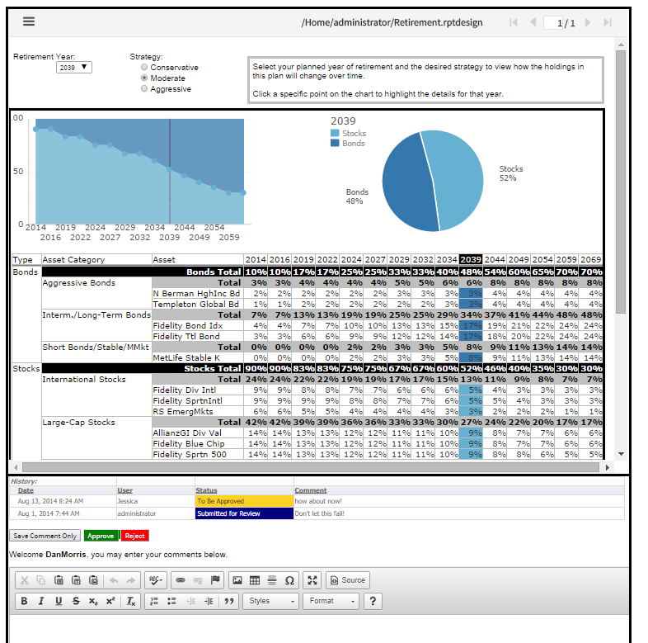
Approver’s view of
an item
Workflow Actions for Approver

Slide 10
Work Flow Application - Approver
Approver
To Be Approved
Approver role can add a comment to an item in the queue, Approve or Reject.
A Comment Only action does not move (change disposition of) the item in the work flow, it is informational only and visible in the history for the item.
Approving and Rejecting requires a comment.
Reject sends the item back to the Reviewer queue.
Approve ends the review and the process for the item, the item is moved to the completed queue.
Items overdue in their current step have a yellow clock, twice the overdue time have a red clock. Duration for overdue can be set at the bottom of the screen to demonstrate the use of parameters in a dashboard and logic with graphical indicators.
Progress is a graphical representation of all the steps the items has been through in the Work Flow. This helps identify items that have been “rejected” a few times.
Integration Points:
  The Queues are from a single report displayed in Reportlet Gadgets with a refresh interval.
  Tracking the views of items can be accomplished with the server’s Usage Logging.
  An item is displayed in a report that has a viewer embedded in it using JSAPI. Reports, Dashboards, Gadgets, HTML, PDF will display in the report, MS Office files will download.
Rejected
Review Item
Approved
Add Comments

Slide 11
Work Flow Application - Completed
After Approved
Completed
No further Work Flow actions can be performed on Approved items.
Item displays in native viewer, not the Work Flow Frame which has the comments.
Comments can be viewed, link provided in listing.
Process after approval is dependent on the content type:
  Reports can be made available to end users through permissions,
  Dashboards can be shared to additional groups,
  Office files can be downloaded to a shared location, etc.
Integration Points:
  Any routine can read the status of the records in the database and act on the content via Actuate APIs.
Content Specific Process

