Slide 1
Traffic Simulation
Washington blvd
Group-01
Members
Tushon Dey Babu (L20585317)
Mostafizur Rahman Shawon (L20570457)
Sonjoy Paul Avi (L20564404) Minhajul Abedin Tajik (
Partha Pratim Roy (

Slide 2
Contributions
Name | Task
Mostafizur Rahman Shawon | Report (Intersection 1) , Vissim Drawing
Tushon Dey Babu | Calculation ,Report (Intersection 2) , Vissim data input
Minhajul Abedin Tajik | Report (Intersection 3) , Vissim Signal Cordination
Sonjoy Paul Avi | Calculation , VISSIM Vehicle input , Presentation Slide
Partha Pratim Roy | Calculation , VISSIM Observation , Presentation Slide

Slide 3
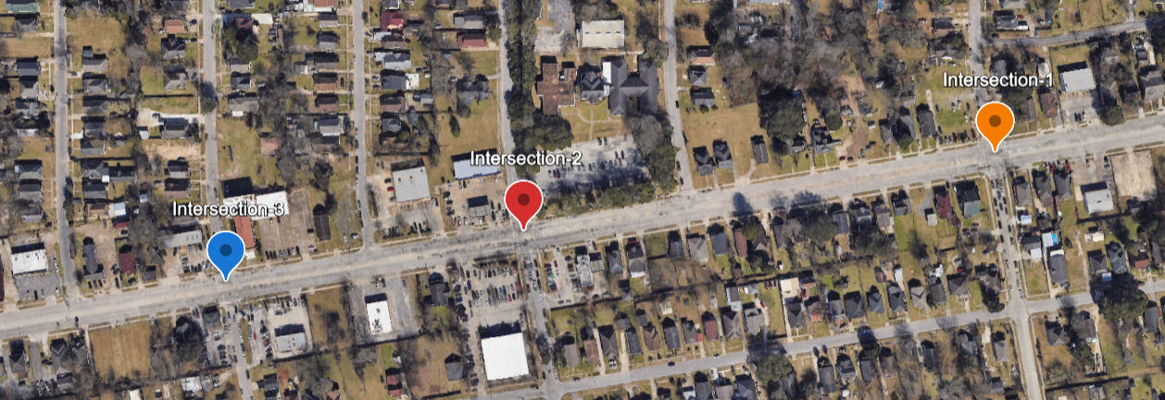
Testbed (Washington Blvd)

Slide 4
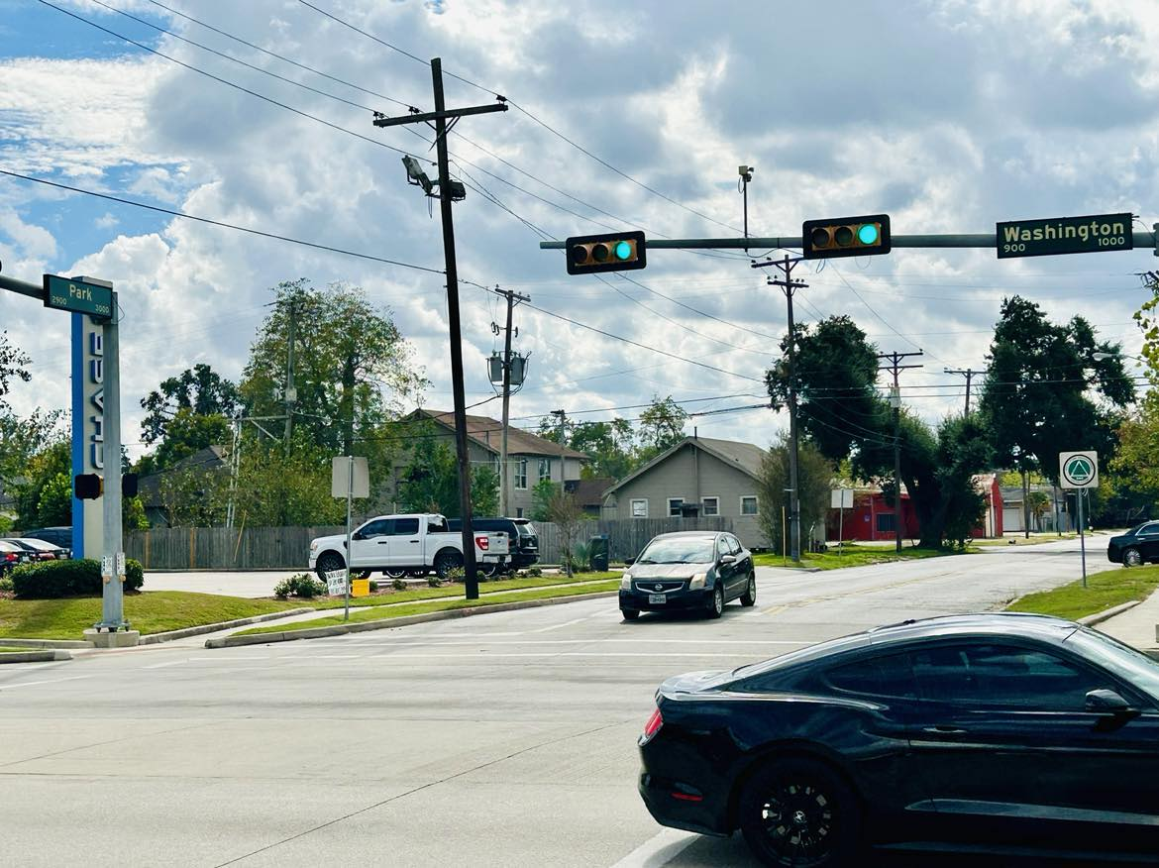
Intersection-I
Park Street and Washington Blvd
Number Of Lanes
Park St | 1
Washington Blvd | 2
Design Speed
35 Mph
 | Intersection I
 | Flow Rate (#veh/hr)
 | Major Road |  | Minor Road
 | EB | WB | NB | SB
LT | 12 | 12 | 72 | 42
TR | 348 | 336 | 18 | 6
RT | 18 | 6 | 42 | 30

Slide 5
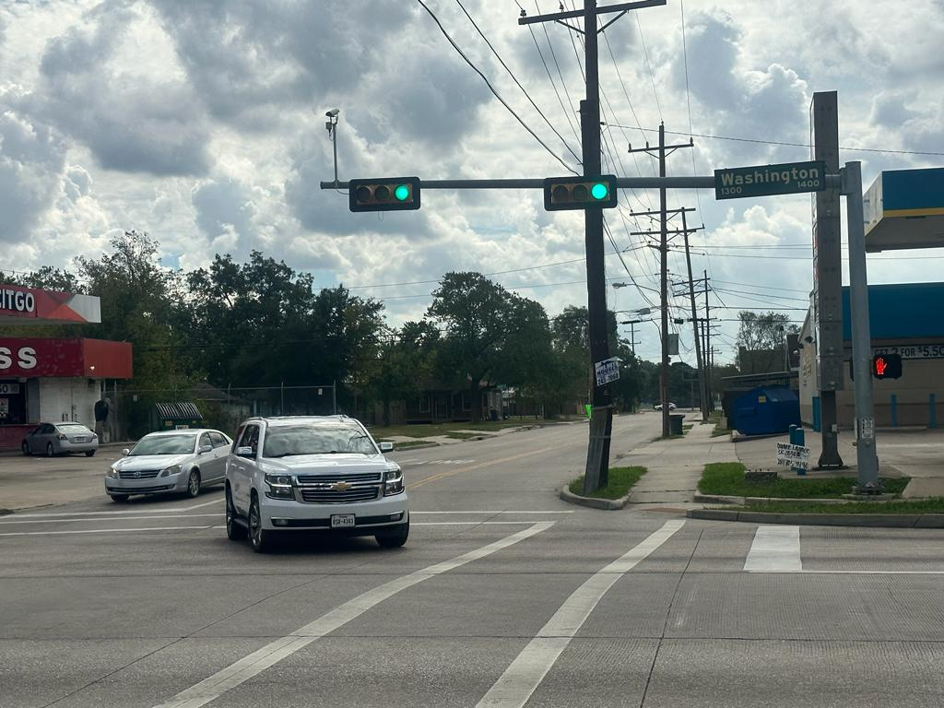
Intersection-II
Ave-A to Washington
Number Of Lanes
Park St | 1
Washington Blvd | 2
Design Speed
35 Mph
 | Intersection II
 | Flow Rate (#veh/hr)
 | Major Road |  | Minor Road
 | EB | WB | NB | SB
LT | 24 | 78 | 18 | 60
TR | 372 | 432 | 72 | 30
RT | 90 | 24 | 12 | 72

Slide 6
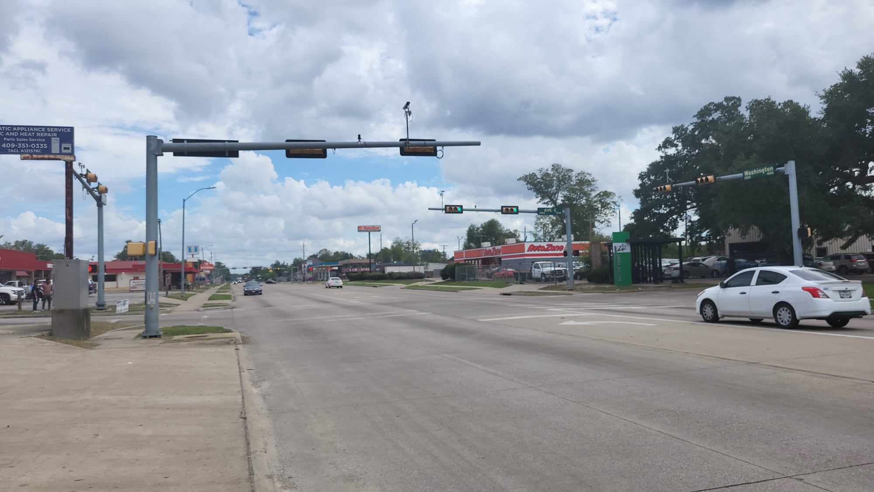
Intersection-III
Park Street and Washington Blvd
Number Of Lanes
Park St | 1
Washington Blvd | 2
Design Speed
35 Mph
 | Intersection III
 | Flow Rate (#veh/hr)
 | Major Road |  | Minor Road
 | EB | WB | NB | SB
LT | 6 | 18 | 36 | 30
TR | 294 | 486 | 30 | 6
RT | 12 | 30 | 24 | 18

Slide 7
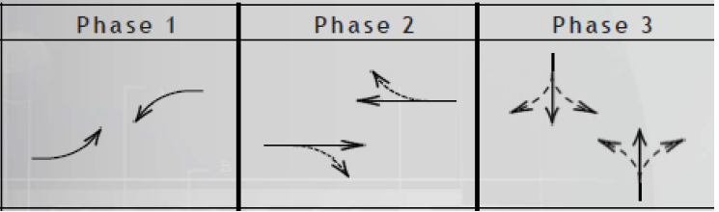
Signal Phase
Applicable for all intersections

Slide 8
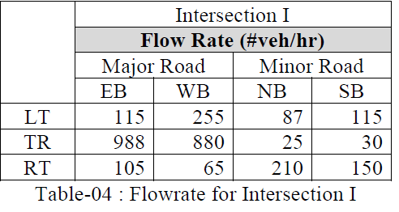
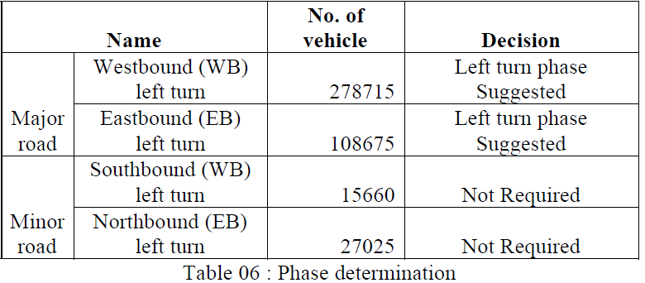
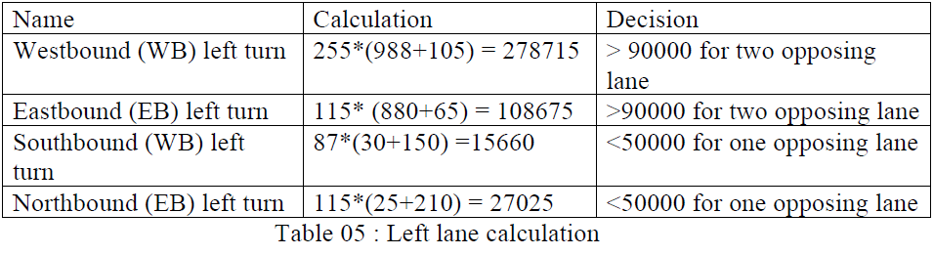

Slide 9
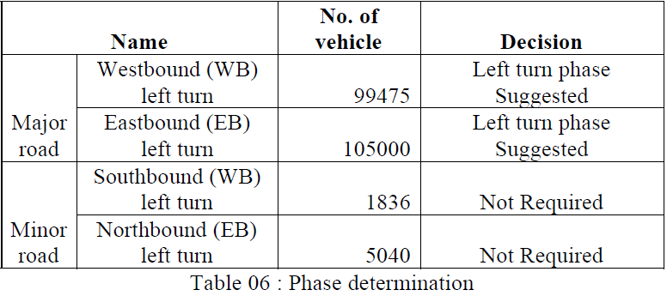
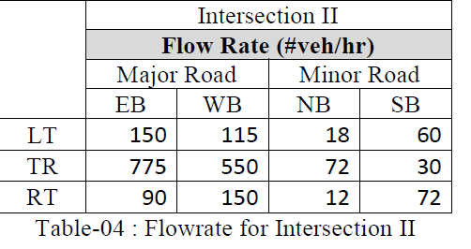
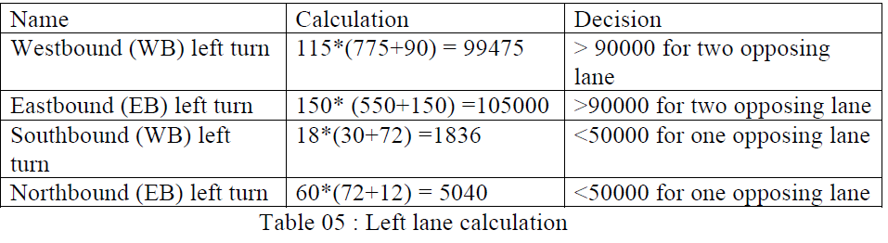

Slide 10
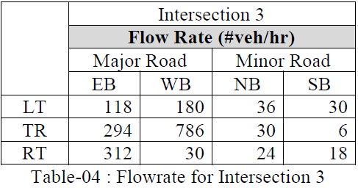
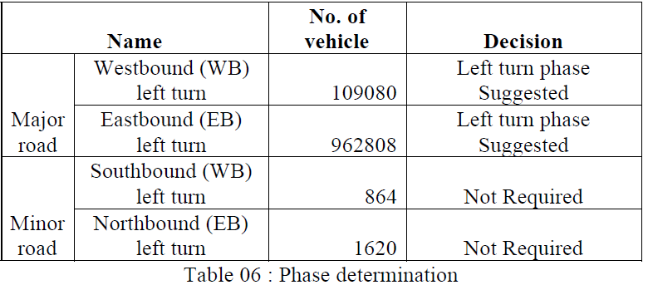
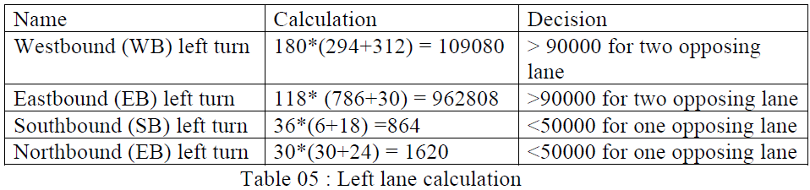

Slide 11
Intersection I
Timing Plan & Offset (Calculated Field Data)
Intersection-1 | Green | Red | Yellow | AR
EB and WB left-turn movements | 11.33 ≈ 11 | 46.50≈ 46 | 3.56≈ 4 | 1
EB and WB through and right-turn movements | 25.96 ≈ 26 | 32.03 ≈ 32
NB and SB left-, through, and right-turn movements | 19.87 ≈ 20 | 38.14 ≈ 38
Offset
44.64 ≈ 45
Intersection II
Intersection-1 | Green | Red | Yellow | AR
EB and WB left-turn movements | 3.25 ≈ 3 | 14.74≈ 15 | 3.56≈ 4 | 1
EB and WB through and right-turn movements | 9.67≈ 10 | 8.32 ≈ 8
NB and SB left-, through, and right-turn movements | 5.06 ≈ 5 | 12.93 ≈ 13
Offset
28.48 ≈ 28

Slide 12
Intersection III
Timing Plan, Offset & Phase
Intersection-1 | Green | Red | Yellow | AR
EB and WB left-turn movements | 2.85 ≈ 3 | 12.71≈ 13 | 3.56≈ 4 | 1
EB and WB through and right-turn movements | 7.89 ≈ 8 | 5.11 ≈ 5
NB and SB left-, through, and right-turn movements | 2.10 ≈ 2 | 10.89 ≈ 11
Offset
28.67 ≈ 29
Intersection | C minimum | C optimum
Intersection I | 65.49 ≈ 70 | 86.82 ≈ 87
Intersection II | 25.31 ≈ 25 | 43.68 ≈ 44
Intersection III | 24.70 ≈ 25 | 42.81 ≈ 43

Slide 13
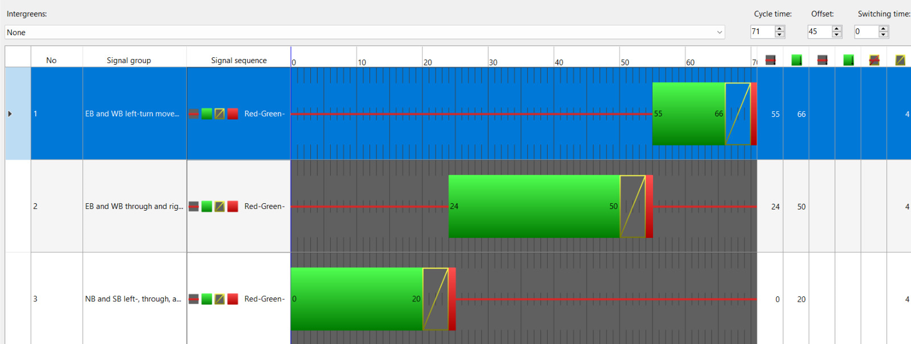
Signal Program (Original)

Slide 14
Simulated Signal Design (Modified)
Intersection I
Intersection II
 | Green | Red | Yellow | AR
EB -WB left-turn | 18 | 23 | 4 | 1
EB – WB- TR-RT | 32 | 12
NB- SB-LT, TR and RT | 12 | 25
 | Cycle time | 98 Seconds
 | Offset | 45 Seconds
 | Green | Red | Yellow | AR
EB -WB left-turn | 4 | 15 | 4 | 1
EB – WB- TR-RT | 19 | 21
NB- SB-LT, TR and RT | 6 | 25
 | Cycle time | 45 Seconds
 | Offset | 29 Seconds
Intersection III
 | Green | Red | Yellow | AR
EB -WB left-turn | 18 | 5 | 4 | 1
EB – WB- TR-RT | 18 | 11
NB- SB-LT, TR and RT | 3 | 23
 | Cycle Time | 54 Sec
 | Offset | 4 Sec

Slide 15
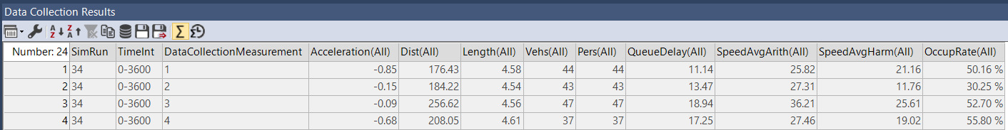
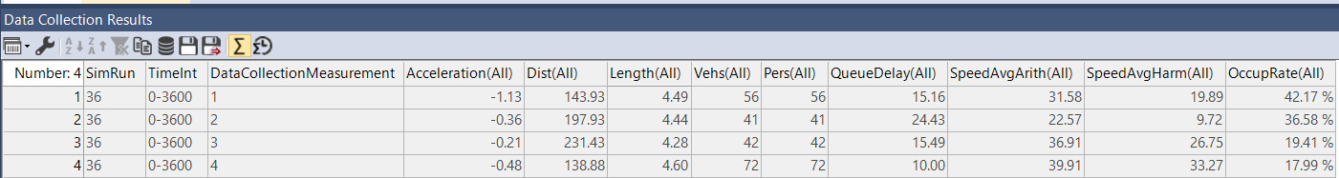
Delay Time after modification
average delay : 15.2 sec
Delay time before modification
average delay : 16.27 sec

Slide 16
Conclusion
At intersection I and III for through and dedicated left lane we observed maximum queue.
- Minor road has less traffic volume so, we improvised signal coordination .
After modification we found that delay time was reduced from 16.27 seconds to 15.2 Seconds.

