Slide 1

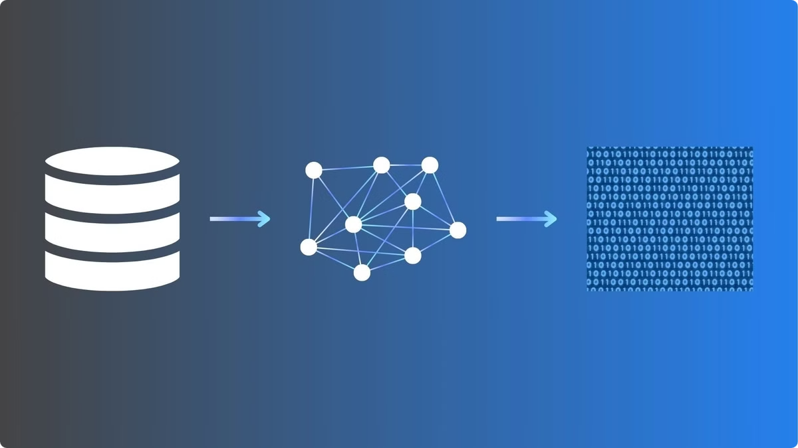
Exploring Image Feature Extraction Techniques for Classification
Topic:
Comparing traditional and deep learning-based feature extraction techniques for image classification.
Team Members: M.Avinash [ CH.SC.U4CYS23024 ]
P.Deepak Sai Vighnesh [ CH.SC.U4CYS23032 ]

Slide 2

Introduction & Objectives
What is Feature Extraction?
Objectives
Converts images into numerical features for classification.
Compare traditional (HOG, SIFT, LBP, GLCM) with deep learning methods (ResNet50).
Why is it Important?
Reduces complexity; improves accuracy.

Slide 3

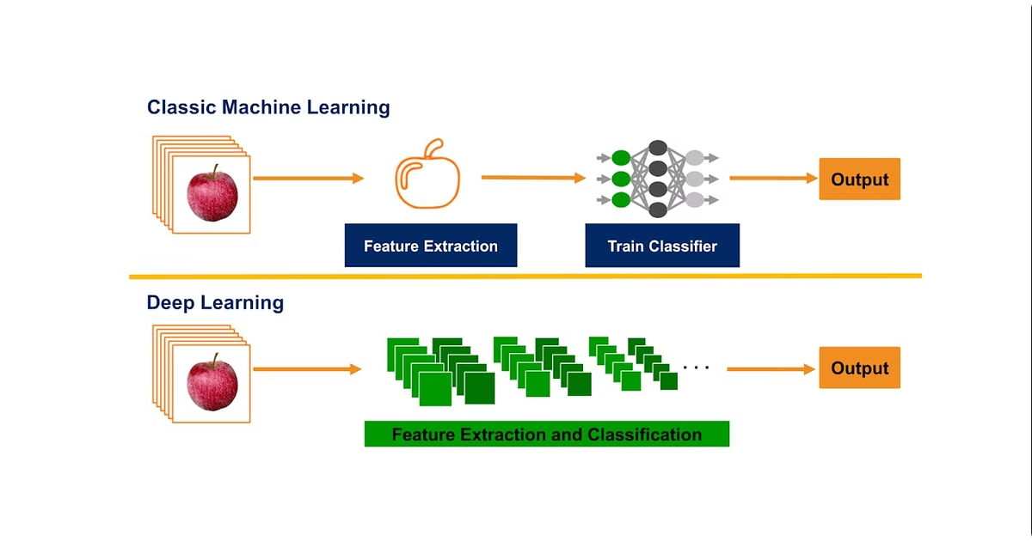
Feature Extraction Techniques
Traditional Methods
Deep Learning
HOG (edge-based features)
ResNet50 (CNN-based feature extraction)
SIFT (scale-invariant keypoints)
GLCM (texture analysis)
LBP (local texture patterns)
Applications
Object detection (HOG, SIFT)
Medical image analysis (GLCM)
Face recognition (LBP, CNNs)

Slide 4

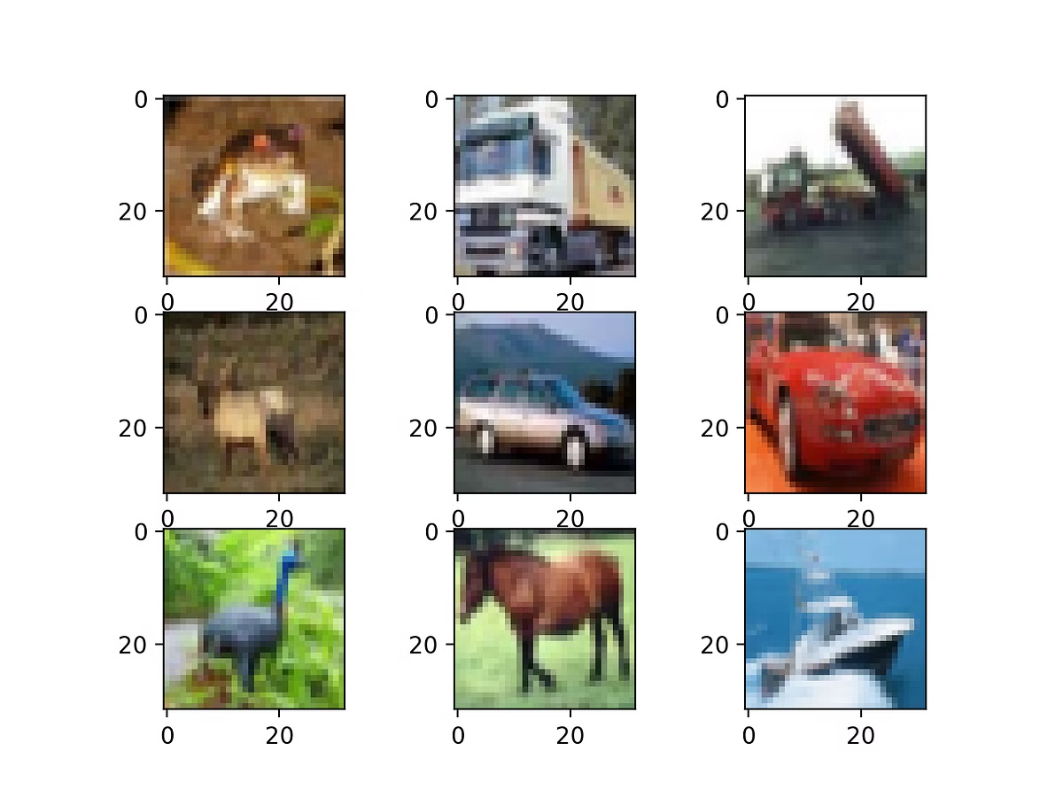



Dataset & Feature Extraction Methods
Dataset
CIFAR-10 (60K images, 10 classes)
Techniques
Traditional: HOG, LBP
Deep Learning: ResNet50
Preprocessing
Image resizing
Normalization
Grayscale conversion

Slide 5


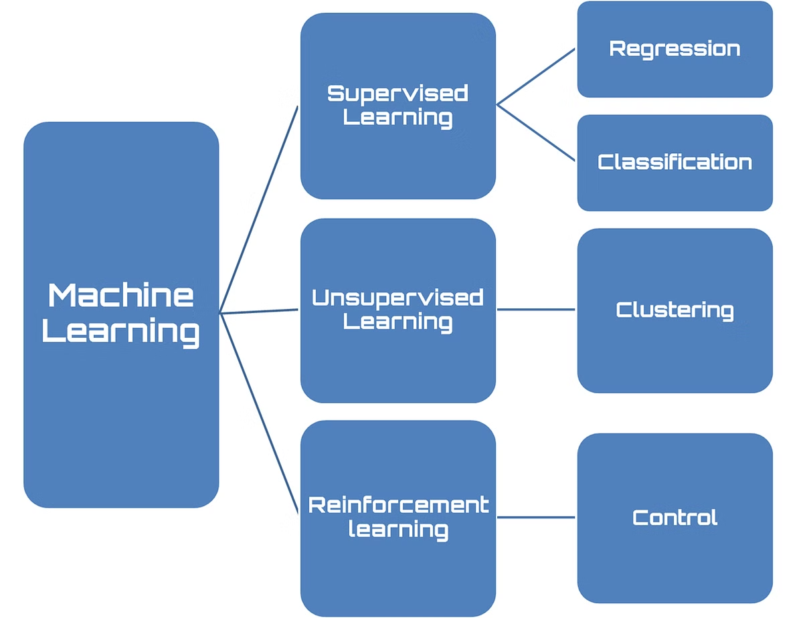


Experimentation
Implementation
HOG, LBP, and ResNet50
Classifiers
Logistic Regression
K-Nearest Neighbors (KNN)
Random Forest
Evaluation Metrics
Accuracy
Precision
Recall
F1-score

Slide 6

Results & Analysis
Method
Classifier
Accuracy
Precision
F1-Score
HOG
Logistic Regression
0.348
0.35
0.35
LBP
KNN
0.200
0.21
0.20
ResNet50
Random Forest
0.642
0.64
0.63
PCA feature distribution plots, HOG and LBP feature maps, ResNet50 activation maps.

Slide 7
Traditional vs. Deep Learning Features
Traditional Methods
Deep Learning (ResNet50)
Computationally efficient
High accuracy
Suitable for small datasets
Robust feature extraction
Limited feature representation
Requires more power

Slide 8

Key Takeaways & Future Directions
Conclusion
Deep learning outperforms
Traditional useful for low-resource
Future Work
Hybrid approaches
Testing on larger datasets
Optimizing deep models

