Slide 1
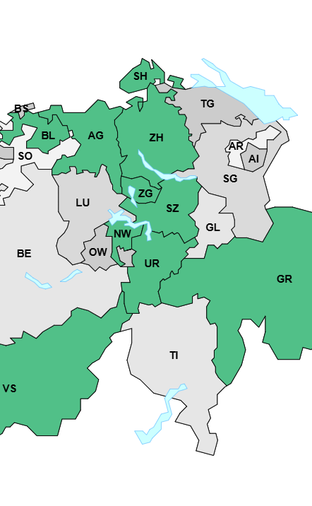
20 Years of Double Pukelsheim in Switzerland
What Is the Mechanical Effect of the Transition from Hagenbach-Bischoff on the Seat Allocation of Smaller Parties?
Author Moritz Beyn
Supervisor Aurélien Sallin

Slide 2
Field of Research
Research question
How does the transition from Hagenbach-Bischoff to double Pukelsheim affect the seat allocation of smaller parties in Swiss cantonal parliamentary elections?
Main hypothesis
Smaller parties with less than 10% canton-wide vote share gain seats under double Pukelsheim.
Why this matters
Small districts under Hagenbach-Bischoff create high implicit thresholds.
This disadvantages smaller parties and weakens electoral equality.
Double Pukelsheim was introduced to improve proportionality and the equal weight of votes
Double Pukelsheim improves canton-wide proportionality and reduces “weightless” votes.
Literature suggests smaller parties benefit under the new system.
Example: in Schwyz in 2016, the GLP would have won 0 seats under Hagenbach-Bischoff but won 3 under the new Doppelter Pukkelsheim Proporz.

Slide 3
Literature and Research Gap
Literature
Pukelsheim F., Schuhmacher C., (2004) Das neue Zürcher Zuteilungsverfahren für Parlamentswahlen
Pukelsheim F., (2017): Proportional Representation: Apportionment Methods and Their Applications
Lago I., I Coma F., (2026) The ‘odd–even effect’: The link between the number of parties and district magnitude
Lüscher S.,(2024) Redeeming the Pledge of Electoral Equity? A Study of the Roads to and Effects of the DivisorBased Biproportional Apportionment Method in Switzerland
Research gap
Existing work is mostly legal, normative, or system-level.
We still lack a standardized empirical measure of the reform’s mechanical seat effect across cantons and elections.
My thesis measures the net seat gain/loss of smaller parties under DP versus a simulated HB counterfactual.

Slide 4
Research Design & Methods
Sources
Cantonal Databases, the not publicly available I contacted throughout Mail
This provides around 30 datasets from 8cantons
Design
Start from the actual seat allocation under double Pukelsheim.
Reconstruct the counterfactual seat allocation under Hagenbach-Bischoff.
Compare both outcomes party by party.
Definition of “small party”
Party with at least 10% vote share in the relevant unit
Swiss Supreme Court BGE 131 | 74, threshold barriers shouldn’t exceed 10%
Youth/special-interest lists assigned to mother party.
Plotting
Each Election, gains or losses in Seats for each Party.
Final Plot: combining all elections with two observations per election (small parties aggregated)

Slide 5
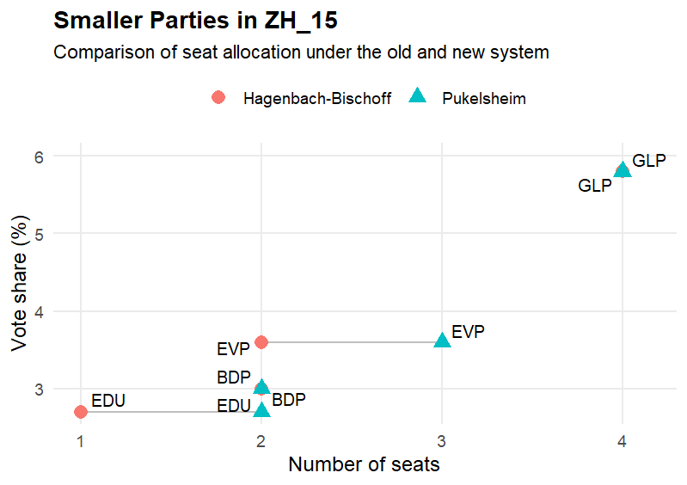
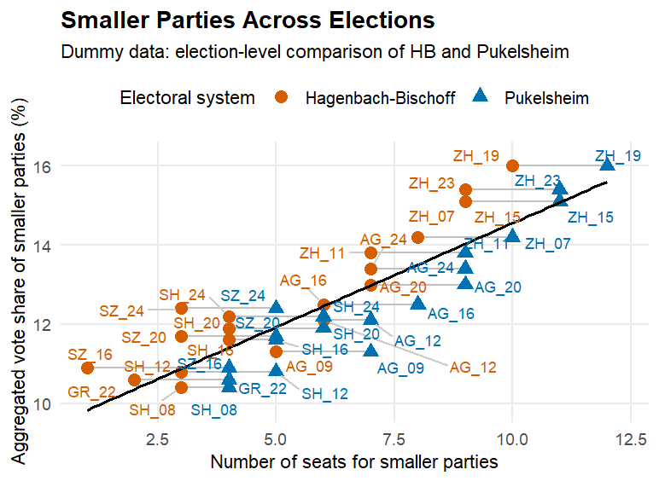
Research Design & Methods

Slide 6
Challenges, Limits & open questions
Potential challenges
Data quality differs across cantons and years.
Some results are only available in PDFs.
Reconstructing HB precisely from fragmented district data may be difficult.
HB isn’t implemented in all cantons equally e.g. Uri
Substantive caveat from the literature
DP may improve party proportionality, but can create tensions with territorial representation.
So more proportionality at canton level may come with district-level trade-offs.
Open questions for feedback
Is 10% the right threshold for “small party”?
Should effects be reported per party, per election, or as a share of all seats?

Slide 7
Thanks
Moritz Beyn
23-611-908

