Slide 1

Three kites in the sky
Class Two Grade Six
孙依晨 张梓玲
许思琪

Slide 2
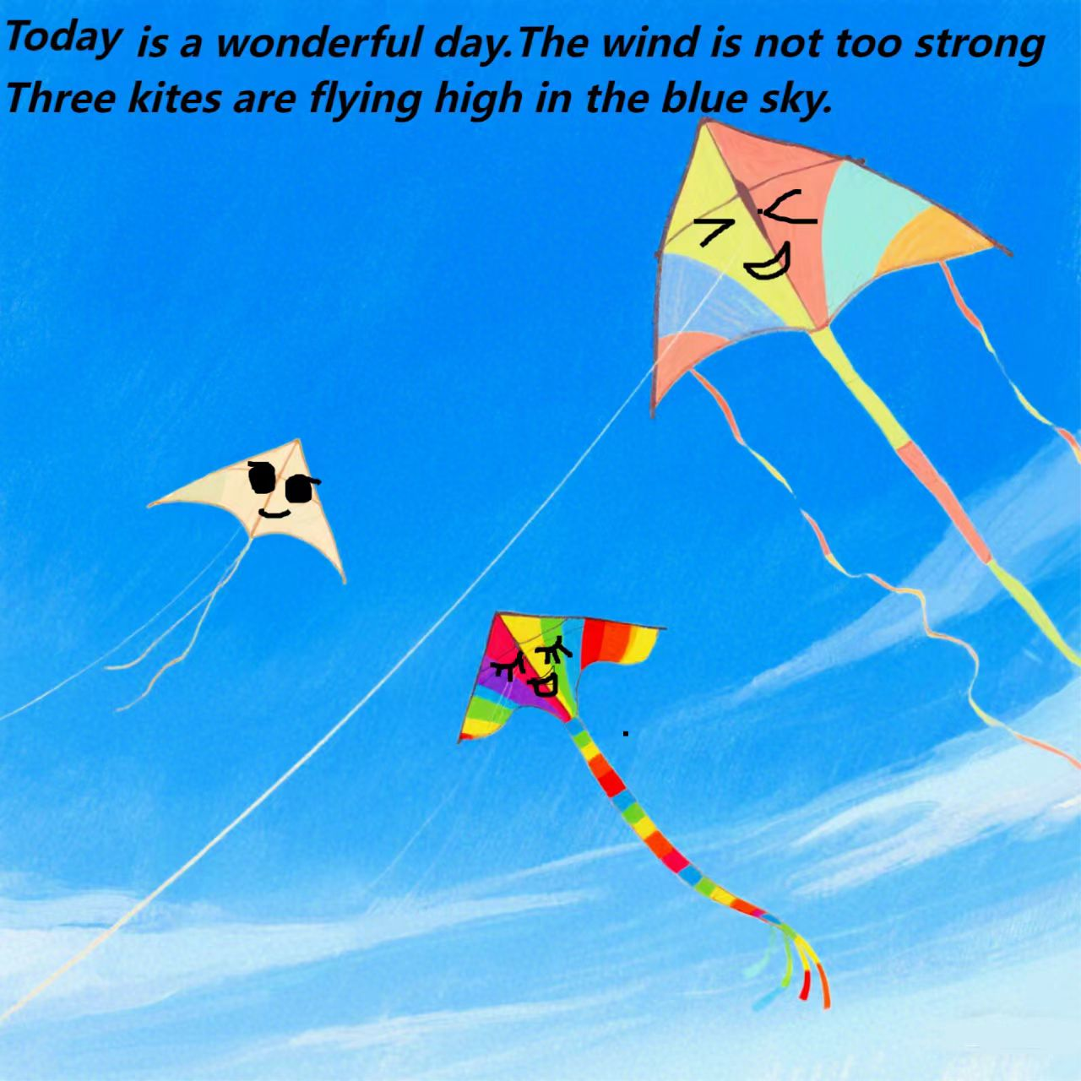

Slide 3
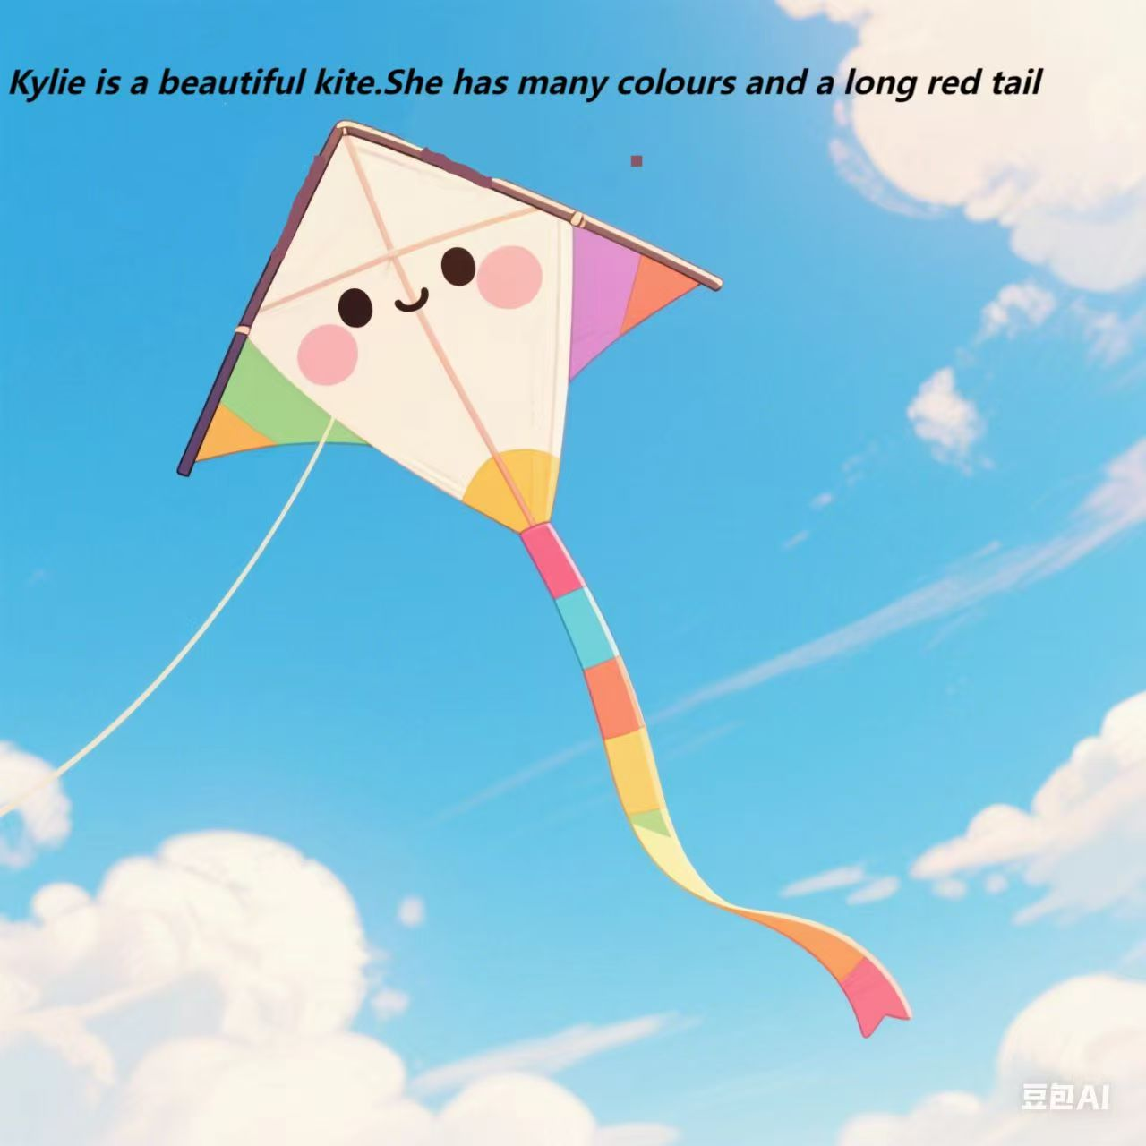

Slide 4
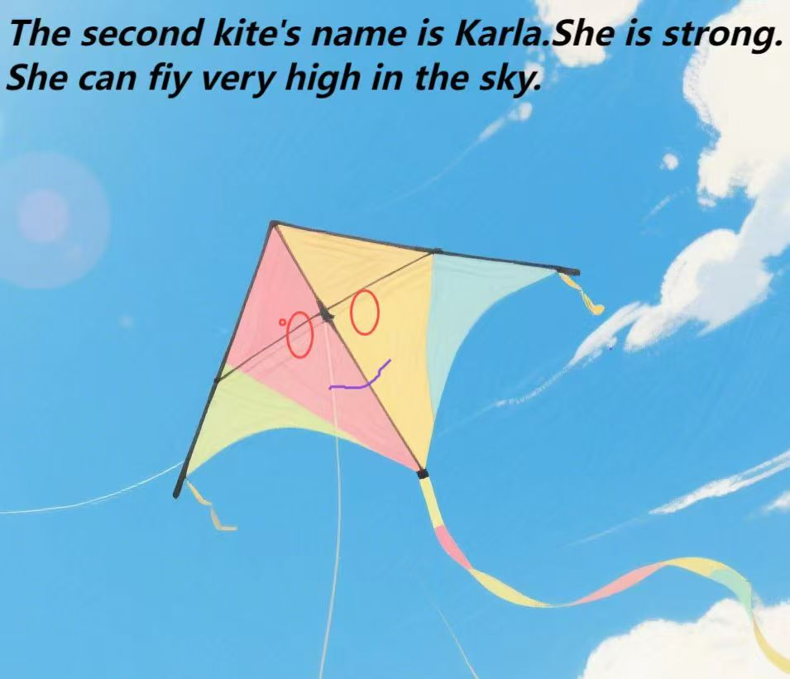

Slide 5
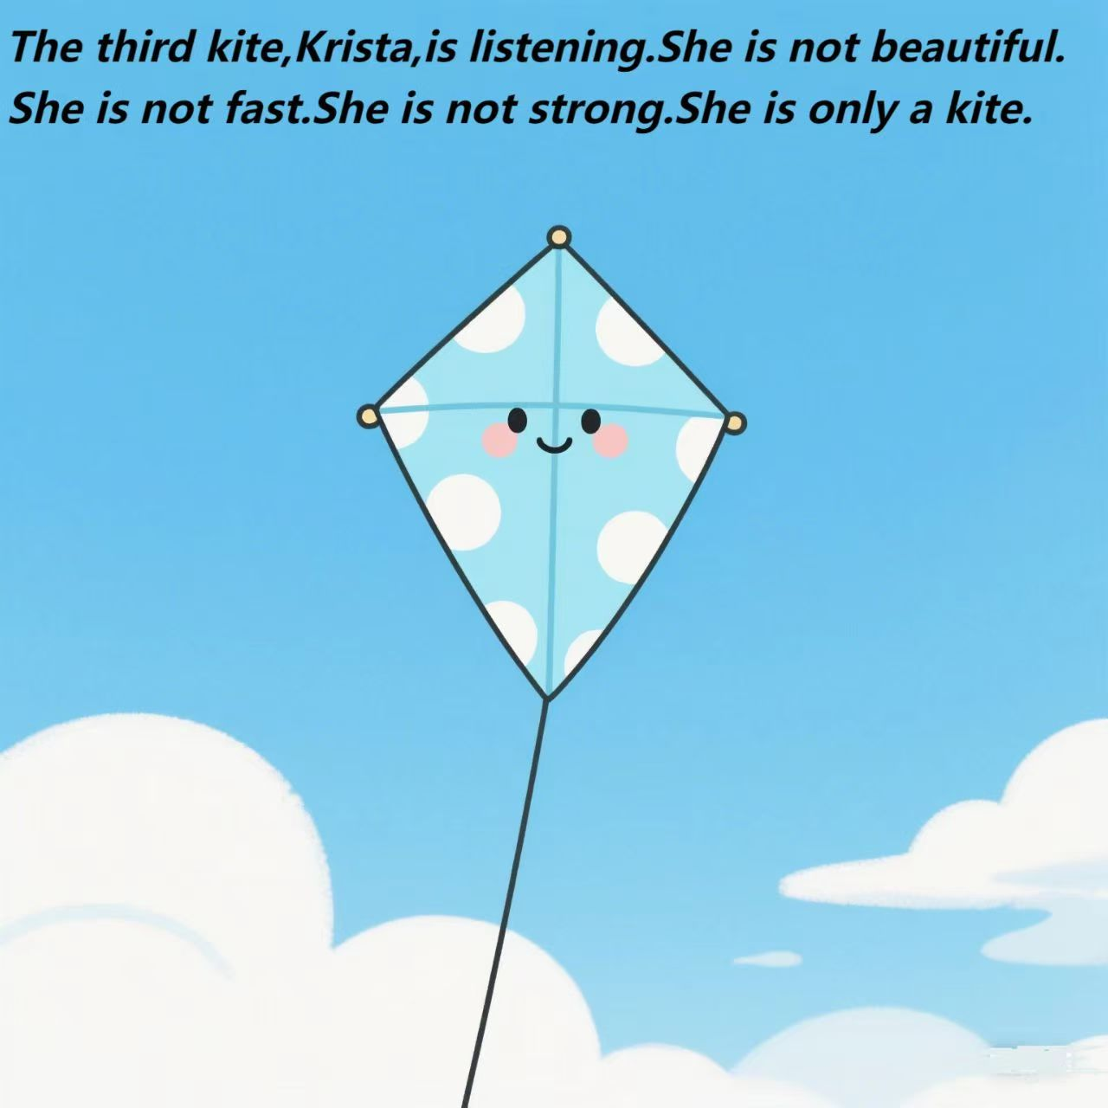

Slide 6
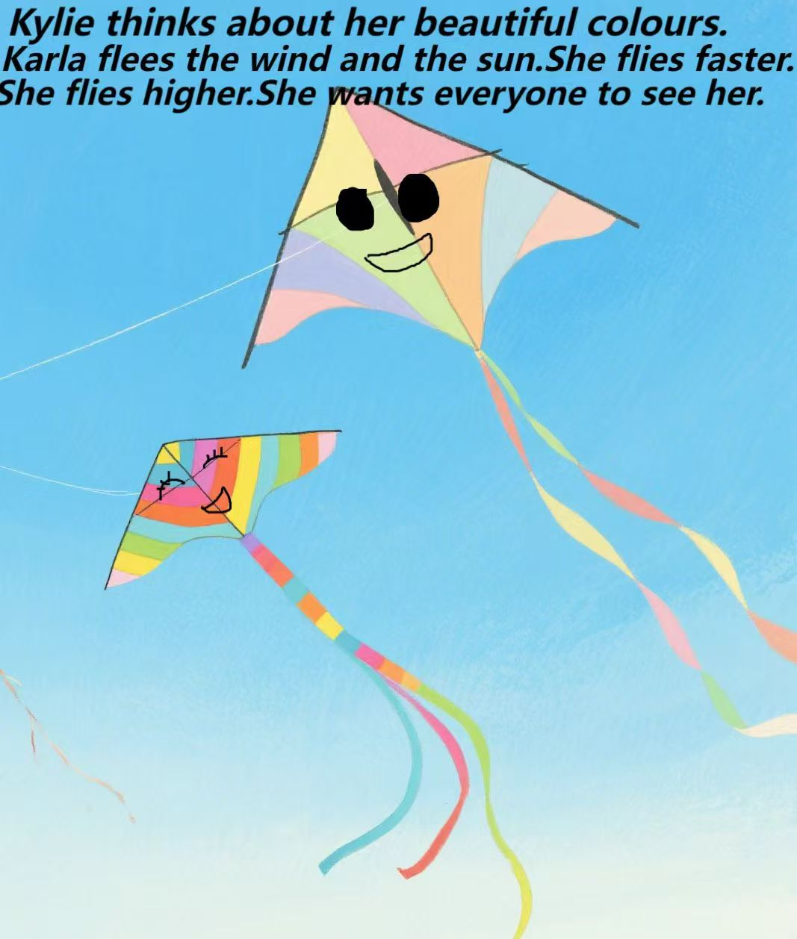

Slide 7
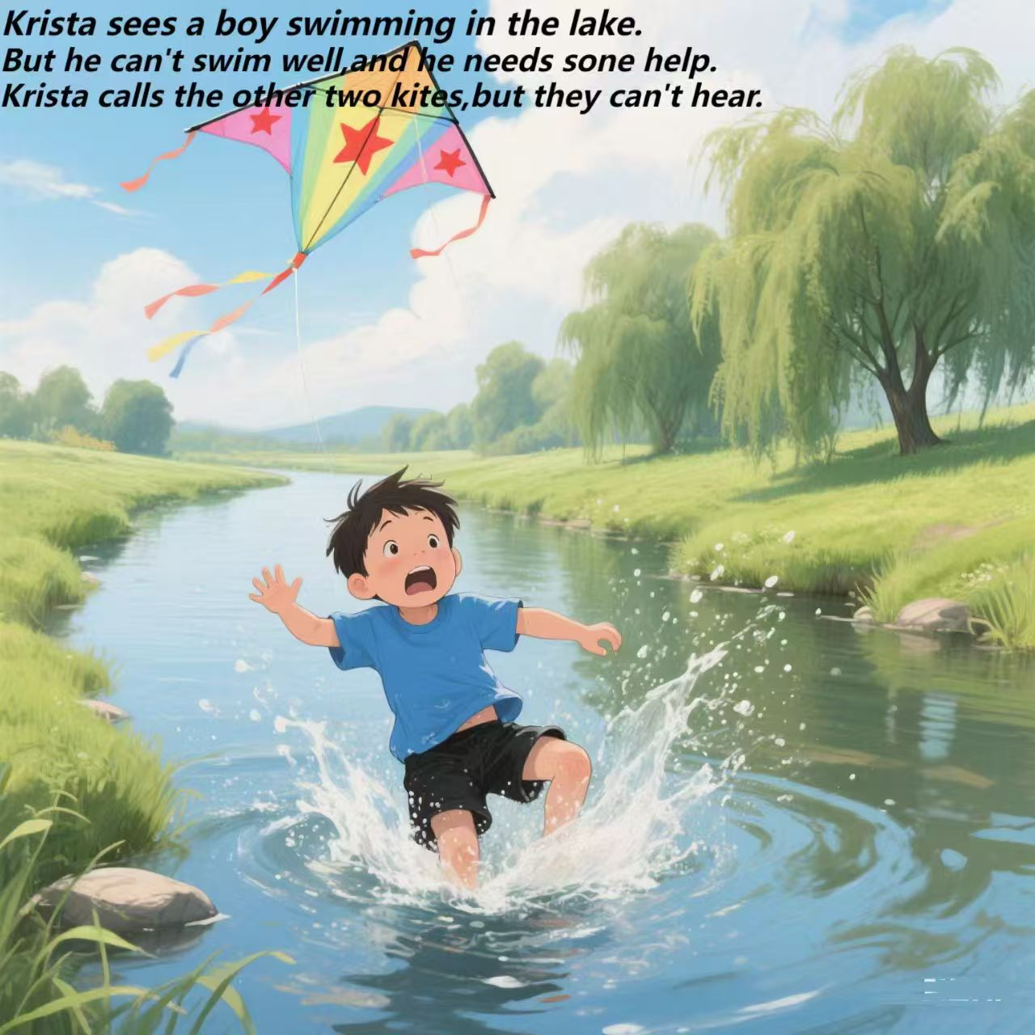

Slide 8
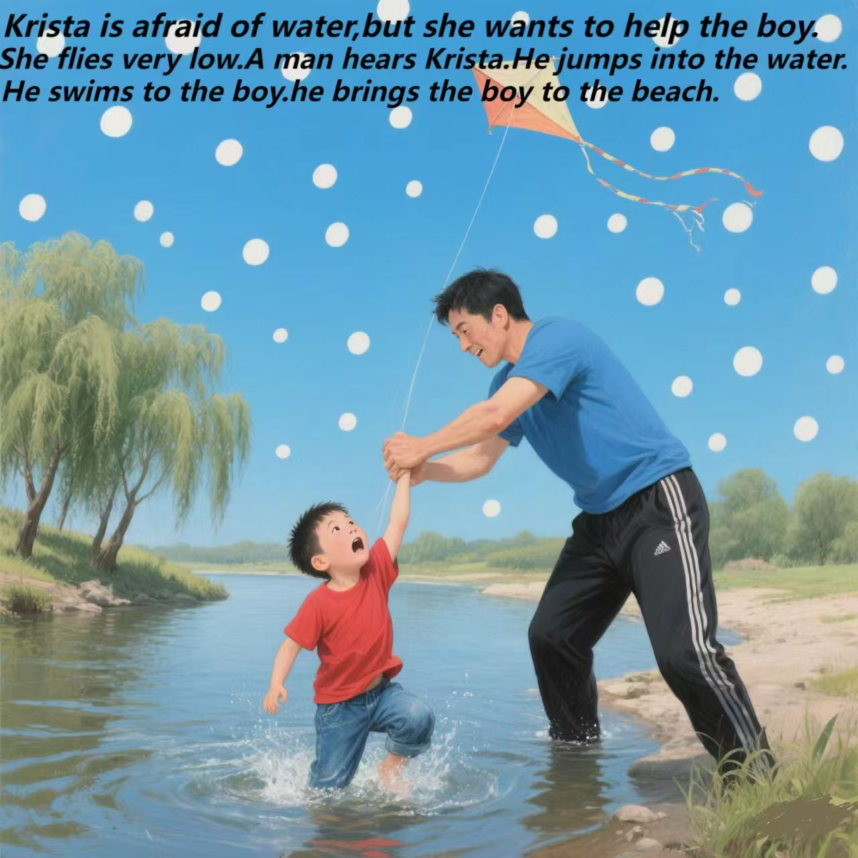

Slide 9
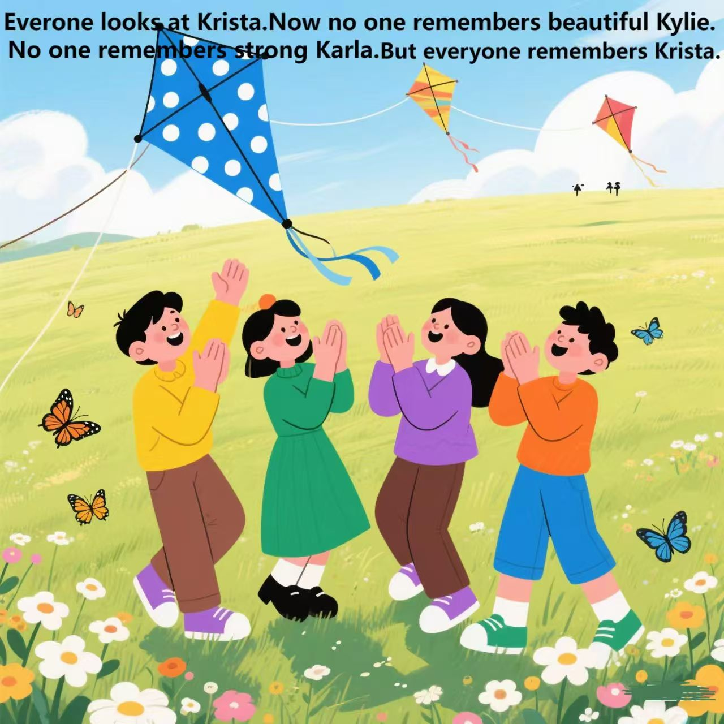

Slide 10

Thank you
Class Two Grade Six
孙依晨 张梓玲
许思琪

