Slide 1


R . L. Jalappa Institute of Technology
(A Unit of Sri Devaraj Urs International Educational Trust,
Kolar) (Affiliated to VTU ,Belagavi and Approved by AICTE,
New Delhi) Doddaballapur-561203, Bangalore Rural District.
Project Presentation
Review on
Mobile Application for Disaster Safety Management
By
M BABA FAKRUDDIN [1RL21CS060]
Under the guidance of
Dr. Kavitha C
Professor
Department of CSE

Slide 2

Mobile Application for
Disaster Safety Management
A Rescue Application for Disaster Safety Management, by several methods by using
Different Technologies

Slide 3

CONTENTS
INTRODUCTION
01
PROBLEM & SOLUTION
02
LITERATURE SURVEY
03
TOOLS
04
ARCHITECTURE
05
SCREENSHOTS
06
CONCLUSION
07

Slide 4
Introduction
Natural disasters like earthquakes, floods, and fires cause major damage to life and property.
Early information and quick actions can save lives.
This mobile app aims to provide real-time alerts, safety tips, SOS location sharing, and disaster predictions using Machine Learning.
The main goal is to empower users to act smartly and stay safe during disasters.

Slide 5

Problem Statement
People often face challenges during sudden natural disasters like earthquakes, floods, and fires due to lack of real-time alerts, proper guidance, and fast communication tools. There is a need for a mobile app that provides live disaster alerts, predicts risks using machine learning, shares the user’s location quickly, and offers easy safety tips to help save lives.

Slide 6
Proposed Solution
A mobile app with:
Real-time weather and disaster alerts (Earthquake, Flood, Fire)
SOS button to share location via SMS, WhatsApp, etc
Safety tips with symbolic/image representation for easy understanding
Disaster prediction using ML models based on real-time weather

Slide 7
Objectives
To develop a mobile app that provides real-time disaster alerts for earthquakes, floods, and fires.
To use machine learning algorithms for predicting disaster risks based on weather conditions.
To enable users to share their live location quickly through SMS, WhatsApp, and more.
To provide simple, categorized safety tips for each type of disaster.

Slide 8
Literature Survey
Several existing apps provide individual services like alerts or location sharing.
But very few apps combine prediction, live weather, maps, SOS, and safety education into one.
Machine Learning for disaster prediction (Random Forest, Logistic Regression) is an emerging solution.
This app takes inspiration but adds real-time ML prediction on mobile itself.

Slide 9
Reference | Methodology | Pros | Cons
Sharma, P. et al. (2022)
"Design and Development of Disaster Alert Mobile App" | Developed and tested a prototype app providing real-time disaster alerts using GPS and cloud notifications. | Real-time updates and location-based alerts enhance user safety. | Requires continuous internet connectivity.
Kim, J.; Lee, H. (2021)
"Mobile Technology for Earthquake Early Warning Systems" | Case study on mobile-based early warning systems in Japan and South Korea. | Case study on mobile-based early warning systems in Japan and South Korea. | High cost of integrating with national alert systems.
Ali, S. et al. (2023)
"Smartphone-Based Emergency Response Apps in Flood-Prone Areas" | "Smartphone-Based Emergency Response Apps in Flood-Prone Areas" | Easy to use UI and offline maps improve accessibility. | Limited coverage in rural areas with poor network.
Gupta, R. & Verma, N. (2020)
Crowdsourcing in Disaster Management Apps" | Analyzed crowdsourced data collection through mobile apps. | Analyzed crowdsourced data collection through mobile apps. | Analyzed crowdsourced data collection through mobile apps.

Slide 10
Tools and Technologies
Flutter – for cross-platform mobile app development
Firebase Authentication – for login/signup
Open Street Map + Flutter _Map – for live location mapping
USGS API – for real-time earthquake alerts
Open Weather Map API – for weather data
Ont Awesome, Lottie – for UI icons and animated splash screen

Slide 11



vv
Tools Used
Flutter is used for Creating fast, beautiful, and cross-platform apps using a single codebase and Firebase for cloud storage and real-time update.

Slide 12
Architecture
User Authentication – SignUp/Login (Firebase)
Home Screen – Map + Weather + Prediction + SOS button
Disaster Category Screens – Earthquake, Flood, Fire (safety tips, precautions)
Prediction System – Using real-time weather, predict risk levels
Alert System – Push notifications for warnings
Location Sharing – Choose to share via multiple apps (SMS, WhatsApp)

Slide 13
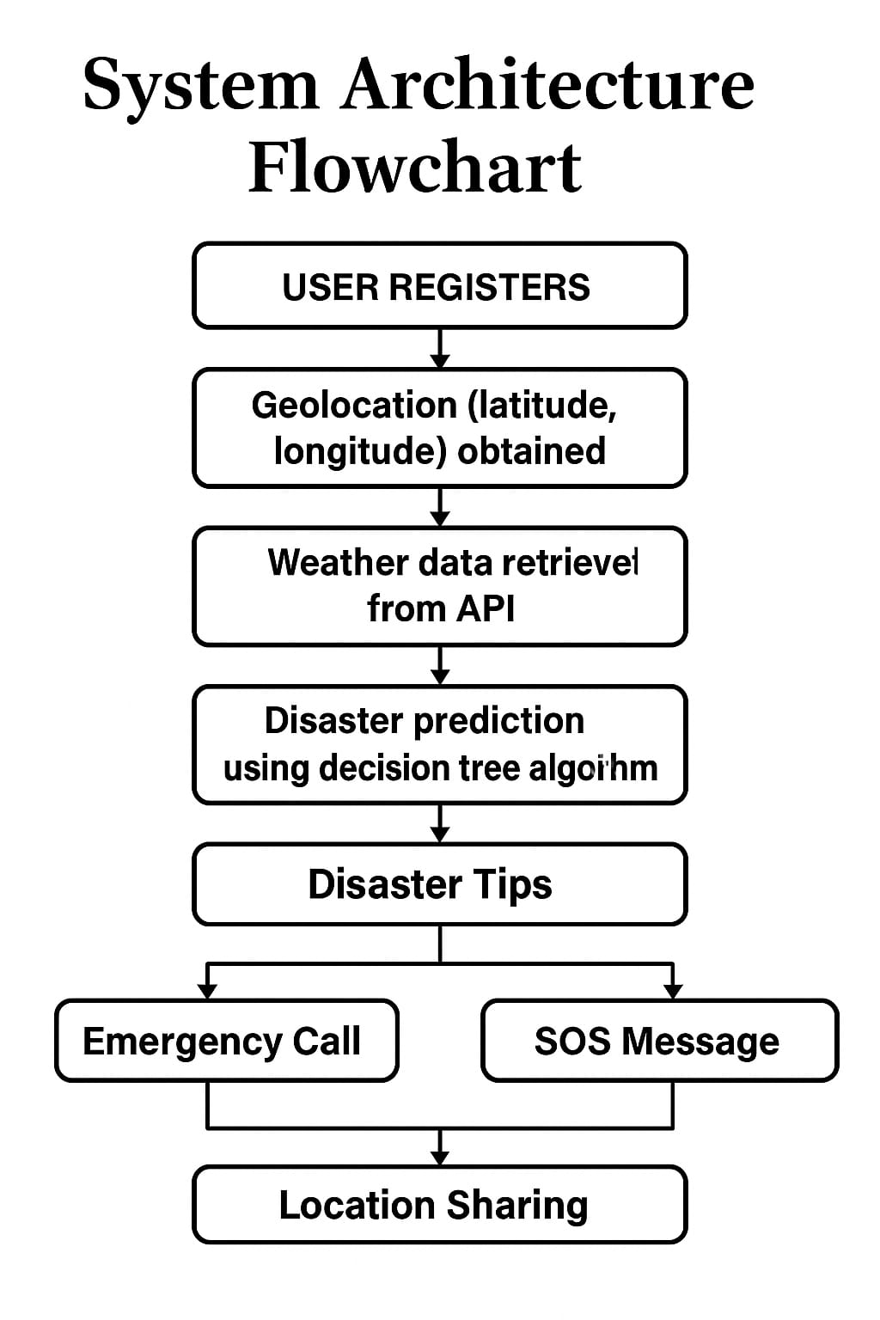

Slide 14
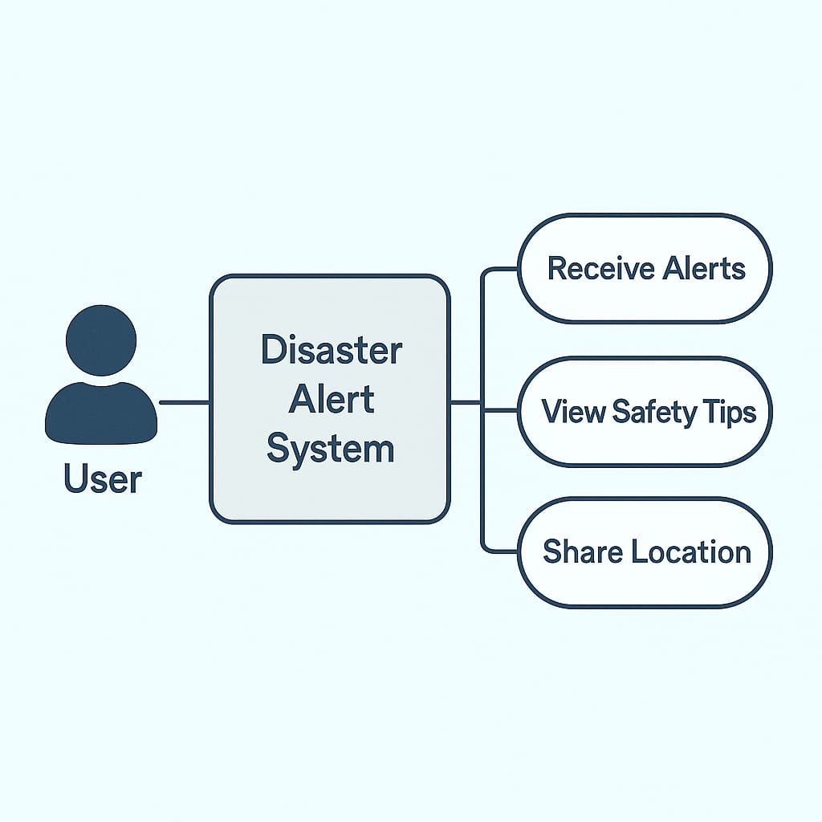
Real World Relevance
Disaster Safety systems helps reduce fatalities and injuries during natural calamities like earthquakes , floods and cyclones.
Mobile apps can provide location-specific warnings using GPS and satellite data.
Governments and disaster agencies can broadcast emergency notifications instantly through push alerts or SMS.

Slide 15
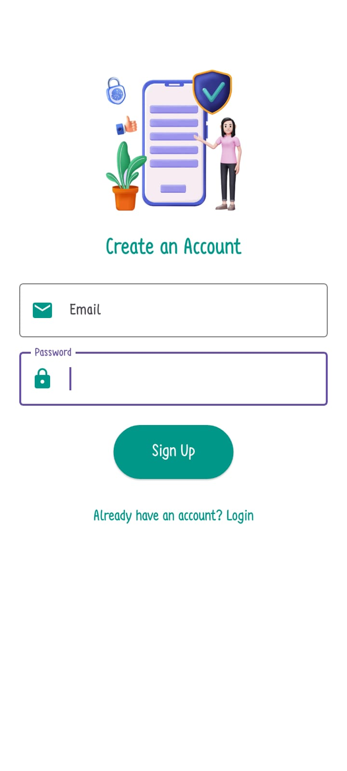
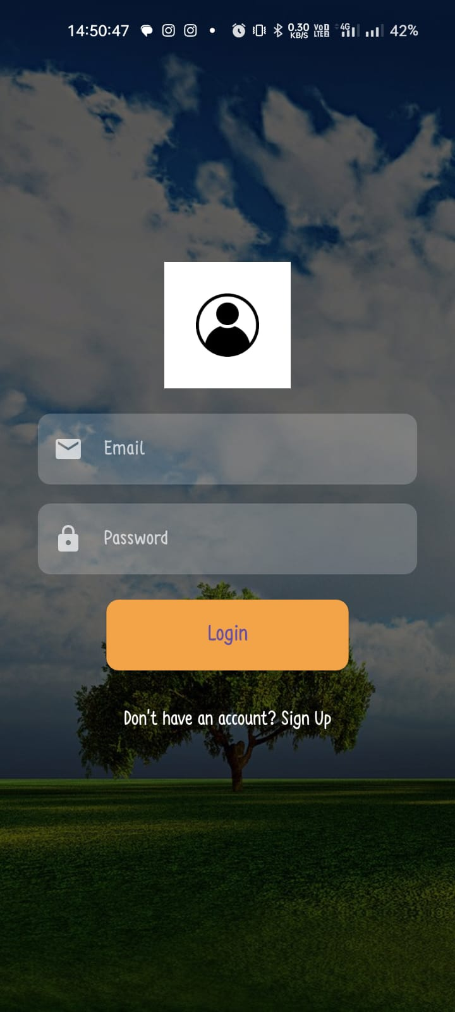
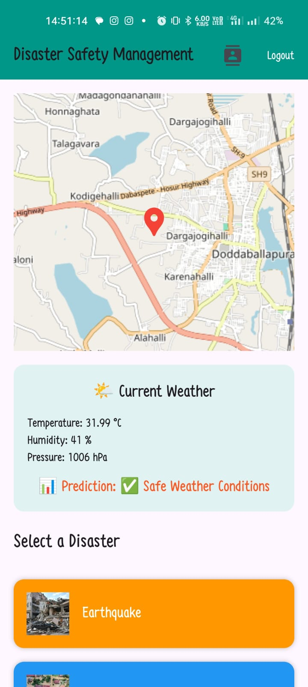
bn
// SPDX-License-Identifier: MIT
pragma solidity ^0.8.19;
contract }
Screenshots
Fig: Login Page

Slide 16
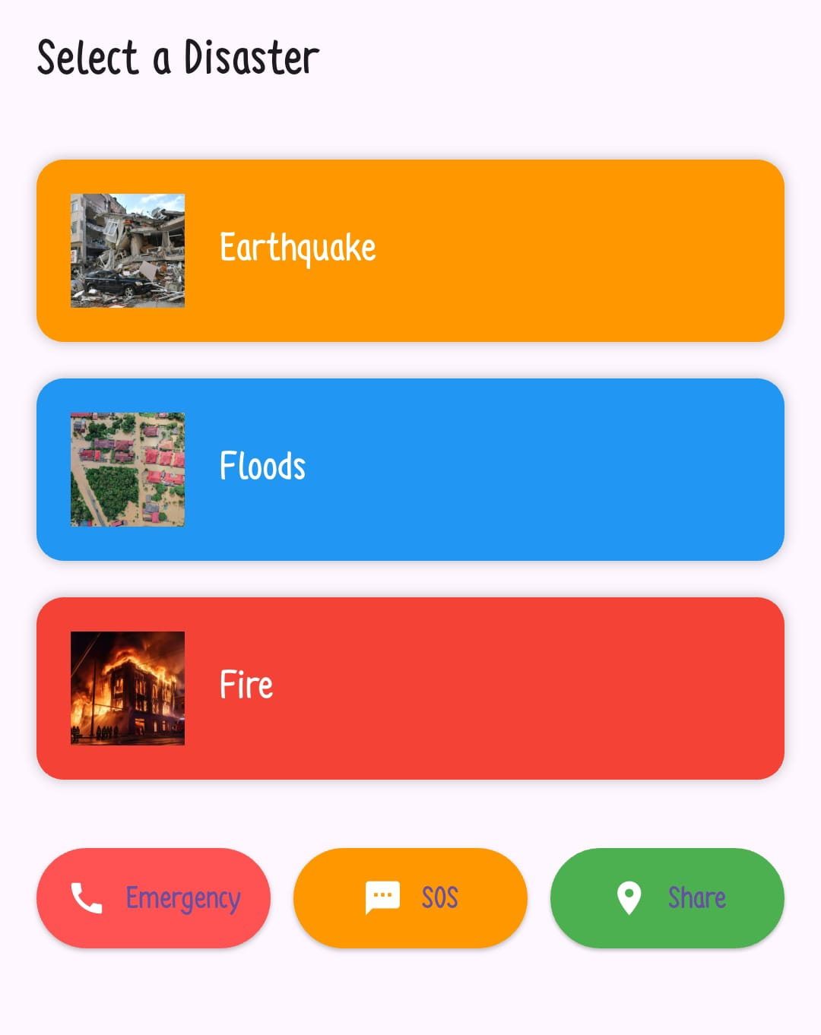
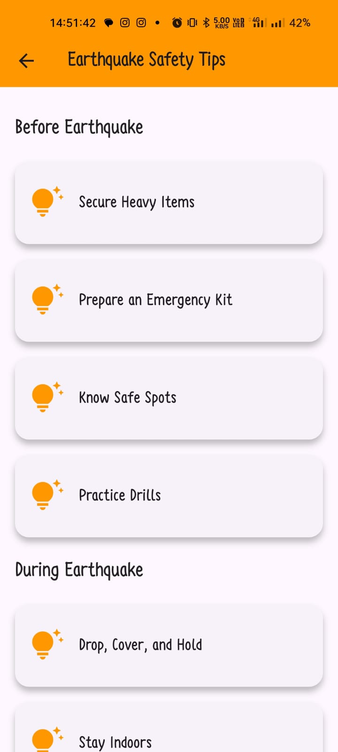
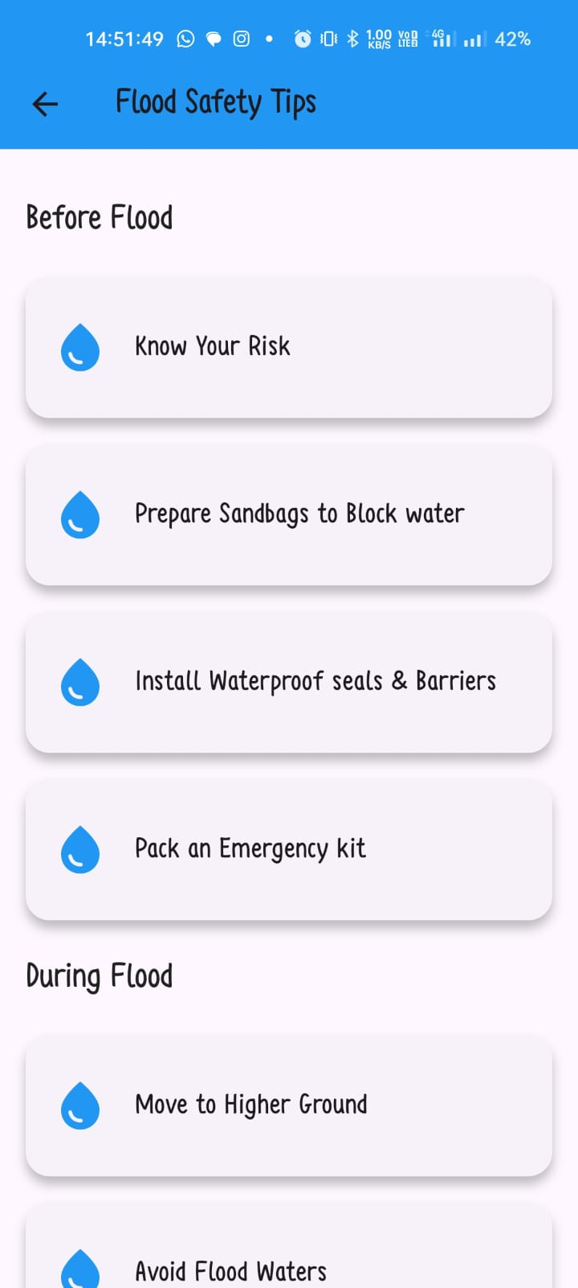
bn
// SPDX-License-Identifier: MIT
);
}
V
Fig: Safety tips based on Register

Slide 17
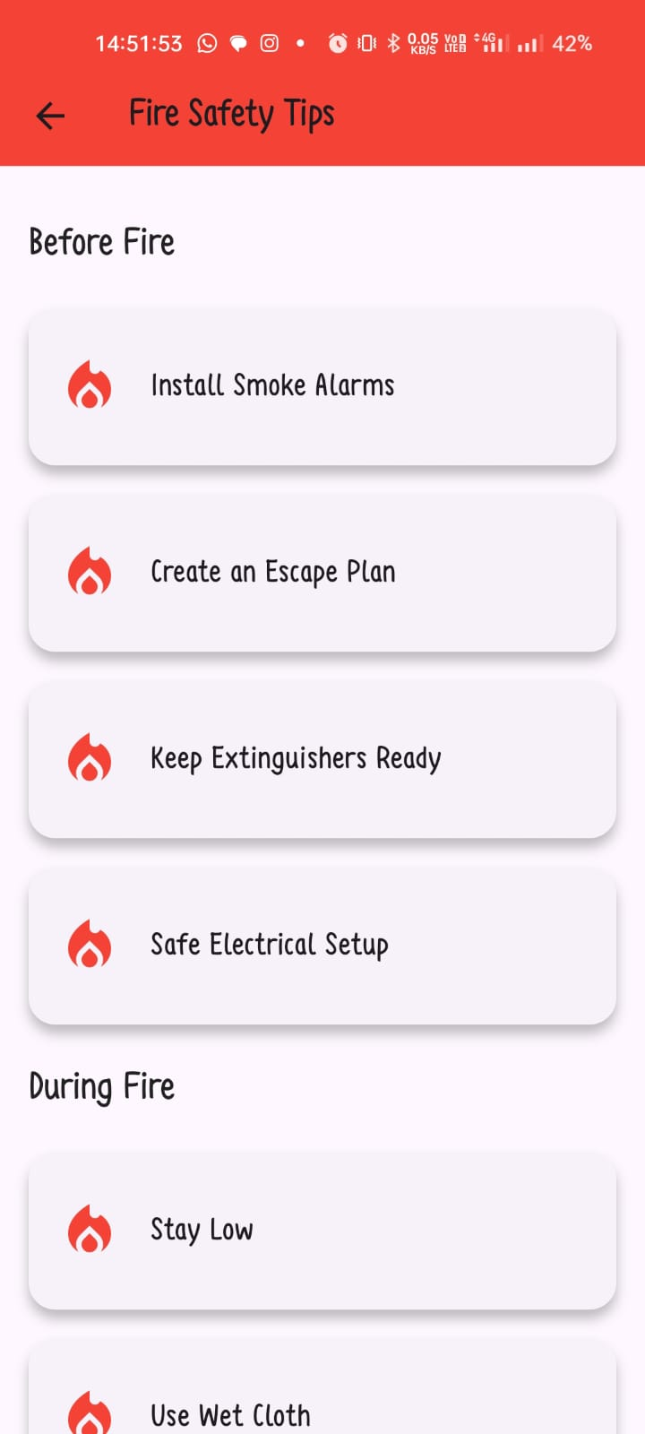
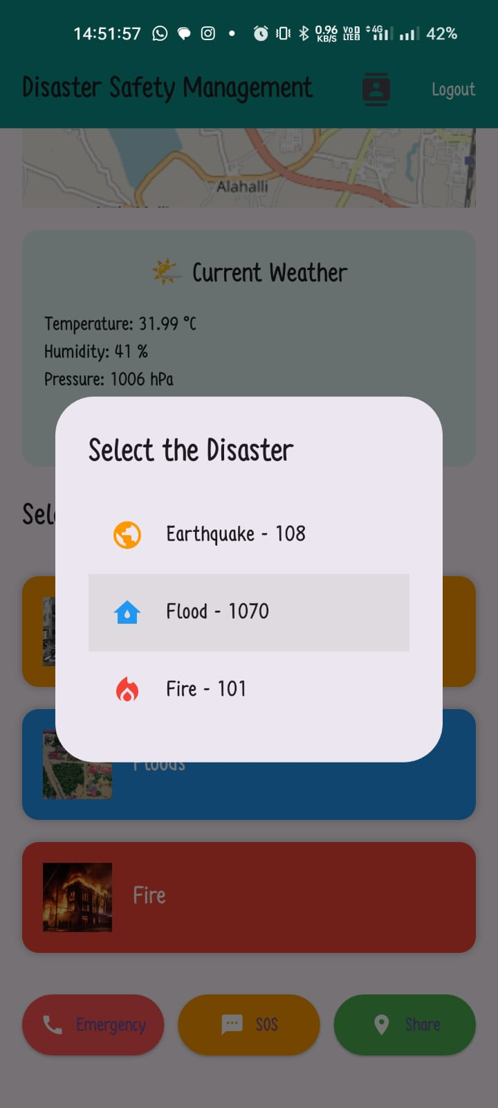
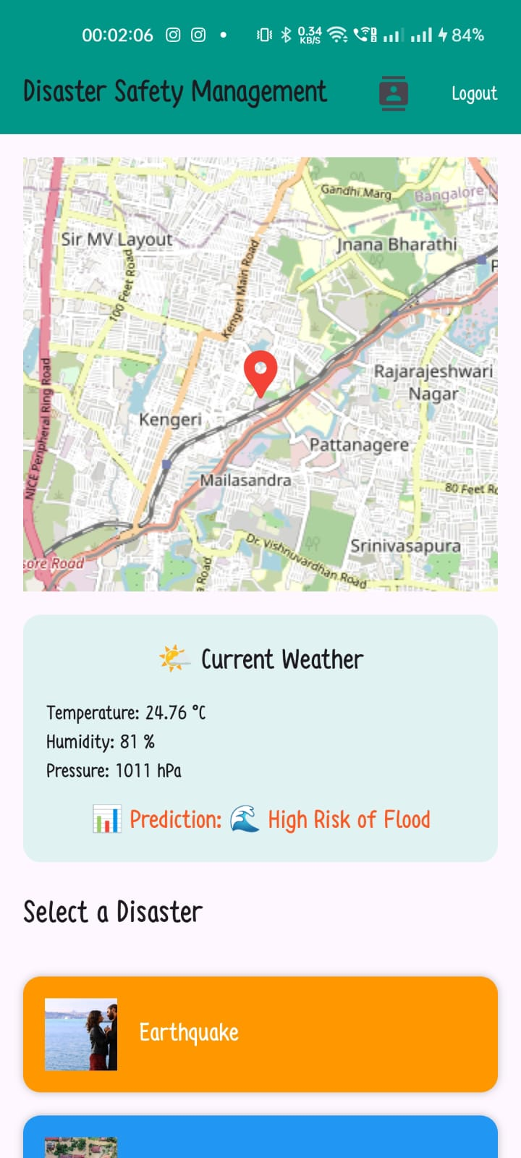
Fig. App Dashboard Fig: Emergency calling Fig: Prediction

Slide 18
bn
// SPDX-License-Identifier: MIT
pragma solidity ^0.8.19;
contract SupplyCruct Cargo {
string itemName;
string status;
uint timestamp;
}
mapping(uint => Cargo) public cargoDetails;
uint public cargoCount = 0;
// Function to add cargo details
function addCargo(string memory _itemName, string memory _status) public {
cargoCount++;
cargoDetails[cargoCount] = Cargo(_itemName, _status, block.timestamp);
}
Conclusion
This project proves that machine learning + real-time APIs + mobile technology can improve disaster safety.
The app is designed to be lightweight, user-friendly, and life-saving.
Future improvements can include:
Adding more disaster types (tsunami, cyclone, landslide)
Improving ML models with more datasets.
Multilingual support for a wider audience.

Slide 19
THANK YOU

