Slide 1
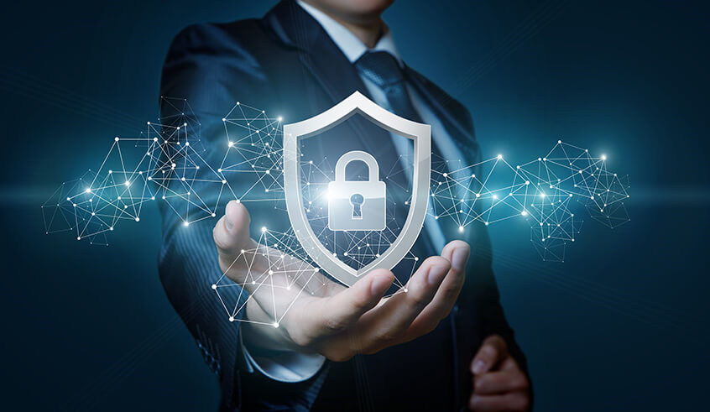
Cyber Security and Awareness Training
Created by: Blake Pierantoni
Notes:
Why is Cyber Security such a big deal today? Because they are Global in nature and increasing in severity every year.

Slide 2

Basic Terminology
Cyber Security
The state or process of protecting and recovering networks, devices, and programs from any type of cyberattack.
Cyber Attack
An evolving danger to organizations, employees, and consumers. Designed to access or destroy sensitive data, equipment, or extort money. Cyber Attacks can, in effect, destroy businesses and damage people’s financial and personal lives.

Slide 3
Basic Terminology
Phishing
Phishing is a cybercrime in which a target or targets are contacted by email, telephone or text message by someone posing as a legitimate institution to lure individuals into providing sensitive data such as personally identifiable information, banking, credit card details, and passwords.
Social Engineering
The art of manipulating people so they give up confidential information.
Data Breach
The intentional or unintentional release of secure or private/confidential information to an untrusted environment.

Slide 4
Data Breach and Cyber Attack Facts
The Average # of employees in an organization that is a victim of ransomware is 71¹
91% of attacks by sophisticated cybercriminals start through spear phishing emails²

Slide 5
Cost Of Data Breaches and Cyber Attacks
Average total Cost of a Data Breach $3.86Million¹
Likelihood of a recurring Data Breach over the next two years 27.9% ¹
Average Cost of Ransomware in a 2017 Study was $133,000²

Slide 6
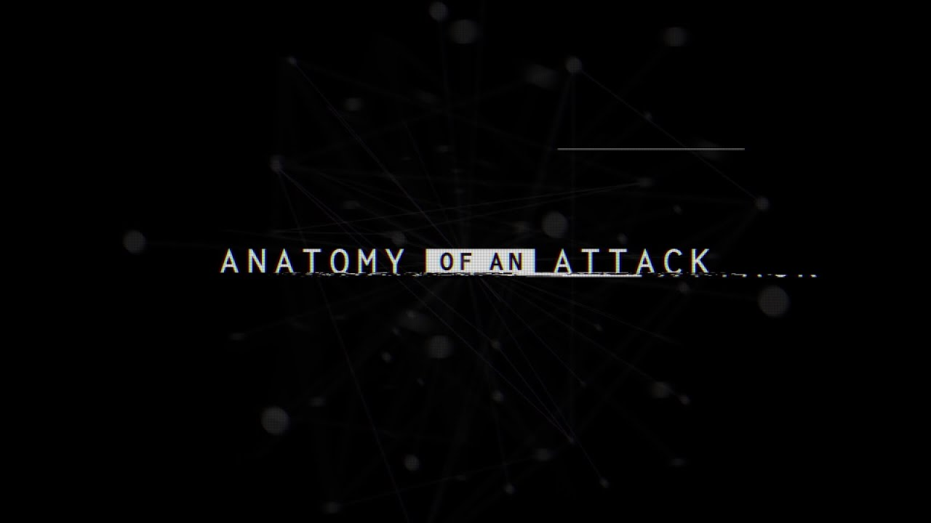
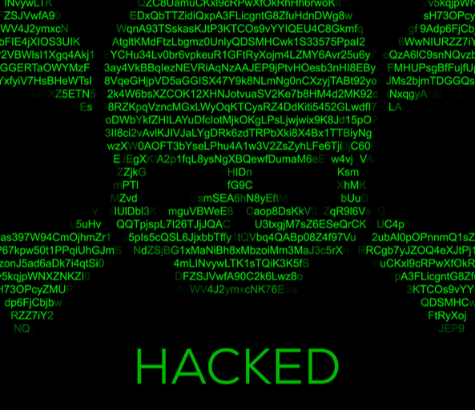

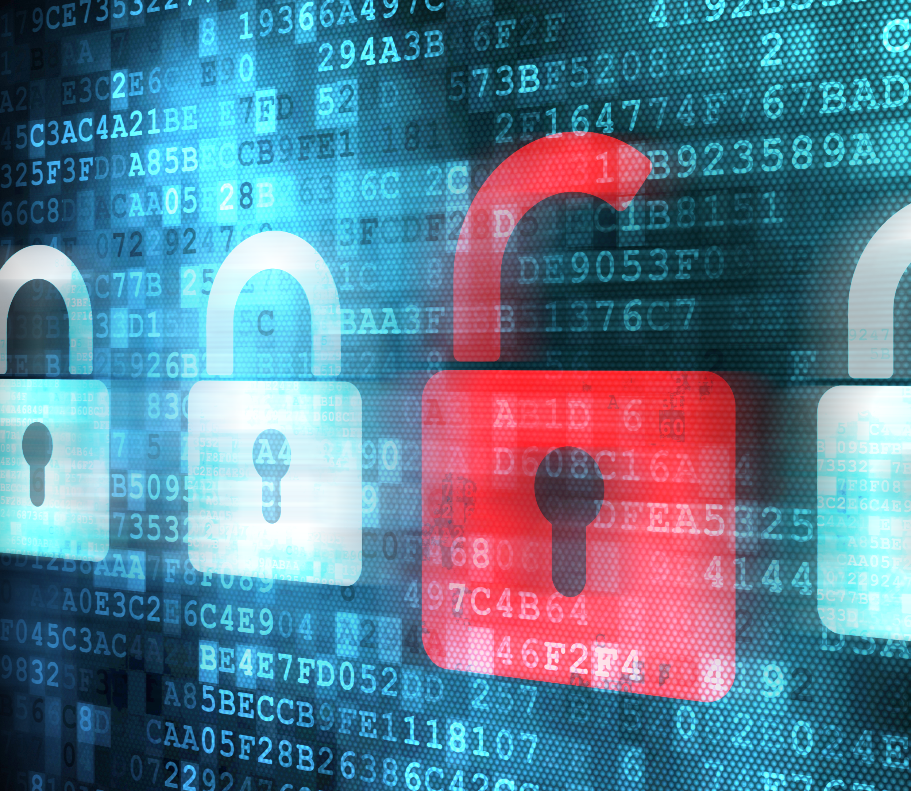


Slide 7
Data Breach and Cyber Attack Examples
A Known Nascar Cup Team
Suffered from a Ransomware Attack in 2018 due to a compromised email.
The Virus wasn’t detected by the companies Anti-Virus software.
All servers and backups were compromised
Employees were locked out of their systems for over 72-Hours
The Cup Team was forced to pay over $100,000 in ransom.
Would have potentially lost all of their data if the ransom wasn’t paid

Slide 8
Data Breach and Cyber Attack Examples
Circle Sport-Leavine Family Racing
Suffered from a Ransomware Attack in 2016
The team estimated that it would take 1,500 man hours to re-create the data with a self proclaimed value of $2,000,000.
“The data that they were threatening to take from us was priceless, we couldn't go one day without it greatly impacting the team's future success”¹
– Dave Winston, CSLFR Crew Chief
¹ESPN: Circle Sport-Leavine Family Racing Learns Valuable Digital Lesson

Slide 9
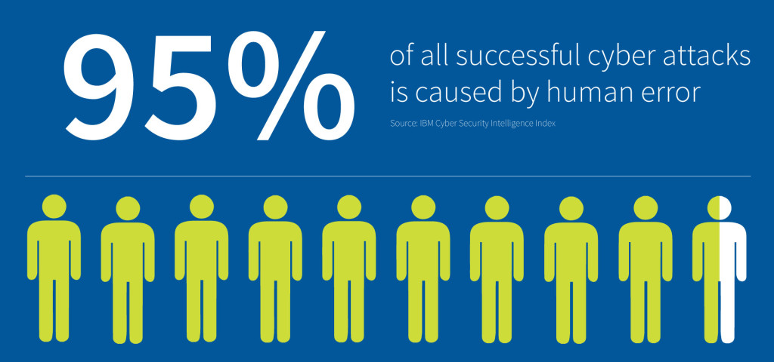
Protecting your company
Notes:
At GMS Racing, We have Layers of security, a Fireall, Anti-Virus, Limit admin rights, Email Protection, Backup Systems, and segregated networks. We should think that we are safe, we can’t get attacked, but the days of set it and forget it are over. Hackers realized that there is a cheaper more effective style of attack, going after Humans.

Slide 10
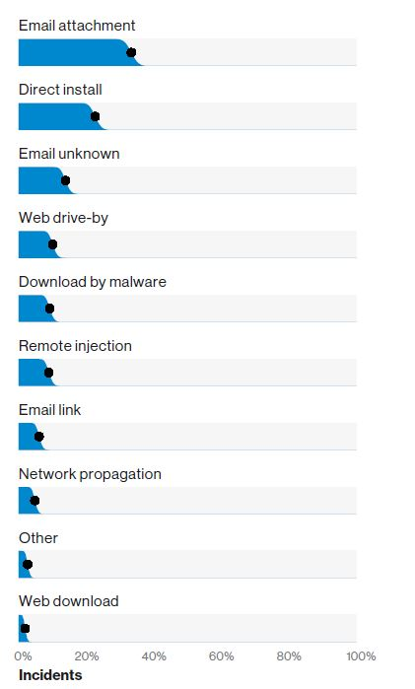
Email Security
Most Common Ways Malware is Installed
Don’t send account credentials over email
Pay close attention to all emails
Verify the Identity of the sender
NEVER download unexpected attachments
Report all suspicious emails to I.T.
Call the sender if you believe the email may be fake

Slide 11
Email Security | Attachments
NEVER blindly open an email attachment. When you receive an attachment, ALWAYS ask yourself the following questions:
Am I expecting this attachment or email?
Does the grammar used in the email sound like its coming from the sender?
Is this the correct file type that I was expecting?
Do I recognize this type of file?
If you answer no to any of these questions, it is best to contact I.T.

Slide 12
Email Security | Attachments Cont.
Microsoft Word
.doc
Microsoft Excel
.xls
.xlsx
.docx
PowerPoint
.ppt
.pptx
PDF
.pdf
Familiar file extensions

Slide 13
Email Security | Attachments Cont.
Common Dangerous File Extensions
Executable
.exe
Windows Scripts
.bat
.ps1
JavaScript
.js
.zip
Compressed Files
By default, these file types are filtered out by our email system.

Slide 14
Phishing
Classic Phishing
Sent out in mass emails, and are usually about sending or receiving money
Spear Phishing
Very Specific and usually targeted to a specific user. May pretend to be an employee or someone you know
Whaling
Everyone likes to catch the big fish. Targeted at High level employees (CEO,CFO,President,VP). Can be extremely convincing.

Slide 15
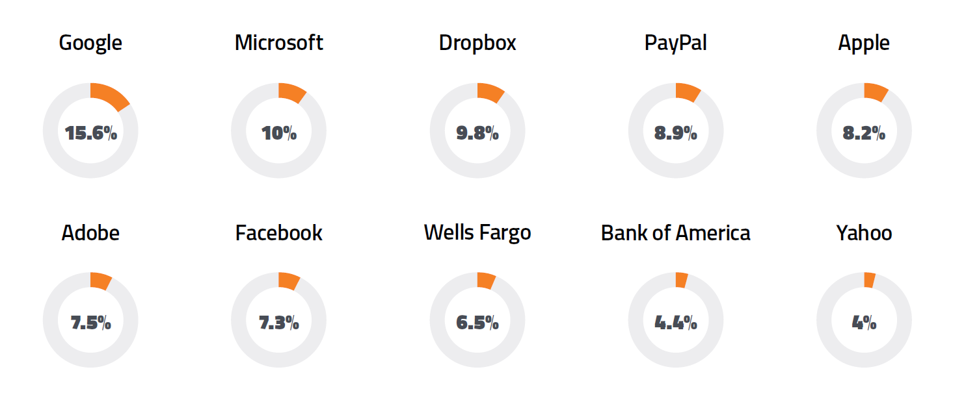
Phishing Cont.
According to the 2019 Webroot Threat report, the number of Phishing grew 36% in 2018
Top 10 impersonated companies of 2018

Slide 16
Spotting a Phishing Email
Pay attention to the close details
Sender Address
Grammar in the email
Verify Links
Pay attention to attachments

Slide 17
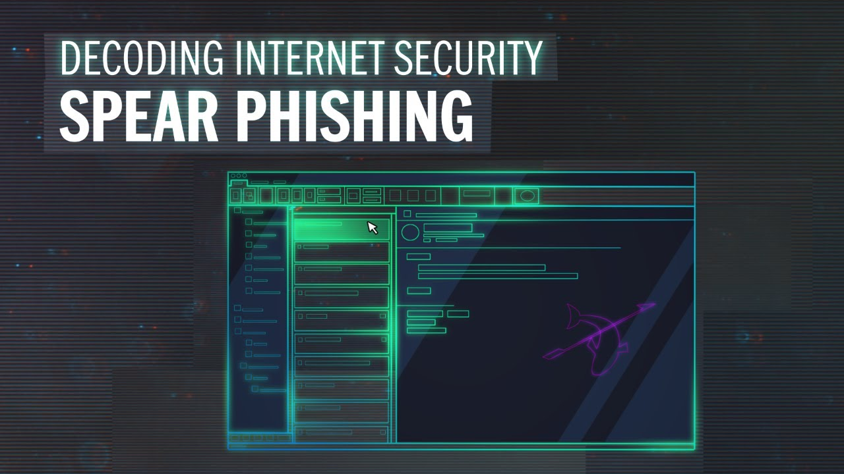

What is Spear Phishing?

Slide 18
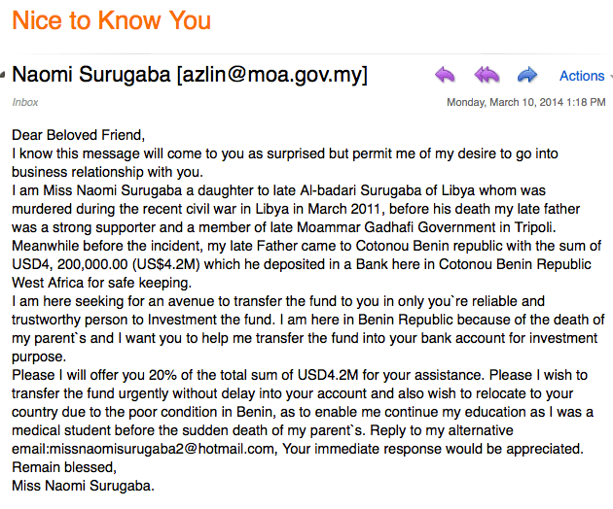
Classic Phishing
Everyone has a rich friend from India
Attempts to get banking information
May ask for small payments

Slide 19
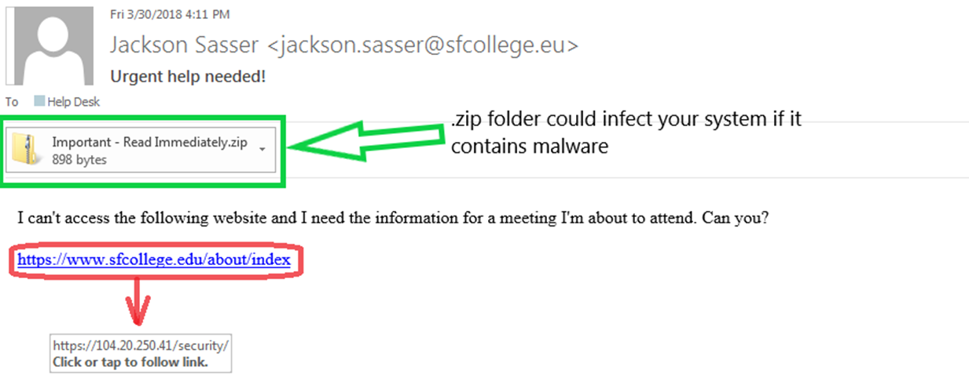
Spear Phishing
A specific and targeted attack at the company. The hacker is using an employees identity to gain trust.
Hacker used “Link Manipulation” to hide a malicious address.
The email account was either spoofed or compromised.
Has an attachment that could contain malware.

Slide 20
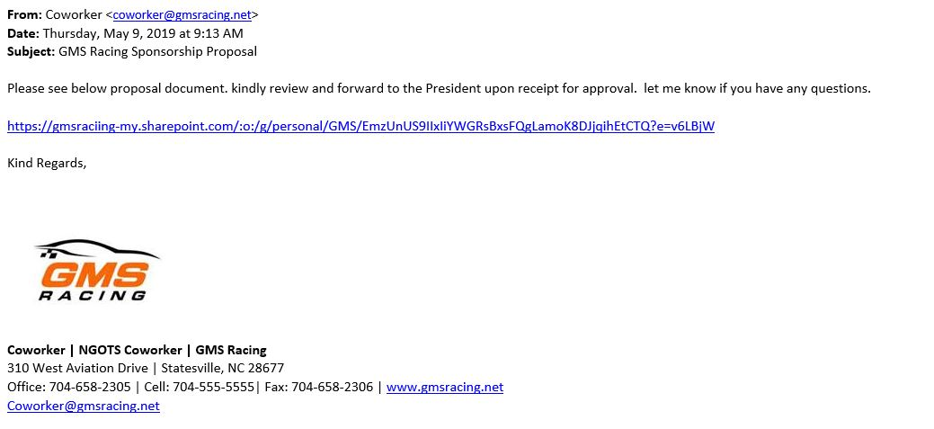
Whaling
Attempts to hijack information or infect the computer of high profile employee (President, Vice President, Owner etc.).
Can even come from the email of another employee (if they had an account breach).
Can be very convincing because the email is usually custom tailored.

Slide 21
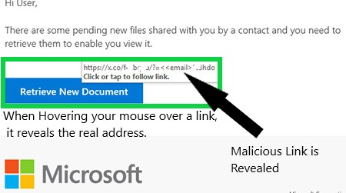
Link Manipulation
Hacker hides a malicious link in the email to redirect the user to a dangerous website
The dangerous websites usually ask for account information

Slide 22
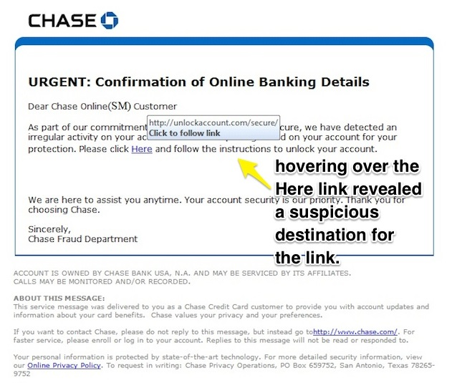
Link Manipulation Cont.
Creates sense of urgency
Attempts link manipulation

Slide 23
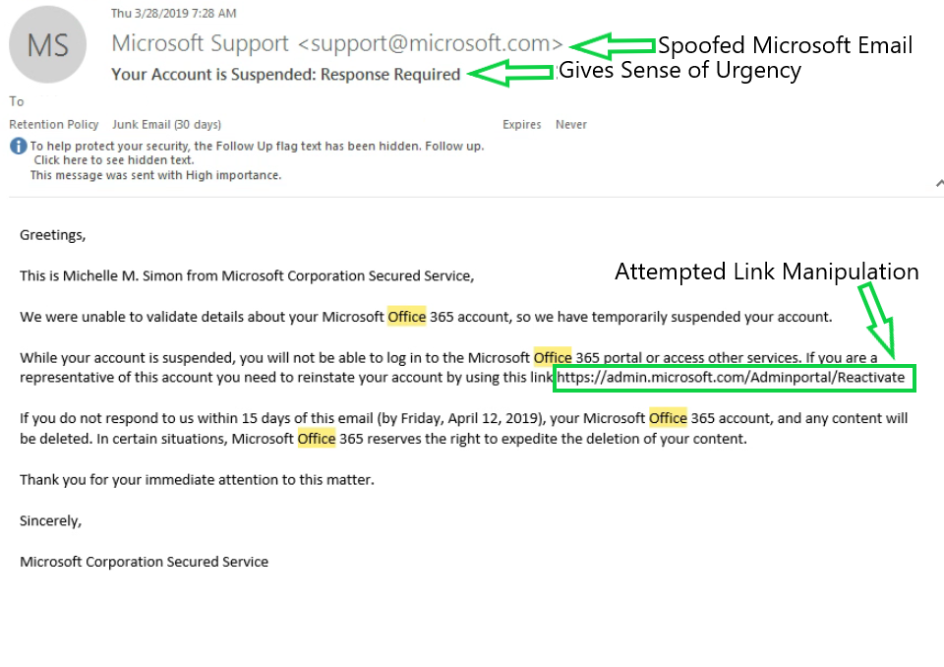
Analyzing a Phishing Attempt
Spoofed the email address
Presented a sense of urgency
Attempted link manipulation(Failed because of our spam filter.)
Used good grammar

Slide 24
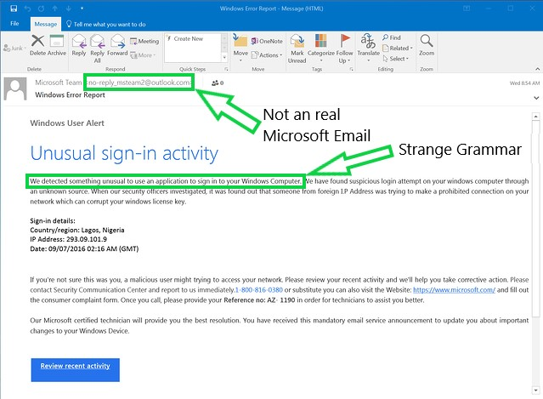
Analyzing a Phishing Attempt Cont.
Used an email that isn’t associated with Microsoft
Strange phrasing and grammar

Slide 25
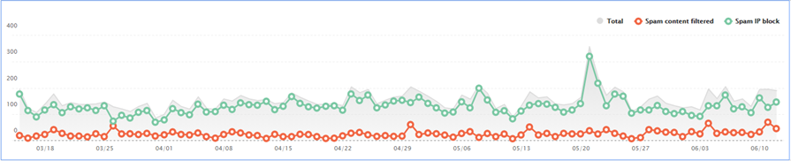
Amount of Spam Filtered by our systems
We currently use Office 365 which has internal spam prevention
3 month graph of successfully filtered spam

Slide 26
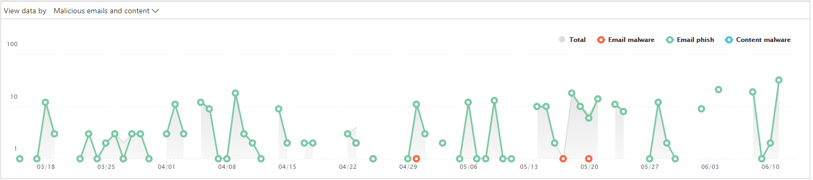
Amount of Phishing Prevented by our System
Office 365 also provides anti-phishing and malware
This data represents malicious content that was detected
Remember, Malicious content can still sneak past filters

Slide 27
Password Security | Don’t be an easy target
Have Strong passwords
A password should contain at least 12 characters containing upper case, lower case, numbers, and symbols. Passwords are never to be shared.
Use Unique Passwords
Every password for every account you own should be unique.
Using the same password for multiple accounts can lead to other accounts being breached if your account information has been involved in a data breach.
No Password Lists
Storing information about accounts and passwords on a word document or excel sheet is extremely dangerous
Encrypted or Locked spread sheets are extremely easy to hack
Instead of using a spreadsheet, try using a password manager like LastPass or 1Password.

Slide 28
Password Security | Creating a Strong Password
Character Selection
Use multiple types of characters
Rules to Creating Passwords
Don’t common passwords like: Jake87 or FLOWERS (Yes, I’ve seen these used…)
Lets Create a Secure Password
Lets use the start with the example FLOWERS for our flower lovers out there.
Upper Case, Lower Case, Numbers, and Symbols.
Use a minimum of 8 Characters
Use a combination of words or phrases
Substitute letters with numbers or symbols
Lets start by Substituting Letters and Numbers.
Okay, That was a good start, but it’s not quite secure enough…yet
Now we are going to turn it into a phrase
FLOWERS ---> F1oW3r$
FLOWERS ---> F1oW3r$ ---> I love Flowers ---> !,1ov3@F1ow3r$
It seems difficult to remember, but its your custom phrase. If you use a password manager then you shouldn’t have any issues.

Slide 29
Password Security|Protecting Your Passwords
Use a Password Manager Like LastPass
Password managers allow you to easily manage your unique passwords.
Despite common belief, Password managers are the most secure way to store your account information
Use Multi-Factor Authentication(MFA)
If possible, enable Multi-factor authentication on every account you can
MFA requires you to enter an additional piece of information when logging into your account (Usually a code sent to your phone)
Notes:
MyTechPro and I will be rolling out Multi-Factor Authentication for everyone at GMS Racing with an Email. This prevent unauthorized users from logging into your account unless they have a code that is texted to your phone.

Slide 30
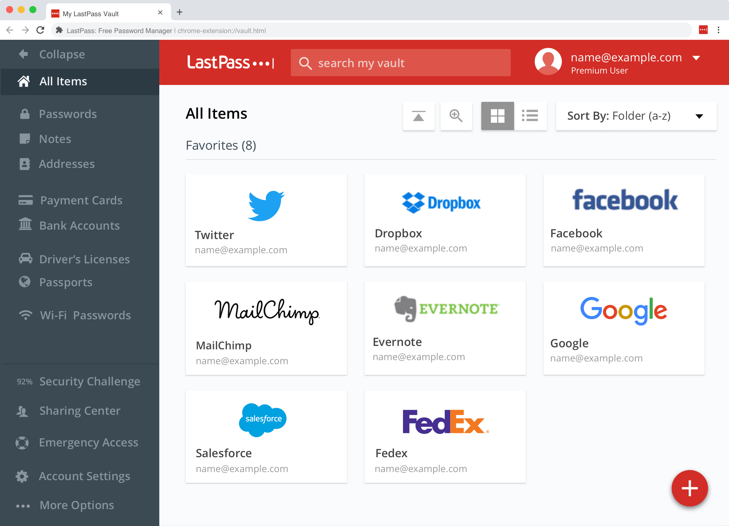
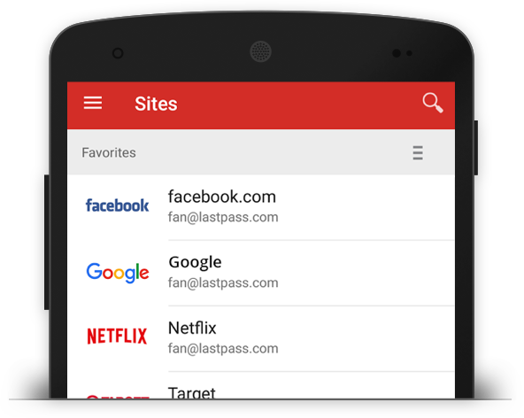
Password Security | Password Managers
Allows you to keep all your passwords unique and lengthy.
Removes the need to store unsecure password lists on your computer.
Most password managers are easy to use and have mobile applications.

Slide 31
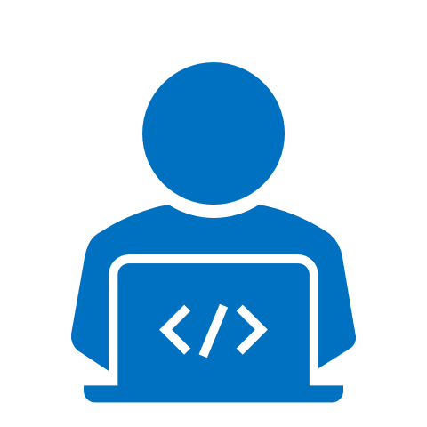
Protecting your Company|Safe Web Browsing
Risky Websites
Pay Attention to HTTPS
Identify Browser Based Hoaxes
Spotting Fake Web Addresses

Slide 32

Safe Web Browsing| Risky Websites
No Adult Content
No Software Piracy
No Gambling Sites
These websites are known to have Viruses and Malware
Notes:
MyTechPro is in the process of rolling out DNS Protection to add another protective layer in preventing users from accidentally accessing dangerous websites.

Slide 33
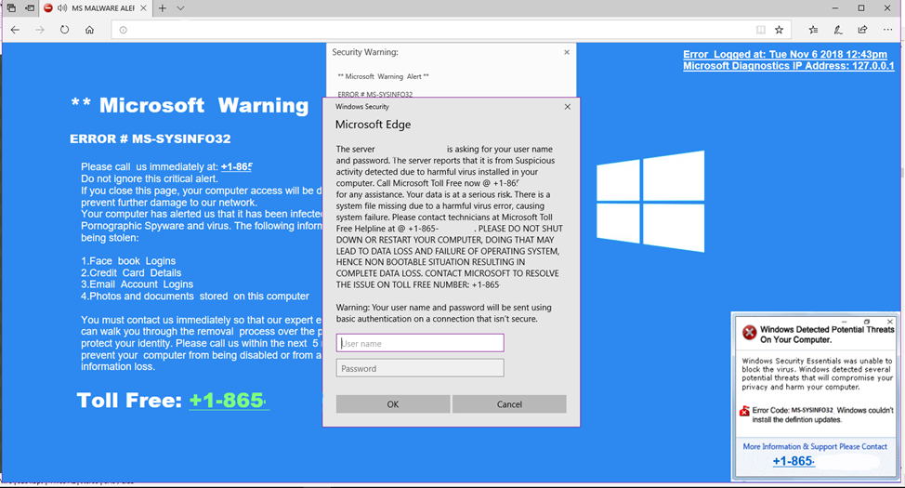
Browser Based Hoax|Fake Tech Support
Fake “tech support” or “infected computer” scam is most common.
May receive an audible alert that your computer is infected
Possibly instructed to download or contact a 3rd party IT company
Commonly pretends to be Microsoft.
Never allow anyone to connect to, or remotely control your computer unless instructed by MyTechPro.

Slide 34
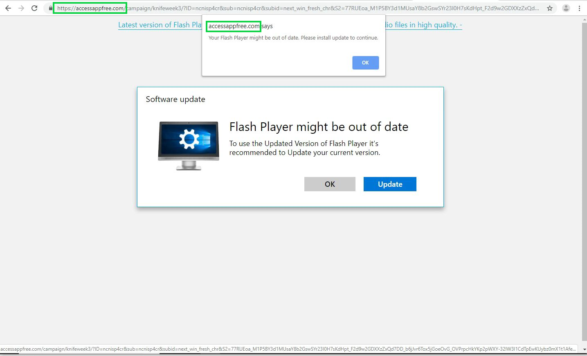
Browser Based Hoax| Malicious Web Redirects
You may find yourself suddenly on an unexpected webpage that asks you to download something.
Usually alerts you to download software or update something on your computer.
The downloads usually contain viruses or Spyware
Close out of the browser and contact I.T.

Slide 35

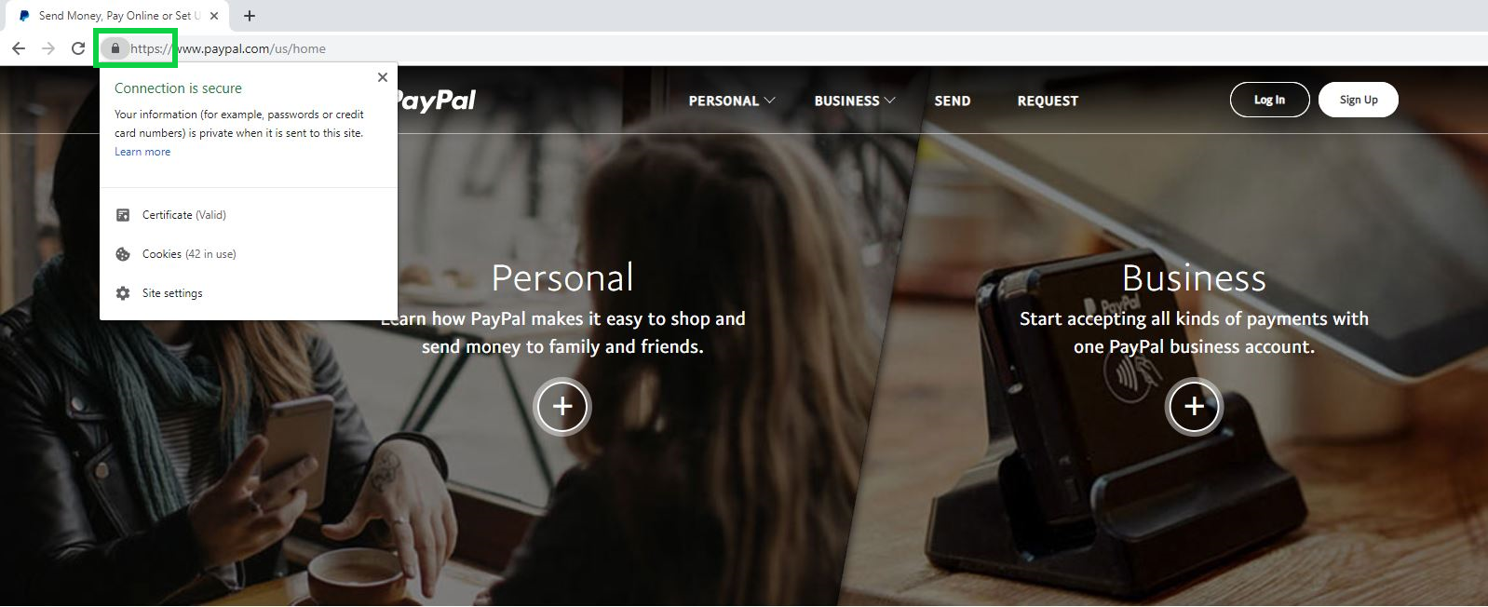
Safe Web Browsing|Unsecure Sites
Look for the Lock, but remember that some Phishing sites have HTTPS
Never enter sensitive information on websites that do not have HTTPS
HTTPS means all information you enter is encrypted when sent to the website.
Notes:
Even though a site says it has HTTPs and it’s secure doesn’t mean it isn’t always malicious.

Slide 36
Safe Web Browsing | Spotting Fake Web Addresses
The Second to last dot rule and the first slash rule
Only Pay Attention to the last two places in the web address and ignore everything that comes after the first slash.
Pay attention to the color Blue and Ignore the Color Red
Microsoft and .com
https://www.microsoft.com/en-us
We see that the website we are going to is microsoft.com
Okay, Now lets use our new rule against a scam website.
https://account.login.microsoft.com.scam.co/microsoft-outlook-login/
Well…if we were to go to that website then we would actually go to: scam.co
This would definitely be a fake website trying to attack you or steal your information
Notes:
Even though the website had HTTPS and said Microsoft.com it wasn’t even associated with Microsoft.com this is how hackers try to trick you into going to their bad websites.

Slide 37
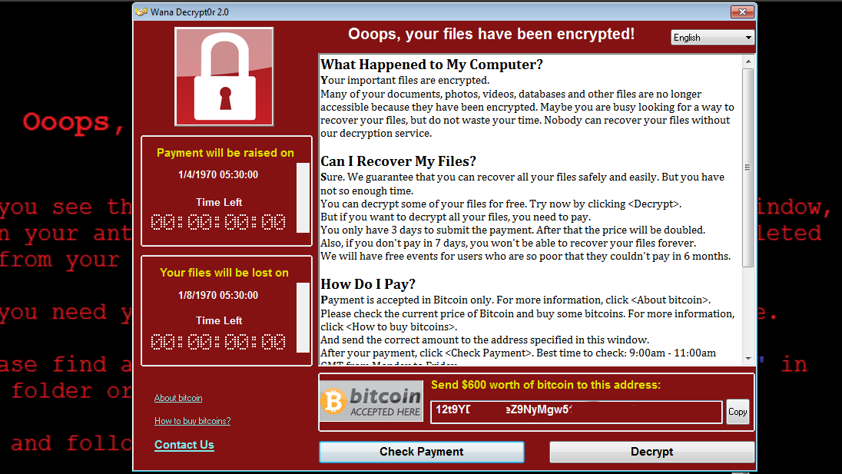
Ransomware
Locks every file and program on your computer and holds them for ransom
Spreads through the network and can infect every computer and server in seconds
May be impossible to remove the encryption
Notes:
One of the main reasons we limit admin rights to users is to help prevent ransomware for executing on the machine.

Slide 38
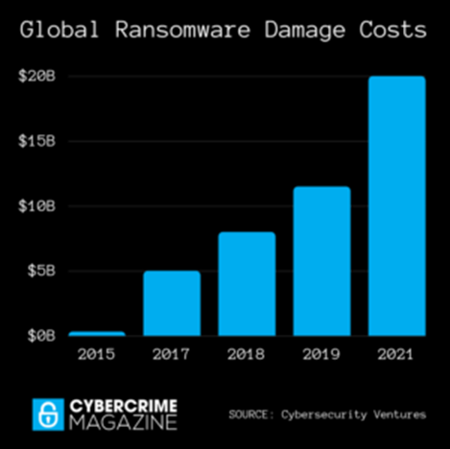
Ransomware Facts
Ransomware attacks increased 350% from 2017 to 2018¹
In 2016, every 40 seconds a business was a victim of a ransom ware attack²
It is estimated that by the end of 2019 that number will be 14 seconds, and 11 seconds by 2021³

Slide 39
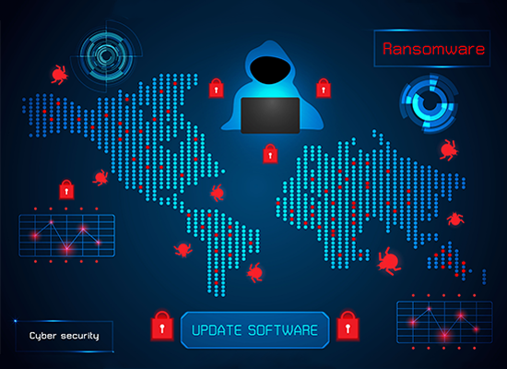
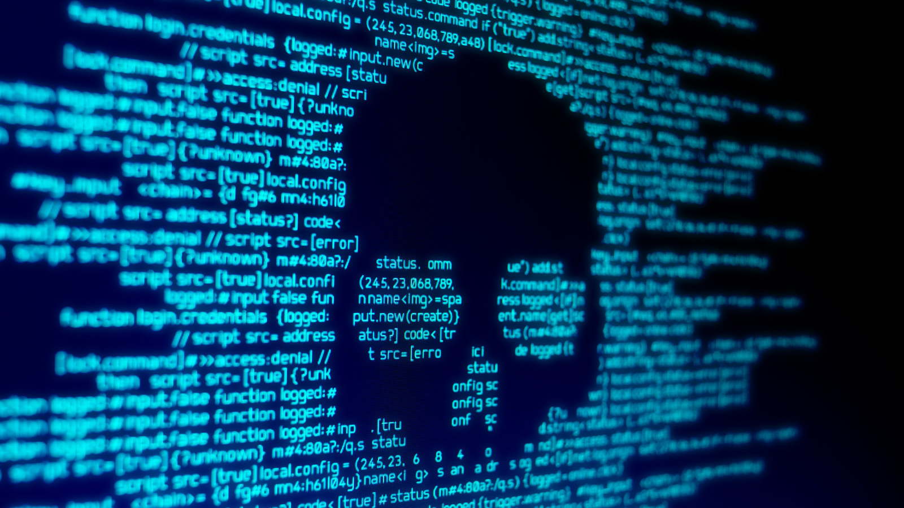
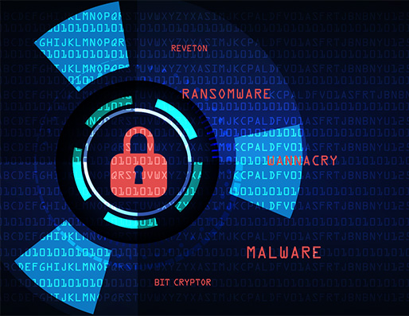
How fast does Ransomware Spread?

Slide 40
Hypothetical Costs of Downtime Due to Network Wide Ransomware Attack
Cost of Downtime = (Impacted Employees) X (Productivity Factor %) X (Average hourly salary)
Failure Point | Employees Effected | Productivity Impact(Loss) | Cost Impact Per Hour | Loss Per Day (8 Hours) | Average Duration Loss(6.4 Days)
File Storage Server | 20 Employees | 60% Loss | $420.00 | $3360.00 | $21,504.00
PC – User Workstation | 50 Employees | 100% Loss | $900.00 | $7,200.00 | $46,080.00

Slide 41
Physical Security in the Workplace
Keeping Unattended Workstations Secure
Protecting Confidential Documents
Prevent Tailgating/Impersonation
Protect yourself from Shoulder Surfing

Slide 42
Unattended Workstations
Keep your workstations locked while unattended.
An unlocked workstation grants complete access to anyone who passes by. Copying your files only takes seconds.
Gives anyone the ability to install malware on your machine (intentional or not)
Notes:
Locking your workstations is extremely Important. At any company, it only takes one disgruntled employee to copy confidential data onto a flash drive. At MyTechPro, Bill McNamara will change your background if you’re caught leaving a workstation unlocked.

Slide 43
Physical Documents
Confidential documents in the workplace should be treated with the same security as documents on your computer
Use secure shred bins for disposing of sensitive paper documents and electronic media
Lock away confidential documents at the end of the work day or when they are unattended

Slide 44
Tailgating & Impersonation
Have a policy in place for visitors (Check-in system, visitor badge, etc)
Don’t be afraid to ask who someone is and why they are there.

Slide 45
Shoulder Surfing
Curiosity, espionage, and competitive advantage can give an incentive to shoulder surf
Don’t view potentially sensitive information in public areas (Airports, Coffee Shops, Flights)
Invest in a privacy filter if you are constantly working with sensitive information

Slide 46
Real or Phish

Slide 47
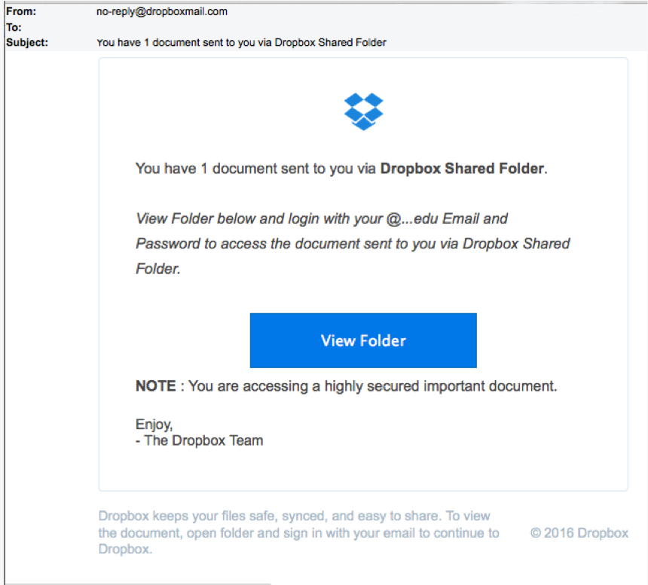
Real or Phish Scenario #1
Plot:
David receives an email from Dropbox informing him that he has a shared document that is waiting for him.

Slide 48
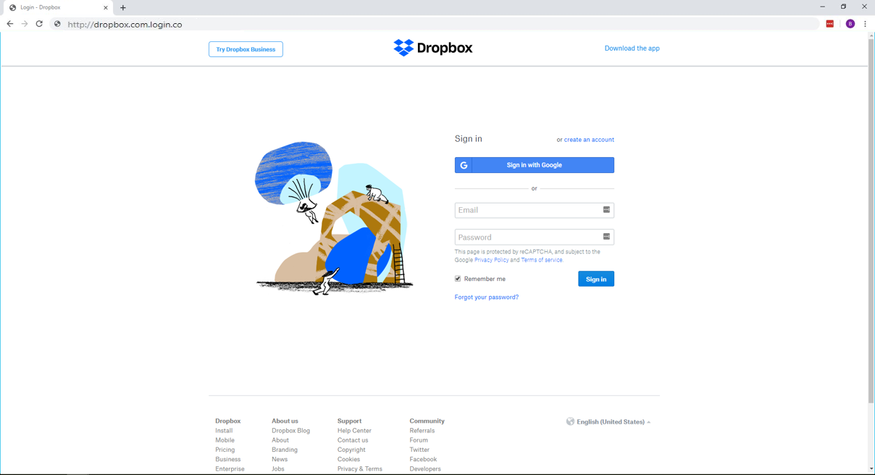

Slide 49

That Looked Real! But it was also a “Real” Phish….
And here is why….

Slide 50
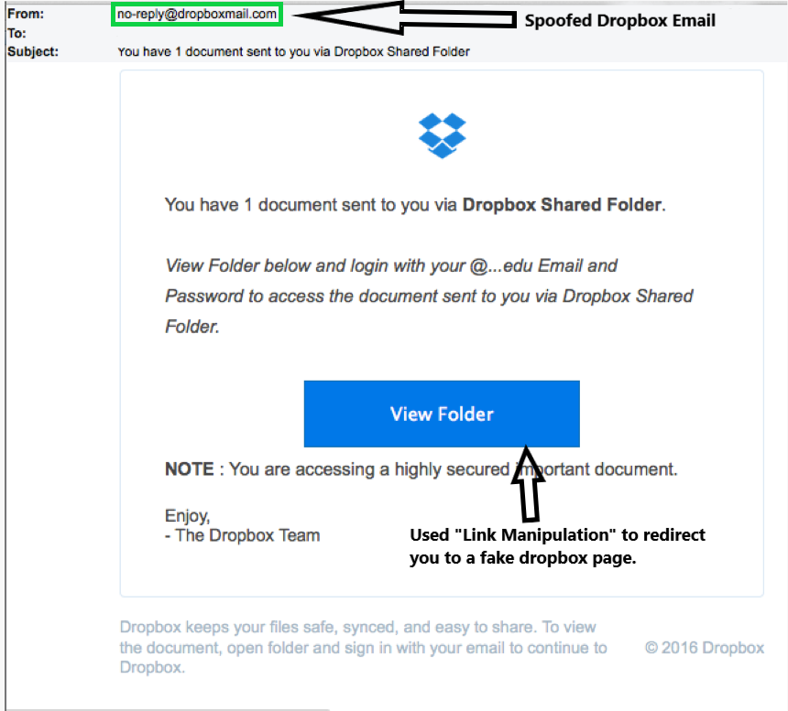
Analyzing the Email | Scenario #1

Slide 51
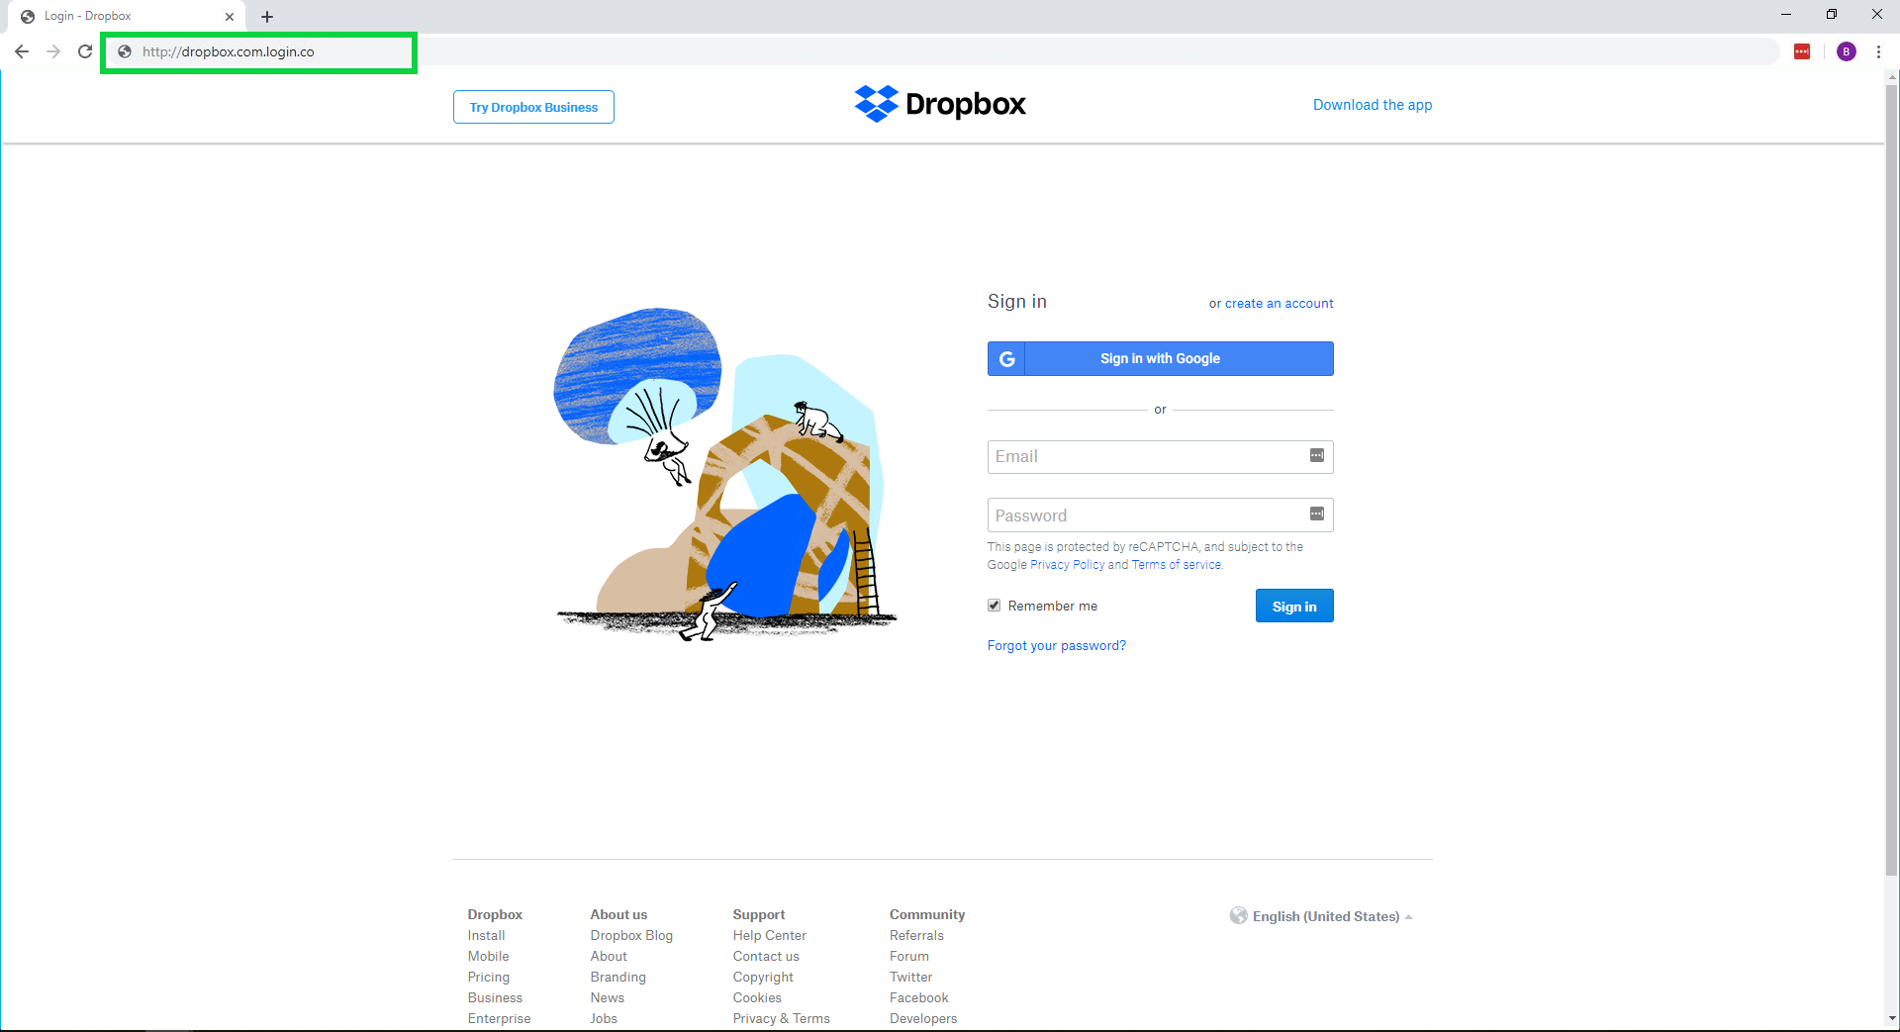


Slide 52

What does the real page look like?
Remember to Pay attention to HTTPS

Slide 53
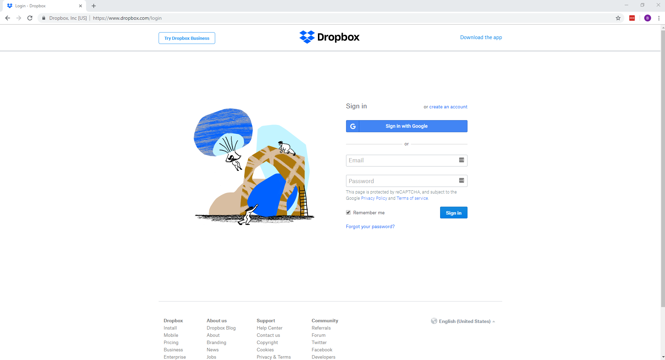

Slide 54
Real or Phish

Slide 55
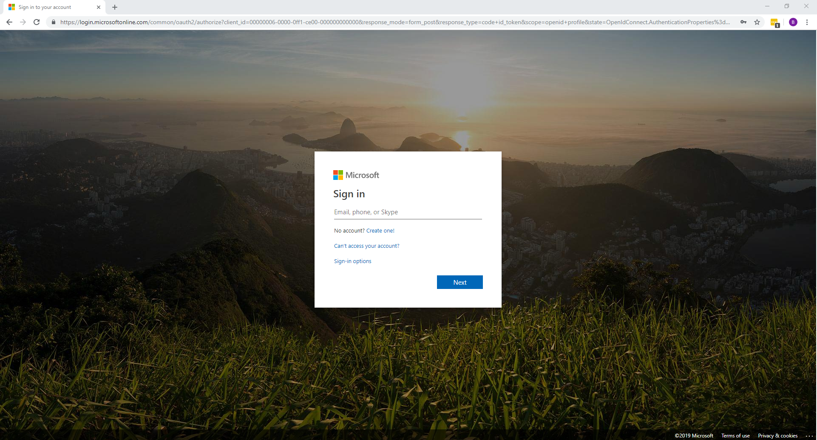

Slide 56

Real!

Slide 57
Real or Phish

Slide 58
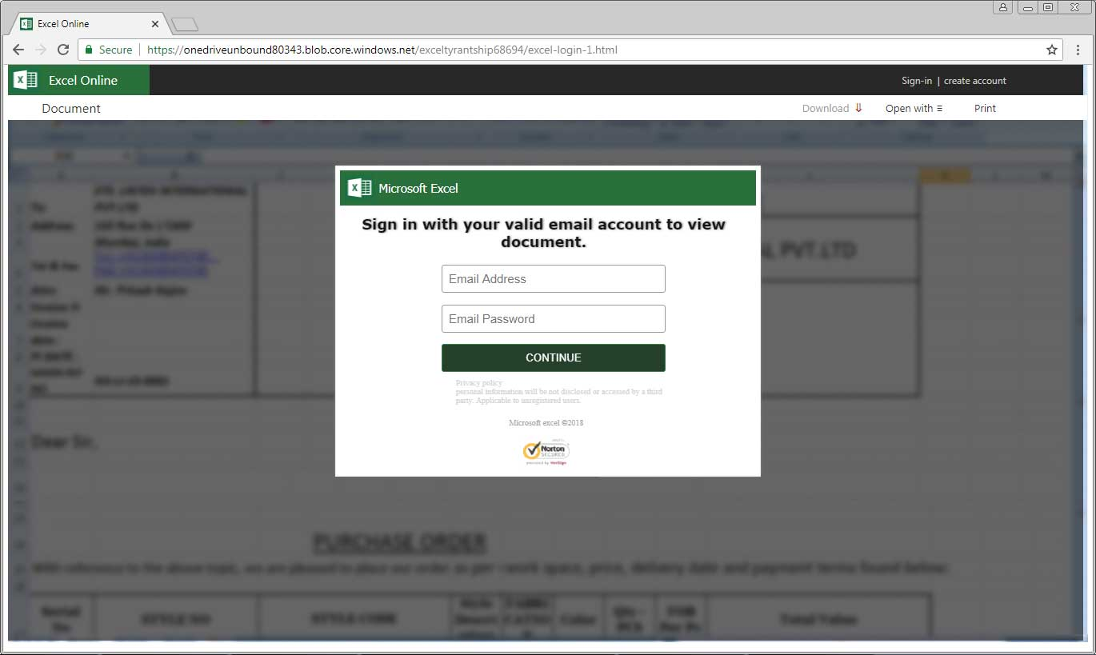

Slide 59
That was also a Phish….
And here is why….

Slide 60
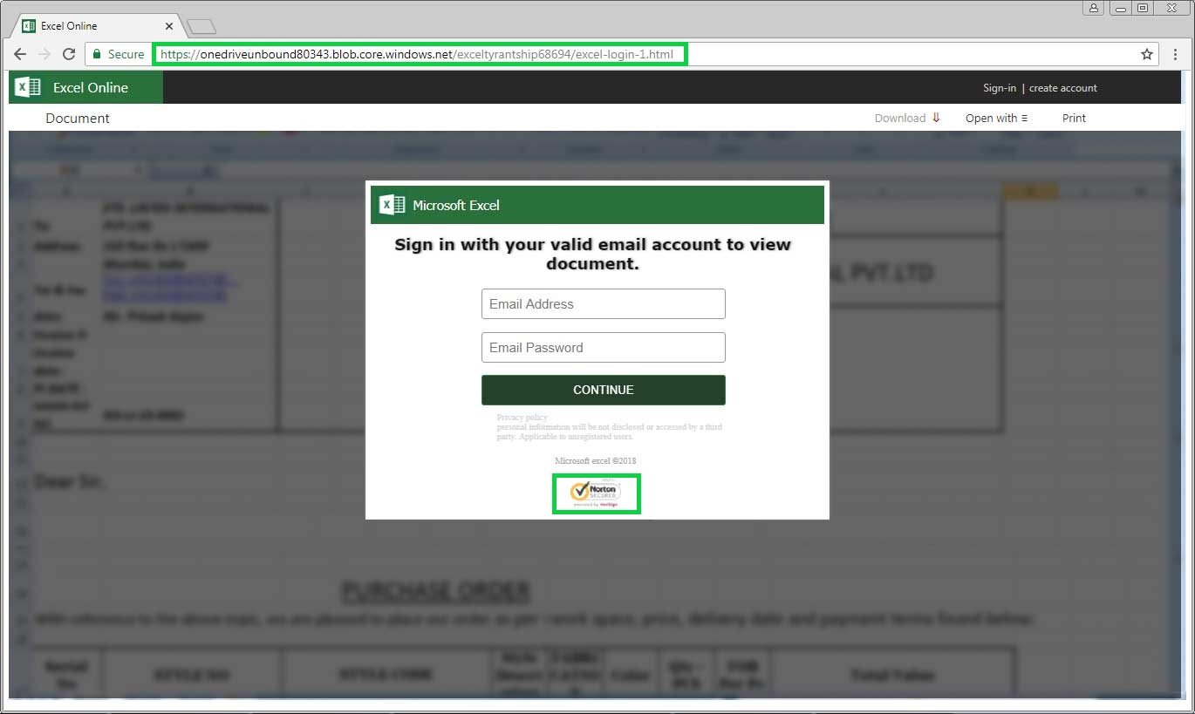

Slide 61
Summary | What you should remember
Pay close attention to emails and attachments. Phishing attacks have been increasing globally at a rapid rate.
Remember the safe web browsing tips when you are using the web.
If you are ever suspicious of an email, document, website, or anything else. Contact I.T.
Always use secure passwords and keep them protected.
Don’t ignore physical security even though it is often overlooked.
Remember, You are the first line of cyber defense for your company.

