Slide 1
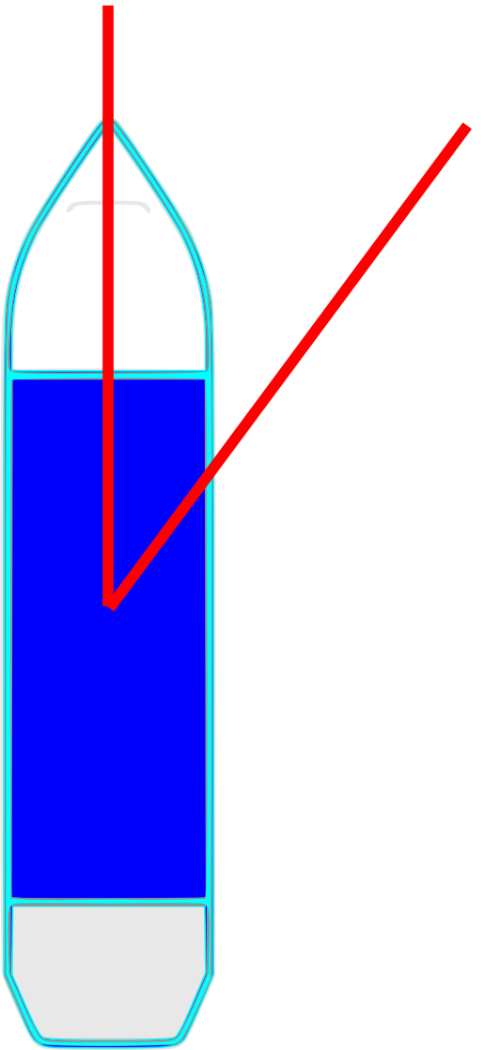
relative
wind angle etc.
α

Slide 2
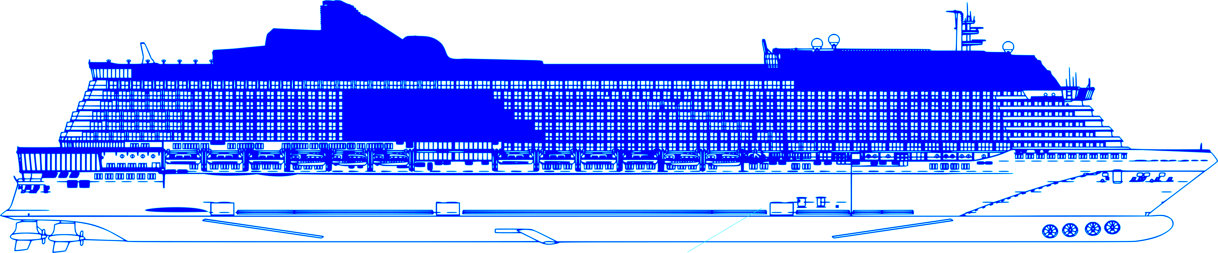

Draft
Stern
Thruster 1, 2
Chillers 1, 2, 3
Bow Thruster
Main Engine
1, 2, 3, 4
Speed over
ground
Relative
water speed
Propulsion
Power
Speed Through Water

