Slide 1


Slide 2
A Note to Remember:
Everything in this PPT is demonstrated in Video. These slides are just remembering notes for beginners. So, steps in this file might be little confusing. For clear understanding of every step, please follow the video.

Slide 3
Outline:
Data format for Yolov5
Data preparation tools
How to use makesense.ai for annotation
Arrange Dataset
Setting Up Yolov5
Start Training
Detection
Results

Slide 4
Data format for Yolov5:
For every image, there will be a separate text file which will have following properties.
class x_center y_center width height format.
Each object will have a new row of same format.
So, The total number of objects in image is equal to number of rows.

Slide 5
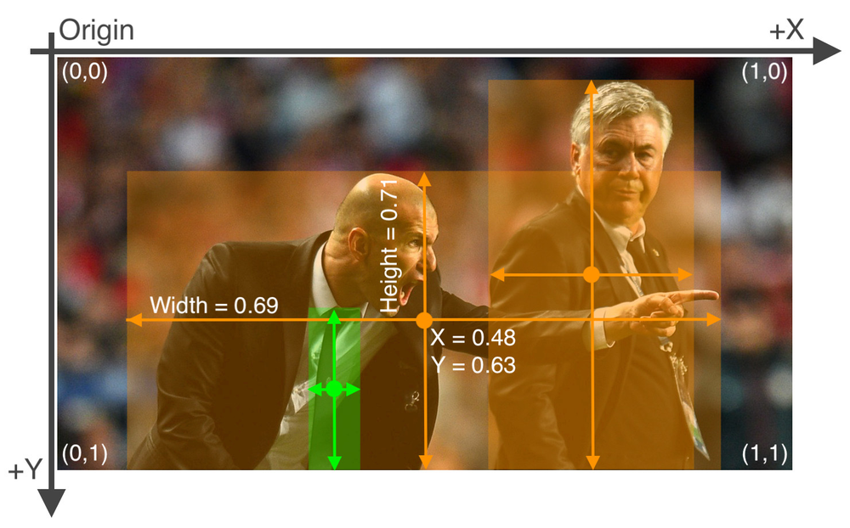
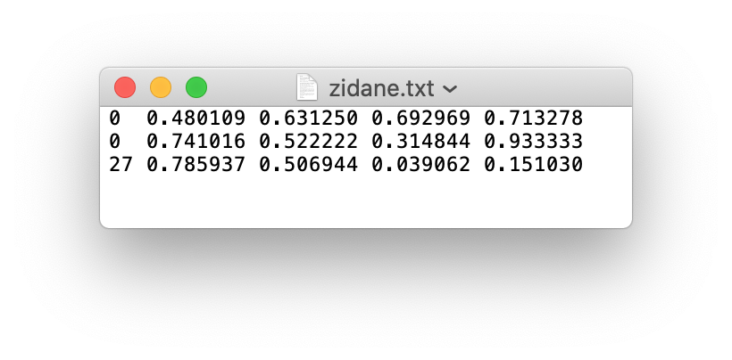
Cont..
Image with 3 objects (2 Person and 1 Tie )
Relevant text file with 3 rows

Slide 6
Data Annotation tools:
Makesense.ai
LabelImg
LabelBox
CVAT

Slide 7
How to use makesense.ai for annotation
Visit makesense.ai
Go for Object Detection
Upload Videos
Create Label List
Start Annotating

Slide 8
Arrange Dataset.
Don’t worry, You don’t need to do it manually. We’ll do it using python code. But, to understand here it is.
Dataset
images
train
val
labels
train
val

Slide 9
Setting Up Yolov5
Simply Open terminal/command prompt
Clone Yolov5 GitHub repo. (make sure you have git installed)
Update dataset.yaml

Slide 10
Start Training:
Open Jupyter Notebook
Change Location to Project Directory
Run following command
python train.py --img 640 --batch 16 --epochs 3 --data dataset.yaml --weights yolov5s.pt

Slide 11
Detection
Detection Sources
Web Cam, Video, Image, Image Directory, Video Stream
Run following Command with source, best weight, and conf
python detect.py --source --weights --conf

Slide 12
Results
View in Train Folder.
Or Run validation command
python val.py --weights --data dataset.yaml --img --iou 0.65

Slide 13
Keep Supporting. Thanks for watching video. Like, share and subscribe the channel.

