Slide 1
Basic usage of computing services at CSC
MBDP-105

Slide 2
CSC - IT CENTER FOR SCIENCE
”Non-profit state enterprise with special tasks”
Provides computing services for academics, research institutes and companies
Free for academic research
Owned by Finnish state (70 %) and higher education institutions (30 %)
Funding from the Ministry of education and culture

Slide 3
Puhti
One of the supercomputers at CSC
Atos BullSequana X400 cluster based on Intel CPU
The best suited for bioinformatics
Has CPU and GPU nodes
Large collection of pre-installed software (modules)
Interactive use and batch job scheduling system (SLURM)
Read more: https://docs.csc.fi/support/tutorials/puhti_quick/

Slide 4
Important concepts
Login node – computing node
CSC projects and folders
Quotas – size and file number
Billing units
Running jobs in SLURM
Interactive use
Serial batch job
Array jobs

Slide 5
The filesystem in Puhti
/
bin
usr
home
CSC projects
bin
lib
/scratch
Downloads
Pictures
Videos
/project_XX
$USER
/scratch/project_2005590/$USER

Slide 6
Further reading and links
CSC webpages for research: https://research.csc.fi/
CSC user guides: https://docs.csc.fi/
Learning materials from CSC: https://www.csc.fi/oppimateriaalit
Support and training: https://research.csc.fi/support-and-training
Puhti web interface: www.puhti.csc.fi
Project management: https://my.csc.fi

Slide 7
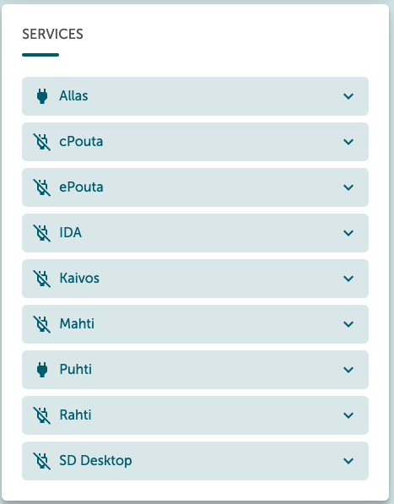
Before we start, check if everything is OK in CSC
Login to https://my.csc.fi/
Go to Projects
Click on MBDP_genomics_2024
Scroll down to Services on the right side and see if access to Puhti is enabled
Make sure you know your CSC username and password

Slide 8
Connecting to Puhti
Launch Visual Studio Code
Down left corner you will have a (green) button with "><”, click it
If not: Open Extensions (one of the icons on the left) and install Remote - SSH
Choose "Connect Current Window to Host..."
Type YOUR_USER_NAME@puhti.csc.fi and hit "Enter"
Type your password and hit "Enter"
In the following dialogue, type yes and hit "Enter"
When the down left corner says SSH:puhti.csc.fi, you're connected.

