Slide 1
Course data
MBDP-105

Slide 2
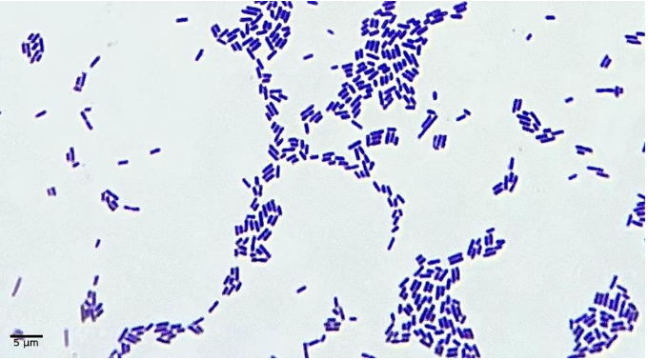
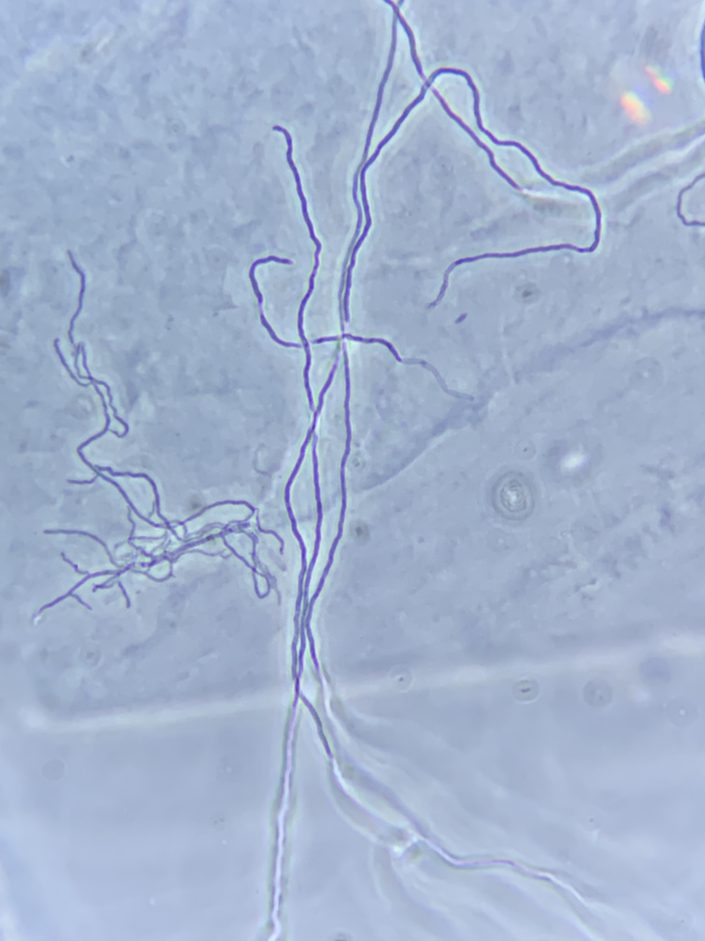
Two strains isolated at the exploraroty microbiology lab course
KLB3.1
WOD100
Isolated from 3-weel old home-made kimchi by Anssi Vuorensyrjä
600 Mbp of Illumina data
33 Mbp of Nanopore data
Isolated from soil collected in a small forest in the Viikki area in September by Alba Maria Negroni
266 Mbp of Illumina data
51 Mbp of Nanopore data

