Slide 1
Sequencing
MBDP-105

Slide 2
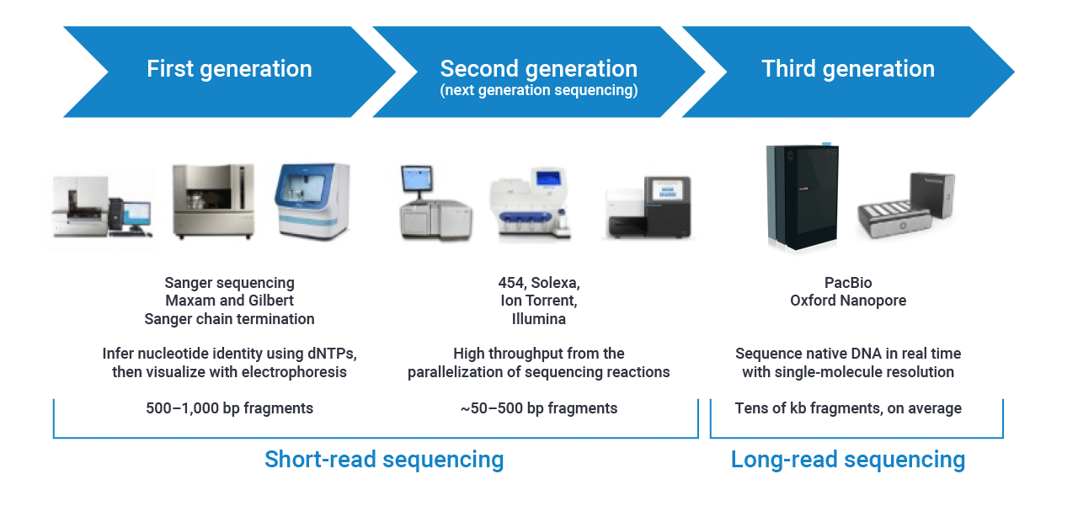
Modern sequencing techniques
https://www.pacb.com/blog/the-evolution-of-dna-sequencing-tools/

Slide 3
Short group discussion
Discuss in groups of 4-6
What are the pros and cons (1–3) of the different sequencing technologies for whole genome sequencing?

Slide 4
Short-read sequencing
Illumina

Slide 5
Illumina library preparation
Size selection
Correct amount of input DNA to avoid under- and overtagmentation
Adapter ligation
Flow cell adapters
Sequencing primers
Sequencing indexes
Optional indexes for multiplexing
Biases in the first bases have been observed
Illumina Inc.

Slide 6
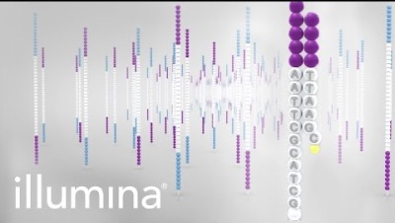
Illumina sequencing
Good compromise between size, amount and error rate of reads
The longer the reads the better.
Current long-read technologies are becoming more relevant due to lower price and better sequence quality
https://www.youtube.com/watch?v=fCd6B5HRaZ8

Slide 7
Long-read sequencing
Nanopore

Slide 8
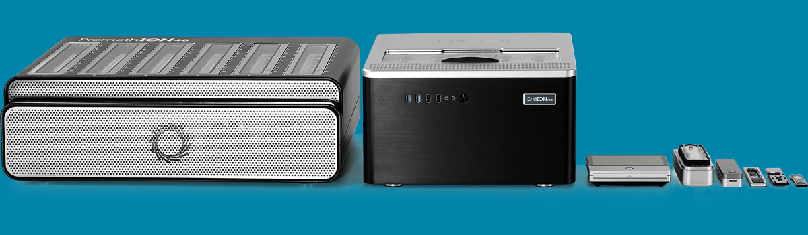
Oxford Nanopore
Different instruments, same technology
PromethION
1–48 flow cells (specific)
GridION
1–5 flow cells
MinION
1 flowcell
Flongle – smaller flow cell

Slide 9
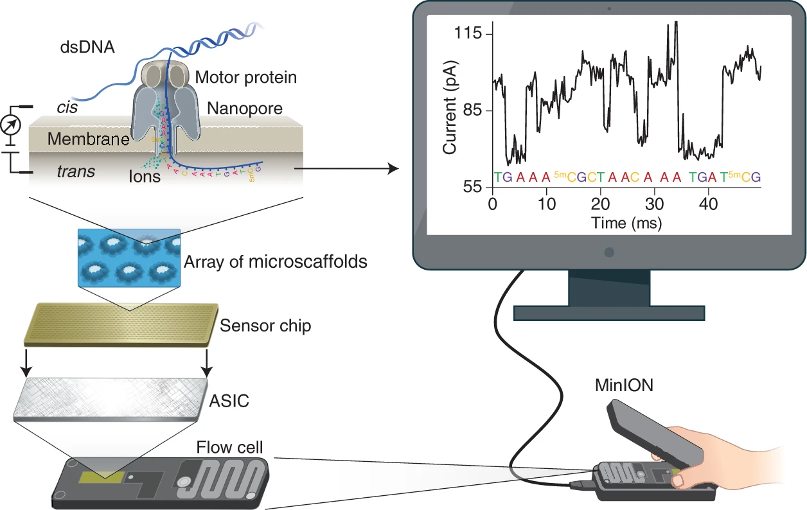
Flowcell - MinION/GridION
Flowcell has 512 channels
Each channels has 4 nanopores
~450 bases s⁻¹
Can read DNA and RNA
Applications:
Amplicon sequencing
Whole-genome sequencing (WGS)
Metagenomics
Transcriptomics
https://doi.org/10.1038/s41587-021-01108-x

Slide 10
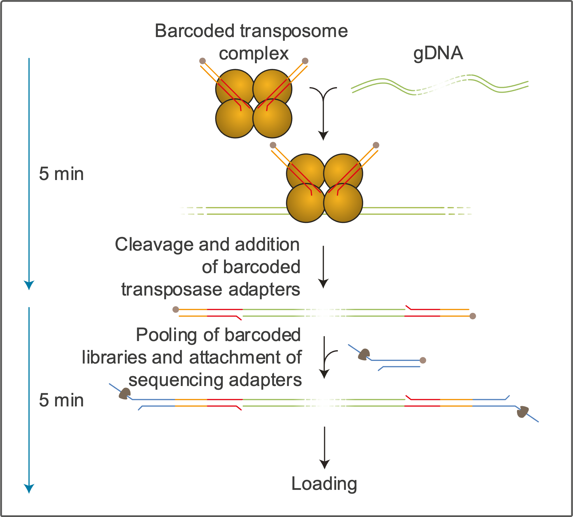
Multiplexing
Each sample will get unique barcode (24 nt)
24/96 barcodes
Sample1:
AAGAAAGTTGTCGGTGTCTTTGTG
Sample 2:
TCGATTCCGTTTGTAGTCGTCTGT
...
Demultiplexing:
Reads will be divided based on the barcode sequence

Slide 11
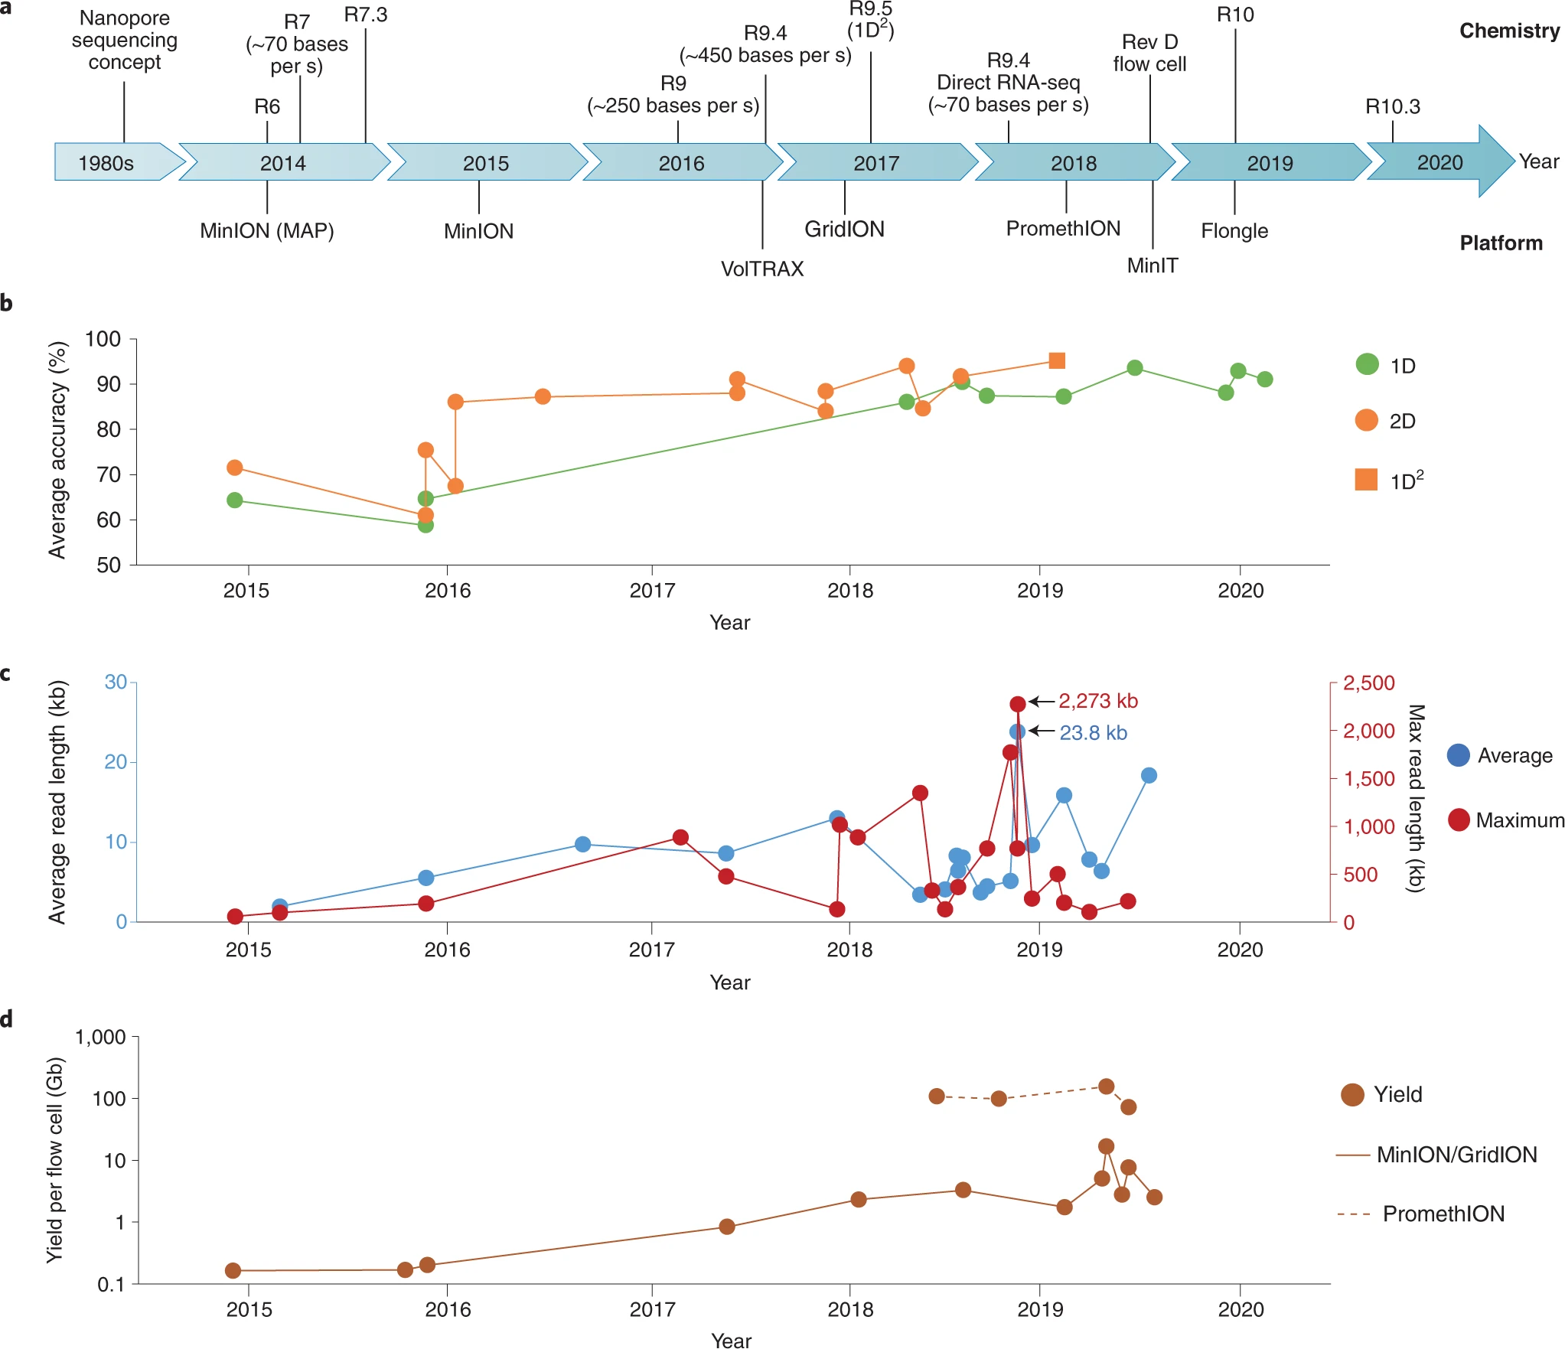
Nanopore sequence quality
R.10.4.1
~99 % accuracy
https://doi.org/10.1038/s41587-021-01108-x

