Slide 1
introduction to binning and MAGs
MBDP metagenomics course 01.05.2026
Igor Pessi

Slide 2
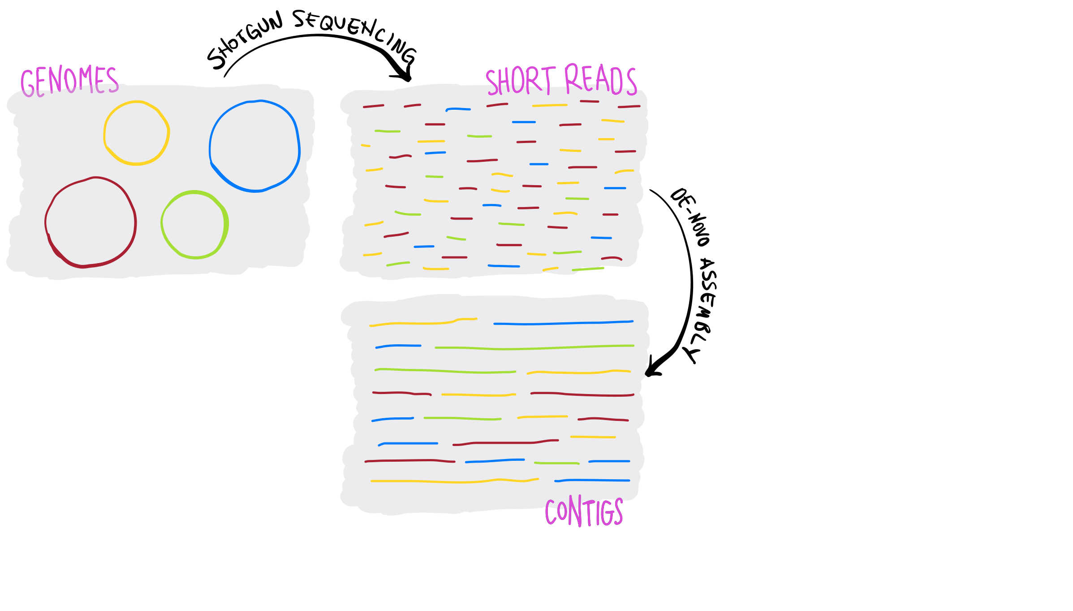
metagenomic assemblies are often highly fragmented, even with long-read sequencing
https://merenlab.org/momics/

Slide 3
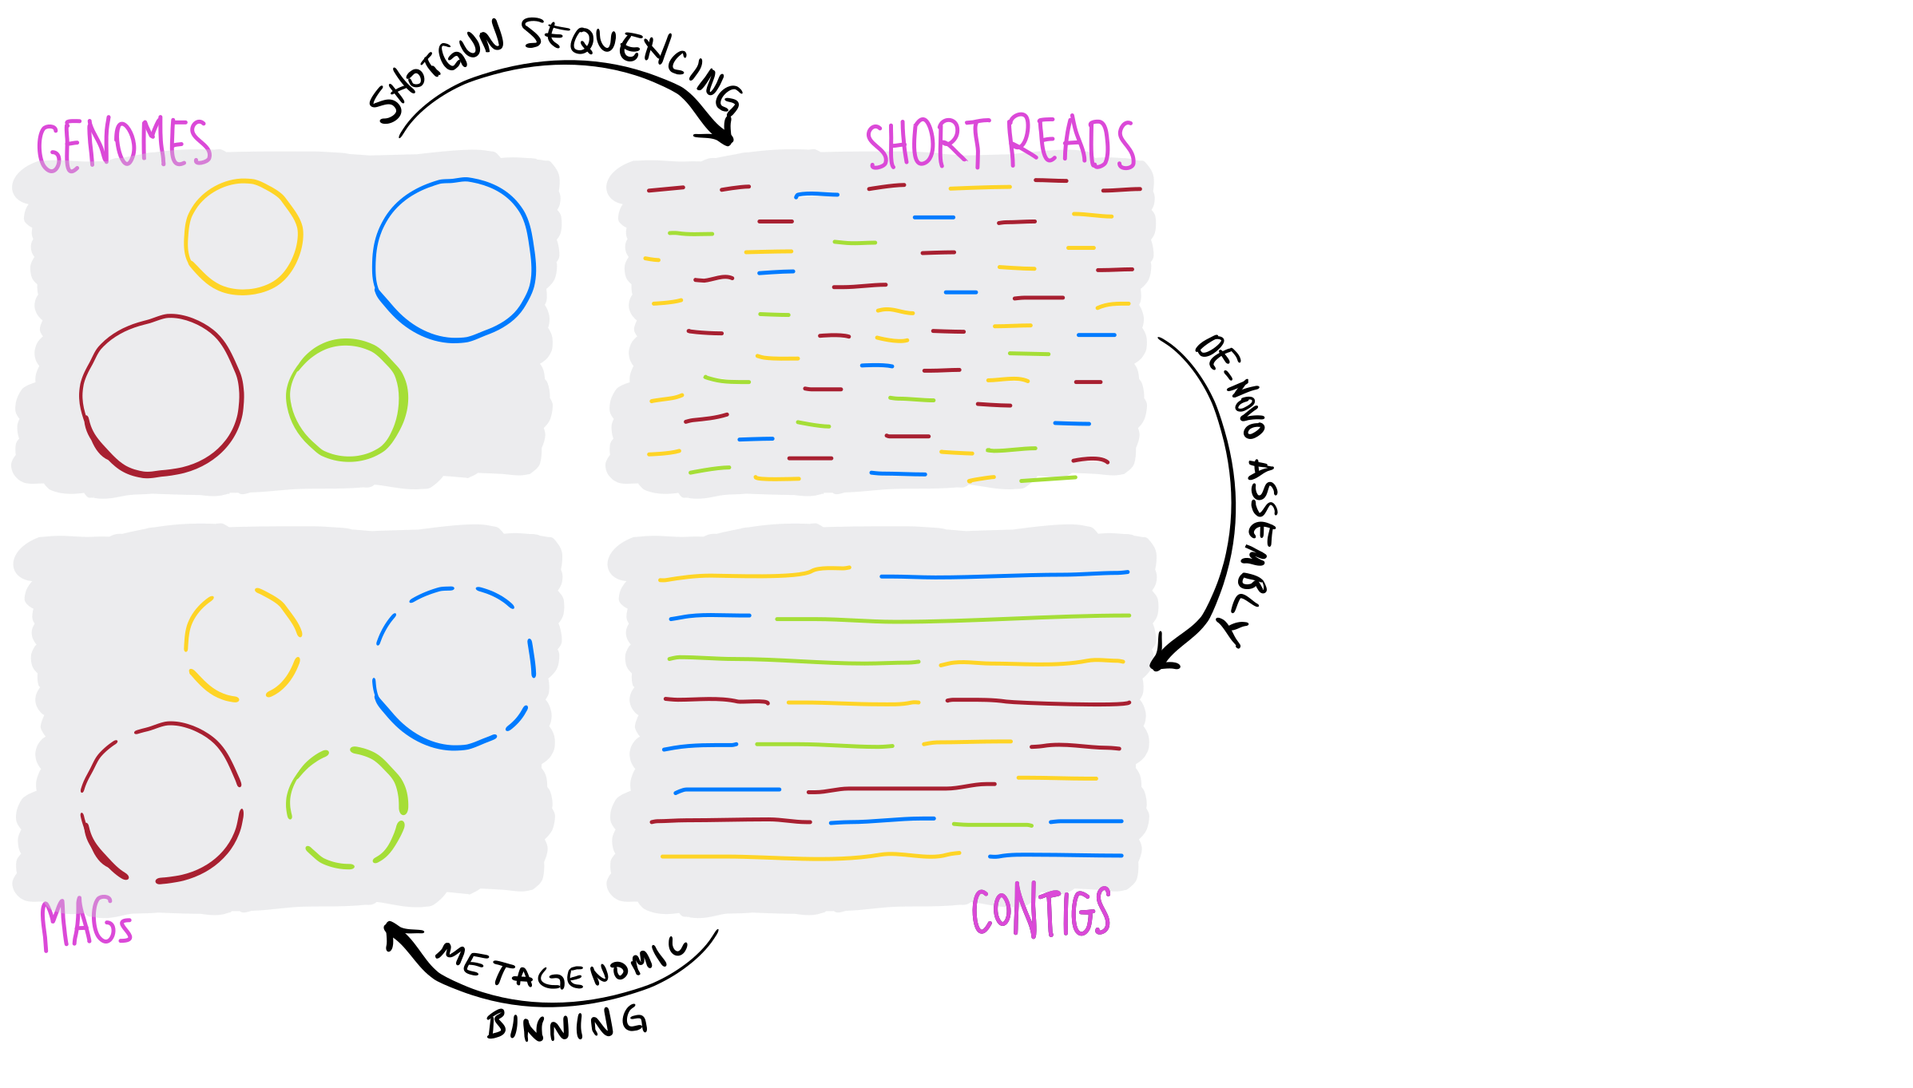
but we can group contigs that are coming from the same population
these are also known as population genomes or metagenome-assembled genomes (MAGs)
https://merenlab.org/momics/

Slide 4
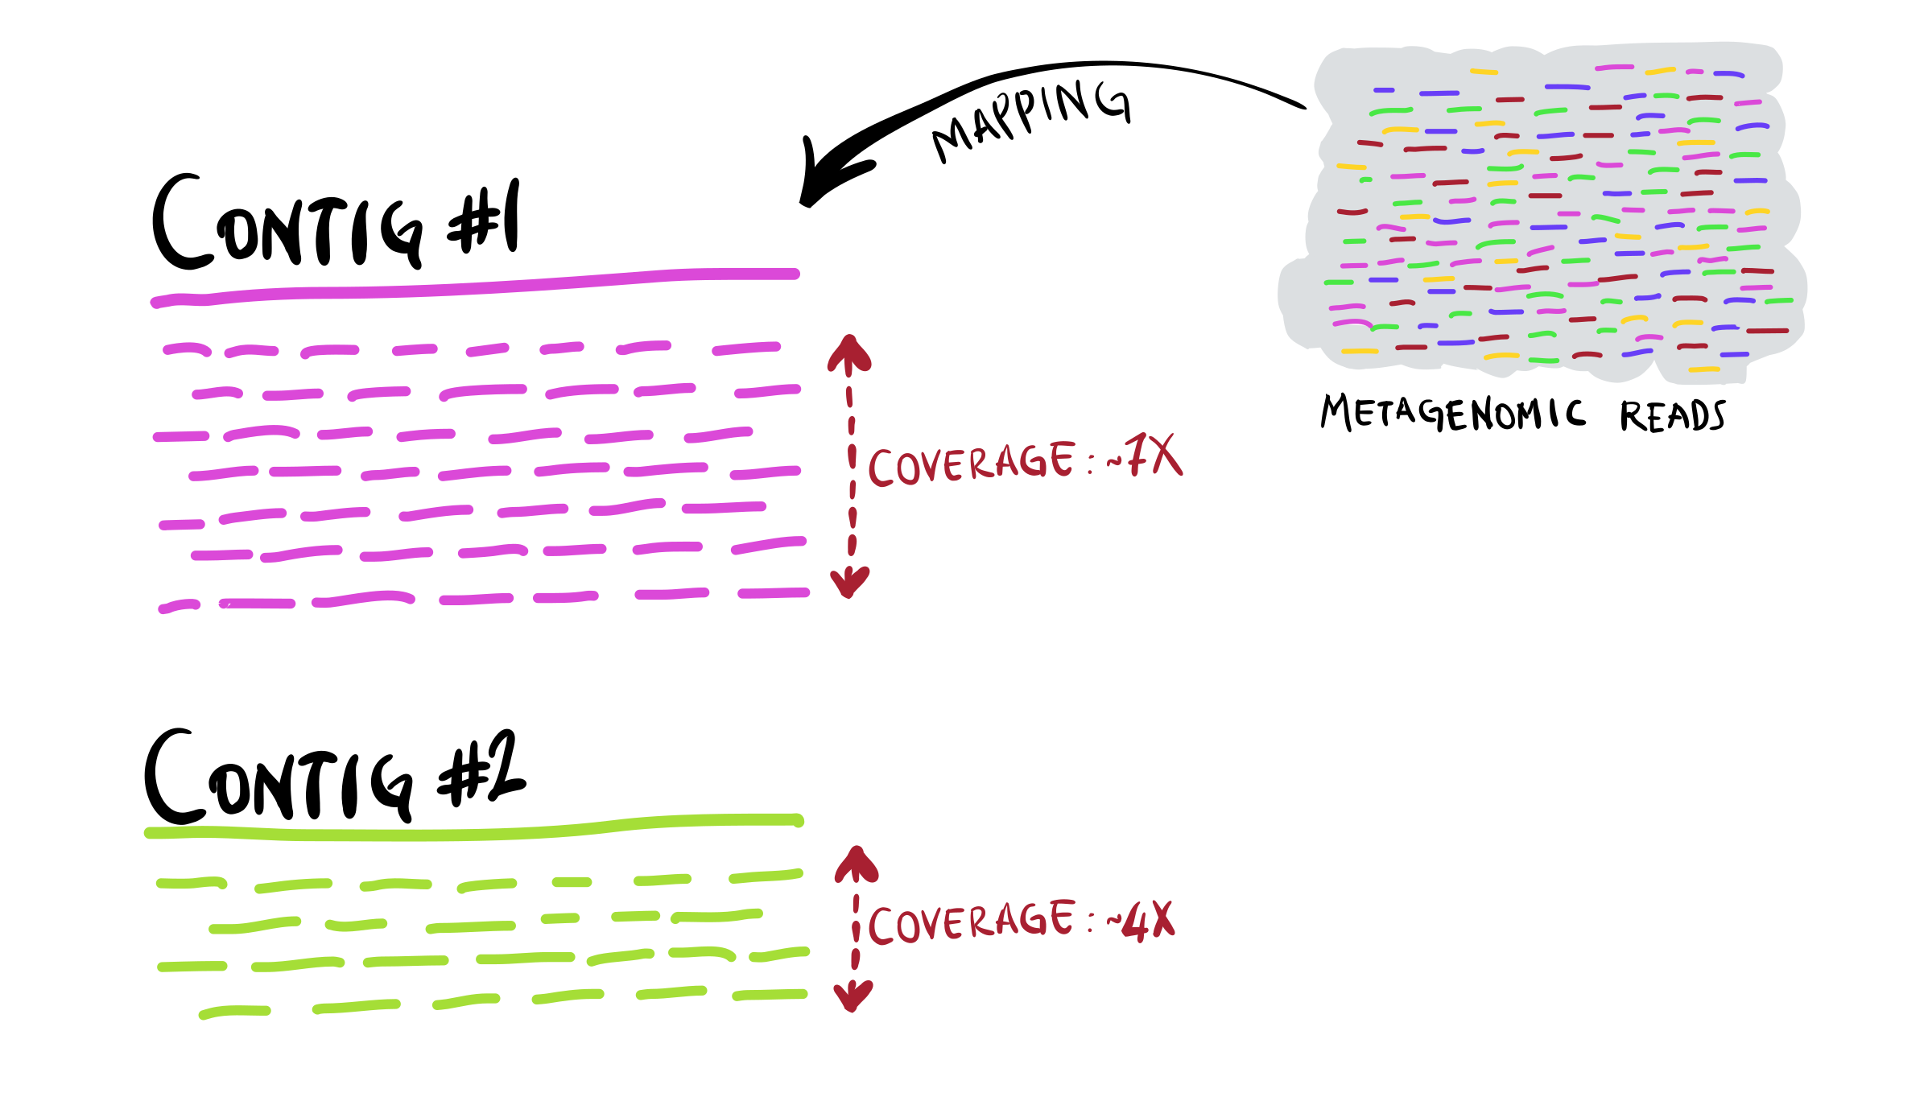
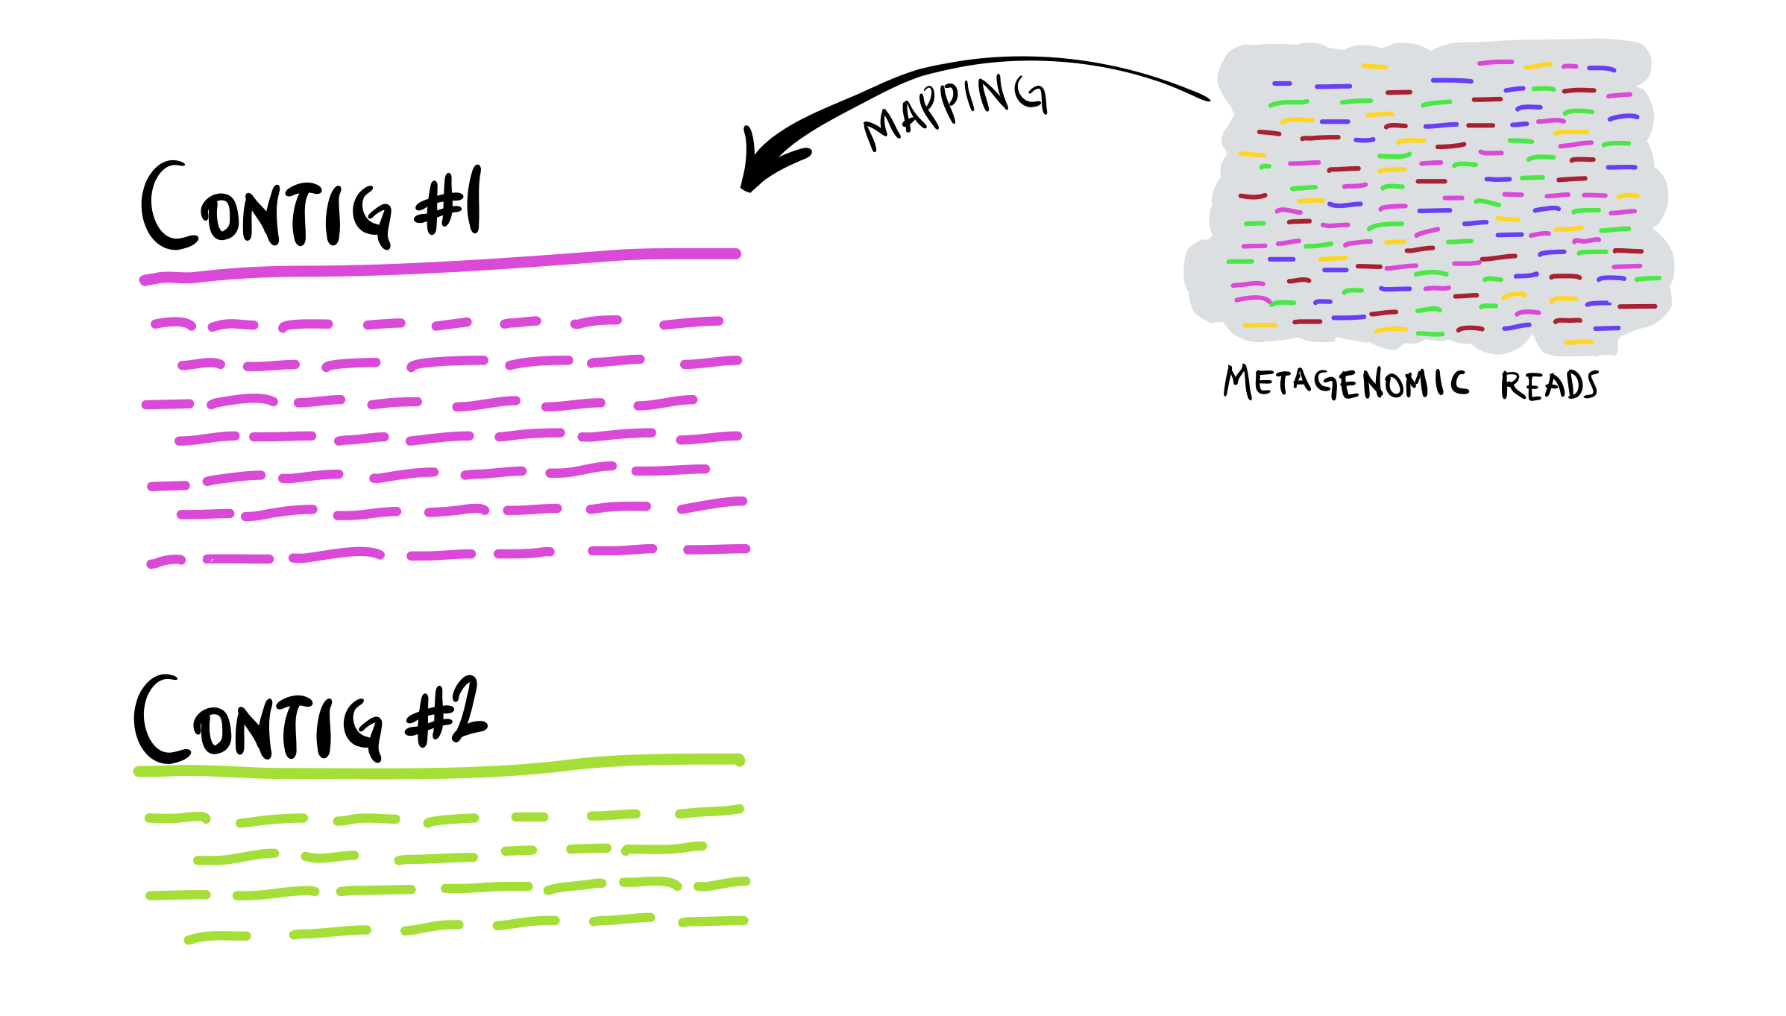
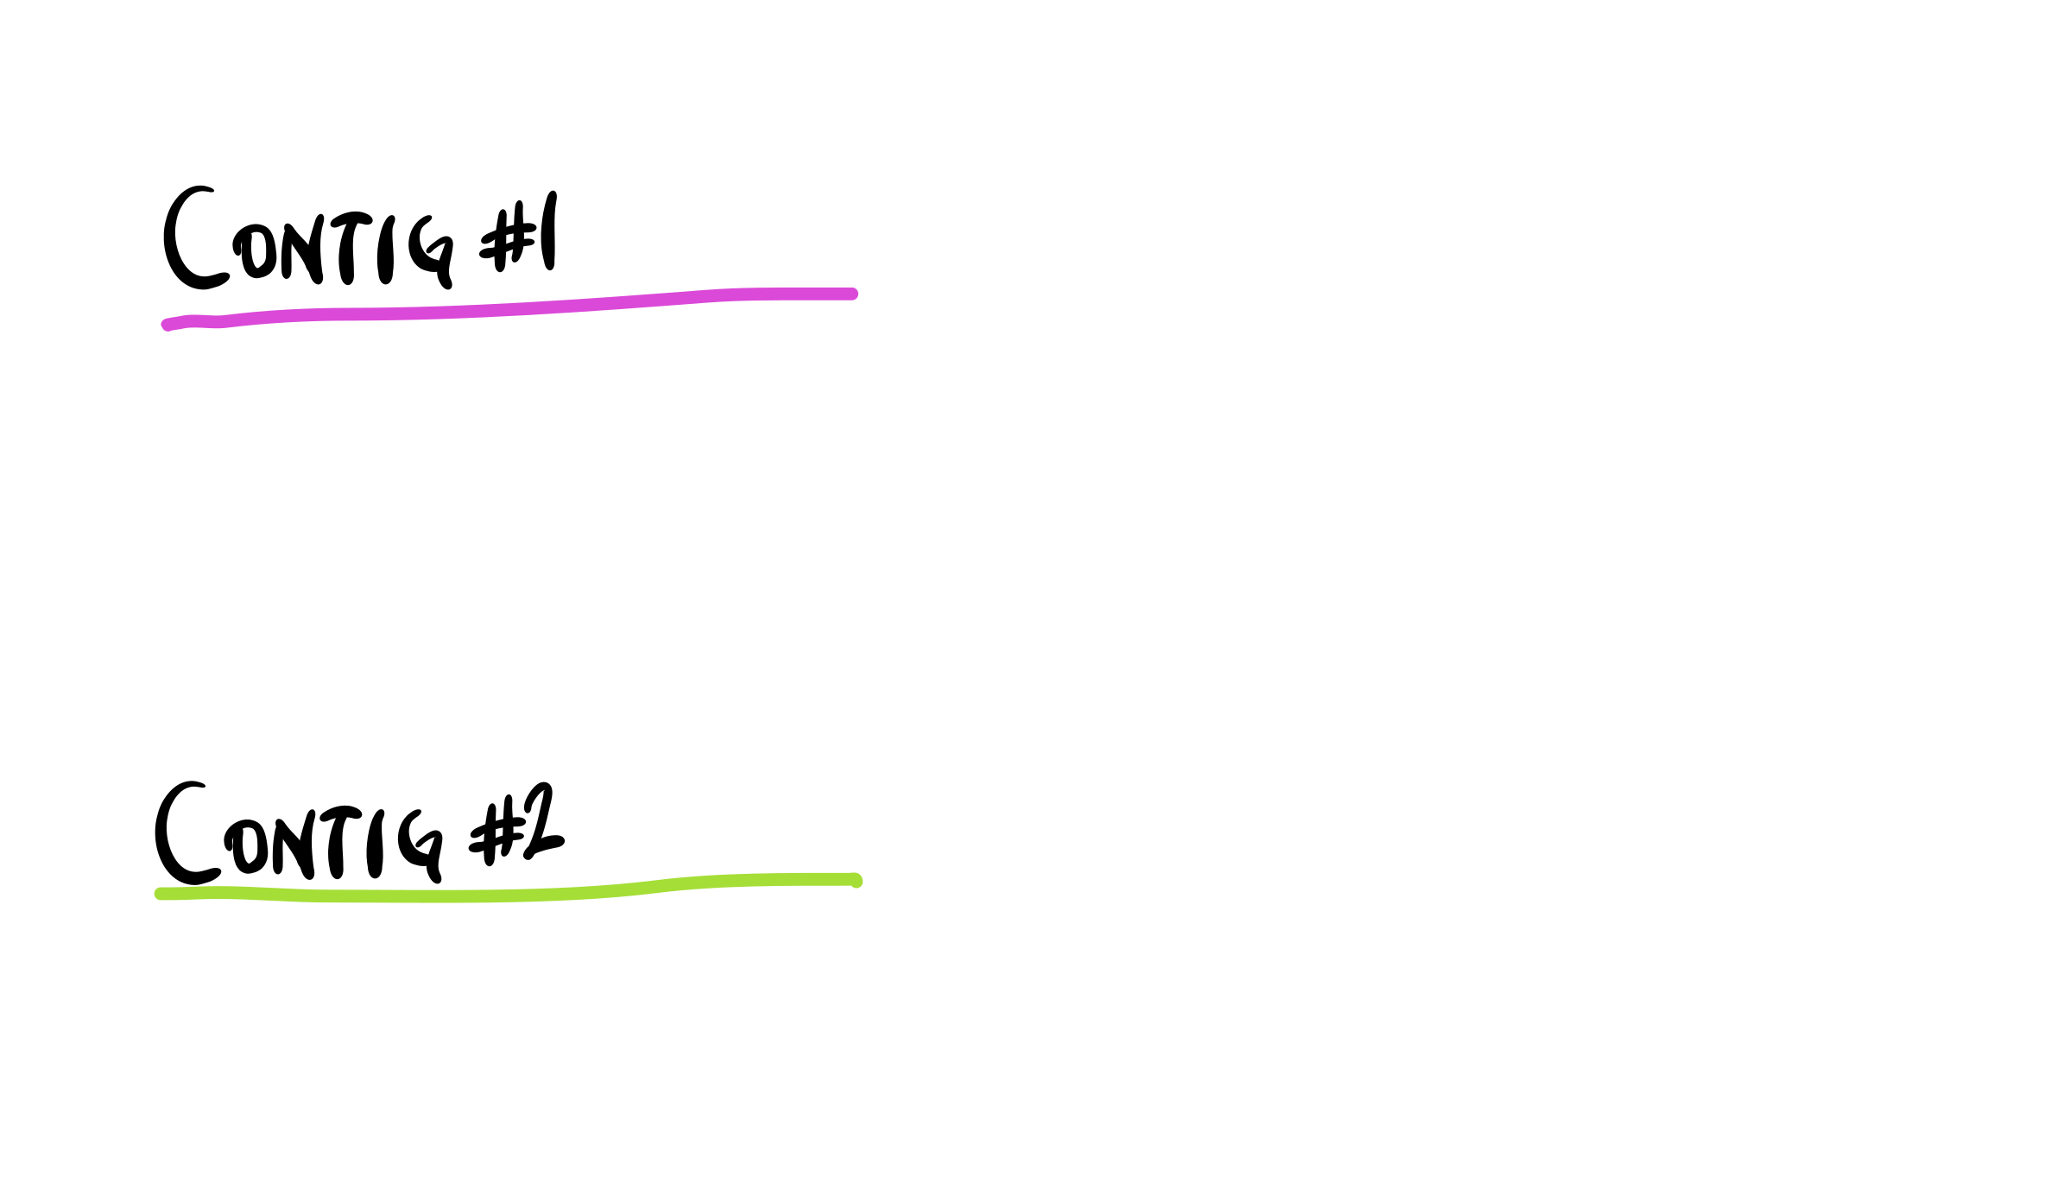
sequencing coverage
https://merenlab.org/momics/

Slide 5
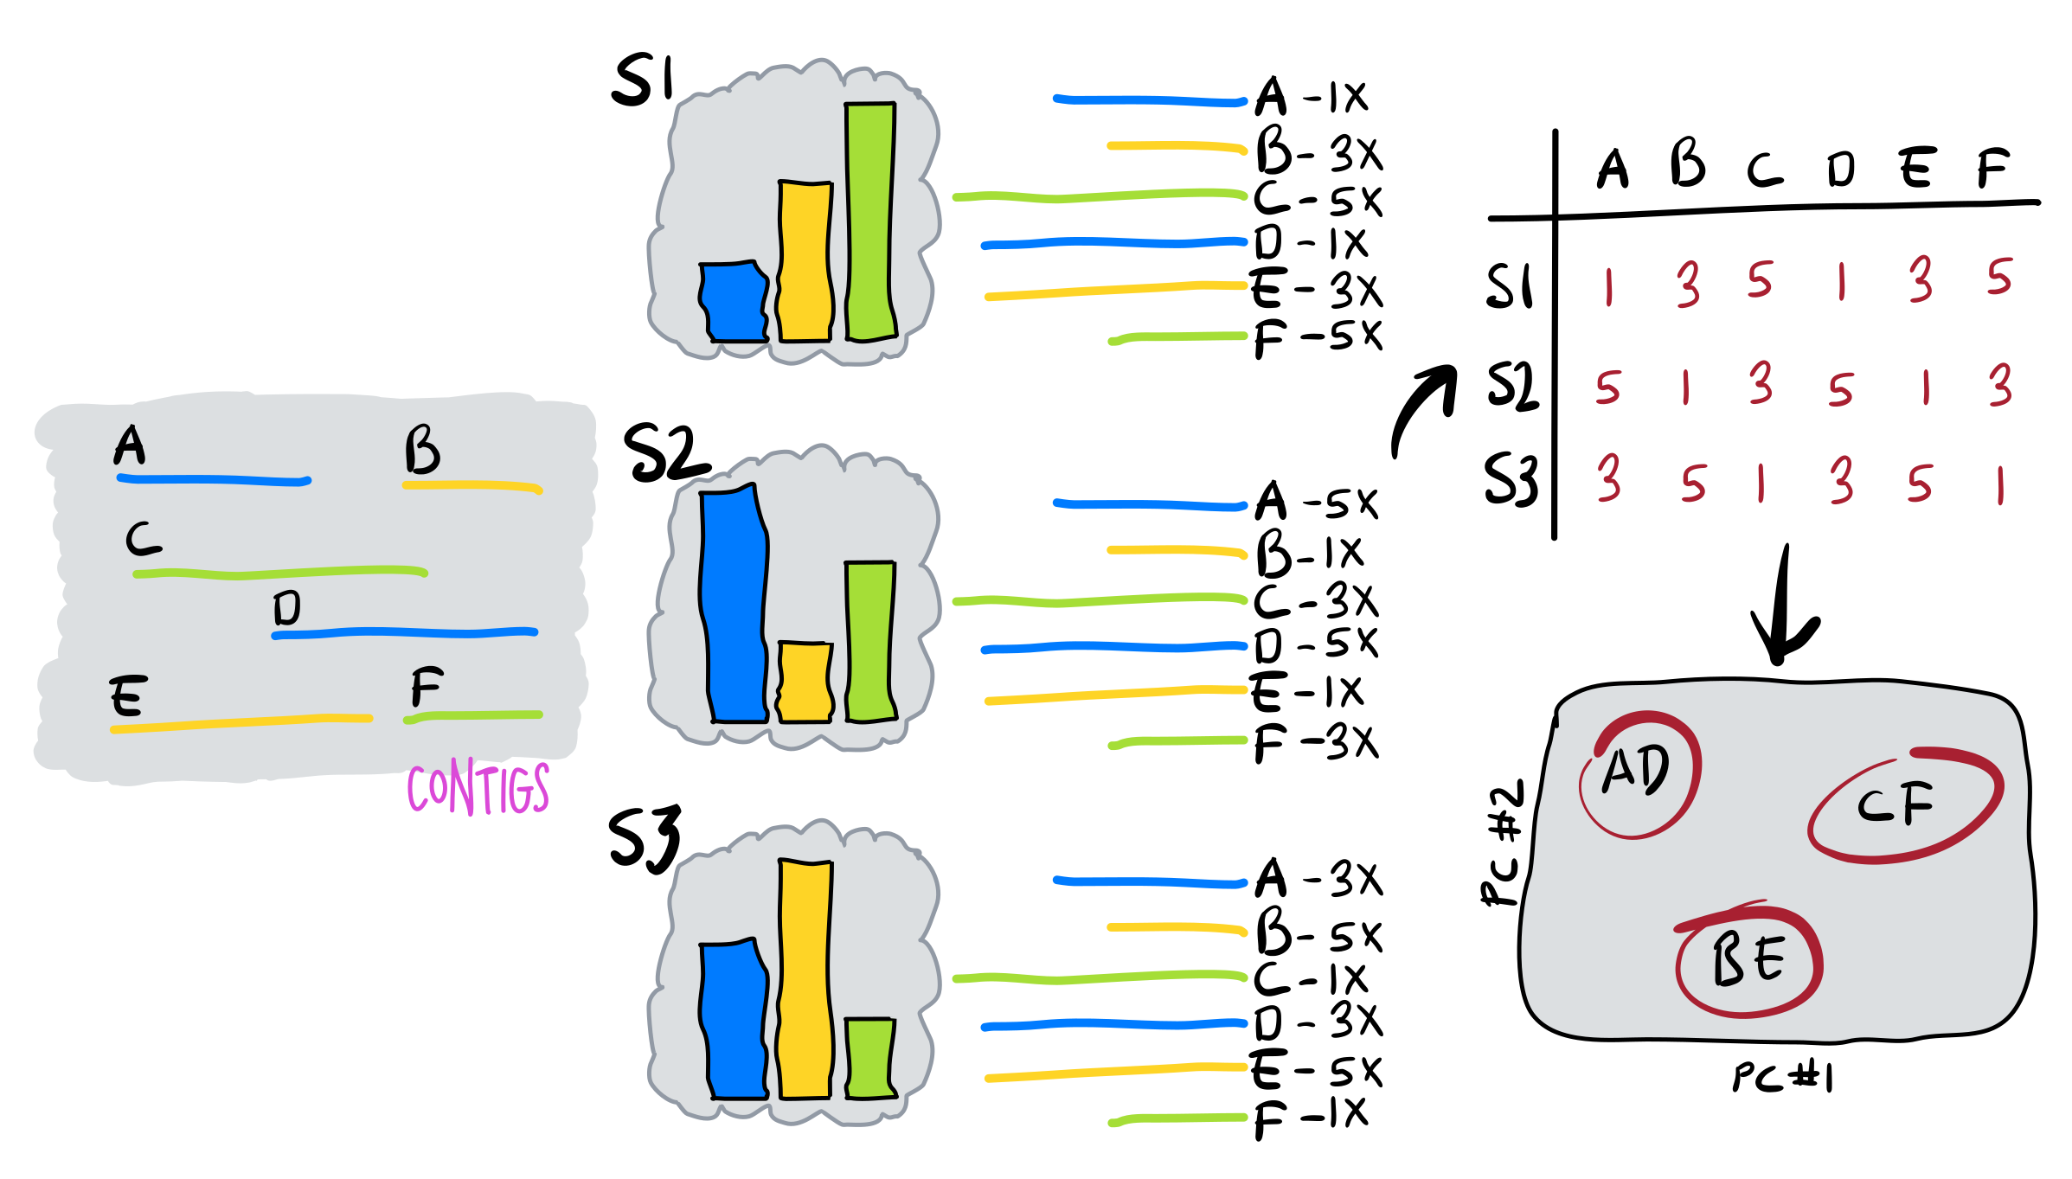
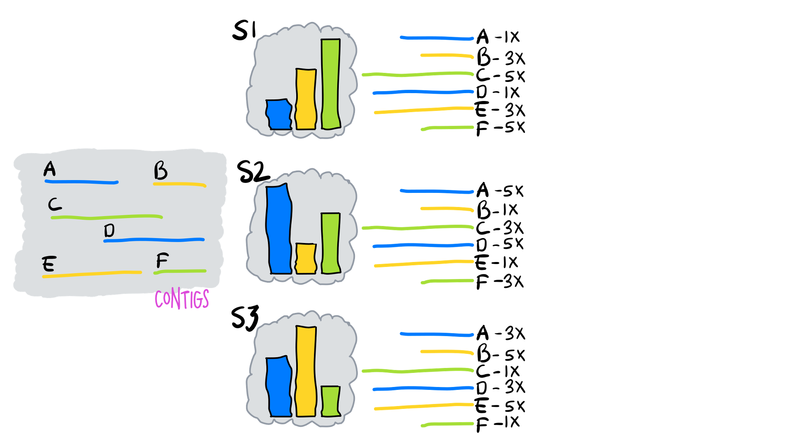
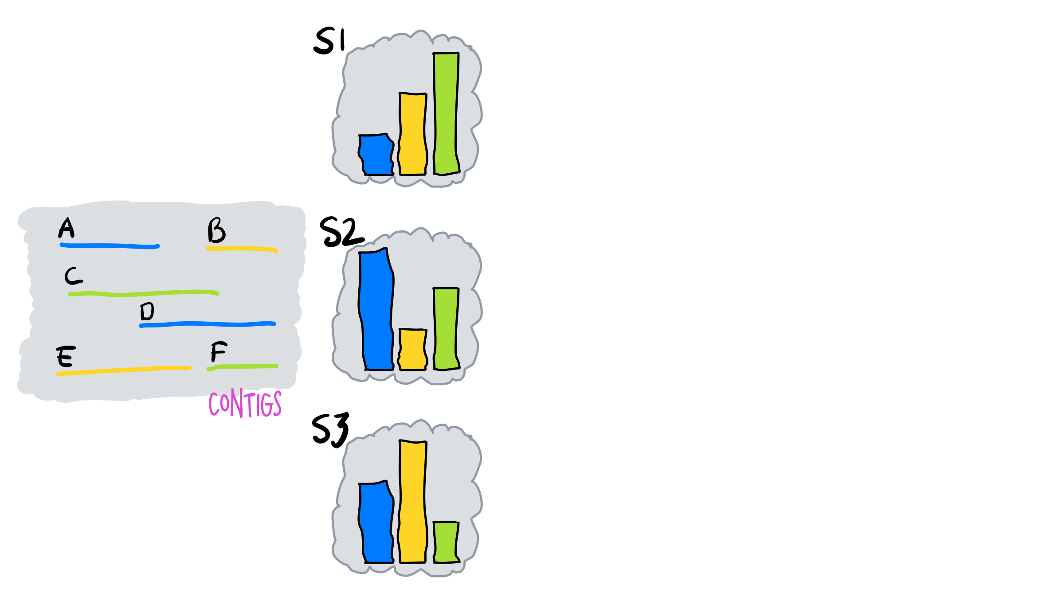
contigs coming from the same population will have similar coverage profiles across different samples
https://merenlab.org/momics/

Slide 6
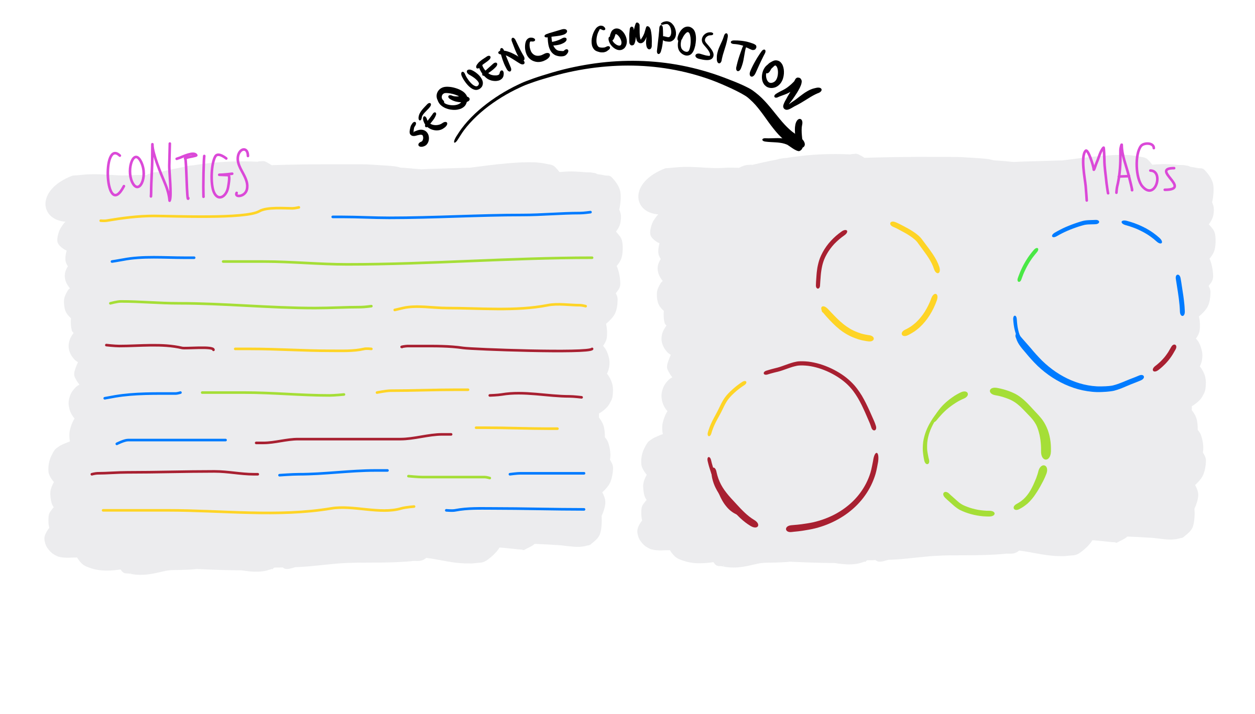
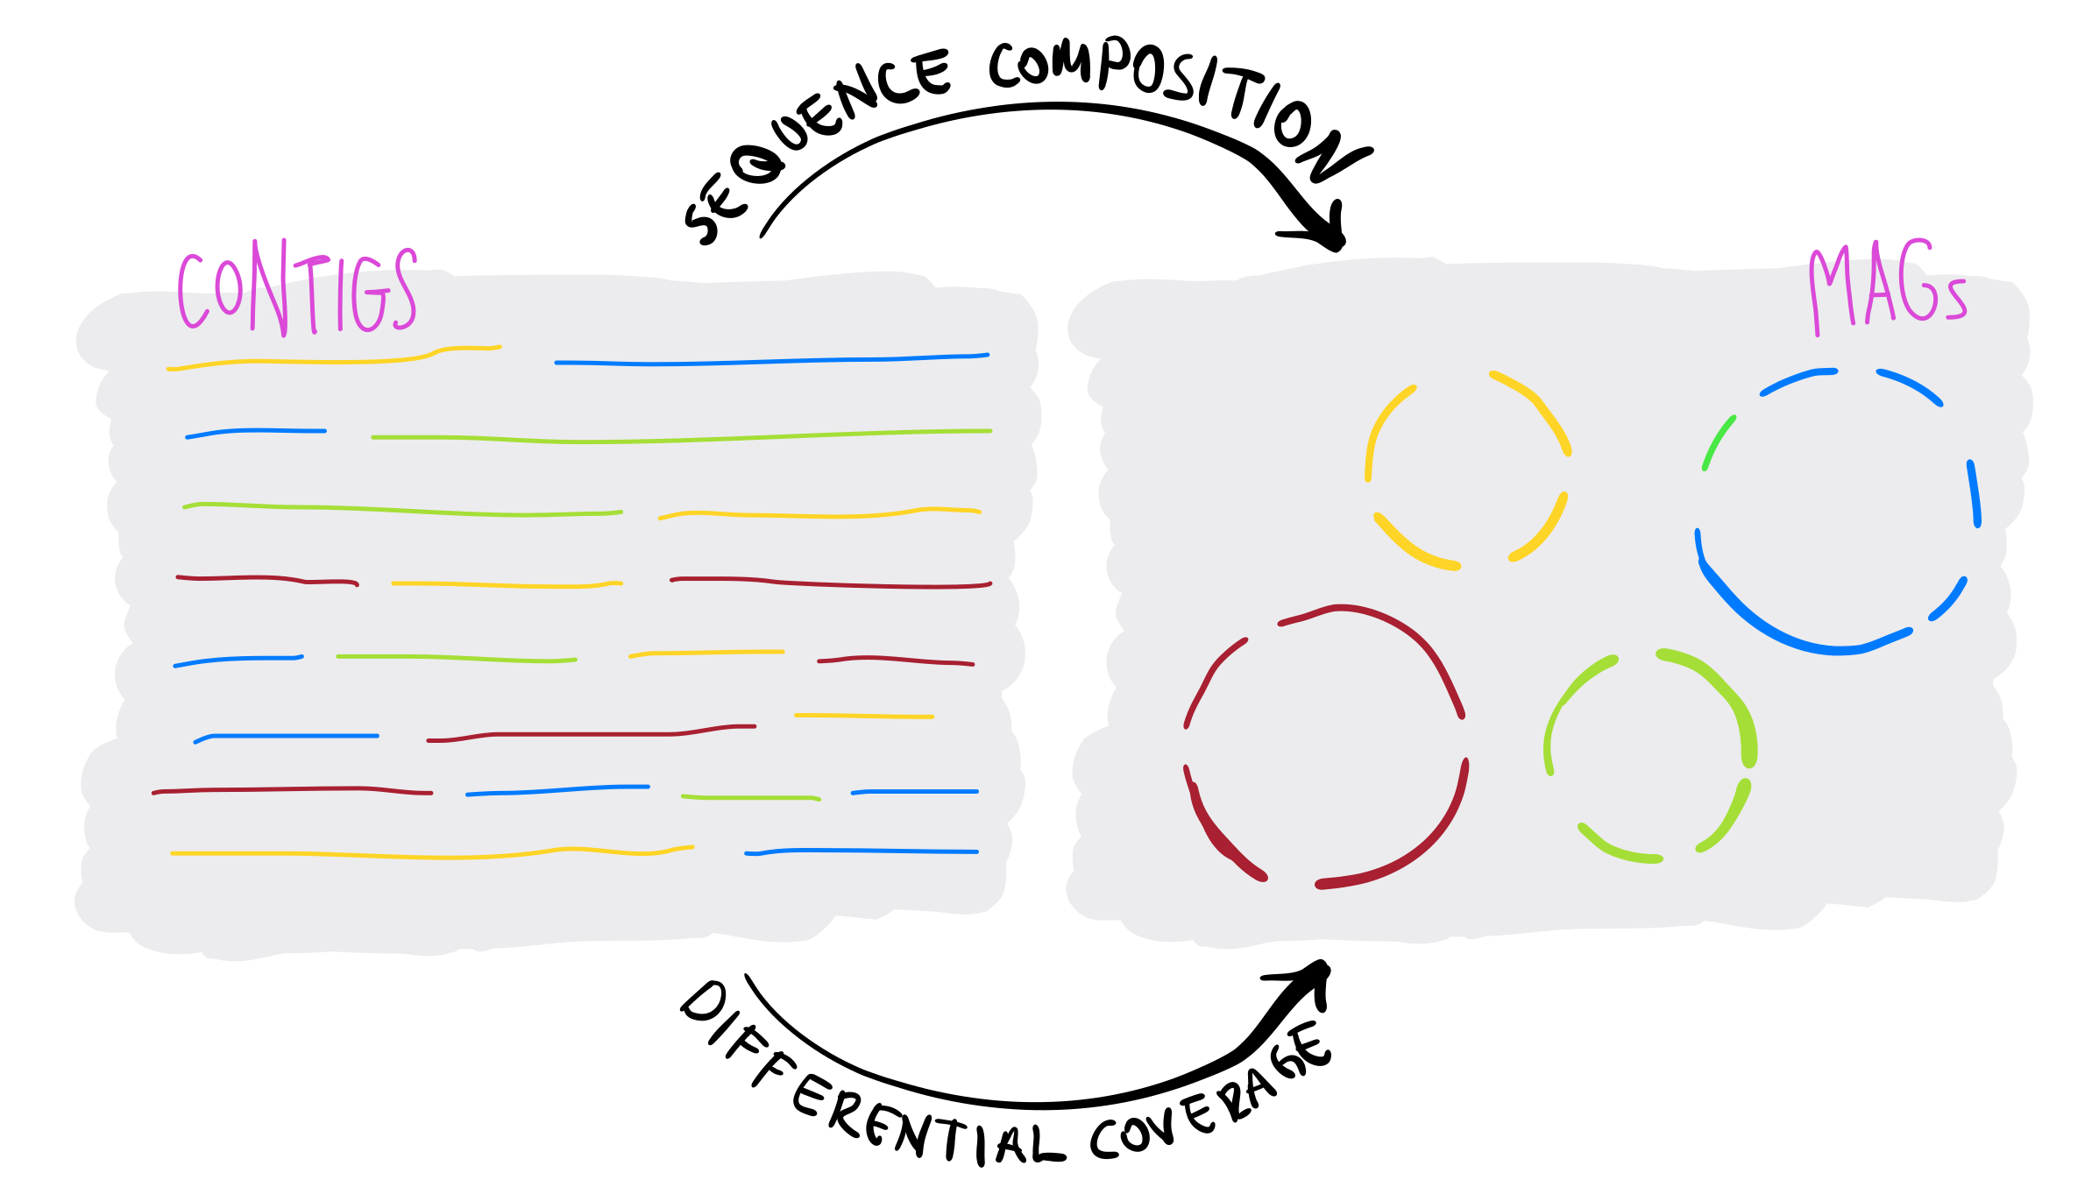
contigs coming from the same population will also share similar nucleotide composition
https://merenlab.org/momics/

Slide 7
sequence composition and differential coverage are the main concepts behind MAG binning
some binning algorithms also use taxonomic annotation and assembly graphs
machine learning algorithms are also popular
other important things
manual versus automatic binning
individual versus co-assemblies
single- versus multi-sample mapping

