Slide 2



Simple Physics-Based Locomotion
gravity force
steering force, etc.

Slide 3
Steering Behaviours
http://www.red3d.com/cwr/steer/
http://www.uxvision.it/projects/ThreeSteer/examples/index.html
https://www.youtube.com/watch?v=uqrt2zFwo_Y
https://gamedevelopment.tutsplus.com/tutorials/understanding-steering-behaviors-flee-and-arrival--gamedev-1303

Slide 4
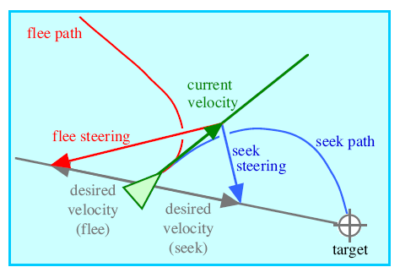
Seek & Flee

Slide 5
VELOCITY IS JUST DIRECTION!

Slide 6
VELOCITY IS JUST DIRECTION!
ACCELERATION CHANGES VELOCITY
SO ACCELERATION CHANGES DIRECTION!

Slide 7




Slide 8
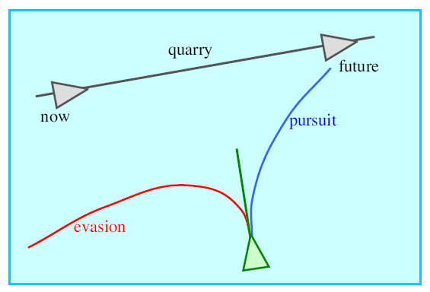
Pursue/Evade

Slide 9


Slide 10
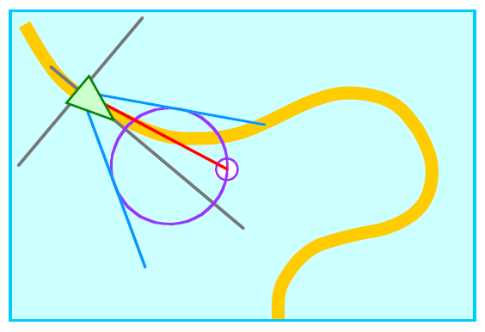
Wander

Slide 11
Pick a point on a circle just in front of you as the target
And then SEEK!

Slide 12
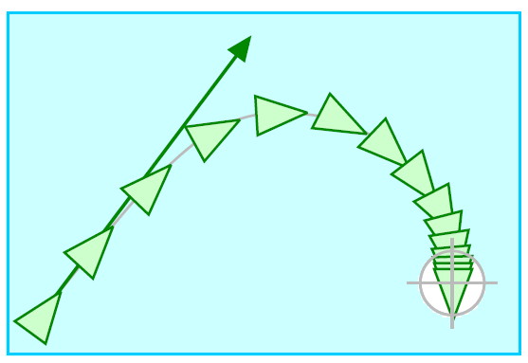
Arrive

Slide 13
Basically SEEK but when you get close to the target
You reduce your speed every frame (make your acceleration vector shorter)

Slide 14
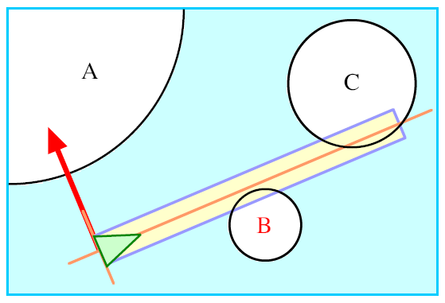
Avoidance

Slide 15
Look forward a certain distance (essentially a box)
If something collides with this box it’s a threat
Need to steer away from it!
Apply a lateral force away from the object!
Figure out which side (left/right) the object is from your vehicle
And apply a force to the left/right of your vehicle

Slide 16
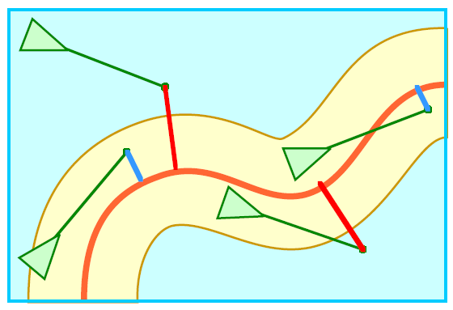
Path Following

Slide 17
Look forward some distance
Find point on your path ---- target!
SEEK towards this target
Convert your position to a distance along the path

Slide 18
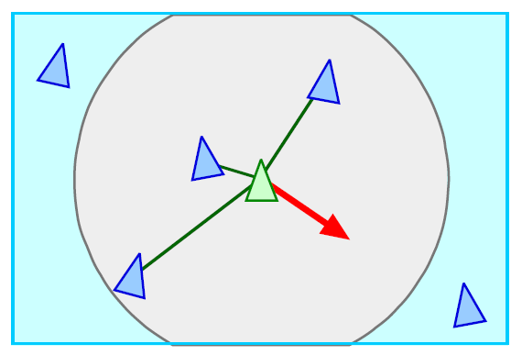
Combining Behaviours
Separation
Path Following

Slide 19
Each behavior gives you an acceleration VECTOR
Add them together and weigh them by their importance!
Path Following
Separation

Slide 20
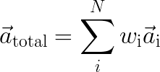
Each behavior gives you an acceleration VECTOR
Add them together and weigh them by their importance!
Linear Blend!
Path Following
Separation

Slide 21
Each behavior gives you an acceleration VECTOR
Add them together and weigh them by their importance!
Path Following
Separation

Slide 22
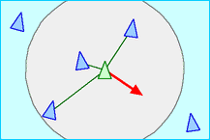
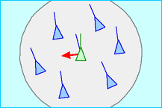
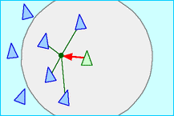
Boids
Separation
Alignment
Cohesion
http://webglboids.s3-website-us-west-2.amazonaws.com/

Slide 23
Your turn to try!
Get into groups of 2
Using either Unity or SpriteLib
Implement Seek and Flee behaviours

