Slide 1
📷
APP DASHBOARD HERO SCREENSHOT
(Paste hero screenshot of FundTracker UI or portfolio growth chart)
FundTracker Advanced:
AI-Powered Wealth & Shariah Intelligence
BanoQabil × Alibaba Cloud AI Hackathon Pakistan
Team: Fund Tracker | ID: P01090 | Lead: Muhammad Bin Jamil
Repository: github.com/MBJ420/banoqabil-alibaba-hackathon-fund-tracker

Slide 2
📷
FEATURE PHOTO / APP VISUAL
(Insert architecture visual, multi-AMC summary, or UI graphic)
PAKISTAN'S FIRST LOCAL-FIRST AI WEALTH PLATFORM
Executive Overview & Platform Vision
Core Mission
Turning scattered bank PDF statements and macroeconomic shifts into clear, inflation-beating, tax-optimized wealth decisions for Pakistani retail investors.
Target Audience
Retail and Islamic finance investors holding units across Pakistan's top AMCs — Al Meezan, HBL Asset Management, Atlas Funds, and Faysal Funds.
Key Breakthrough
Automated PDF statement parsing with missing P&L calculation, daily headless MUFAP scraping (210+ funds), AAOIFI Shariah Zakat, and 100% Alibaba Cloud Qwen 2.5 AI.
Inclusive Access
Full Roman Urdu localization and conversational AI Copilot, eliminating complex English jargon for retail investors.

Slide 3
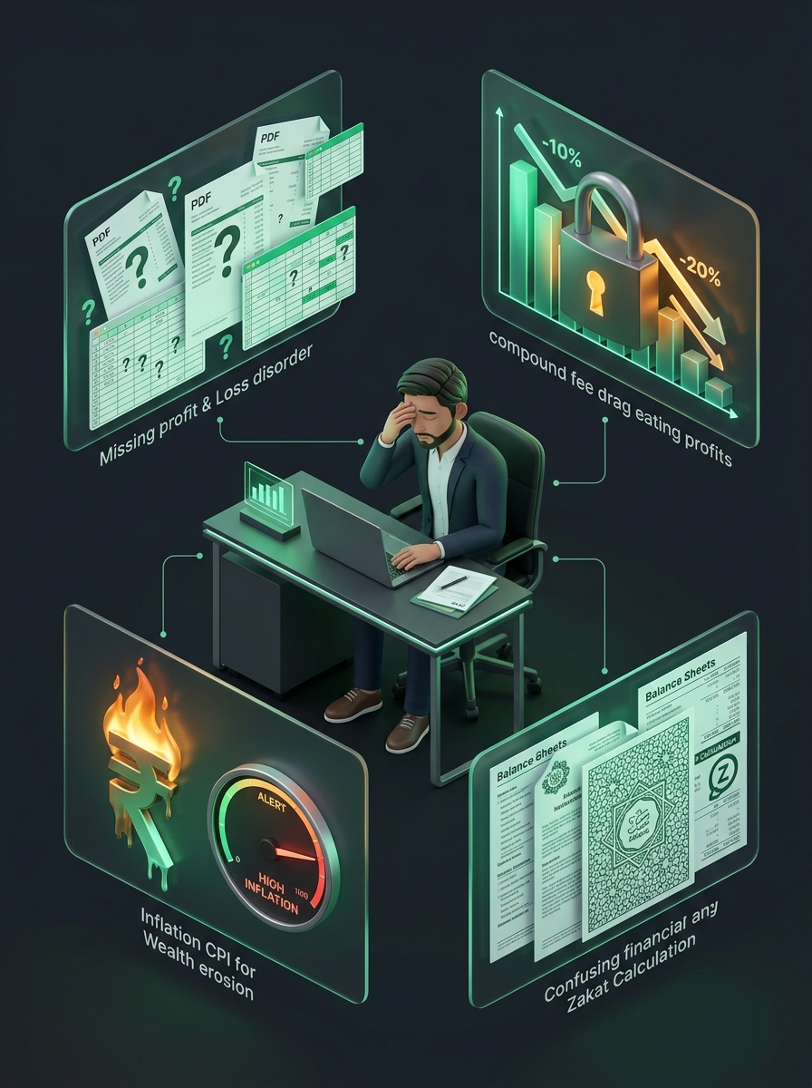
MARKET BREAKDOWN
The Core Problems: Why Pakistani Investors Lose Wealth in Silence
1. Missing P&L & Statement Blindness
Most AMC statements (e.g. HBL) omit cumulative profit/loss and purchase costs. Multi-portal tracking in Excel is tedious, error-prone, and instantly stale.
2. The Discovery Gap & 1.5–3.5% Fee Drag
Over 200+ mutual funds exist, yet investors lack tools to discover superior funds, unknowingly losing compound wealth to high Total Expense Ratios.
3. Double-Digit Inflation & News Overload
CPI inflation (12–29%) silently destroys real purchasing power, while reading voluminous economic news articles daily is exhausting and time-consuming.
4. Complex Shariah Zakat & Jargon Barriers
Calculating Zakat on equity funds requires complex working-capital deductions. Institutional English jargon alienates first-time investors.

Slide 4
INSTITUTIONAL WEALTH INTELLIGENCE DELIVERED TO YOUR LOCAL MACHINE
The Solution: FundTracker Advanced
📊
Unified Multi-AMC & P&L Tracker
Consolidates Meezan, HBL, Atlas, and Faysal accounts into one screen; computes missing profit/loss, cost basis, and real yields.
💻
Local-First & Absolute Privacy
Runs locally on Electron & SQLite WAL. Sensitive monetary balances, CNIC, and bank account numbers never leave the user's PC.
📄
Automated Statement Ingestion
Watches folders for bank e-statement PDFs; extracts fund units, purchase values, and closing balances without manual typing.
🕌
AAOIFI Shariah Zakat Terminal
Dynamically deducts illiquid fixed assets (~28% working capital ratio on equities) and computes lunar/solar Zakat and Nisab.
📈
Live MUFAP Scraper & Discovery
Scrapes daily closing NAVs for 210+ funds; benchmarks holdings against top-quartile peers to reveal outperforming alternatives.
🤖
100% Alibaba Cloud & Roman Urdu
Qwen 2.5 powers two-pass macro news impact forecasting and conversational advice natively in English and Roman Urdu.

Slide 5
ELIMINATING MANUAL EXCEL & STATEMENT BLINDNESS
Automated Statement Ingestion & P&L Reconstruction
How the Ingestion Engine Operates
• Watchdog Folder Monitor: Watches 'Fund Tracker PDF Data/' subfolders (Meezan, HBL, Atlas, Faysal) and ingests new statements automatically.
• Native pdfplumber Extraction: Extracts digital text layers directly without external OCR latency or cloud privacy exposure.
• Missing P&L Ledger Reconstruction: Reconstructs cost basis and unrealized gain/loss for AMCs like HBL that omit profit on statements: P&L = (Current NAV - Cost NAV) × Units.
• Auditable SQLite Ledger: Stores historical statements for instant auditing, editing, or re-parsing anytime.
📷
STATEMENT UPLOAD & P&L RECONCILER GUI
(Insert screenshot of PortfolioDataManagerModal or Statement Ledger UI)

Slide 6
AUTOMATED HEADLESS BROWSER INGESTION & PEER BENCHMARKING
Daily MUFAP Headless Scraper & Outperformer Discovery
Market Grounding & Peer Intelligence
• The Web Challenge: MUFAP renders tables dynamically via JavaScript and employs Cloudflare bot mitigation. Standard HTTP GET requests fail with 403 Forbidden.
• Playwright Headless Chromium: Automated browser engine with realistic user headers and WindowsProactorEventLoopPolicy reliably extracts tables.
• Daily 6:00 PM PKT Cron: APScheduler triggers once daily when AMCs upload closing valuations, syncing 210+ mutual funds with zero manual work.
• Cross-AMC Outperformer Discovery: Scans same-category peers (Equity, Cash, Sukuk) and alerts investors if a peer fund generates superior Sharpe ratio or yields.
📷
FUND PERFORMANCE & PEER DISCOVERY GUI
(Insert screenshot of fund performance table or outperformer suggestion card)

Slide 7
ENTERPRISE CLOUD AI DELIVERING SOVEREIGN FINANCIAL INTELLIGENCE — INTEGRATED VIA DASHSCOPE API (QWEN-PLUS / QWEN-MAX)
100% Alibaba Cloud Model Studio (Qwen 2.5) AI Architecture
1
FMR Document Parser
Combines PyMuPDF (fitz) text extraction with Qwen 2.5 structured JSON formatting.
Extracts fund risk ratings (Low/Moderate/High), asset allocation strings, and historical returns from monthly PDF Fund Manager Reports.
2
Two-Pass Macro News Engine
Pass 1 (World Context): Qwen 2.5 tracks ongoing macro developments (SBP Policy Rate, IMF loans) in persistent memory using KEEP, AMEND, RESOLVE directives.
Pass 2 (Sector Impact): Forecasts market direction (Bullish/Bearish) and impact scores (0-10) across Equities, Money Market, and Gold over Short, Med, and Long horizons.
3
Zero-Knowledge Copilot
Structured reasoning over asset concentration, macro drift, and fee drag under an airtight zero-knowledge contract.
Generates ranked rebalancing recommendations and portfolio health scores (0-100) natively in English and Roman Urdu.

Slide 8
ABSOLUTE MATHEMATICAL PRIVACY VIA LOCAL SANITIZATION ENVELOPES
Zero-Knowledge AI Financial Privacy Architecture
Stage 1: Local Data Store
ON USER MACHINE ONLY
• Raw bank statements parsed into local SQLite.
• Total Net Worth: PKR 4,850,000.
• Account numbers, CNIC, and holder name.
• Strictly quarantined on the user's PC.
• NEVER transmitted over the network.
Stage 2: Sanitization Filter
LOCAL BACKEND SHIELD
• Backend strips ALL PKR currency balances.
• Strips account numbers and user identities.
• Calculates relative % allocations only.
• Example: Equity 58.4%, Money Market 41.6%.
• Appends live macro market context.
Stage 3: Cloud Reasoning
ALIBABA CLOUD DASHSCOPE
• Cloud model receives sanitized % values only.
• Evaluates risk score (0-100) & asset drift.
• Contextualizes with SBP interest rate cycle.
• Outputs strictly validated JSON diagnosis.
• Zero personal wealth data ever exposed.

Slide 9
DYNAMIC WORKING CAPITAL DEDUCTIONS FOR EQUITY & HYBRID FUNDS
AAOIFI Shariah-Compliant Zakat & Purification Engine
Authentic Shariah Implementation
• The Fiqh Ruling (AAOIFI Standard 35): Shares represent business ownership. Zakat is due ONLY on liquid working capital (cash, receivables, inventory), NOT on illiquid fixed assets (plants, land, machinery).
• Dynamic Equity Working Capital Deduction: Applies a prudent ~28% ceiling on equity fund values (Zakatable Base = Market Value × 28%), while applying 100% to liquid cash and Sukuk funds.
• Balanced Funds Blended Ratio: Applies 70% cash/debt (100%) + 30% equity (28%), creating an effective ~64% blended zakatable ratio.
• Nisab & Calendar Standards: Live/configurable Silver (52.5 tolas) and Gold (7.5 tolas) thresholds; supports Lunar Hijri (2.5%) and Solar Gregorian (2.577%) calendars.
• Section 60 Tax Deduction Certificate: Generates printable certificates for claiming statutory income tax relief under Section 60 of the Income Tax Ordinance.
📷
SHARIAH ZAKAT TERMINAL GUI SCREENSHOT
(Insert screenshot of IslamicZakatModal.tsx (Nisab, holding table, and Zakat due))

Slide 10
SOVEREIGN TAX LAW & WEALTH MATH
Finance Act 2024 Tax Optimizer & Inflation Simulator
Capital Gains & Pension Optimization
• FBR 2024-25 Salaried Tax Slabs: Models tiered income tax brackets from 0% (up to Rs 600k) through 5%, 15%, 25%, 30%, up to 35% top bracket.
• Section 37A Capital Gains Tax: 15% for Active Tax Filers vs 30% punitive rate for Non-Filers (100% tax surcharge).
• Tax-Loss Harvesting: Under FBR rules, losses on underperforming funds offset profits on winning funds before tax is calculated.
• Section 63 VPS Pension Advisor: Calculates exact rupee salary tax rebates when investing in approved pension funds (up to 20% taxable income relief).
• Inflation vs Investment Simulator: Fisher formulation: Real Purchasing Power = Nominal FV / (1 + CPI)^t based on SBP historical prints.
📷
TAX OPTIMIZER & PENSION GUI SCREENSHOT
(Insert screenshot of TaxOptimizer.tsx (FBR slabs, Pension 20% Advisor))

Slide 11
REVEALING WHETHER YOUR FUND MANAGER JUSTIFIES THEIR FEES
Benchmark Alpha & Fee Drag Analyzer
The Active vs Passive Dilemma
Pakistani asset managers charge 1.5% to 3.5% annually in Total Expense Ratios (TER). Over 10 years, a 3% fee consumes over 25% of compound returns.
Mathematical Formulations
• Gross Jensen's Alpha: Gross Alpha = Fund Return - Benchmark Return (vs KSE-100 / KMI-30).
• Net Alpha (Fee Drag): Net Alpha = Gross Alpha - Total Expense Ratio (TER).
• Sharpe Ratio: Risk-adjusted return relative to Pakistan's risk-free treasury baseline.
📷
BENCHMARK ANALYZER GUI SCREENSHOT
(Insert screenshot of BenchmarkAnalyzer.tsx (alpha chart & fee comparison table))
Great Value
Fair Value
Overpriced

Slide 12
BREAKING DOWN JARGON BARRIERS FOR PAKISTANI RETAIL INVESTORS
Inclusive Financial Literacy & Roman Urdu Localization
Financial Inclusion Through Local Language
• The Jargon Barrier: Financial terms like NAV, TER, Jensen's Alpha, and Asset Allocation intimidate retail investors who lack formal finance backgrounds.
• Bilingual LanguageContext: Instant UI language toggle switching between English and intuitive Roman Urdu ('Maliyati Intelligence', 'Kul Nafa / Nuqsan', 'Mehngai Simulator').
• Bilingual AI Copilot: Integrated /dashboard/copilot accepts questions and replies fluently in Roman Urdu, providing culturally grounded investment guidance.
• Plain-Language Ratio Guides: Interactive tooltips and educational callouts explain how mutual funds work, enabling beginners to make informed, confident choices.
📷
ROMAN URDU UI & AI COPILOT SCREENSHOT
(Insert screenshot of Roman Urdu dashboard or FinancialCopilotModal in Urdu mode)

Slide 13
FULL-STACK SYSTEM DESIGN
Technical Architecture & Concurrency Engineering
Desktop Client Layer
Electron + React 18
• Native Electron window with no browser required
• React 18 + TypeScript bundled via Vite
• Bilingual LanguageContext (English ↔ Roman Urdu)
• ApexCharts interactive time-series NAV tracking
Backend API Engine
FastAPI + Python 3.12
• Asynchronous worker thread dispatching
• JWT auth & multi-user portfolio scoping
• Batched query optimization (95% fewer DB calls)
• Argon2 password hashing & input sanitizers
Embedded Database
SQLite in WAL Mode
• PRAGMA journal_mode=WAL (Zero Read Locks)
• PRAGMA busy_timeout=5000ms & Synchronous Normal
• Composite indexes on (fund_id, date)
• Non-blocking reads during background writes

Slide 14
LIVE CODEBASE & DATABASE VERIFICATION
Production Footprint & Verified System Metrics
210+
Verified Mutual Funds
Seeded and mapped across Meezan, HBL, Atlas, and Faysal
1,770+
Daily NAV History Records
Historical time-series prices indexed in SQLite WAL database
1,770+
Performance Metric Records
1-Month, 6-Month, 1-Year, and YTD return records
18
Statement Audit Records
Complete transaction ledger tracked in SQLite database
26
Macro News Articles
Processed from Dawn & Business Recorder financial feeds
100%
Alibaba Cloud Qwen 2.5
All AI features powered via DashScope API bindings

Slide 15
SUBMISSION OVERVIEW
Project Summary & Reviewer Evaluation Notes
Key Takeaways for Evaluation Judges
• Comprehensive Problem Solving: Reconstructs missing P&L on bank statements, unifies fragmented multi-AMC holdings, and provides authentic AAOIFI Shariah Zakat calculation.
• Privacy-First Cloud AI: Proven that advanced cloud LLMs (Alibaba Cloud Qwen 2.5) can power retail finance without exposing sensitive PKR balances or user PII.
• Sovereign Pakistani Engineering: Built specifically for Pakistan: Playwright scraping of MUFAP (210+ funds), Finance Act 2024 tax compliance, Section 63 VPS pension credits, and Roman Urdu localization.
🔗 GitHub Repository: github.com/MBJ420/banoqabil-alibaba-hackathon-fund-tracker
📁 Supporting Attachments: Architecture Diagrams (PNG), AI Privacy Flow (PNG), and Dataset (CSV) in submission_docs/.

