Slide 1
Rice 1968
A Path-Independent Integral
The J-integral and the birth of nonlinear fracture mechanics
same J
J
Path-independent contour integral
Bridge from energy release to crack-tip severity
A practical language for elastic-plastic fracture
1/9
Notes:
This presentation is about J. R. Rice's 1968 paper, "A Path Independent Integral and the Approximate Analysis of Strain Concentration by Notches and Cracks." The central idea is surprisingly compact: for a crack or notch in a two-dimensional deformation field, you can draw a contour around the tip and calculate a quantity called J. Under the assumptions of the paper, that value is the same for every valid contour around the tip. So the paper is not just about a new equation. It is about a new way to think about crack-tip severity.

Slide 2
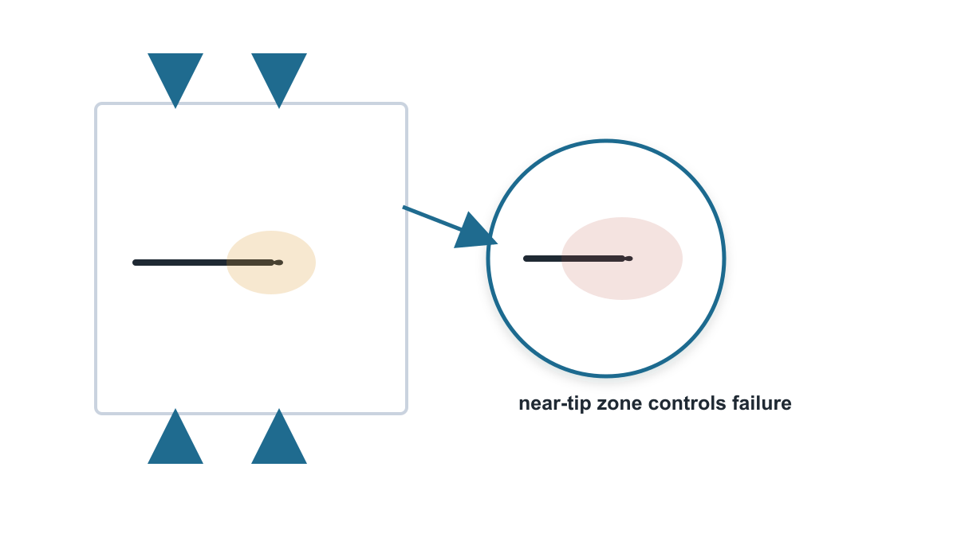
Rice 1968
Why This Paper Matters
Failure begins in a tiny near-tip region
Loads and geometry are usually known far away
Plasticity makes the local field hard to solve
Rice connects the global problem to the local crack-tip danger.
2/9
Notes:
Cracks are difficult because they are very local problems with structural consequences. In a real component, the load may be applied far away and the geometry may be large and complicated. But failure often starts in a very small region near the crack tip, where stress and strain become highly concentrated. Rice's paper matters because it gives a way to connect the global loading of the body to the local intensity of the crack-tip deformation, even when the material response is nonlinear in the deformation-theory sense.

Slide 3
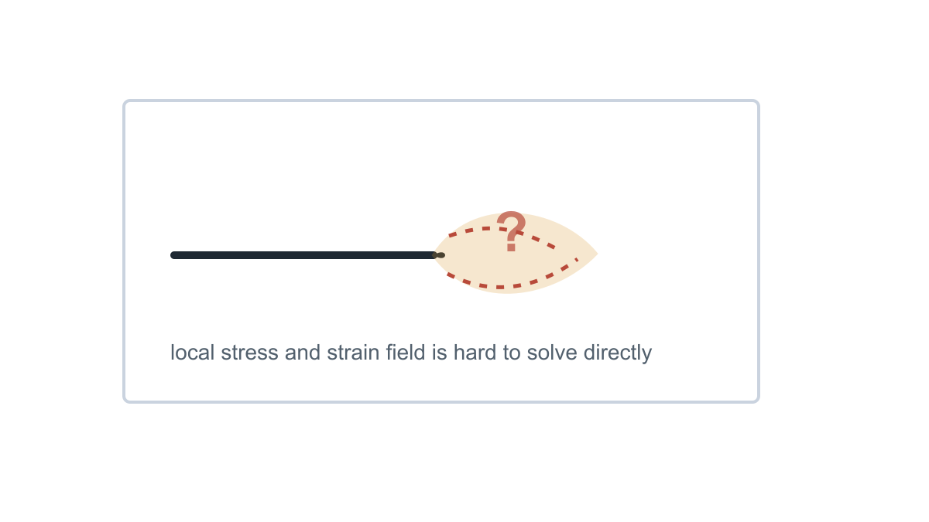
Rice 1968
The Problem Before the Paper
Linear elastic fracture used K and energy release rate
Elastic-plastic metals develop concentrated near-tip strain
Full nonlinear boundary-value solutions are difficult
Can we characterize the tip without solving every local detail?
3/9
Notes:
Before this work, one major difficulty was that crack-tip fields were mathematically hard to determine, especially for nonlinear materials. If the material is linear elastic, the near-tip stress field has a known singular form and the stress intensity factor tells you how strong that field is. But when plastic deformation appears near the crack tip, the local field becomes much more complicated. Rice's practical question was whether we can characterize the crack tip without solving the entire detailed local boundary-value problem every time.

Slide 4
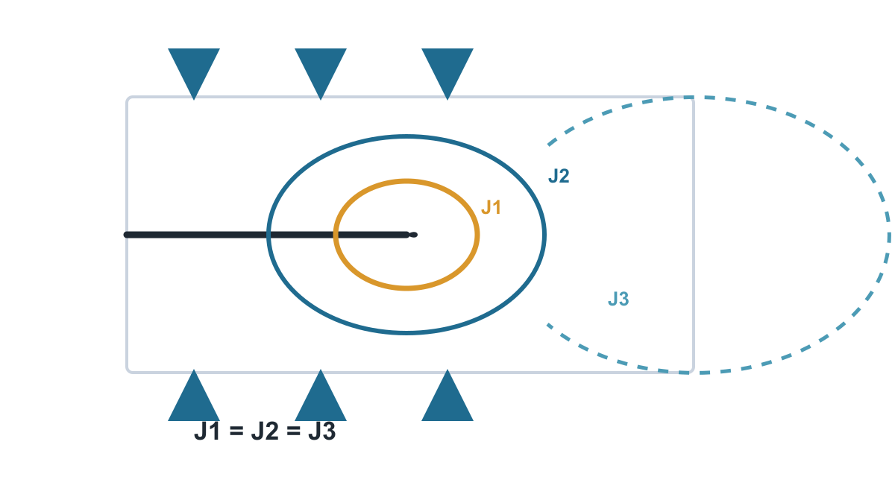
Rice 1968
Rice's Core Move
Draw any valid contour around the tip
Integrate stored energy and boundary work
The value is the same: J1 = J2 = J3
Path independence is the central idea.
4/9
Notes:
Rice's core move was to define a contour integral around the crack or notch tip. The contour can be close to the tip, where deformation is intense, or farther away, where the field may be easier to know from the loading and geometry. The remarkable result is that the integral has the same value on all valid paths. That means J can be evaluated where the mathematics or measurements are convenient, and then interpreted as information about the near-tip region.

Slide 5
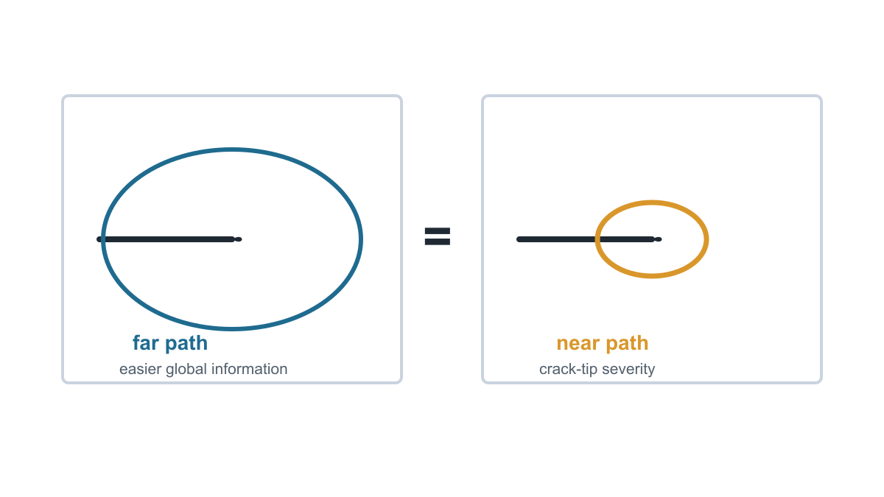
How to read J
Intuitive Example
Evaluate where convenient. Interpret where failure begins.
5/9
Notes:
One useful way to think about this is to compare a far contour and a near contour. The near contour directly samples the high strain and stress concentration, but that is exactly where the field is hardest to describe. The far contour is farther away, where stresses and displacements may be easier to estimate. Path independence lets these two views communicate. J acts like a bridge between the accessible global problem and the dangerous local region.

Slide 6
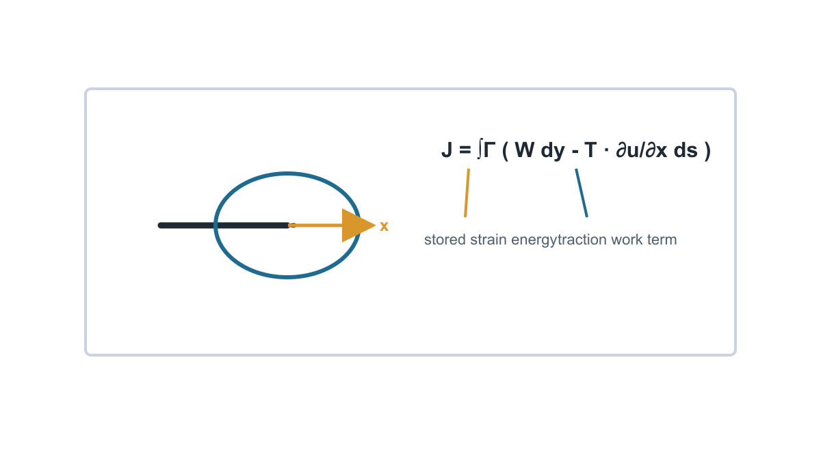
Rice 1968
The Essential Equation
J = ∫Γ ( W dy - T · ∂u/∂x ds )
W: strain energy density
T: traction on the contour
u: displacement field
x: crack-extension direction
6/9
Notes:
Here is the essential equation, without deriving every line. J equals the contour integral of W dy minus T dot partial u by partial x times ds. W is the strain energy density. T is the traction vector on the contour. u is displacement, and x is the crack extension direction. The first term is tied to stored energy. The second term accounts for mechanical work associated with tractions and displacement gradients along the contour. The proof uses equilibrium and Green's theorem: the area contribution between two contours vanishes, so both contours give the same J.

Slide 7
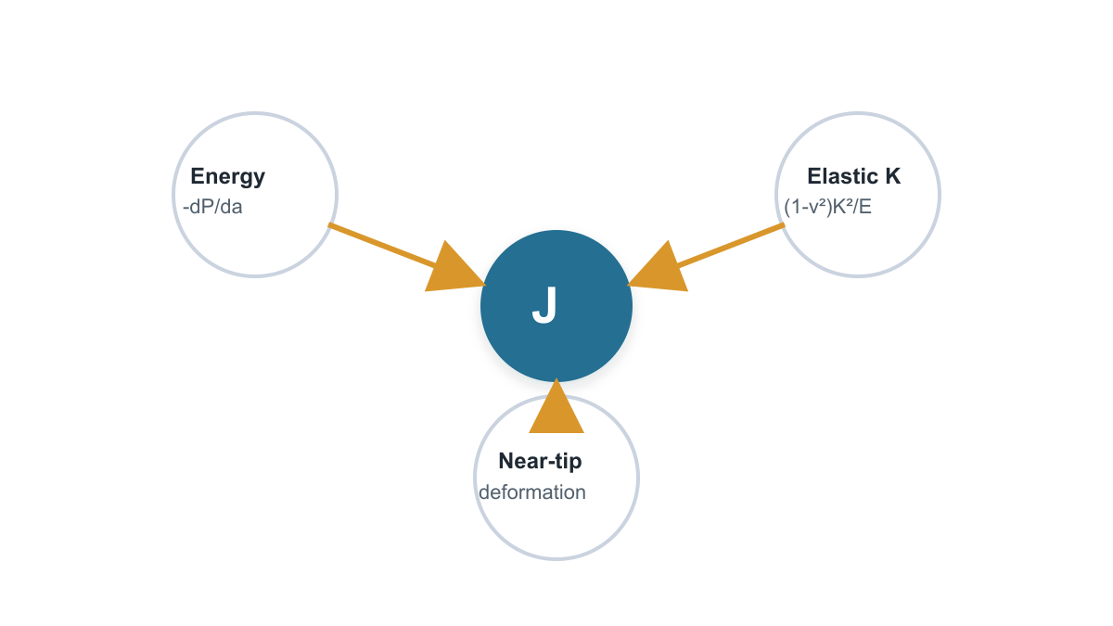
Rice 1968
What J Connects
Energy rate: J = -dP/da
Small-scale yielding: J = (1 - ν²)K²/E
Near-tip severity: averaged local deformation measure
Rice generalized classical fracture mechanics rather than replacing it.
7/9
Notes:
The importance of J becomes clearer when we look at what it connects. First, Rice gives J an energy interpretation: it equals the rate at which potential energy decreases as the crack or notch length increases. Second, in small-scale yielding it reduces to the familiar linear elastic result. For Mode I plane strain, J equals one minus Poisson's ratio squared, times K-I squared, divided by Young's modulus. Third, J is connected to the near-tip deformation field. So Rice generalized classical fracture mechanics rather than replacing it.

Slide 8
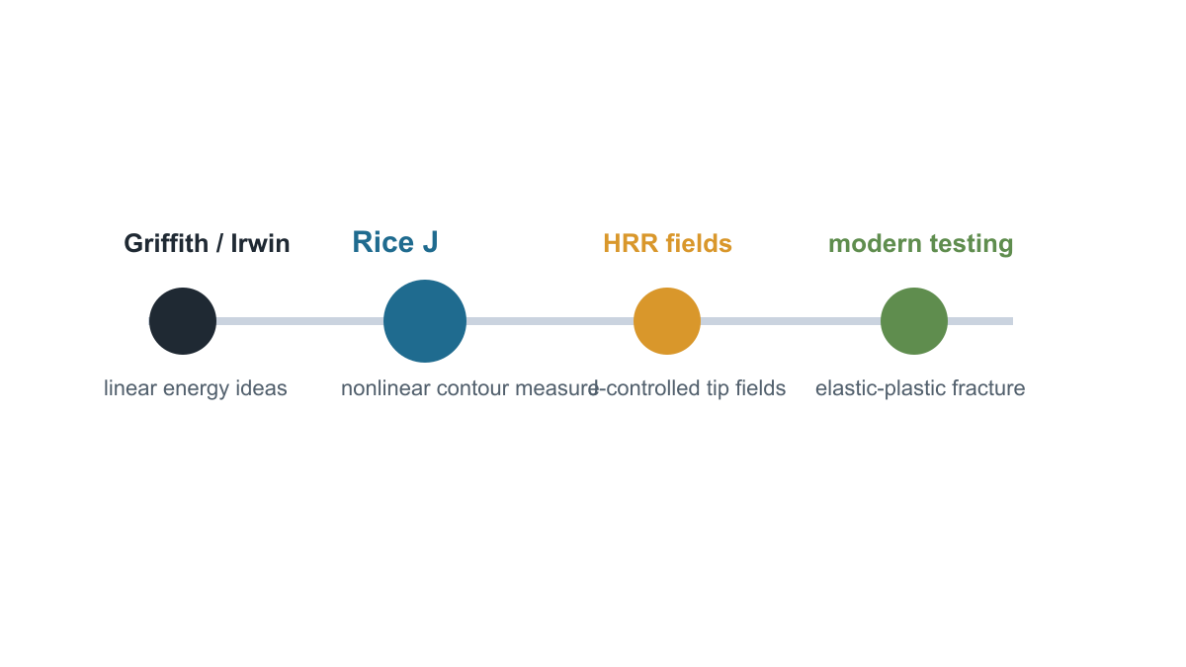
Rice 1968
What Changed, and What It Does Not Solve
Assumptions: 2D fields, no body forces, traction-free crack faces, deformation-theory material behavior.
8/9
Notes:
Historically, the J-integral became one of the central ideas in elastic-plastic fracture mechanics. It connected Griffith and Irwin energy ideas to nonlinear material behavior, and it set the stage for the Hutchinson-Rice-Rosengren crack-tip fields. But the paper is careful about its limits. The path independence applies under assumptions such as two-dimensional fields, no body forces, traction-free crack surfaces, and elastic or deformation-theory elastic-plastic behavior. Rice also notes that an analogous integral had not been successfully formulated for incremental plasticity.

Slide 9
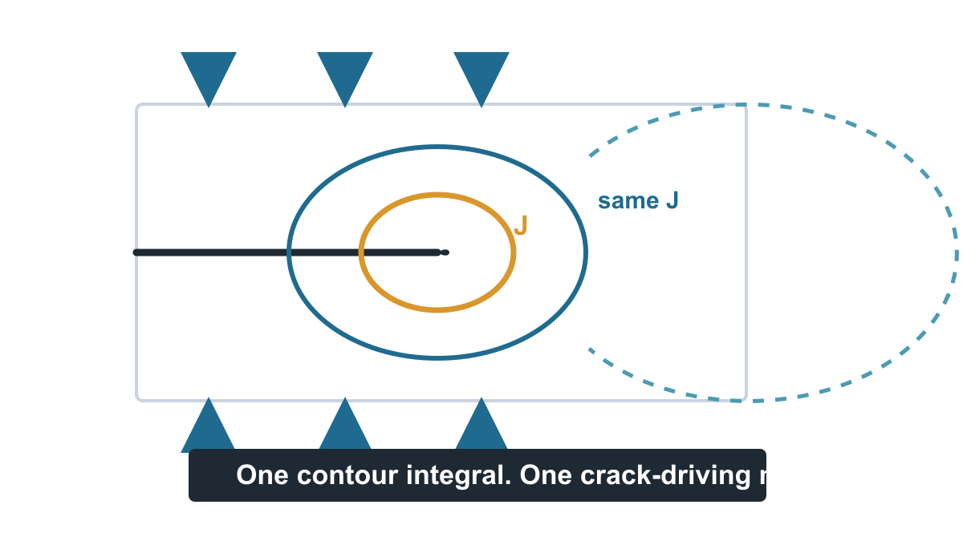
Rice 1968
Final Takeaway
A hard local crack problem becomes a contour-energy measure
Evaluate J where it is convenient
Interpret J where failure begins
That quantity is J.
9/9
Notes:
The final takeaway is this: Rice turned a hard local fracture problem into a portable energy measure. Instead of needing the full detailed crack-tip solution from the start, we can calculate J on a convenient contour and use it to characterize crack-tip severity. The genius of the paper is not that it solves every crack problem. It gives engineers and researchers a quantity that makes nonlinear crack problems discussable, measurable, and comparable. That quantity is J.

