Slide 1


MBP Tech Talks presents: Intro to Machine Learning
Grey Kuling¹
¹ University of Toronto, Faculty of Medical Biophysics
^{Nov, 16, 2018}

Slide 2
Recap of last lecture
Machine Learning is a form of coding where the user sets up a virtual task using lots of data and trains a ML algorithm to perform better at that task by repeated experience
Discussed the three types of ML:
Unsupervised
Supervised
Reinforcement
Discussed Supervised Training:
Data set split into Training, validation and test set
Then we reviewed some common ML algorithms and looked at some examples in medicine

Slide 3
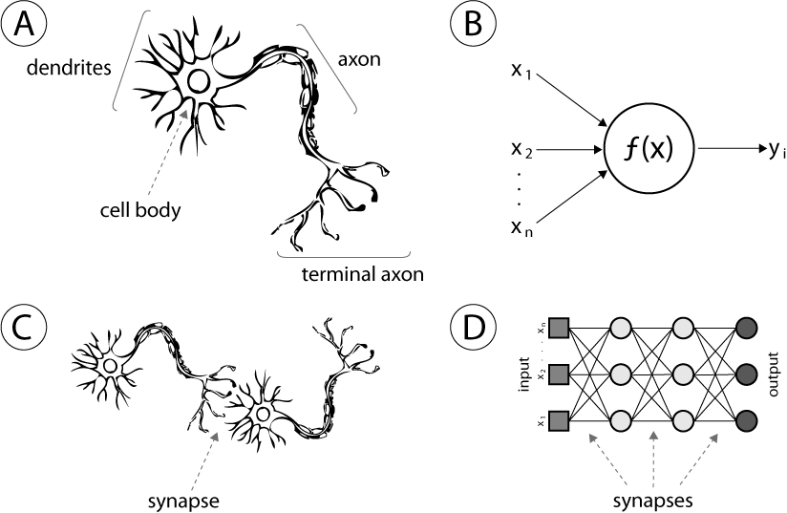
Neural Networks
Computing systems vaguely inspired by the biological neural networks that constitute an animal brain
It is a system of nodes connected by edges that transport information onto the next layer depending on their weights and biases
Another way to think of it is that it is a big forward directed belief network (graph theory)

Slide 4
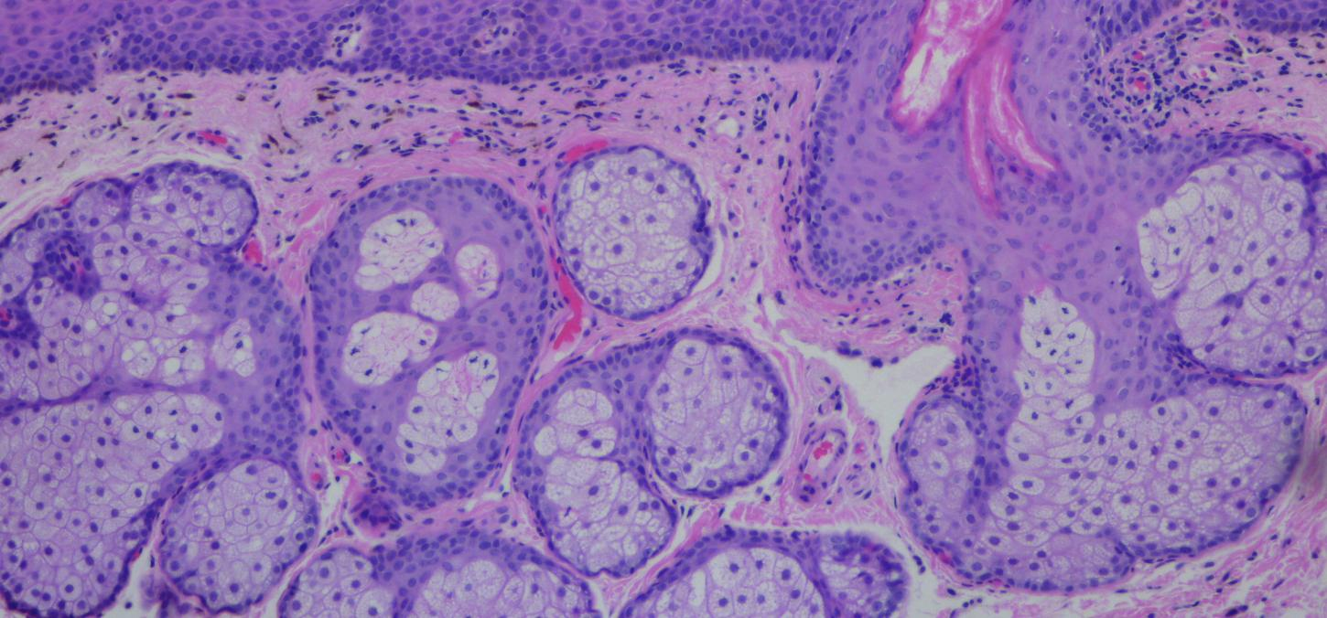
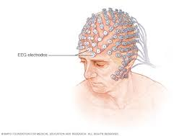
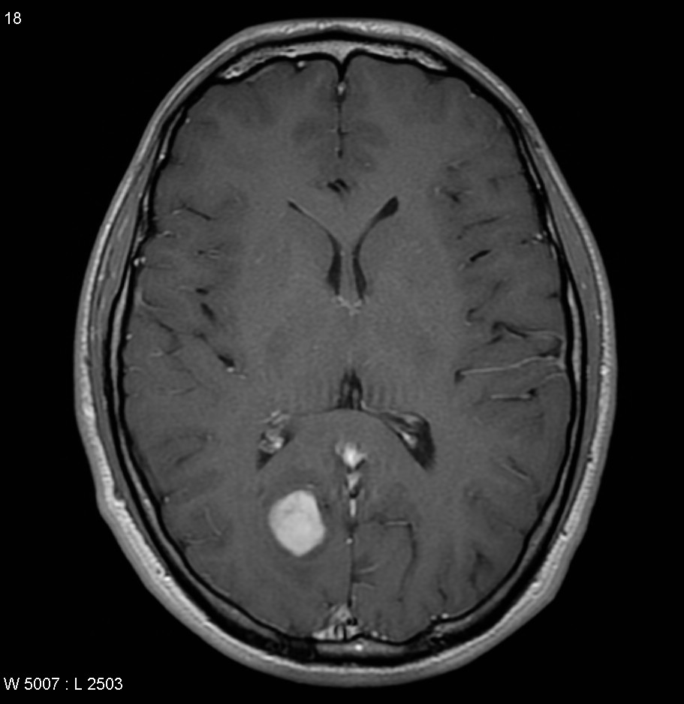
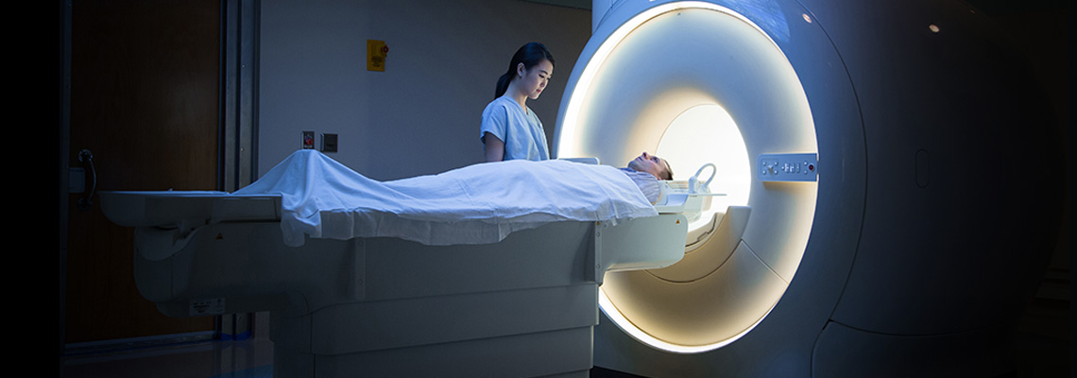
NNs in Medicine
NNs have been used for many tasks in medicine
Classification of lesions and tumors
Diagnosis of cancer based on gene expression
Dimensionality reduction for data comprehension
Encoding for image denoising and processing
Pattern recognition
Prediction of outcomes and hospital stay length

Slide 5
Neural Networks
So there is a lot of hype about NNs because they are quite powerful and useful for different data sets and tasks
The hard part is that NNs have multiple parameters with many MANY options
Therefore, the use and application is quite tedious because there is a vast amount of ways to use Neural networks
So we’re going to go through each parameter and give a brief overview of how it works, discuss the training algorithm that is used for NNs, and the add ons that make NNs very powerful
NNs have the following parameters:
Nodes and Activation functions
Loss Function
Regularization
Feature learning
Epoches and Mini-batches
Backpropoagation
Gradient descent
Chain rule
Optimizers
Convolutional Filters

Slide 6
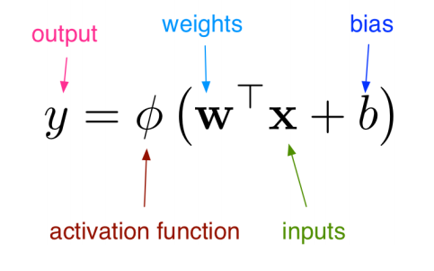
Nodes and Activation Functions
So each layer of a neural network is a transform of data multiplied by weights, and added in biases
Then this information is normalized into a set out put using an activation function

Slide 7
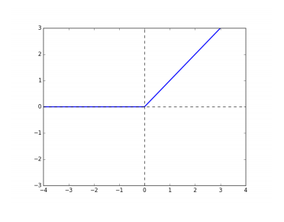
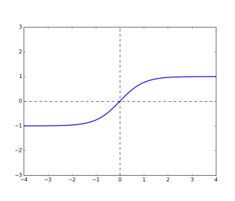
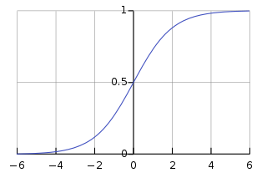
Activation Functions
Activation function options:
Rectified Linear Unit (Relu)
Sigmoid
Logistic
Hyperbolic tangent
Softmax
These are important for keeping the activations in a specific range when outputted. This makes sure that weights and biases don’t explode during training
Rectified Linear Unit
Sigmoid Function
Hyperbolic Tangent Function

Slide 8
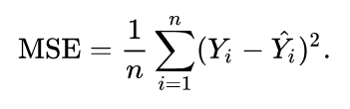

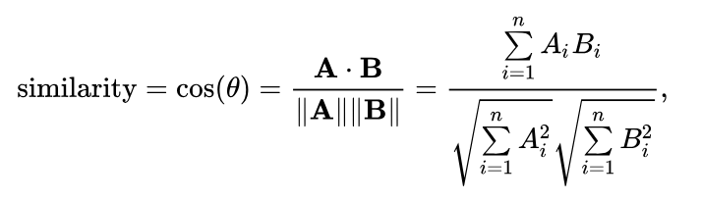
Loss Function
In optimization, a loss function is a function that maps an event onto a real valued cost function
This is a function used to quantify how wrong or right the ML algorithm is doing
Common loss functions:
Mean squared error
Cross entropy
Cosine proximity
We can find a value for the weights and biases by minimizing the loss function during training

Slide 9




Regularization
The loss function is typically minimized to find values for W and b
But sometimes we may not want these values to get too large
Therefore we add on regularization to restrict the domain of the W and b
This is typically done with L1-norm, L2-norm or elastic net
This is typically used to avoid overfitting on a small data set

Slide 10
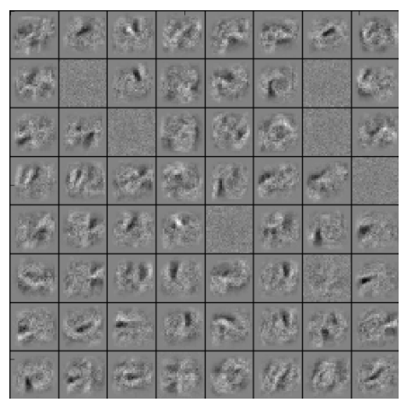
Feature Learning
What ends up occurring after training is these weights, biases and activation functions adapt to the data
In the end it learns specific features from the data set to assist in making decision on a test set
These features are not entirely interpretable but are considered combined linear transformations of the data to a learned feature space to make the data separable for classification

Slide 11
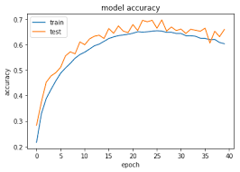
Epoches and mini-batches
When training there is a possibility to train on everything, but this method is not super efficient for training.
An Epoch is one whole pass over all the data
Training has been adapted to update weights more often during an epoch by using mini-batches
Using mini-batches decreases the training time and increases generalizability of the network

Slide 12
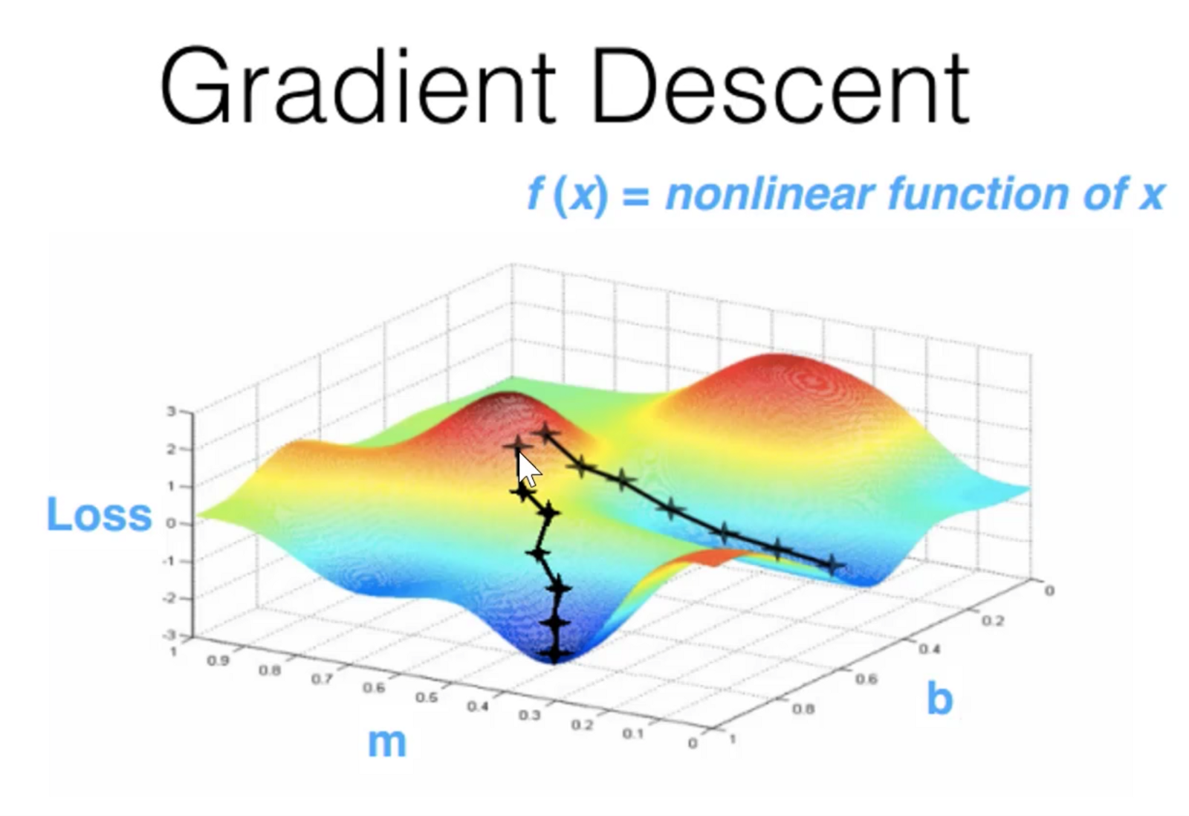
Gradient Descent
Training and solving for the weights and biases is based on Gradient descent
GD is a first order iterative optimization algorithm for finding the minimum of a function
The idea is to evaluate the derivative at the given point and move in the opposite direction of the gradient until you reach a function minimum
With NNs we want to minimize the loss function with respect to the weights and biases, therefore we do high dimensional gradient descent to solve for the ideal weights and biases
This technique has a step size which in Machine Learning we call a Learning Rate

Slide 13

Chain Rule
Before we get into how GD is used to solve for the weights, we should review the chain rule
The chain rule is used to make the calculation of updates to the weights easier in different layers
As we can see the chain rule explains the solvable change to a layer’s weights ands biases based on it’s output

Slide 14
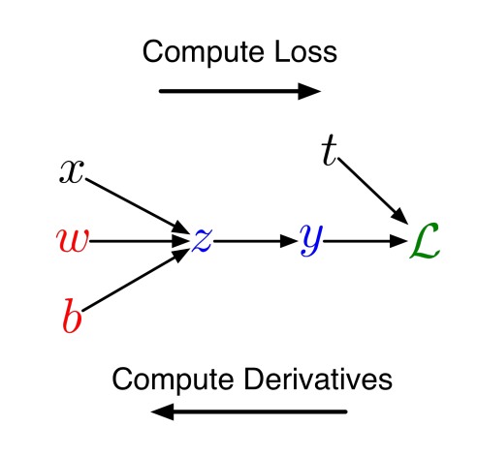
Backpropagation
Therefore, the use of GD and the chain rule makes it simple to solve for the best weights and biases to give the output we are looking for
Back prop encompasses 2 phases
Forward pass: where training examples are put through the network and their loss is averaged
Backward pass: then each layer’s weights are updated using the chain rule to propagate the error backward
Thus this system learns the weights by using this very simple optimization algorithm

Slide 15
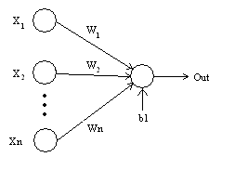
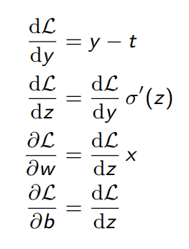
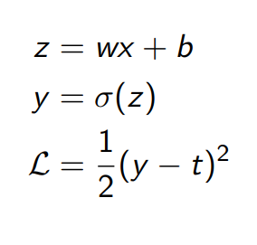
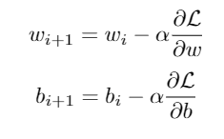
Backpropagation of a single layer NN
The Derivatives Calculated in the Backward Pass
Data Calculation for a Forward Pass
The Update step in the Backward Pass

Slide 16
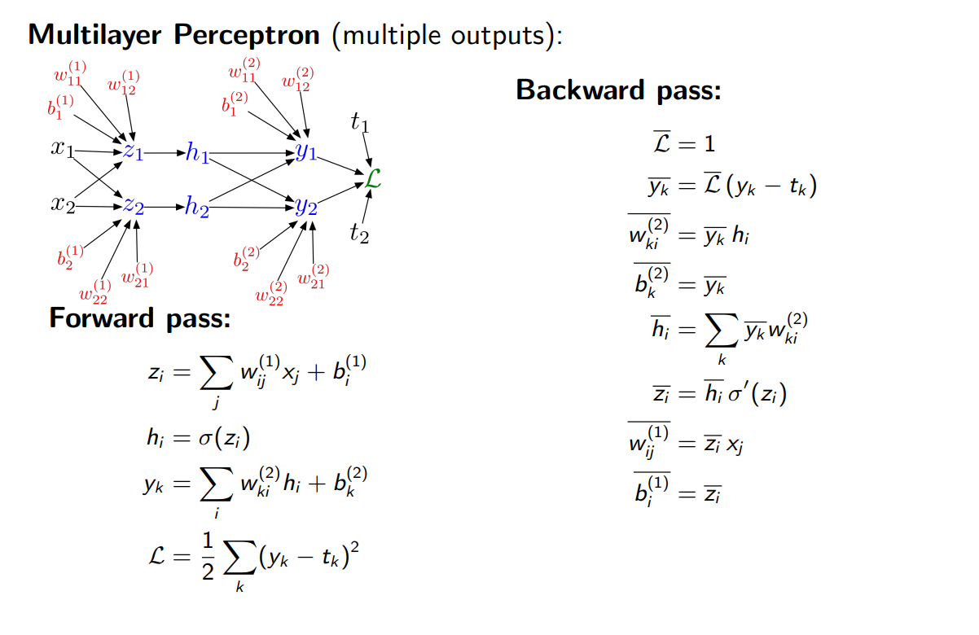
Backpropagation

Slide 17
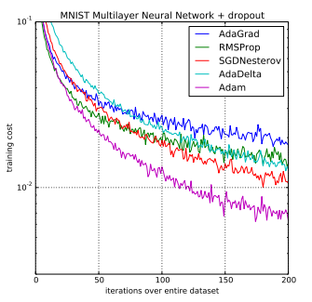
Optimizers
When it comes GD optimization, there are many options and parameters:
Learning rate: the step size we take on the surface of the loss
Momentum: possibility of using the previous step in combination with the current step
Learning rate schemes: can decay the LR over time
This results in many different optimizer options.
The classic is stochastic GD, which takes an average over a mini-batch

Slide 18
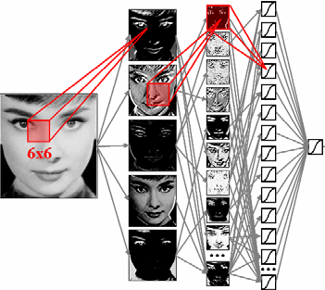
Convolutional filters and CNNs
Convolutional filters are a means to reduce the dimension of images to make classification easier
Convolutional filters are a window operation that is multiplied against the image to reduce it into a certain feature space based on the filter window
CNNs are based on using these filters to increase optimization speed for large inputs and give less weights to update
This results in CNNs having a more easier time identifying images of specific objects than compressing the info into a linear vector and making that the input of the network
CNNs also use pooling to reduce the dimensionality of the images to increase discrimination, translation invariance and rotation invariance

Slide 19
Class Activity
Now we will open our Jupyter notebook and go through a few examples of neural networks on the MNIST data set
We will be trying to identify hand written numbers in small images

