Slide 1


Slide 2


DATA VISUALIZATION & STORYTELLING
→BUSINESS ANALYTICS
WITH EXCEL

Slide 3

Exercise 1

Slide 4
The graph below is meant to demonstrate that the 2011 to 2012 increase observed in total new marriages was driven primarily by an increase in those having a bachelor’s degree or more (there doesn’t actually appear to be an increase based on the “All” trend shown, but let’s ignore this).
The design of the graph does little to draw this clearly to our attention, however. How would you improve it? First, try to declutter the graph. After that, move to the next slide.
New Marriage Rate by Education
Number of newly married adults per 1,000 marriage eligible adults
Note: Marriage eligible includes the newly married plus those widowed, divorced or never married at interview.
Source: US Census
Adapted from PEW RESEARCH CENTER
Knaflic, Cole. Storytelling With Data: A Data Visualization Guide for Business Professionals, Wiley, © 2015.

Slide 5
The graph similar to this appeared actually in a report of PEW Research Center. However, the attention is drawn to the 2012 bars within the various groups because they are rendered in a darker color than the rest. What would you change to draw attention to the Bachelor’s degree education?
New Marriage Rate by Education
Number of newly married adults per 1,000 marriage eligible adults
'08 '09 '10 '11 '12
Note: Marriage eligible includes the newly married plus those widowed, divorced or never married at interview.
Source: US Census
Adapted from PEW RESEARCH CENTER
Knaflic, Cole. Storytelling With Data: A Data Visualization Guide for Business Professionals, Wiley, © 2015.

Slide 6
Exercise 2

Slide 7
Let’s look at an example table and explore both how we can improve it and take things a step further to visualize the data it contains.
It shows the breakdown of new clients by tier for the recent year. Use this table to complete the following steps.
Knaflic, Cole. Storytelling With Data: A Data Visualization Guide for Business Professionals, Wiley, © 2015.

Slide 8
Let’s look at an example table and explore both how we can improve it and take things a step further to visualize the data it contains.
It shows the breakdown of new clients by tier for the recent year. Use this table to complete the following steps.
STEP 1: Review the data in the Table. What observations can you make? Do you have to make any assumptions when interpreting this data? What questions do you have about this data?
STEP 2: Consider the layout of the table. Let’s assume you’ve been told this information must be communicated in a table. Are there any changes you would make to the way the data is presented or the overall manner in which the table is designed?
STEP 3: Let’s assume the main comparison you want to make is between how accounts are distributed across the tiers compared to how revenue is distributed— and that you have the freedom to make bigger changes (it’s not required to be a table). How would you visualize this data? Create a graph in the tool of your choice.
Knaflic, Cole. Storytelling With Data: A Data Visualization Guide for Business Professionals, Wiley, © 2015.

Slide 9
Exercise 3

Slide 10
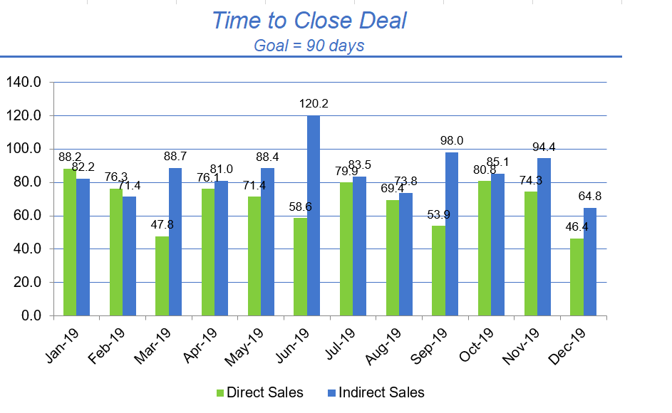
Open file Exercise 3. Try to declutter the graph to make it more transparent.
What other changes would you make to what is shown or how it’s shown to reduce cognitive burden? Assume that that your goal to Close a Deal is 90 days. How would you highlight the months in which you missed the goal?
Knaflic, Cole. Storytelling With Data: A Data Visualization Guide for Business Professionals, Wiley, © 2015.

Slide 11
Exercise 4

Slide 12
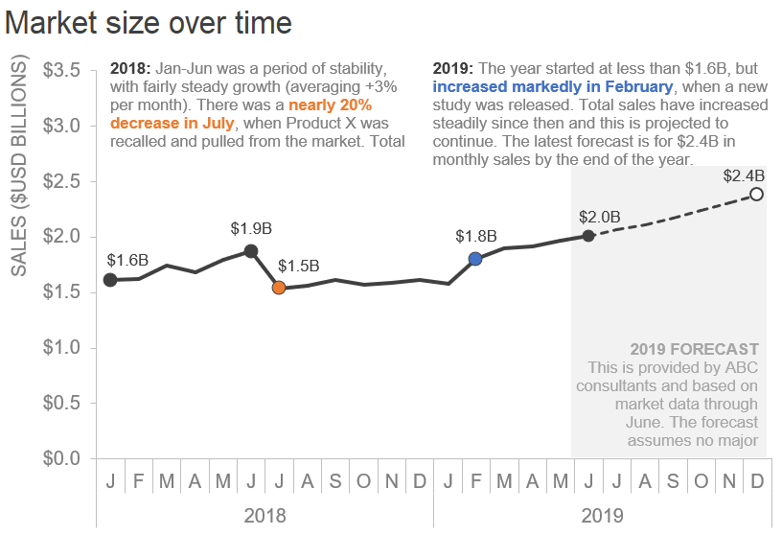
Open file Exercise 4. Think like a designer and try to redesign the graph to make it look better.
Knaflic, Cole. Storytelling With Data: A Data Visualization Guide for Business Professionals, Wiley, © 2015.

