Slide 1

Go, change the world
RV College of
Engineering
Unit 3-
UDP client/server and Name server

Slide 2

RV College of
Engineering
Go, change the world
Contents
Introduction to all protocols
Socket options :introduction,
getsockopt and setsockopt functions.
recvfrom and sendto functions,
UDP Echo server & UDP Echo client, lost datagrams.
DNS, Gethostbyname function, gethostbyaddr function, getservbyname and getservbyport functions,
getaddrinfo function,
gai_strerror function, freeaddrinfo function,
getaddrinfo function: example, host_serv function

Slide 3
RV College of
Engineering
Go, change the world
There are various ways to get and set the options that affect a socket:
The getsockopt and setsockopt functions
The fcntl function
The ioctl function

Slide 4
getsockopt and setsockopt Functions:
Go, change the world
RV College of
Engineering
sockfd must refer to an open socket descriptor.
level specifies the code in the system that interprets the option: the general socket code or some protocol-specific code (e.g., IPv4, IPv6, TCP, or SCTP).
optval is a pointer to a variable from which the new value of the option is fetched by getsockopt, or into which the current value of the option is stored by setsockopt.
The size of this variable is specified by the final argument, as a value for setsockopt and as a value-result for getsockopt.

Slide 5
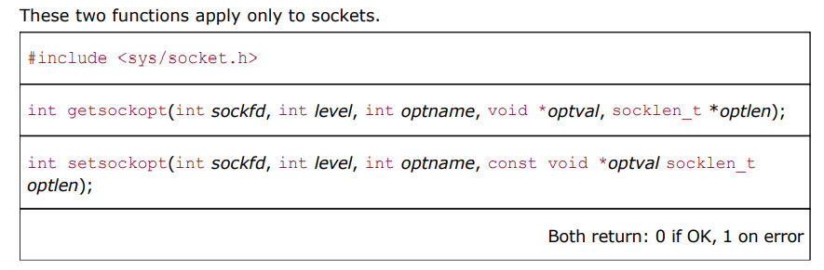

Slide 6
RV College of
Engineering
Go, change the world
Some of the socket and IP-layer and transport layer socket options for getsockopt and setsockopt.
level | optname | get | set | Description | Flag | Datatype
IPPROTO_TCP | TCP_MAXSEG |  |  | Maximum segment size |  | int
IPPROTO_SCTCP | SCTCP_MAXSEG |  |  | Max fragmentation size |  | int
IPPROTO_IP or IPPROTO_IPV6 | MCAST_JOIN_GROUP |  |  | Join multicast group |  | group_req{}
IPPROTO_IP | IP_TTL |  |  | TTL |  | int
SOL_SOCKET | SO_SNDBUF |  |  | Send buffer size |  | int

Slide 7
RV College of
Engineering
Go, change the world
There are two basic types of options:
    binary options that enable or disable a certain feature (flags), and
    options that fetch and return specific values that we can either set or examine (values).
The column labelled "Flag" specifies if the option is a flag option.
When calling getsockopt for these flag options, *optval is an integer.
The value returned in *optval is zero if the option is disabled, or nonzero if the option is enabled. Similarly, setsockopt requires a nonzero *optval to turn the option on, and a zero value to turn the option off.
If the "Flag" column does not contain a "•," then the option is used to pass a value of the specified datatype between the user process and the system.

Slide 8
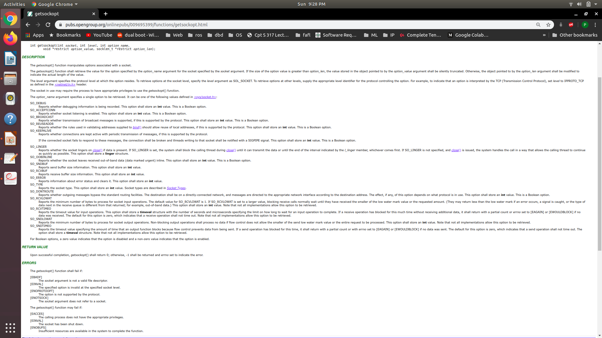

Slide 9
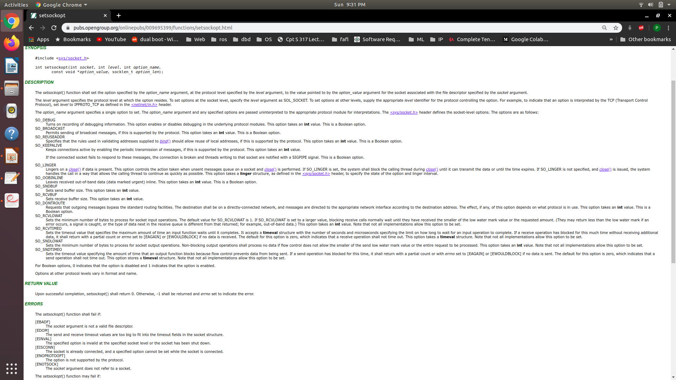

Slide 10
RV College of
Engineering
Go, change the world
Introduction to UDP
There are fundamental differences between applications written using TCP versus those that use UDP.
It is because differences in UDP and TCP protocols.
UDP is a connectionless, unreliable, datagram protocol.
TCP is connection-oriented, reliable byte stream.
Applications built using UDP are: DNS, NFS, and SNMP

Slide 11
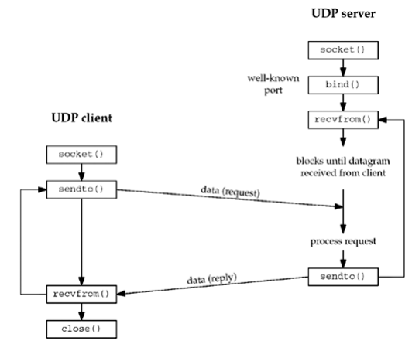
RV College of
Engineering
Go, change the world
Socket functions for UDP client and server

Slide 12
RV College of
Engineering
Go, change the world
The client does not establish a connection with the server.
Instead, the client just sends a datagram to the server using the sendto().
Sendto() takes the address of the destination (the server) as a parameter.
The server does not accept a connection from a client.
Instead, the server calls the recvfrom(), which waits until data arrives from some client.
Recvfrom returns the protocol address of the client, along with the datagram, so the server can send a response to the correct client.

Slide 13
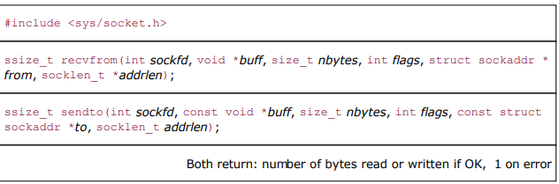
RV College of
Engineering
Go, change the world
sendto() and recvfrom()

Slide 14
RV College of
Engineering
Go, change the world
The first three arguments, sockfd, buff, and nbytes, are identical to the first three arguments of send() and recv() : descriptor, pointer to buffer to read into or write from, and number of bytes to read or write.
The flag argument is set to 0.
to argument for sendto is a socket address structure containing the protocol address (e.g., IP address and port number) of where the data is to be sent.
The size of this socket address structure is specified by addrlen.

Slide 15
RV College of
Engineering
Go, change the world
The recvfrom function fills in the socket address structure pointed to by from with the protocol address of who sent the datagram.
The number of bytes stored in this socket address structure is also returned to the caller in the integer pointed to by addrlen.
Note: the final argument to sendto is an integer value, while the final argument to recvfrom is a pointer to an integer value (a value-result argument).

Slide 16
RV College of
Engineering
Go, change the world
The final two arguments to recvfrom are similar to the final two arguments to accept: The contents of the socket address structure upon return tell us who sent the datagram (in the case of UDP) or who initiated the connection (in the case of TCP).
The final two arguments to sendto are similar to the final two arguments to connect: We fill in the socket address structure with the protocol address of where to send the datagram (in the case of UDP) or with whom to establish a connection (in the case of TCP).

Slide 17
RV College of
Engineering
Go, change the world
Both functions return the length of the data that was read or written as the value of the function.
In the typical use of recvfrom, with a datagram protocol, the return value is the amount of user data in the datagram received.
Writing a datagram of length 0 is acceptable.
In UDP, this results in an IP datagram containing an IP header (normally 20 bytes for IPv4 and 40 bytes for IPv6), an 8-byte UDP header, and no data.
This also means that a return value of 0 from recvfrom is acceptable for a datagram protocol.
It does not mean that the peer has closed the connection, as does a return value of 0 from read on a TCP socket. Since UDP is connectionless, there is no such thing as closing a UDP connection.

Slide 18
RV College of
Engineering
Go, change the world
If the from argument to recvfrom is a null pointer, then the corresponding length argument ( addrlen) must also be a null pointer, and this indicates that we are not interested in knowing the protocol address of who sent us data.

Slide 19
RV College of
Engineering
Go, change the world
Lost Datagrams
UDP client/server example is not reliable.
If a client datagram is lost (say it is discarded by some router between the client and server), the client will block forever in its call to recvfrom.
Similarly, if the client datagram arrives at the server but the server's reply is lost, the client will again block forever in its call to recvfrom.
A typical way to prevent this is to place a timeout on the client's call to recvfrom

Slide 20
RV College of
Engineering
Go, change the world
Lost Datagrams
There are three ways to place a timeout on an I/O operation involving a socket:
Call alarm, which generates the SIGALRM signal when the specified time has expired.
Block waiting for I/O in select, which has a time limit built-in, instead of blocking in a call to read or write.
Use the newer SO_RCVTIMEO and SO_SNDTIMEO socket options.

Slide 21
RV College of
Engineering
Go, change the world
Domain Name Systems(DNS).
The DNS is used primarily to map between hostnames and IP addresses.
A hostname can be either a simple name, such as solaris or freebsd or google.
A fully qualified domain name (FQDN) such as solaris.unpbook.com.
An FQDN is also called an absolute name and must end with a DOT, but users often omit the ending period.
The trailing DOT tells the resolver that this name is fully qualified and it doesn't need to search its list of possible domains.

Slide 22
RV College of
Engineering
Go, change the world
Entries in the DNS are known as resource records (RRs).
Few types of RRs that are of interest are:
A- An A record maps a hostname into a 32-bit IPv4 address.
AAAA- a AAAA record, called a "quad A" record, maps a hostname into a 128-bit IPv6 address.
    The term "quad A" is used because a 128-bit address is four times larger than a 32-bit address.
PTR - PTR records (called "pointer records") map IP addresses into hostnames. PTR records are used for the reverse DNS lookup

Slide 23
RV College of
Engineering
Go, change the world
A reverse DNS lookup is the opposite of this process: it is a query that starts with the IP address and looks up the domain name.
While DNS A records are stored under the given domain name, DNS PTR records are stored under the IP address — reversed, and with ".in-addr.arpa" added.
For example, the PTR record for the IP address 192.0.2.255 would be stored under "255.2.0.192.in-addr.arpa".
"in-addr.arpa" has to be added because PTR records are stored within the .arpa top-level domain in the DNS.
.arpa is a domain used mostly for managing network infrastructure, and it was the first top-level domain name defined for the Internet.

Slide 24
RV College of
Engineering
Go, change the world
IPv6 addresses are constructed differently from IPv4 addresses.
IPv6 PTR records exist in a different namespace within .arpa.
IPv6 PTR records are stored under the IPv6 address, reversed and converted into four-bit sections (as opposed to 8-bit sections, as in IPv4), plus ".ip6.arpa".
Uses for reverse DNS include:
    Anti-spam: Some email anti-spam filters use reverse DNS to check the domain names of email addresses and see if the associated IP addresses are likely to be used by legitimate email servers.
    Troubleshooting email delivery issues: Because anti-spam filters perform these checks, email delivery problems can result from a misconfigured or missing PTR record.
    Logging: System logs typically record only IP addresses; a reverse DNS lookup can convert these into domain names for logs that are more human-readable.

Slide 25
RV College of
Engineering
Go, change the world
MX - An MX record specifies a host to act as a "mail exchanger" for the specified host.
The MX record indicates how email messages should be routed in accordance with the Simple Mail Transfer Protocol
The 'priority' numbers before the domains for these MX records indicate preference; the lower 'priority' value is preferred.
The server will always try mailhost1 first because 10 is lower than 20. In the result of a message send failure, the server will default to mailhost2.
Example of an MX record:
example.com | record type: | priority: | value: | TTL
@ | MX | 10 | mailhost1.example.com | 45000
@ | MX | 20 | mailhost2.example.com | 45000

Slide 26
RV College of
Engineering
Go, change the world
What is the process of querying an MX record?
Message transfer agent (MTA) software is responsible for querying MX records.
When a user sends an email, the MTA sends a DNS query to identify the mail servers for the email recipients.
The MTA establishes an SMTP connection with those mail servers, starting with the prioritized domains (in the first example above, mailhost1).

Slide 27
RV College of
Engineering
Go, change the world
CNAME The ‘canonical name’ (CNAME) record is used in lieu of an A record, when a domain or subdomain is an alias of another domain.
All CNAME records must point to a domain, never to an IP address.
A common use is to assign CNAME records for common services, such as ftp and www. If people use these service names instead of the actual hostnames, it is transparent when a service is moved to another host.

Slide 28
RV College of
Engineering
Go, change the world
For example, suppose blog.example.com has a CNAME record with a value of ‘example.com’ (without the ‘blog’).
This means when a DNS server hits the DNS records for blog.example.com, it actually triggers another DNS lookup to example.com, returning example.com’s IP address via its A record.
In this case we would say that example.com is the canonical name (or true name) of blog.example.com.
Oftentimes, when sites have subdomains such as blog.example.com or shop.example.com, those subdomains will have CNAME records that point to a root domain (example.com).
This way if the IP address of the host changes, only the DNS A record for the root domain needs to be updated and all the CNAME records will follow along with whatever changes are made to the root.

Slide 29
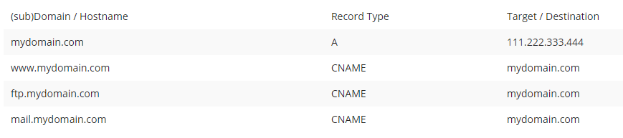
RV College of
Engineering
Go, change the world
For example, say you have several subdomains, like www.mydomain.com, ftp.mydomain.com, mail.mydomain.com etc and you want these sub domains to point to your main domain name mydomain.com. Instead of creating A records for each sub-domain and binding it to the IP address of your domain you can create CNAME records.
As you can see in the table below, in the case where the IP address of your server changes, you only need to update one A record and all the subdomains follow automatically because all the CNAMES point to the main domain with the A record:

Slide 30
RV College of
Engineering
Go, change the world
Limitations of CNAME records:
Usage of CNAME records means that there is an additional request sent to the DNS servers, which can cause a delay of a few milliseconds.
You cannot create a CNAME record for the main domain name (mydomain.com) itself, this must be an A record.
For example, you cannot map mydomain.com to google.com, however, you can map google.mydomain.com to google.com.
MX or NS (nameserver) records may never point to a CNAME record, only A records.

Slide 31
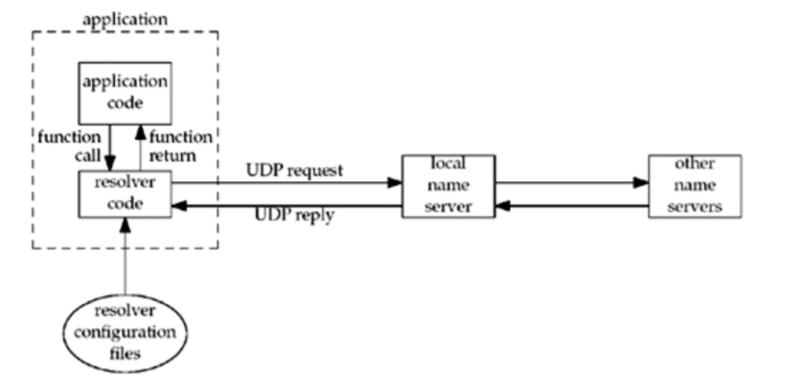
RV College of
Engineering
Go, change the world
Resolvers and Name Servers.
Organizations run one or more name servers, often the program known as BIND (Berkeley Internet Name Domain).
Applications such as the clients and servers that we are writing in this text contact a DNS server by calling functions in a library known as the resolver.
The common resolver functions are gethostbyname and gethostbyaddr.
The former maps a hostname into its IPv4 addresses, and the latter does the reverse mapping.

Slide 32
RV College of
Engineering
Go, change the world
Arrangements of clients ,resolvers and name Servers.

Slide 33
RV College of
Engineering
Go, change the world
On some systems, the resolver code is contained in a system library and is link-edited into the application when the application is built.
On others, there is a centralized resolver daemon that all applications share, and the system library code performs RPCs to this daemon.
In either case, application code calls the resolver code using normal function calls, typically calling the functions gethostbyname and gethostbyaddr.
The resolver code reads its system-dependent configuration files to determine the location of the organization's name servers.
The file /etc/resolv.conf normally contains the IP addresses of the local name servers.

Slide 34
RV College of
Engineering
Go, change the world
The resolver sends the query to the local name server using UDP.
If the local name server does not know the answer, it will normally query other name servers across the Internet, also using UDP.
If the answers are too large to fit in a UDP packet, the resolver will automatically switch to TCP.

Slide 35
RV College of
Engineering
Go, change the world
DNS Alternatives
It is possible to obtain name and address information without using the DNS.
Common alternatives are static host files (normally the file /etc/hosts), the Network Information System (NIS) or Lightweight Directory Access Protocol (LDAP).
It is implementation-dependent how an administrator configures a host to use the different types of name services.
If a name server is to be used for hostname lookups, then all these systems use the file /etc/resolv.conf to specify the IP addresses of the name servers.
Fortunately, these differences are normally hidden to the application programmer, so we just call the resolver functions such as gethostbyname and gethostbyaddr.

Slide 36
RV College of
Engineering
Go, change the world
Gethostbyname Function
Host computers are normally known by human-readable names.
But functions, connect, accept, bind…… these use IP addresses.
Most applications should deal with names, not addresses. (especially IPv6).
The most basic function that looks up a hostname is gethostbyname.
If successful, it returns a pointer to a hostent structure that contains all the IPv4 addresses for the host.
However, it is limited in that it can only return IPv4 addresses.(newer variant is getaddrinfo() )

Slide 37
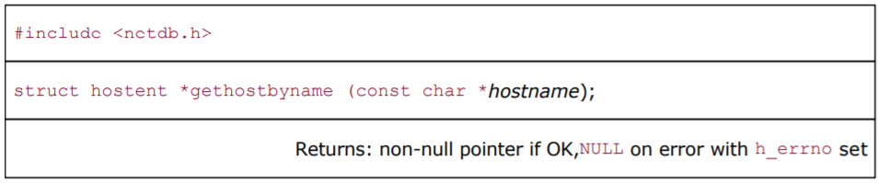
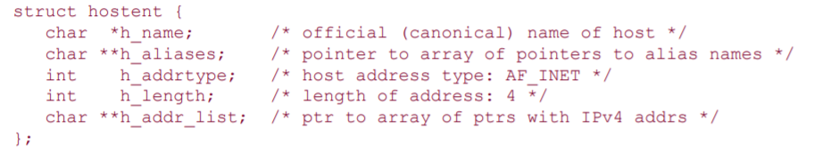
RV College of
Engineering
Go, change the world
Gethostbyname Function
The non-null pointer returned by this function points to the following hostent structure:

Slide 38
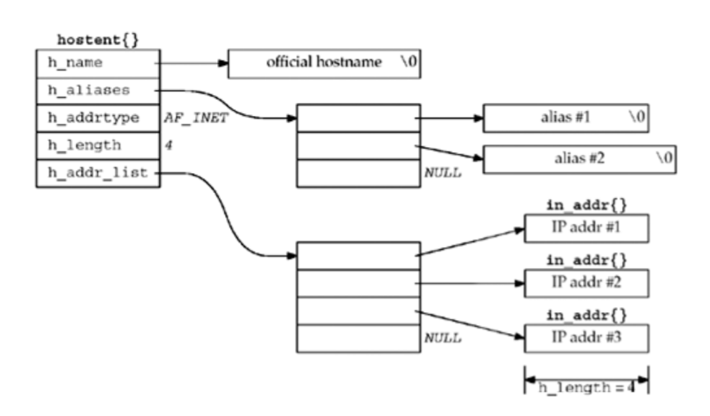
RV College of
Engineering
Go, change the world
Gethostbyname Function
In terms of the DNS, gethostbyname performs a query for an A record. This function can return only IPv4 addresses.
Arrangements of hostent structure

Slide 39
RV College of
Engineering
Go, change the world
gethostbyname differs from the other socket functions as it does not set errno when an error occurs.
Instead, it sets the global integer h_errno to one of the following constants defined by including <netdb.h>:
      HOST_NOT_FOUND
      TRY_AGAIN
      NO_RECOVERY
      NO_DATA (identical to NO_ADDRESS)
The NO_DATA error means the specified name is valid, but it does not have an A record.

Slide 40
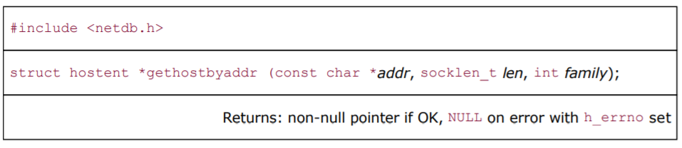
RV College of
Engineering
Go, change the world
gethostbyaddr Function
The function gethostbyaddr takes a binary IPv4 address and tries to find the hostname
corresponding to that address.
This is the reverse of gethostbyname.

Slide 41
RV College of
Engineering
Go, change the world
This function returns a pointer to the same hostent structure
The field of interest in this structure is normally h_name, the canonical hostname.
The addr argument is not a char*, but is really a pointer to an in_addr structure containing the IPv4 address.
len is the size of this structure: 4 for an IPv4 address.
The family argument is AF_INET.
In terms of the DNS, gethostbyaddr queries a name server for a PTR record in the in-addr.arpa domain

Slide 42
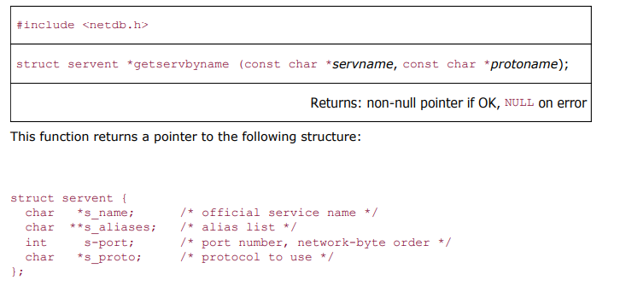
RV College of
Engineering
Go, change the world
getservbyname Functions:
If we refer to a service by its name in our code, instead of by its port number, and if the mapping from the name to port number is contained in a file (normally /etc/services), then if the port number changes, all we need to modify is one line in the /etc/services file instead of having to recompile the applications.
The next function, getservbyname, looks up a service given its name.

Slide 43
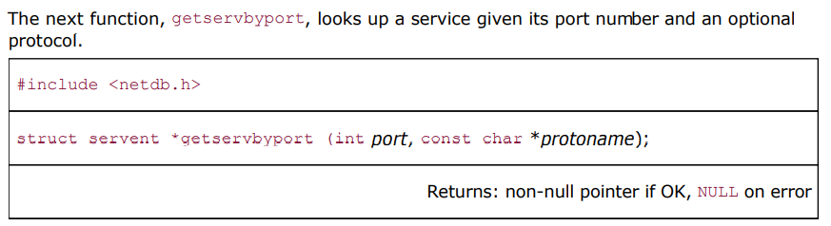
RV College of
Engineering
Go, change the world
getservbyport Functions:
getservbyport, looks up a service given its port number and an optional protocol.
The port value must be network byte ordered.
Use the folloing command to know port and protocol combinations

Slide 44
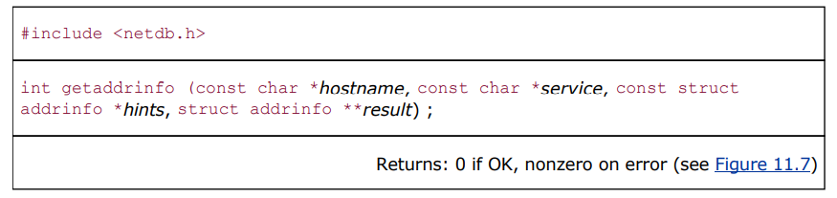
RV College of
Engineering
Go, change the world
getaddrinfo Function:
getaddrinfo function is for IPv6 , where as gethostbyname and gethostbyaddr functions only support IPv4.
The getaddrinfo function handles both name-to-address and service-to-port translation, and returns sockaddr structures instead of a list of addresses.
These sockaddr structures can then be used by the socket functions directly
This function is defined in the POSIX specification.
The POSIX definition of this function comes from an earlier proposal by Keith Sklower for a function named getconninfo.

Slide 45
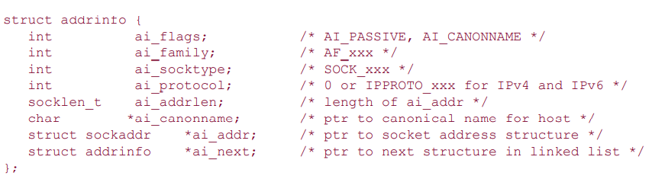
RV College of
Engineering
Go, change the world
This function returns through the result pointer a pointer to a linked list of addrinfo structures, which is defined by including <netdb.h>
The hostname is either a hostname or an address string (dotted-decimal for IPv4 or a hex string for IPv6). The service is either a service name or a decimal port number string.
hints is either a null pointer or a pointer to an addrinfo structure that the caller fills in with hints about the types of information the caller wants returned. For example, if the specified service is provided for both TCP and UDP (e.g., the domain service, which refers to a DNS server), the caller can set the ai_socktype member of the hints structure to SOCK_DGRAM. The only information returned
will be for datagram sockets.

Slide 46
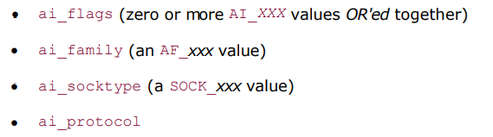
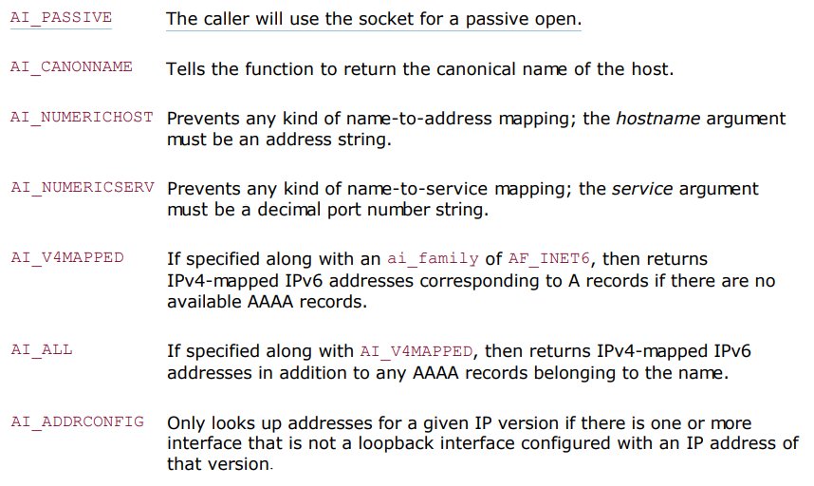
RV College of
Engineering
Go, change the world
The members of the hints structure that can be set by the caller are:
The possible values for the ai_flags member and their meanings are:

Slide 47
RV College of
Engineering
Go, change the world
If the hints argument is a null pointer, the function assumes a value of 0 for ai_flags, ai_socktype, and ai_protocol, and a value of AF_UNSPEC for ai_family.
If the function returns success (0), the variable pointed to by the result argument is filled in with a pointer to a linked list of addrinfo structures, linked through the ai_next pointer.
There are two ways that multiple structures can be returned:
    If there are multiple addresses associated with the hostname, one structure is returned for each address that is usable with the requested address family (the ai_family hint, if specified).
    If the service is provided for multiple socket types, one structure can be returned for each socket type, depending on the ai_socktype hint.

Slide 48
RV College of
Engineering
Go, change the world
For example, if no hints are provided and if the domain service is looked up for a host with two IP addresses, four addrinfo structures are returned:
      One for the first IP address and a socket type of SOCK_STREAM
      One for the first IP address and a socket type of SOCK_DGRAM
      One for the second IP address and a socket type of SOCK_STREAM
      One for the second IP address and a socket type of SOCK_DGRAM

Slide 49
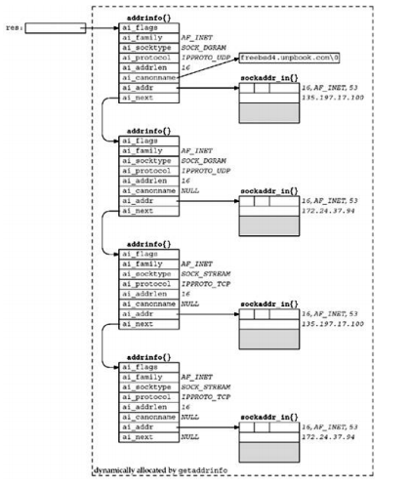
RV College of
Engineering
Go, change the world

Slide 50
RV College of
Engineering
Go, change the world
-> Not guaranteed that an implementation should return the IP addresses in the same order as they are returned by the DNS.
->Some resolvers allow the administrator to specify an address sorting order in the /etc/resolv.conf file- which could affect the order of addresses returned by getaddrinfo.
->The information returned in the addrinfo structures is ready for a call to socket and then either a call to connect or sendto (for a client), or bind (for a server).
->The arguments to socket are the members ai_family, ai_socktype, and ai_protocol.
->The second and third arguments to either connect or bind are ai_addr (a pointer to a socket address structure of the appropriate type, filled in by getaddrinfo) and ai_addrlen (the length of this socket address structure).

Slide 51
RV College of
Engineering
Go, change the world
If we were to enumerate all 64 possible inputs to getaddrinfo (there are six input variables), many would be invalid and some would make little sense.
Specify the hostname and service. This is normal for a TCP or UDP client. On return, a TCP client loops through all returned IP addresses, calling socket and connect for each one, until the connection succeeds or until all addresses have been tried.
For a UDP client, the socket address structure filled in by getaddrinfo would be used in a call to sendto or connect. If the client can tell that the first address doesn't appear to work (either by receiving an error on a connected UDP socket or by experiencing a timeout on an unconnected socket), additional addresses can be tried.
If the client knows it handles only one type of socket (e.g., Telnet and FTP clients handle only TCP; TFTP clients handle only UDP), then the ai_socktype member of the hints structure should be specified as either SOCK_STREAM or SOCK_DGRAM.

Slide 52
RV College of
Engineering
Go, change the world
A typical server specifies the service but not the hostname, and specifies the AI_PASSIVE flag in the hints structure. The socket address structures returned should contain an IP address of INADDR_ANY (for IPv4) or IN6ADDR_ANY_INIT (for IPv6). A TCP server then calls socket, bind, and listen. If the server wants to malloc another socket address structure to obtain the client's address from accept, the returned ai_addrlen value specifies this size.
A UDP server would call socket, bind, and then recvfrom. If the server wants to malloc another socket address structure to obtain the client's address from recvfrom, the returned ai_addrlen value specifies this size.
As with the typical client code, if the server knows it only handles one type of socket, the ai_socktype member of the hints structure should be set to either SOCK_STREAM or SOCK_DGRAM. This avoids having multiple structures returned, possibly with the wrong ai_socktype value.

Slide 53
RV College of
Engineering
Go, change the world
The TCP servers that we have shown so far create one listening socket, and the UDP servers create one datagram socket. That is what we assume in the previous item. An alternate server design is for the server to handle multiple sockets using select or poll. In this scenario, the server would go through the entire list of structures returned by getaddrinfo, create one socket per structure, and use select or poll.
The problem with this technique is that one reason for getaddrinfo returning multiple structures is when a service can be handled by IPv4 and IPv6.

Slide 54
RV College of
Engineering
Go, change the world
getaddrinfo is "better" than the gethostbyname and getservbynamefunctions
    It makes it easier to write protocol-independent code;
    One function handles both the hostname and the service and all the returned information is dynamically allocated, not statically allocated.
    Disadvantages:
    Allocate a hints structure, initialize it to 0, fill in the desired fields, call getaddrinfo, and then traverse a linked list trying each one.

Slide 55
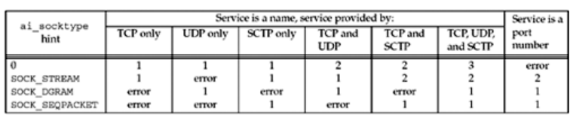
RV College of
Engineering
Go, change the world
Number of addrinfo structures returned per IP address.

Slide 56
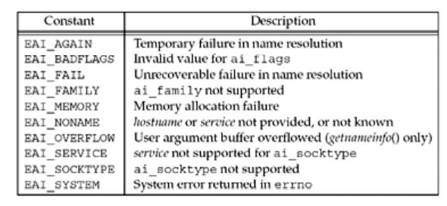
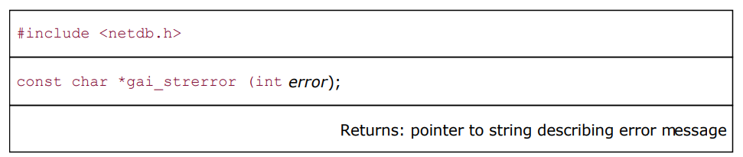
RV College of
Engineering
Go, change the world
gai_strerror Function
The nonzero error return values from getaddrinfo have the names and meanings shown:

Slide 57
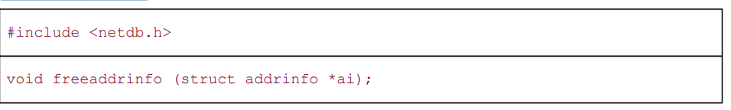
RV College of
Engineering
Go, change the world
freeaddrinfo Function
All the storage returned by getaddrinfo, the addrinfo structures, the ai_addr structures, and the ai_canonname string are obtained dynamically (e.g., from malloc).
This storage is returned by calling freeaddrinfo.
ai should point to the first addrinfo structure returned by getaddrinfo.
All the structures in the linked list are freed, along with any dynamic storage pointed to by those structures

Slide 58
RV College of
Engineering
Go, change the world
Note:
Making a copy of just the addrinfo structure and not the structures that it in turn points to is called a shallow copy.
Copying the addrinfo structure and all the structures that it points to is called a deep copy

Slide 59
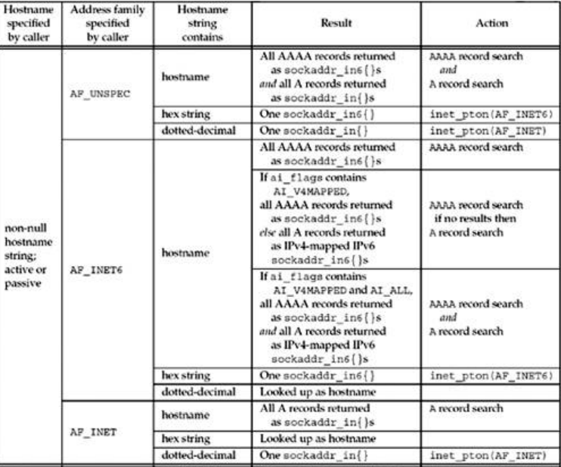
RV College of
Engineering
Go, change the world
getaddrinfo Function: IPv6
Summary of how getaddrinfo handles IPv4 and IPv6 addresses. .
The "Result" column is what is to be returned to the caller, given the variables in the first three columns.
The "Action" column is how the function obtains this result.

Slide 60
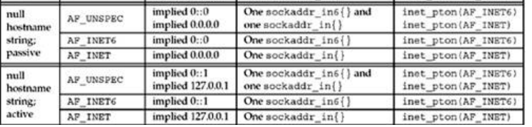
RV College of
Engineering
Go, change the world
getaddrinfo Function: IPv6

Slide 61
RV College of
Engineering
Go, change the world
Remember:
getaddrinfo is dealing with two different inputs
  The type of socket address structure the caller wants back.
  The type of records that should be searched for in the DNS or other database.
  The address family in the hints structure provided by the caller specifies the type of socket address structure that the caller expects to be returned.
  specifying AF_UNSPEC will return addresses that can be used with any protocol family that can be used with the hostname and service name.
    This implies that if a host has both AAAA records and A records, the AAAA records are returned as sockaddr_in6 structures and the A records are returned as sockaddr_in structures.

Slide 62
RV College of
Engineering
Go, change the world
Remember:
If the AI_PASSIVE flag is specified without a hostname, then the IPv6 wildcard address (IN6ADDR_ANY_INIT or 0::0) should be returned as a sockaddr_in6 structure, along with the IPv4 wildcard address (INADDR_ANY or 0.0.0.0), which is returned as a sockaddr_in structure.
The address family specified in the hint structure's ai_family member, along with the flags such as AI_V4MAPPED and AI_ALL specified in the ai_flags member, dictate the type of records that are searched for in the DNS (A and/or AAAA) and what type of addresses are returned (IPv4, IPv6, and/or IPv4-mapped IPv6).

Slide 63
RV College of
Engineering
Go, change the world
Remember:
The hostname can also be either an IPv6 hex string or an IPv4 dotted-decimal string. The validity of this string depends on the address family specified by the caller. (AF_INET for IPV4, AF_INET6 for IPV6 and AF_UNSPEC for both )

