Slide 1

CREATED BY
Bradley Mizinga
Notes:
Welcome. This is THE AXIOM: fleet diesel fraud intelligence, created by Bradley Mizinga.

Slide 2
Diesel leaks quietly.
Easy to edit
Hidden in plain sight
Small, repeated skimming stays under the radar. No single entry looks wrong enough to question.
Manual logs and loose paperwork can be changed after the fact, with no trail of who did what.
Found too late
If a number can be quietly changed, it can’t be trusted.
By the time month-end reports show a problem, the diesel is gone and so is the evidence.
Notes:
Problem one: records that can be edited without a trace.

Slide 3
Diesel leaks quietly.
Hidden in plain sight
Easy to edit
Manual logs and loose paperwork can be changed after the fact, with no trail of who did what.
Small, repeated skimming stays under the radar. No single entry looks wrong enough to question.
Found too late
Ten litres a day looks harmless. Across a fleet and a year, it isn’t.
By the time month-end reports show a problem, the diesel is gone and so is the evidence.
Notes:
Problem two: the loss is small per entry but constant.

Slide 4
Diesel leaks quietly.
Found too late
Easy to edit
Manual logs and loose paperwork can be changed after the fact, with no trail of who did what.
By the time month-end reports show a problem, the diesel is gone and so is the evidence.
Hidden in plain sight
No evidence means nothing to recover and nothing to act on.
Small, repeated skimming stays under the radar. No single entry looks wrong enough to question.
Notes:
Problem three: you find out after the fact.

Slide 5
How THE AXIOM works
01 Capture
02 Detect
Every entry is scored against expected use. Outliers and slow drift are flagged automatically.
Log fills and trips in seconds: distance, litres, route and a receipt photo.
03 Act
Fast on a phone, with proof attached to every entry.
Open a case, assign an investigator, track recovery and report the result.
Notes:
Step one: capture clean data at the source.

Slide 6
How THE AXIOM works
02 Detect
01 Capture
Log fills and trips in seconds: distance, litres, route and a receipt photo.
Every entry is scored against expected use. Outliers and slow drift are flagged automatically.
03 Act
Alerts show why they fired, so investigators start with facts.
Open a case, assign an investigator, track recovery and report the result.
Notes:
Step two: detection that explains itself.

Slide 7
How THE AXIOM works
03 Act
01 Capture
Log fills and trips in seconds: distance, litres, route and a receipt photo.
Open a case, assign an investigator, track recovery and report the result.
02 Detect
Every step is recorded in a tamper-evident trail.
Every entry is scored against expected use. Outliers and slow drift are flagged automatically.
Notes:
Step three: act with evidence.

Slide 8
What you get
Explainable alerts
Drift detection
Data-quality scores
See exactly why an entry fired, and test what would change the verdict.
CUSUM tracking catches slow, sustained leakage a single check would miss.
Every truck gets a 0–100 score for completeness and plausibility.
Tamper-evident log
Cases & recovery
Finance & ESG
Hash-chained audit trail shows if any record was changed.
Assign, review in bulk, and track litres and money recovered.
Loss reserve, ROI, cost per km and Scope 1 CO₂e in one view.
Notes:
Six capabilities, all live in the product today.

Slide 9
One platform, three views
Fleet managers
Finance leaders
Leakage in currency, a loss reserve with a confidence range, and a board pack to download.
A live alert queue, saved views and bulk actions to clear the risky entries first.
Drivers & teams
Save views like “my high-risk queue” and share them by link.
Fair, transparent scoring with reasons, so honest drivers are protected, not punished.
Notes:
For fleet managers: speed through the queue.

Slide 10
One platform, three views
Finance leaders
Fleet managers
A live alert queue, saved views and bulk actions to clear the risky entries first.
Leakage in currency, a loss reserve with a confidence range, and a board pack to download.
Drivers & teams
Print the board pack straight to PDF for the next meeting.
Fair, transparent scoring with reasons, so honest drivers are protected, not punished.
Notes:
For finance: numbers they can take to the board.

Slide 11
One platform, three views
Drivers & teams
Fleet managers
A live alert queue, saved views and bulk actions to clear the risky entries first.
Fair, transparent scoring with reasons, so honest drivers are protected, not punished.
Finance leaders
Every flag comes with reasons, so a driver can explain it.
Leakage in currency, a loss reserve with a confidence range, and a board pack to download.
Notes:
For drivers: transparency and fairness.

Slide 12
Built to be fair and defensible
Transparent
Auditable
Accessible
Multilingual
Every score shows its reasons.
Changes are logged and verifiable.
Works on phones, dark, light and high-contrast.
Navigation in ten languages, more coming.
Your data stays in your browser; nothing is sent to third parties.
Notes:
Evidence has to stand up to scrutiny, and the people it scores deserve to understand it.

Slide 13
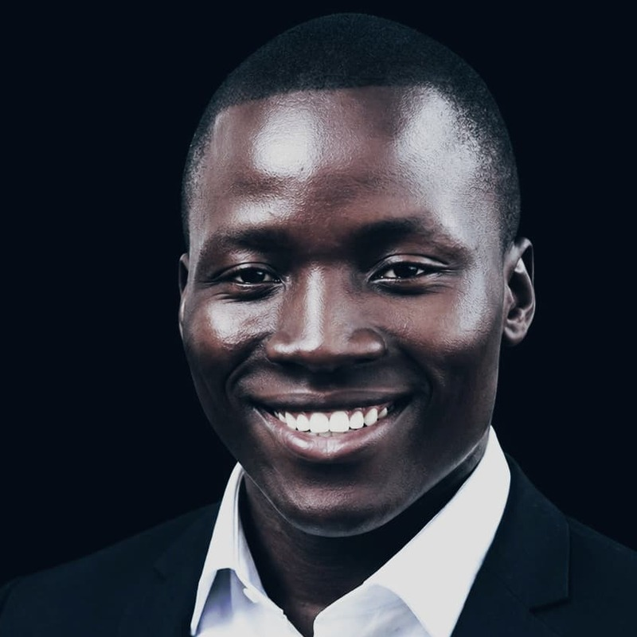
Behind THE AXIOM
CREATED BY
Bradley Mizinga
Creator of THE AXIOM, built to give transport operators clear, honest answers about every litre of diesel.
Notes:
Introduce the creator.

Slide 14
Stop the leak. Start today.
Create your company, add your trucks, log your first fills, and see your first insights in minutes.
Notes:
Close: invite them to try it, request a demo, or ask questions.

