Slide 1
What is egoism?
Presented by Yeabsira Tesfaye

Slide 2

Egoism:
Is the philosophy concerned with the self’s role, or ego, as the motivation and goal of one’s own action

Slide 3
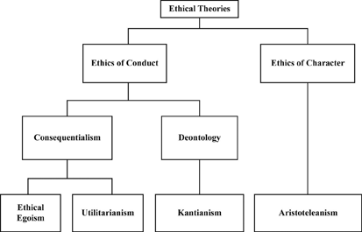

Slide 4
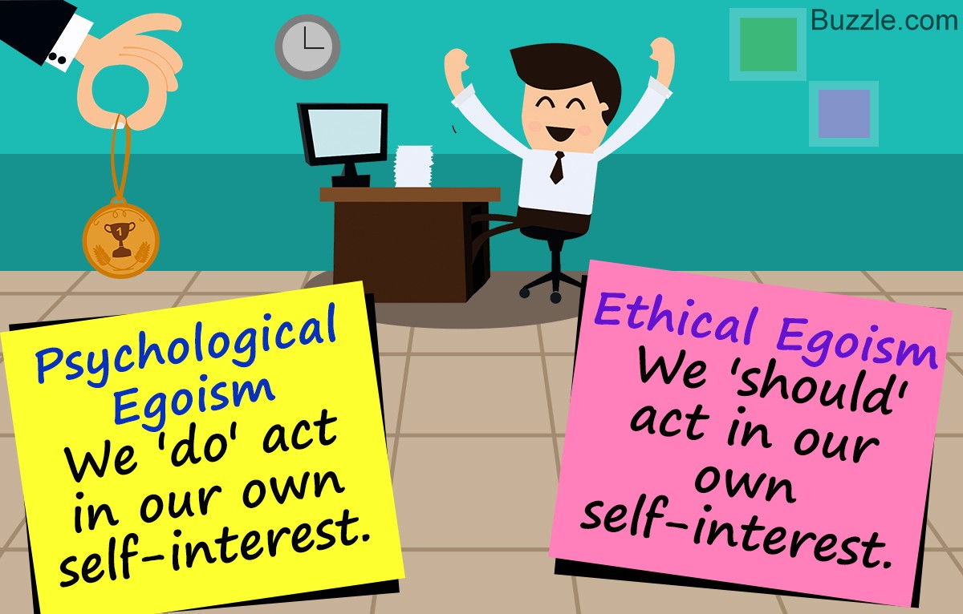
Egoism
Psychological
Ethical
Rational

Slide 5
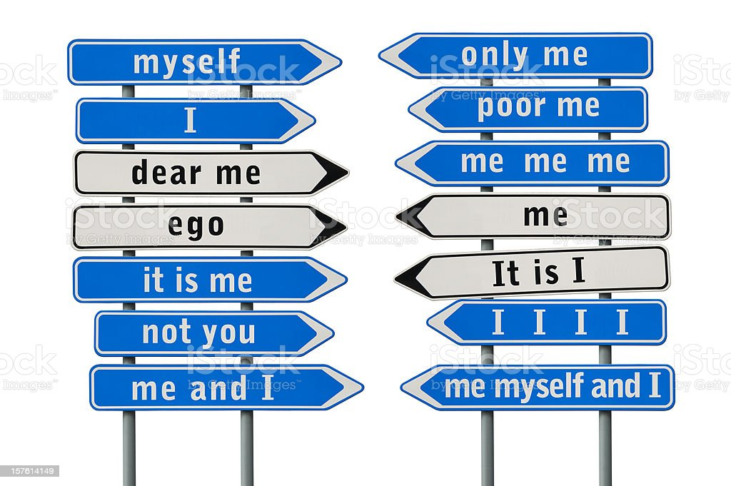
Psychological egoism:
People are always motivated by self-interest, even in what seems to be act of alturism

Slide 6
Ethical egoism
Which is the theory that one morally ought to perform some action if and only if, and because performing that action maximize one’s self interest.
Henry Sedgwick 1861-1957

Slide 7
Ethical egoism
Individual
Personal
universal

Slide 8
Rational egoism
An action is rational if and only if it maximizes one’s self interest.

Slide 9
Strength Weakness
Egoism allows freedom to the individual.
Sometimes doing what is in your own best interests promotes the interests of other people as well.
People who are egoists should have less difficulty in deciding what they think is right.
Common sense seems to tell us that we should do what suits us best.
Egoism does not promote the common good.
Egoists may be able to claim that what seem to be objectionable actions are morally right (eg gluttony)
What is right for one person could be wrong for another.
There is no sense in arguing about what is right-it’s right if it benefits me.

