Slide 1
Jenkins

Slide 2
1)Introduction to Jenkins
CI/CD:
→Whenever developers write a code, we integrate all the code of all developers at that point of time and we build, test and deliver/deploy to the client. This process is called CI/CD.

Slide 3
→Jenkins helps in achieving this.
→So instead of doing night builds as when commit occurs by integrating all code is what continues integration.
→So, in a day, there will be so many integrations, builds, tests and delivers/deployments.
→So that bugs will be repaired fast and get rectified fast. So development happens fast.
→Continuous Integration: Your changes are getting integrated and quality checked continuously.
→Simply it means every commit a developer does, immediately you integrate all the changes then do a build so that whether there is a problem or not you can find it out.
→Commit all the changes in a repo then do a build.
→Jenkins is an open source CI server - tool used to achieve CI.
→Jenkins is maintained by Oracle.
→Works in client-server model.
→Dashboard shows the jobs, where they run and the status with history.
→If new change is happened:
1)Integrate (git pull)
2)Repository (poll scm)
3)Build (maven we will call)
1)compile
2)Test
3)Package

Slide 4
4)Deploy
5)Code coverage
6)Code analysis
Key Terminology:
Integrate:
→Combine all the code written by developers till some point of time.
Build:
→Combine the code and make a small executable package.
Test:
→Test in all environments whether application is working properly or not.
Achieved:
→Stored in an antifactory so that in future we may use/deliver again.
Deliver:
→Handling the product to client.
Deploy:
→Installing product in client’s machine.
Jenkins work flow:
→We attach git, maven, sonar and antifactory plugins to Jenkins.
→Once developers put code in git, Jenkins pull that code and send to maven for build.
→Once build is done, Jenkins pull that build code and send to sonar for testing.
→Once testing is done, then Jenkins will pull that code and send to antifactory as per requirement.
→We can also deploy with Jenkins.

Slide 5
Ways of continues Integration:
→Can do manually
→Can write scripts
→Can use tool like Jenkins
Benefits of CI:
→Defects caught early.
→Delete bugs as soon as possible.
→Maintains history for references.
→If you want, you can stop SDLC process at any stage. For example, you can stop at test stage only or you can continue till deployment.
→Easy to setup and maintain.
→Easy integration with other tools by using plugins.
→Can run on cloud infra as well as data center.
Why only Jenkins:
→It has many plugins.
→You can write your own plugin
→You can use community plugins.
→Jenkins is not a just tool. It is a framework means you can do anything whatever you want. All you need is plugins.
→Jenkins is not going to do any job. It instructs others to do job. If other servers are not available, Jenkins itself does the job.
→Jenkins also acts as c server replacement means you can do repeated tasks automatically.
→Can create labels (group of servers)

Slide 6
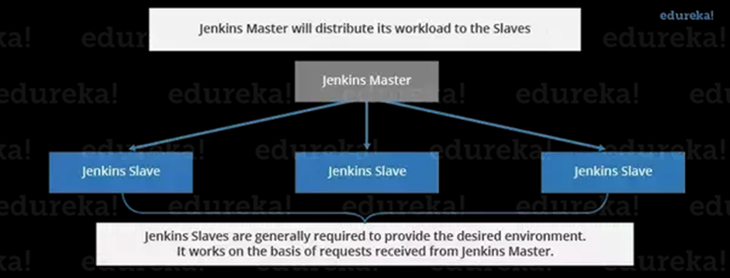
Jenkins Architecture:
→Client-server model.
→When you install Jenkins, it acts as master.
→Jenkins invoke clients to perform jobs.
→Supported OS
→Can install in any os.
→You will be accessing Jenkins with web only.
→choose long term support release.
→install java
→Open source- jenkins
Enterprise edition- hudson
→Three types of configurations
1)Global configuration
2)Node configuration
3)Job configuration

Slide 7
1)Global system configuration: Tools, environment variables.
2)Node configuration: Job in which machine you want to run
3)Plugin Configuration: In Jenkins master install plugins.
4)Job configuration: All jobs will be configured here.
2)Installation of Jenkins
https://www.jenkins.io/doc/tutorials/tutorial-for-installing-jenkins-on-AWS/
1)yum update -y
2)sudo yum install java-1.8.0-openjdk-devel
3)curl --silent --location http://pkg.jenkins-ci.org/redhat-stable/jenkins.repo | sudo tee /etc/yum.repos.d/jenkins.repo
4)sudo rpm --import https://jenkins-ci.org/redhat/jenkins-ci.org.key
5)sudo yum install jenkins
6)sudo systemctl start jenkins
7)systemctl status jenkins
8)sudo systemctl enable jenkins
9)cat /var/lib/jenkins/secrets/initialAdminPassword

Slide 8
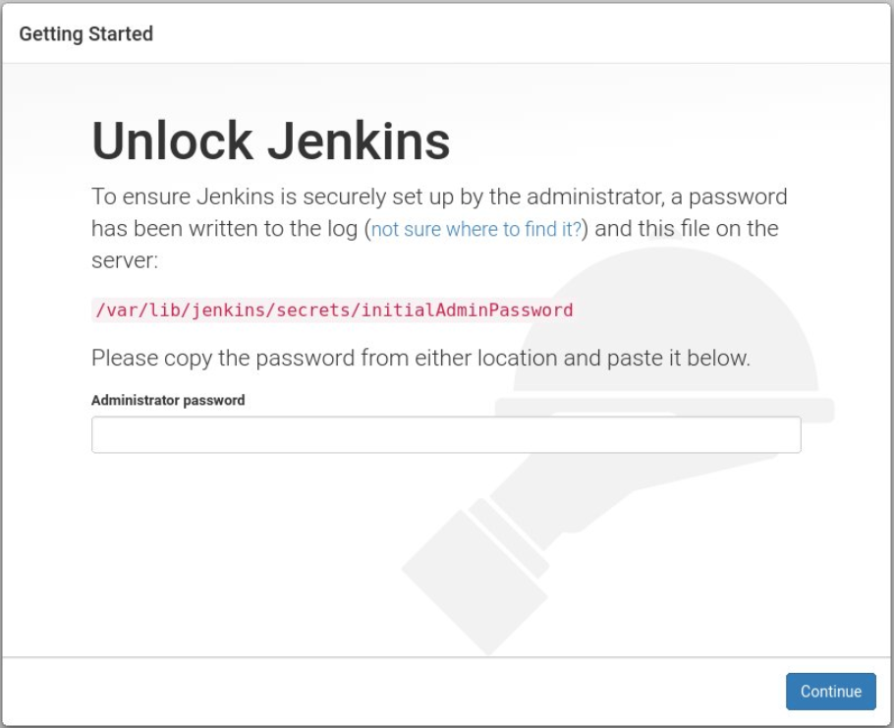
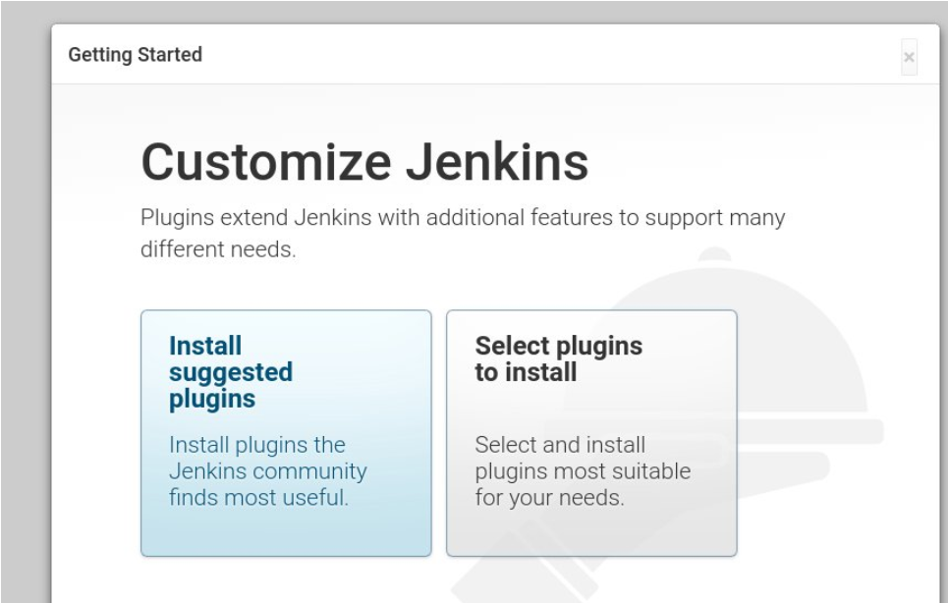

Slide 9
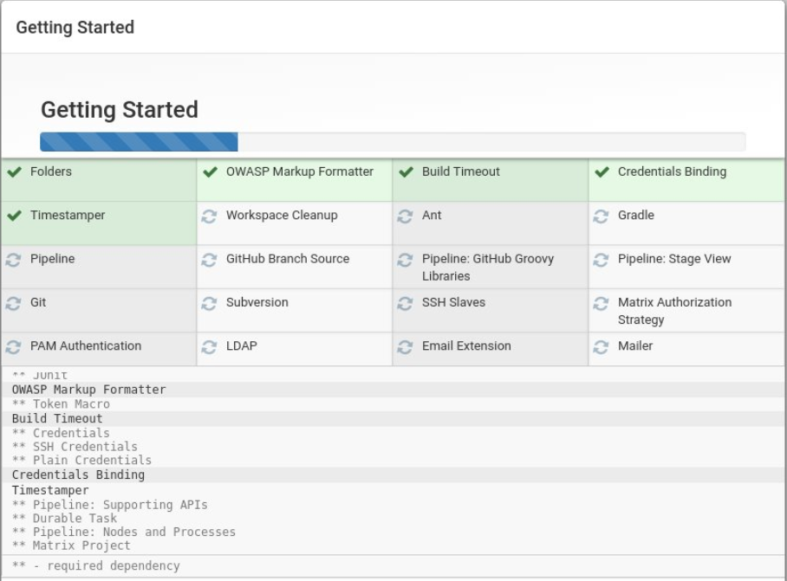
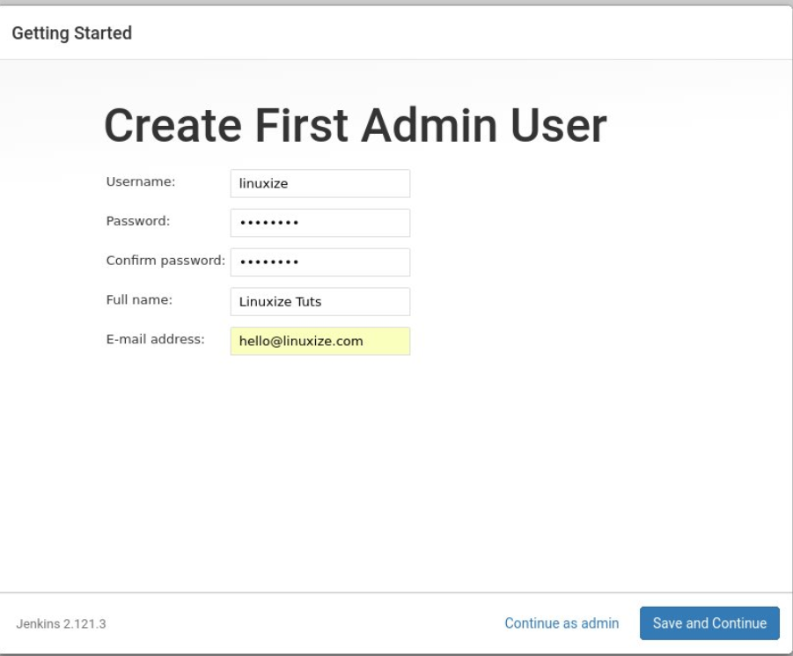

Slide 10
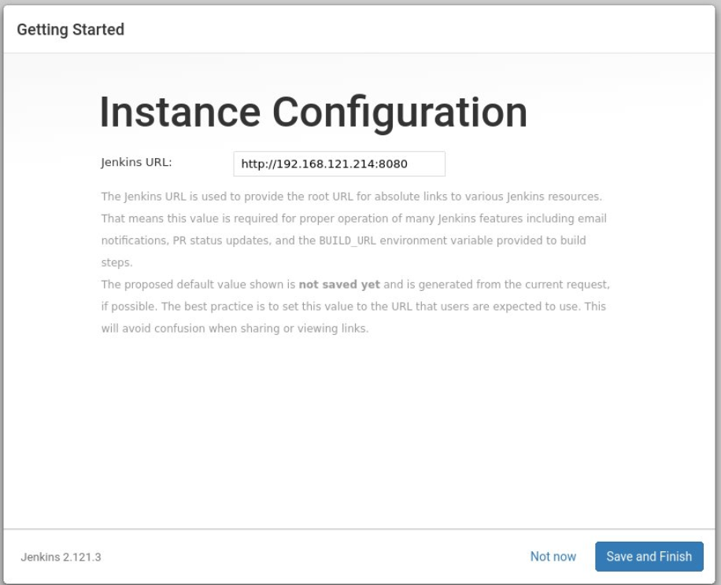
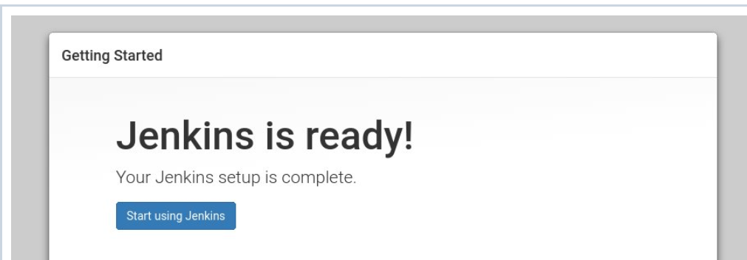

Slide 11
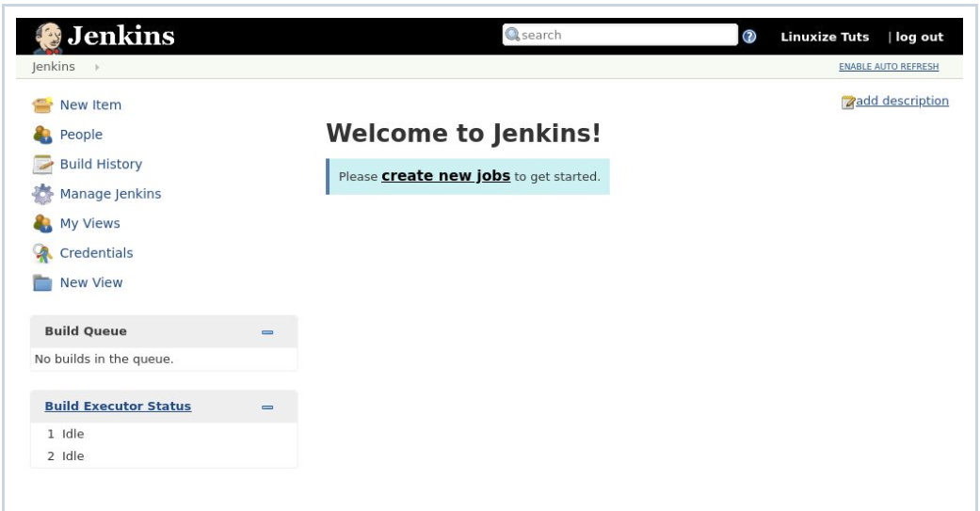
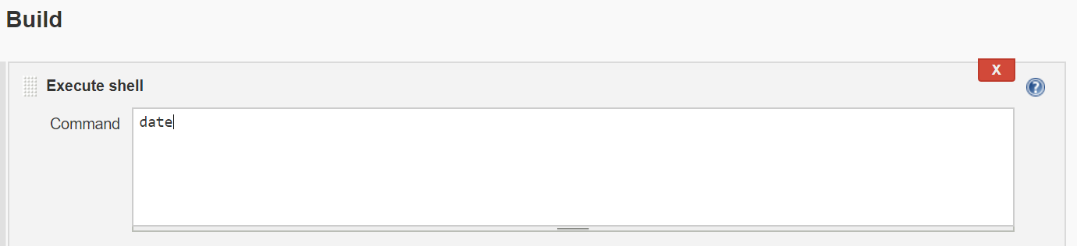
3)Creating first job in Jenkins:
1)Click on new item→Enter the item name→like give it as script→Click on free style project→click on Ok
2)Go to Build tab→click on execute shell
3)Click on apply and save
4)Click on Build now
5)Check the console output

Slide 12
From CLI checking:
/var/lib/jenkins/jobs/script/builds/1
4)Git integration
For git integration first we must install git in Jenkins server.
[] yum -y install git
→Go to Jenkins dashboard→Click on new item→Give name→Free style→ok
→Navigate to source code management→Click on git→Enter the url
→Click apply and save.
-->Build the job
5)Maven integration
What is Maven:
→Build tool
→Dependency management tool
→Documentation tool
→Project management tool
→Project life cycle
Build: compile+ assembly+ create deliverable
Compile: Convert source code to machine readable format.
Assembly: grouping all class files
Deliverable: .war, .jar

Slide 13
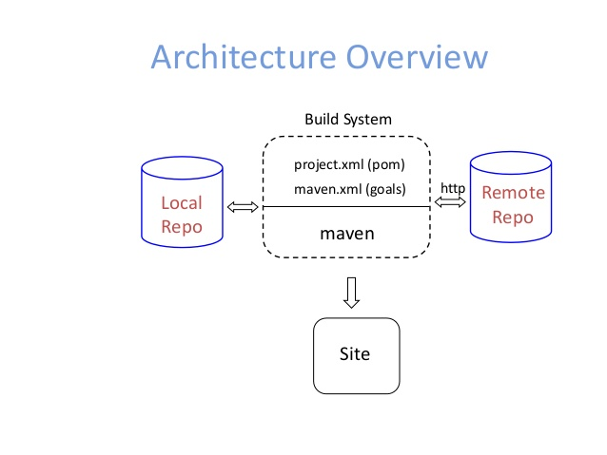
Maven Architecture:
→Main configuration file is pom.xml
→one project-one workspace-one pom.xml
→requirements for build
1)Source code (present in workspace)
2)Compiler (maven compiler not java compiler)
3)dependencies
→Anything you want to do in maven in terms of goals. Goals will invoke plugins. Plugins will do task.
Maven->goals->plugins->task
→pom.xml is inside workspace. Goals are inside pom.xml
→Whenever you are using maven, it will go to pom.xml file then it will check for goals what are specified in it.

Slide 14
Pom.xml:
→list of sources (goals)
→list of resources(plugins)
Local repo:
→In current directory, maven check for list of sources and list of resources.
→If resources are not available in local repo, it will check in remote repo.
Advantages of Maven:
→Automated tasks
→Multiple tasks at a time
→quality product
→minimize bad builds
→keep history
→save time
→documentation
→gives set of standards
→Gives define project life cycle
→manage all dependencies.
→reusability
→Why separate build team: to match customers environment.
Build tools:
C,c++ - makefile
.net – visual studio
Java – ant, maven

Slide 15
Maven build life cycle:
1)Default life cycle
2)non-default cycle
Default life cycle:
1)generate sources and resources
2)Compile(java files converted into class files)
3)test(unit test)
4)package(.jar, .war,.ear)
5)install
6)deploy
Package:
→Package is nothing but assembly.
→It is giving one deliverable
→.jar: java archive. It contains one or more class files through which you will be getting functionality.
→.war: stands for web archive. For web applications. For installing web applications, you need war. War contains web related files.
→. ear: Enterprise based archive. It is also for web application but is license based.
Non-default life cycle:
→clean, site come under non-default life cycle. If you are doing non-default life cycle it will execute only particular phase. Not all the phases.
→clean: It will delete all the run time files (.class files, test result). It will not delete source code.

Slide 16
→Site: It is another independent phase, which is going to help for creation of documentation. How project is created, what dependencies we have, it will mention in documentation.
Workspace(or)project directory:
1)src→src main, src test
2)pom.xml →configuration files
Project Name:
→maven uniquely identifies a project by using groupid, artifact, version.
→groupid: arbitrary project grouping identifier
→artifact: arbitrary name of a project
→version: version of a project
→Syntax: groupid:artifactid:version
Maven Environment setup:
→M2_Home: It is a directory contains content maven zip file or tar file.
→You will install maven in m2_Home.
→M2: refers to a value
→under m2_Home you will be having bin folder, that bin folder is nothing but M2.
Creating Project:
→[] mvn archetype:generate
Maven Repository:
Remote Repo:
→Dependencies are downloaded from repos via http

Slide 17
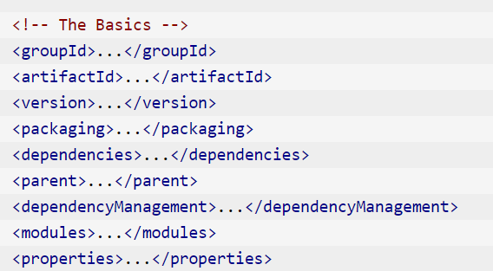
Local Repo:
→downloaded dependencies are cached in a local repo.
Pom:
What is pom:
→pom stands for project object model.
→It is a fundamental unit of work in maven, pom is an xml file that contains information about project and configuration details used by maven to build the project.
→pom contains name and version, artifact type, source code location, dependencies, plugins, profiles.

Slide 18
Plugin types:
Build plugins: default life cycle phases are called build plugins.
Reporting plugins: site plugin
Maven snapshot:
Multi Module project:
→project can be divided into modules.
→Each module will act as separate mini project
Dependency management:
→With GAV we are identifying project.
→So, dependencies are mentioning with GAV.
Profiles:
→Profiles are nothing but group of plugins when you want you can call.
Maven Snapshot:
Diff between version and snapshot:
→In terms of version, maven has a downloaded a dependency project version 1. 0.. It will not download the latest version of 1.0 while building the project.
To get the latest version, the dependent project needs to get upgrade its version to 1.1.
→In case of maven snapshot, maven will automatically download the latest snapshot of the dependency project every time the project is build.
Maven setup in Jenkins:
→Go to manage Jenkins→global tool configuration→maven→Add maven→give name and version→apply and save

Slide 19
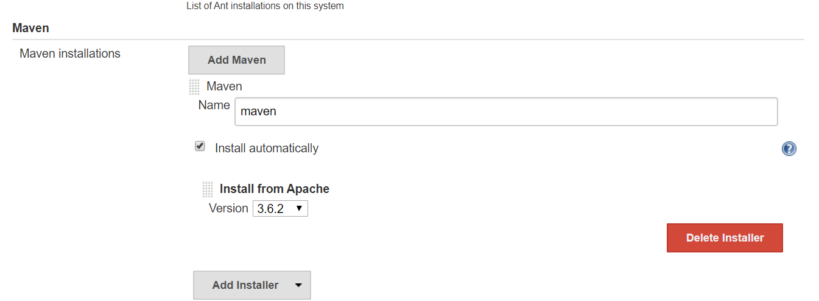
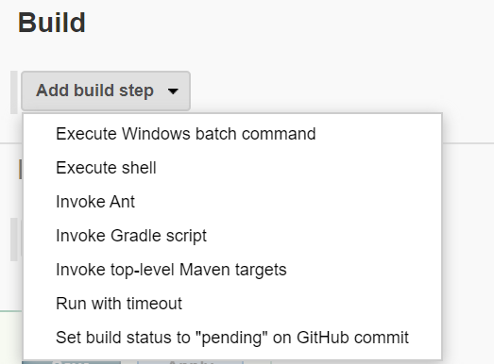
Example Job configuration:
→Click on new item→give name →Ok
→go to configuration and source code management click on git and give the url.
→go to build →click on invoke top level maven targets

Slide 20
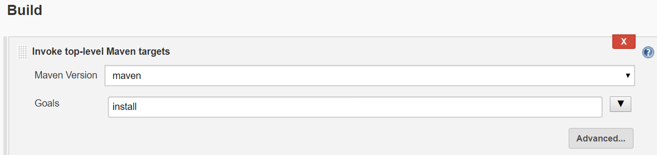
→give maven version and goal as install
→Click on apply and save
→Click on build now and check the console output.
6)Nexus Integration
What is nexus
→Nexus is a repository manager, it stores "artifacts"
→It allows you to collect, and manage your dependencies
→It makes it easy to distribute your software. Internally, you configure your build to publish artifacts to Nexus and they then become available to other developers.
Types of repositories:
A repository group is a collection of other repositories, where you can combine multiple repositories of the same format into a single item.
A proxy repository is a repository that is linked to a remote repository. Any request for a component is verified against the local content of the proxy repository. If no local component is found, the request is forwarded to the remote repository.

Slide 21
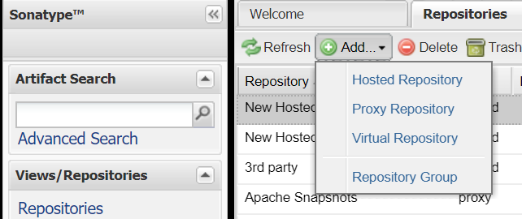
This hosted repository can be used for third-party dependencies not available in the public Maven repositories.
Installing nexus:
1)yum install java-1.8.0-openjdk-devel -y
2)wget http://www.sonatype.org/downloads/nexus-latest-bundle.zip
3)ls -la
4)chmod 777 nexus-latest-bundle.zip
5)unzip nexus-latest-bundle.zip
6)ls -la
7)cd nexus-2.14.14-01/
8)cd bin/
9)RUN_AS_USER=root ./nexus start
10)hit the browser with = ip:8081/nexus
11)login with user name as admin and password is admin123
12)click on repository and again click on hosted repository.
13)give the repoid, name and click on save.

Slide 22
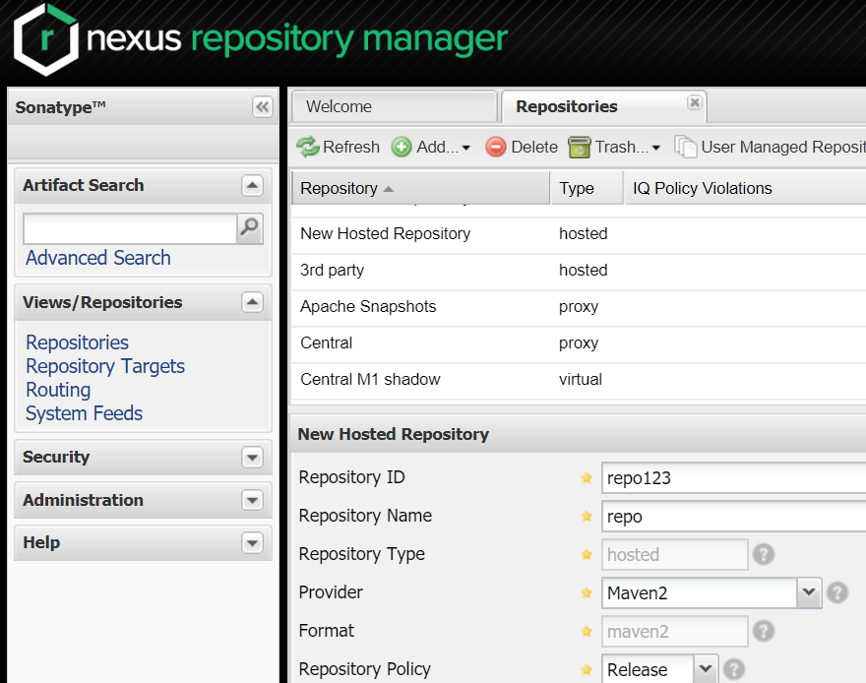
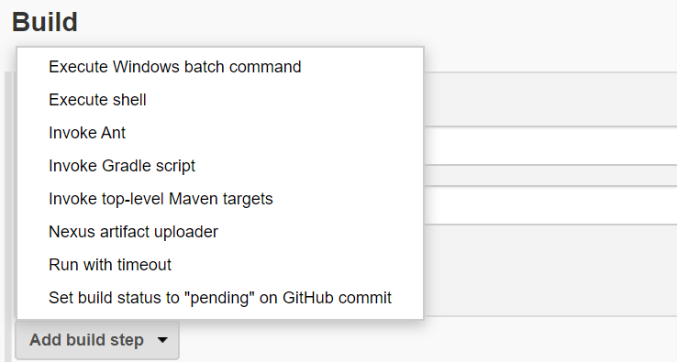
Configuring Job:
→Go to Jenkins UI→install the nexus antifactory uploader plugin.
→Go to Build and click on Nexus artifact uploader.

Slide 23
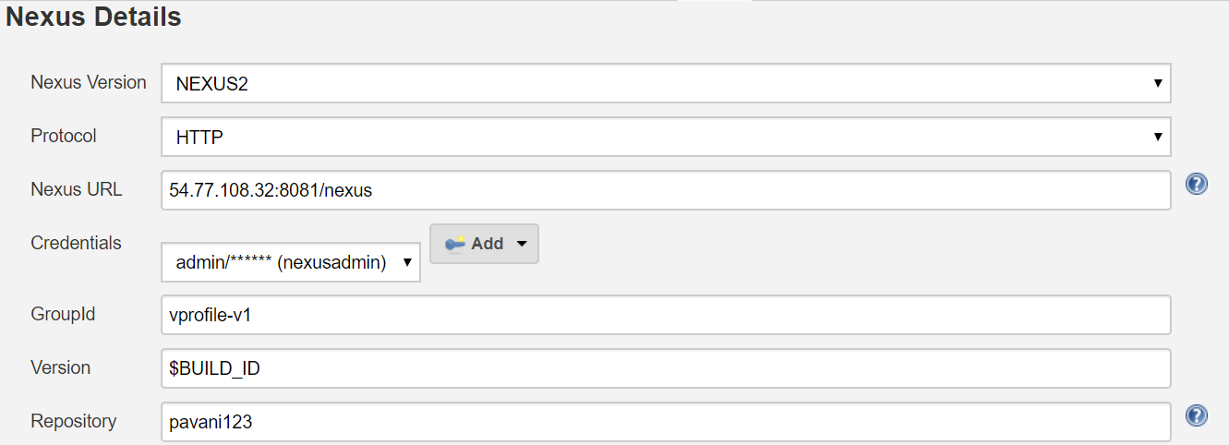
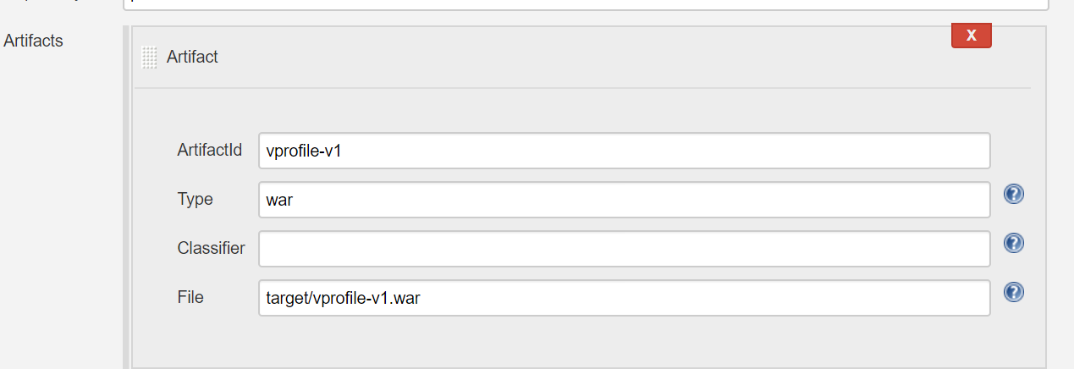
→Parameters:
Nexus URL: 54.77.108.32:8081/nexus
Credentials: username as admin and password is admin123
Groupid: vprofile-v1
Version: $BUILD_ID
Repository: Repoid
Artifactid: vprofile-v1
Type: war
File: target/vprofile-v1.war

Slide 24
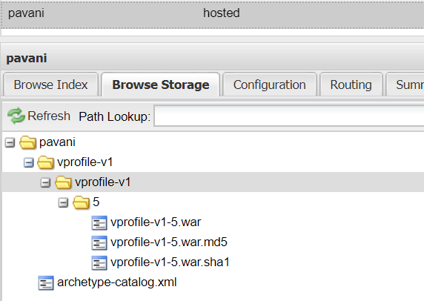
Checking Output:
Go to Nexus UI and check the output

Slide 25
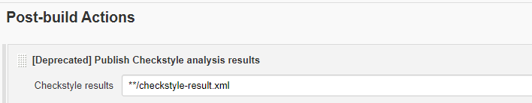
-->Check the result in static analysis warnings.
8)Tomcat integration
Continues Deployment
-->CD is the practice to continuously release software in production.
-->Code changes are continuously built, tested and pushed to a nonproduction and production environments by using automating tools.
-->Software delivery cycles are more rapid and effective.
Advantages of Continues deployment:
-->Automates software releases
-->Increase developer productivity.
-->Locates and addressing bugs quicker
Continues Delivery:
-->Continuous Delivery is a process, where code changes are automatically built, tested, and prepared for a release to production.
-->Continuous Delivery aims to make software releases, remove risk, so we can deliver frequently and get fast feedback on what users care about.
-->Manually giving product to client and we are not deploying product in application servers.

Slide 26
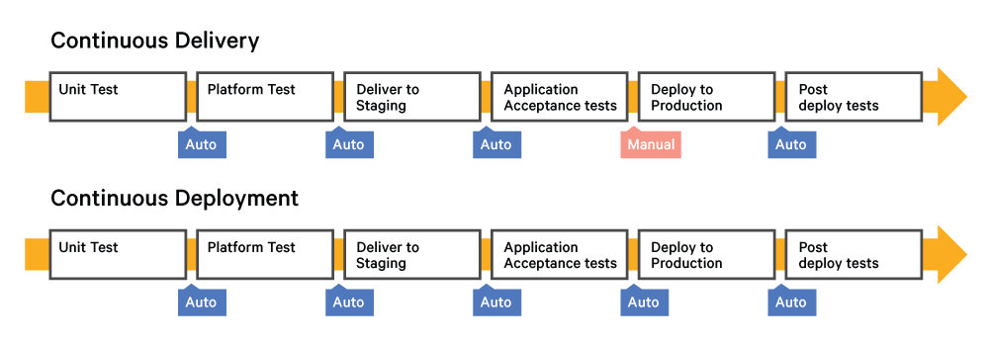
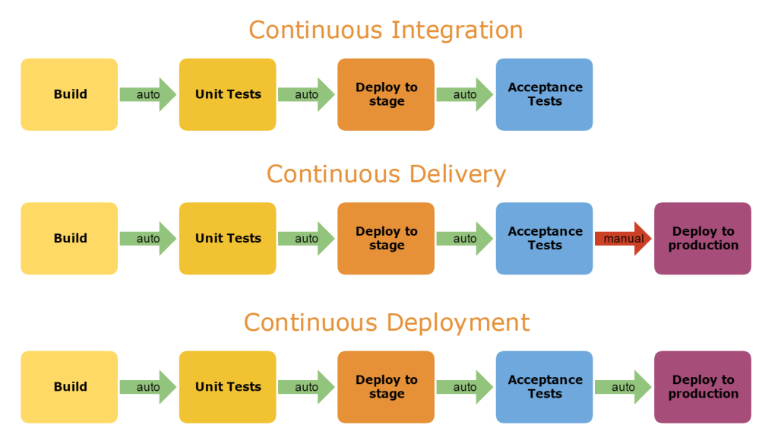
Advantages of Continues Delivery:
-->Automates software releases
-->Increase developer productivity.
-->Locates and addressing bugs quicker.

Slide 27
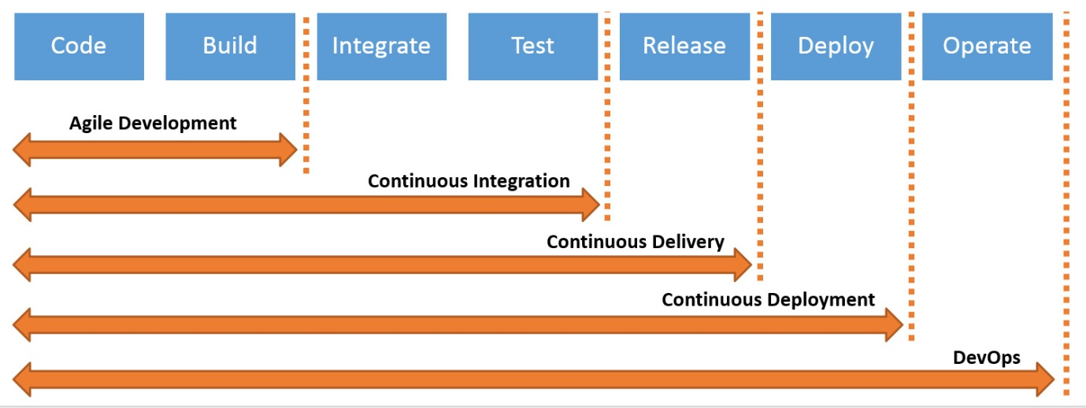
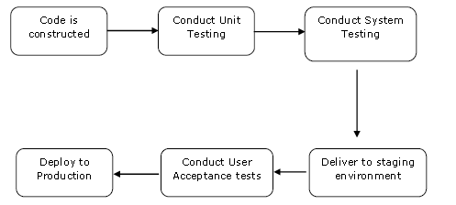
Tomcat for Continues deployment
-->Apache tomcat is used as application server where we are deploying our code.
-->Application servers are used to deploy the code
-->JBoss, tomcat used as application servers.

Slide 28
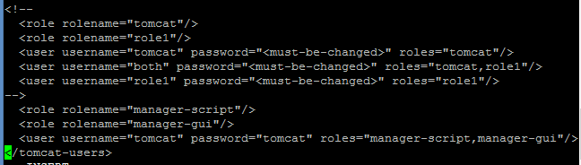
Integration with Tomcat
1)Installation of tomcat:
a)Download tomcat from web
1)yum install java-1.8.0-openjdk-devel -y
[]wget https://downloads.apache.org/tomcat/tomcat-8/v8.5.54/bin/apache-tomcat-8.5.54.tar.gz
[]tar -xvzf apache-tomcat-8.5.54.tar.gz
[]ls -la
[]cd apache-tomcat-8.5.54
[]cd conf
[]vi tomcatusers.xml
<role rolename="manager-script"/>
<role rolename="manager-gui"/>
<user username="tomcat" password="tomcat" roles="manager-script,manager-gui"/>
:wq!

Slide 29
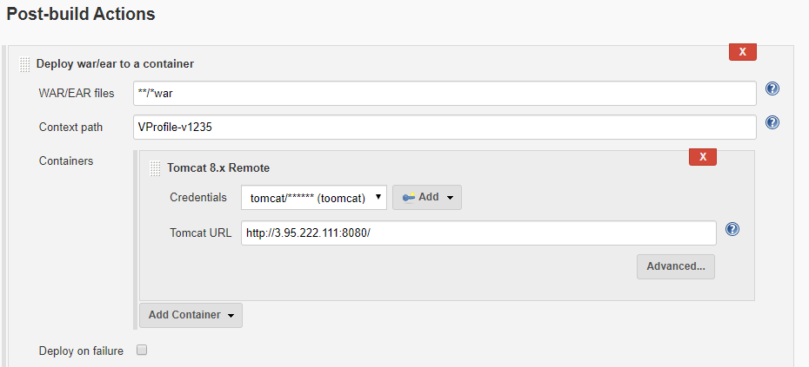
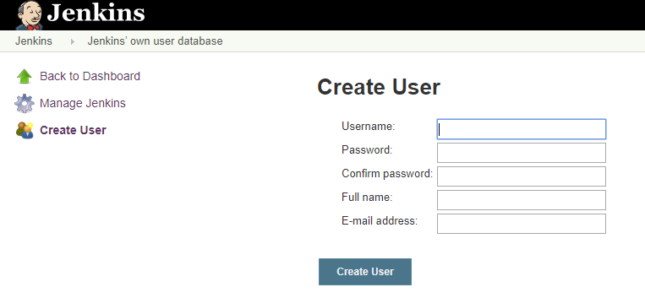
2)Integrating tomcat with jenkins
Step1)Go to jenkins and manage jenkins next install plugin called deploy to container.
Step2)Go to job configuration and next go for post build actions follow thee below.
9)User management
-->We can provide access to different users in Jenkins and also can provide them with roles based on project-based access. ...
-->Go to Manage Jenkins -> Manage Users -> Create user -> Set Credentials

Slide 30
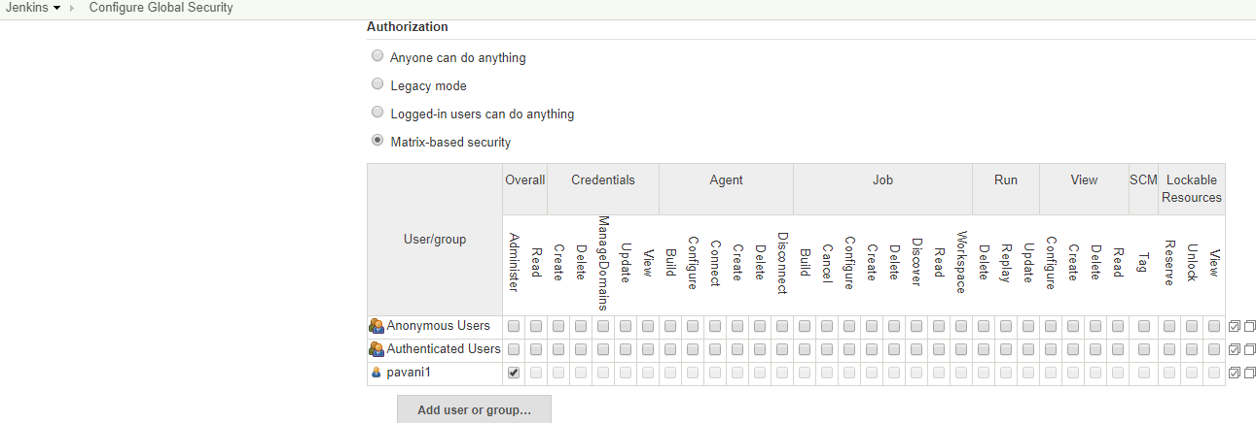
-->Go to Jenkins -->configure global securuty-->Authorization -->Matrix based authentication-->click on add user-->apply and save.
11)upstrem and downstream
-->The upstream job is the one that is triggered before the actual job is triggered. -->The downstream job is the one that is triggered after the actual job is triggered.
Setting downstream:
-->Create new item and go to configure.
-->Go to post build actions and click on other projects to build
-->Click on apply and save.

Slide 31
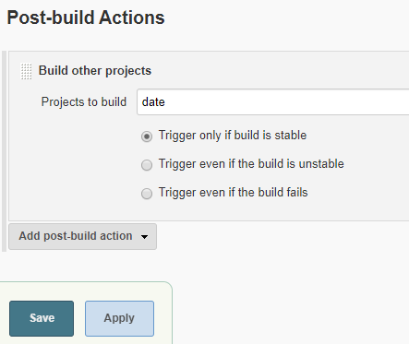
12)Pipeline
-->Jenkins pipeline is collection of jenkins jobs which trigger eachother in a specefic sequence.
-->We can create pipeline in 2 ways.
1)pipeline view
2)Pipeline script

Slide 32
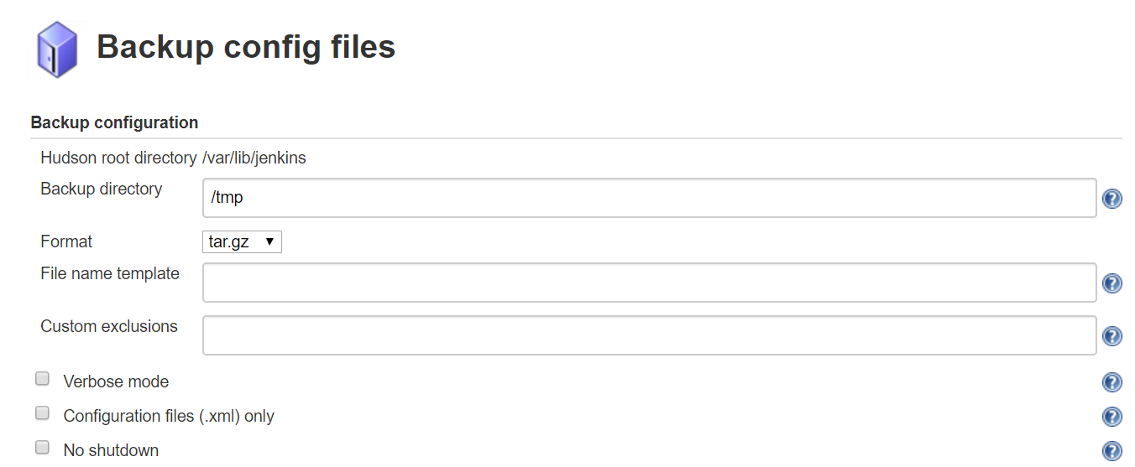
14)Jenkins backup
Introduction:
→Jenkins has a backup plugin which can be used to backup critical configurations settings related to Jenkins.
→Install Backup plugin: Backup plugin
Setup:
→Navigate to manage Jenkins→Backup manager→click on backup manager→Click on setup
1)Setup:
We have to mention the directory name where we want to take backup.

Slide 33
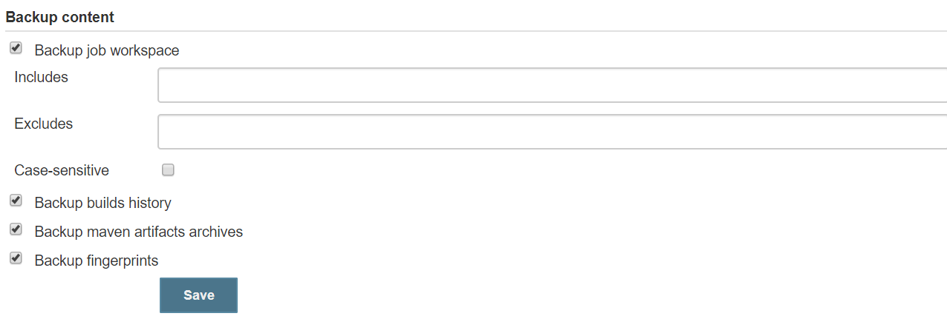
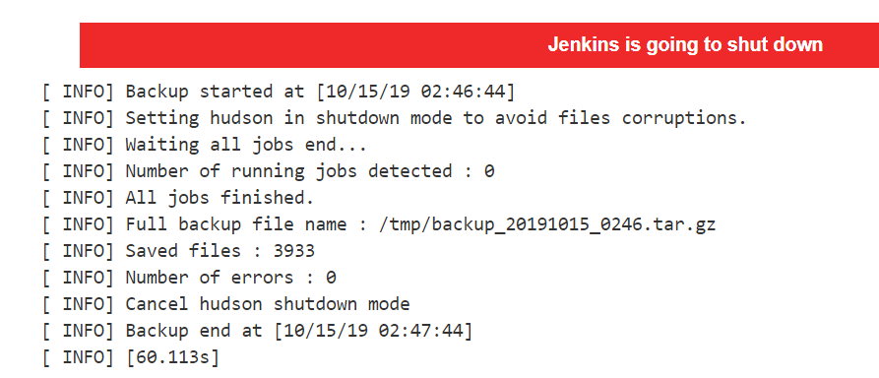
2)Click on Backup Hudson configuration
In this step Jenkins is taking backup and before taking backupjenkins is shutting down.

Slide 34
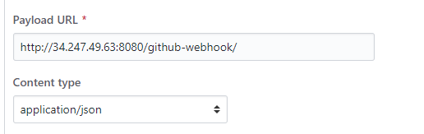
15)Differences between buid periodically, pollscm and Webhook:
Build periodically:
-->Build periodically builds the project periodically even if nothing has committed in the code.
Pollscm:
-->Poll scm checks whether changes were made and builds the project if new commits are there.
-->For example polling freequecy is every 12 hours and just now poll happened. Very next minute if the code got commited in the git master branch but the build will not happend untill the next poll. It will wait for the next poll.
Webhook
-->Used ti trigger the builds whenever a developer commits to the master branch.
How to setup webhook:
-->Go to your github account-->goto your repo-->settings-->click on webhook-->

Slide 35
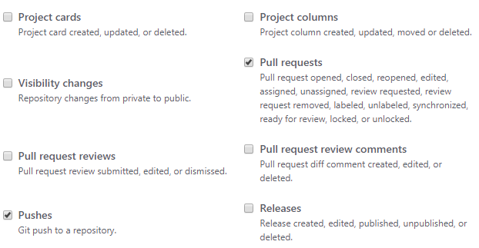
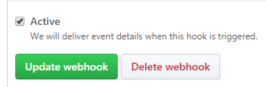
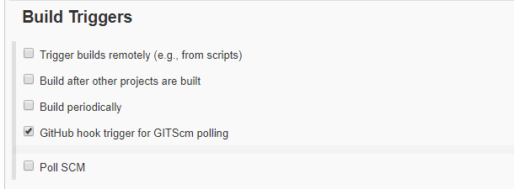
-->Here select only pull requests and pushes only
-->click on active and add webhhok.
-->Open jenkins console add git url under source code management.
-->Go to build triggers-->select the GitHub hook trigger for GITScm polling
-->Click on apply and save.

