Slide 1

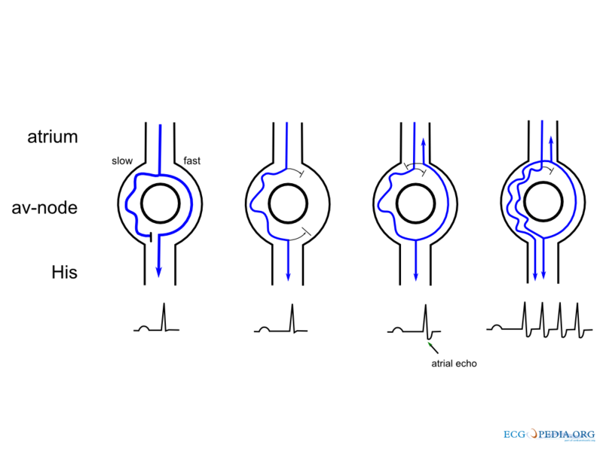
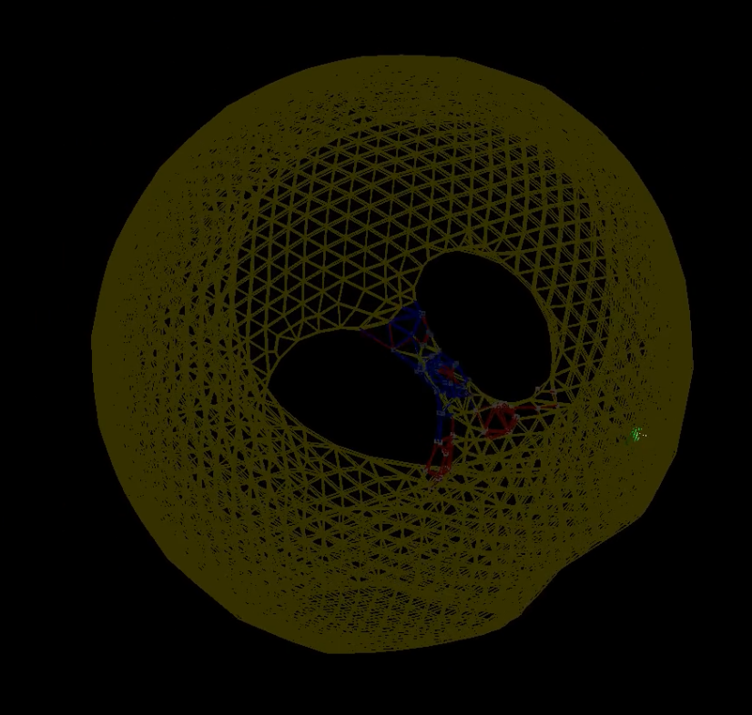

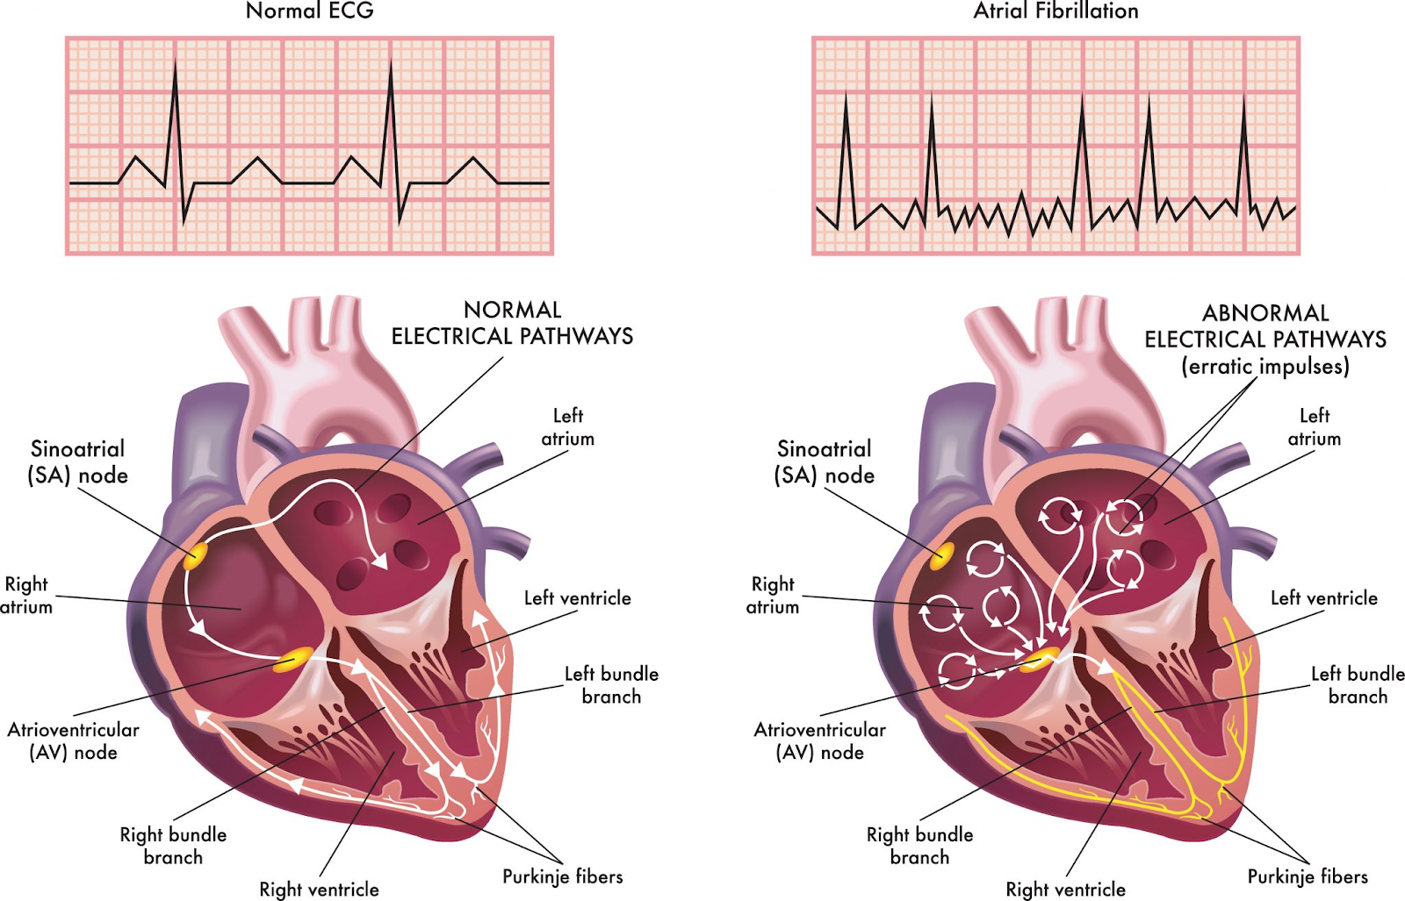
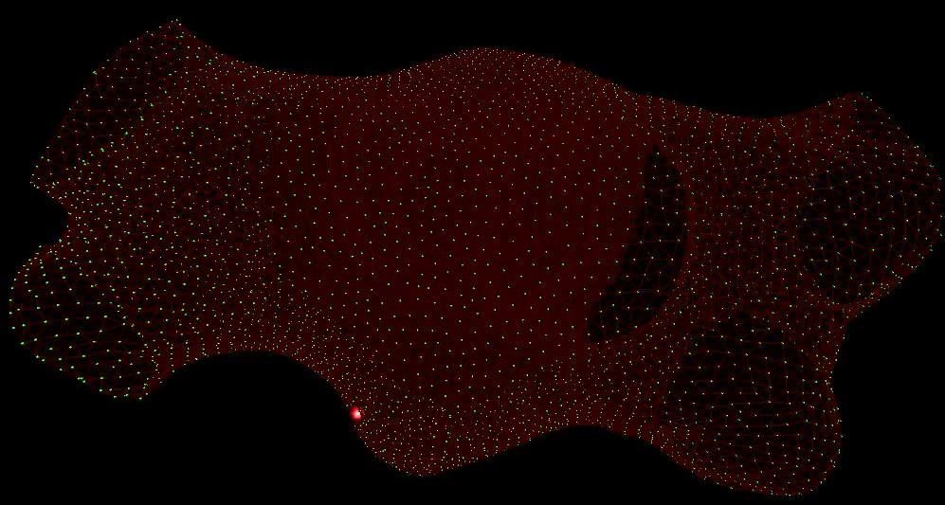
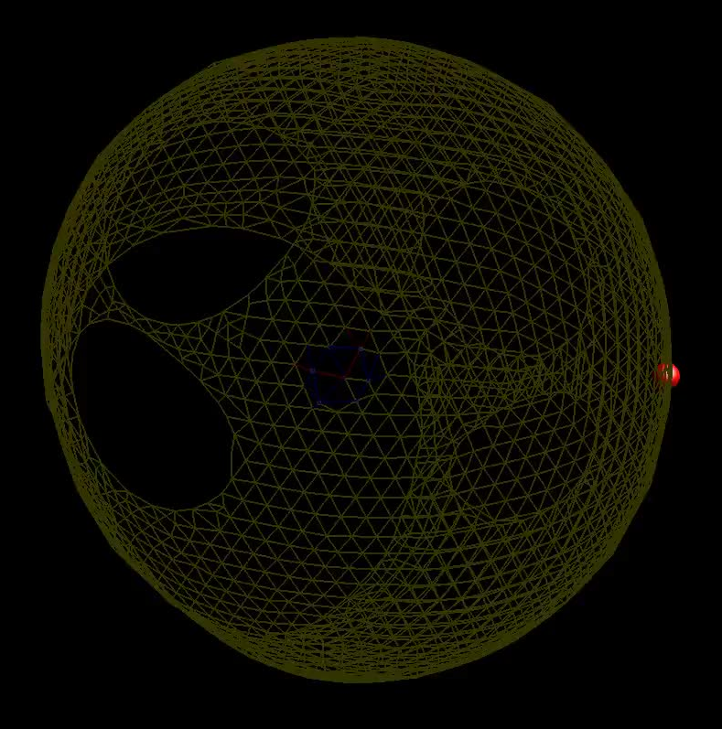


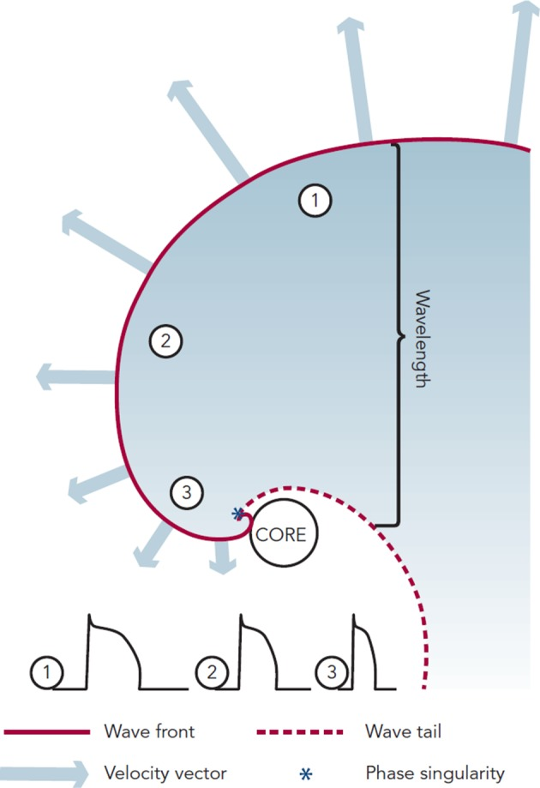
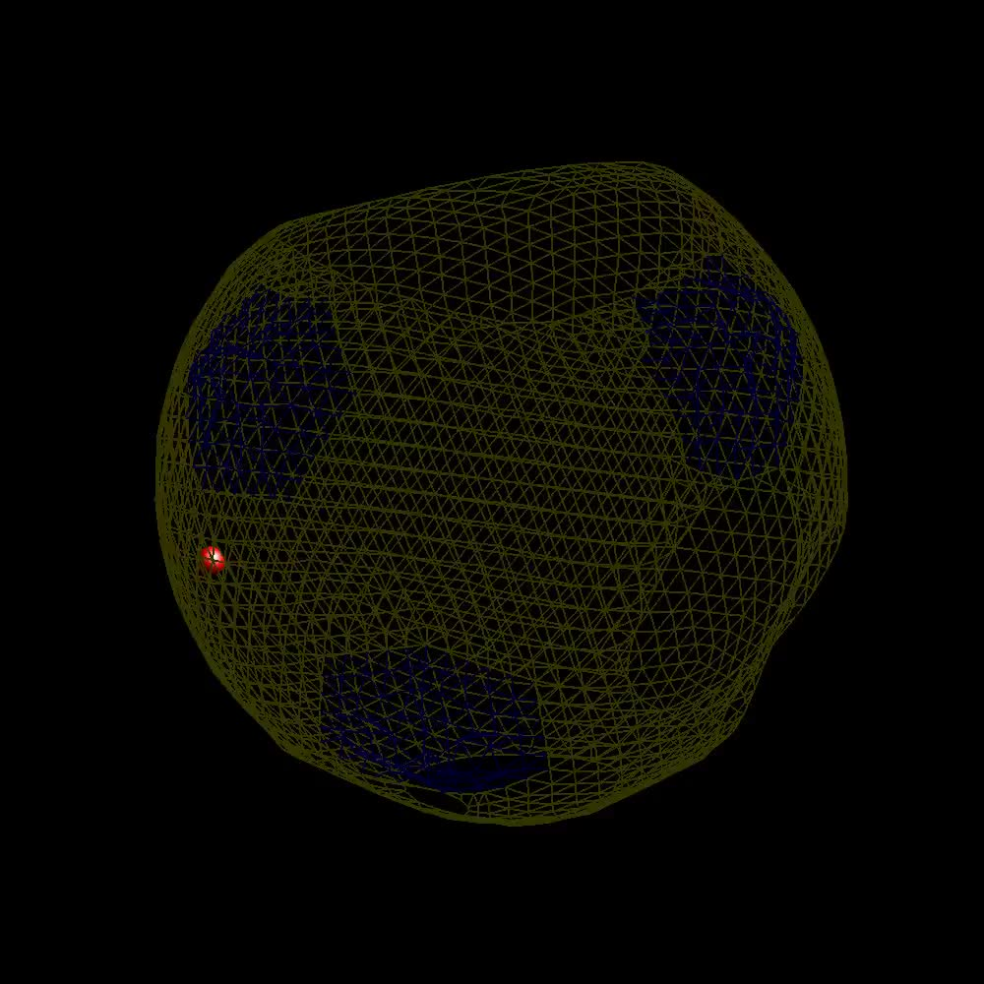

Atrial Fibrillation: Insights and Advances in Management through Computational Modeling
Hayden Rawlings, Leah Rogers, Dr. Bryant Wyatt
Department of Mathematics at Tarleton State University
Introduction
Reentry
Macro Reentry Video
Conclusion and Future
Introduction
AF Mechanisms
Rotors Video
Conclusions and Future Work
Atrial Fibrillation(AF) is an irregular and often rapid heart rhythm[1]. It is the most common and complex cardiac arrhythmia seen in clinical practice, affecting more people each year[2-3]. It is expected that over 12 million Americans will have AF by 2030. AF has a significant negative impact on morbidity and mortality worldwide associated with strokes and heart failure, the 2 leading causes of death globally[3-6]. Even with today’s advanced technology, understanding of the many highly complex mechanisms that initiate and sustain AF is still relatively limited despite its frequency. This limited understanding has prevented doctors from being able to truly cure AF even with the use of catheter ablation and antiarrhythmic drugs[7-13].
We are currently working towards simulating rotors in our model. We are looking into complex fractionated atrial electrograms as potential drivers for AF. Implementing the structural and electrical remodeling, that occurs during and before AF, into our model could help answer many of our questions.
Atrial Fibrillation is a serious problem in the lives of people around the world. Our ability to treat patients with AF is less than ideal at the present time because the underlying mechanisms that cause it are not understood. Through our work we hope to use computational modeling to increase the understanding of the mechanisms that initiate and sustain AF. Understanding these mechanisms will help to improve quality of life for those living with AF.
A
Reentry occurs when the electrical signals that regulate the heartbeat are delayed and loop back around and restimulate the area of the heart that it came from leading to an irregular and rapid heartbeat[2, 6-7].
This video shows a slowed pathway between the pulmonary veins that created atrial flutter.
Normal heartbeat vs. AF heartbeat
Micro Reentry Video
Acknowledgments
Heart Model
We would like to thank:
The Presidential excellence in Research Grant,
The Tarleton State University Mathematics department for the use of their High-Performance Computing Lab,
The NVIDIA corporation for hardware donations.
Video of a micro reentry causing the left atrium to follow its lead instead of the signal from the sinus node.
References
This is a video of our model in action.
About the heart. Atrial Fibrillation. (n.d.).
https://www.stopafib.org/learn-about-afib/what-is-afib/about-the-heart/
2. Mechanisms of Atrial Fibrillation: Reentry, Rotors, and Reality.
https://www.ncbi.nlm.nih.gov/pmc/articles/PMC4711504/
3. Heart Disease Resources for Health Professionals: Atrial Fibrillation.
https://www.cdc.gov/heartdisease/atrial_fibrillation.htm
4. Atrial Fibrillation Pathophysiology.
https://www.ahajournals.org/doi/full/10.1161/CIRCULATIONAHA.111.019893
5. Management of Atrial Fibrillation.
https://www.sciencedirect.com/science/article/pii/S0140673607613002
6. Rotor Mechanism and its Mapping in Atrial Fibrillation.
https://academic.oup.com/europace/article/25/3/783/7025410
7. Mother Rotors and Fibrillatory Conduction: A Mechanism of Atrial Fibrillation.
https://academic.oup.com/cardiovascres/article/54/2/204/270646
8. The Electrophysiology of Atrial Fibrillation: From Basic Mechanisms to Catheter Ablation.
https://www.hindawi.com/journals/crp/2021/4109269/
9. Mechanisms of Cardiac Arrhythmias.
https://www.ncbi.nlm.nih.gov/pmc/articles/PMC4823581/
10. Left Atrial Remodeling Mechanisms Associated with Atrial Fibrillation.
https://link.springer.com/article/10.1007/s13239-021-00527-w
11. Recent Advances in The Molecular Pathophysiology of Atrial Fibrillation.
https://www.jci.org/articles/view/46315
12. Dynamics of Wavelets and Their Role in Atrial Fibrillation in The Isolated Sheep Heart
https://academic.oup.com/cardiovascres/article/48/2/220/330622
13. Computational Models of Atrial Fibrillation: Achievements, Challenges, and Perspectives for Improving Clinical Care.
https://academic.oup.com/cardiovascres/article/117/7/1682/6247759?login=true
Our model uses a collection of nodes, connect with muscles in a 3D environment to simulate a beating left atrium. Through callback functions we can interact with a running simulation and change muscle attributes to create arrythmias that we can then study.
Rotors
A competing theory for micro reentry is rotors. Rotors are spiral waves formed by the electrical impulses rather than a simple circle[2, 6]. In a rotor the wavefront almost meets the core, but due to its spiral formation the conduction velocity is slowest at the core making the wavefront unable to infiltrate the tissue at the core. The tissue at the core forms a functional block that is not truly refractory but extremely difficult to penetrate and excite[2]. Since the spiral formation creates a changing conduction velocity the wavefronts action potential duration is constantly changing in gradient form[7-8].
AF Mechanisms
Automaticity Video
Abnormal automaticity: In the normal heart the SA node generates the impulse that initiates each heartbeat. However, in AF random cells will automatically generate electrical impulses that take over and lead to the rapid and irregular beat[9].
Macro Reentry: This term refers to reentry circuits that involve a large area of heart tissue. Macro reentry can involve the entire atria.
Micro Reentry: This term refers to reentry circuits that involve a small areas of heart tissue. These small circuits can form around abnormalities, such as scarring from heart disease or previous heart surgery[6-10].
Electrical and Structural Remodeling: Overtime AF can change the structure and electrical behavior of the heart which leads to more persistent AF and makes the heart more susceptible to AF episodes[10].
Video of abnormal automaticity causing the heart to begin beating in three different places simultaneously instead of beating from the sinus node.

