Slide 1

Legal Policy Analyser
Brand tip
Download our PowerPoint Timesaver to access hundreds of pre-designed slides with editable tables, charts, graphics and more!
Hrishikesh Venkatakrishnan
M Barath Vikraman
25th July 2025

Slide 2
Problem Statement
Summarize legal PDFs into readable summaries.
Extract English text only, ignore Hindi.
Allow upload or scrape of MeitY PDFs.
Provide summary as downloadable PDF.

Slide 3
Core Challenges
Scraped PDFs are inconsistently structured.
Mixed-language documents (Hindi + English).
Azure API errors: version/model issues.
Text summaries are not machine-comparable.
Azure OpenAI faces challenges with very large documents (chunking required).
Prompt needs to be broad enough to cover all the possible bases of RBI policy updates.

Slide 4
Solution Architecture — Backend
Azure OpenAI: Summarizes legal rules/sections.
PyMuPDF + Regex: Text extraction, Hindi filtering.
Playwright + BeautifulSoup: Scrape MeitY site.
FPDF: Generates summary PDF.

Slide 5
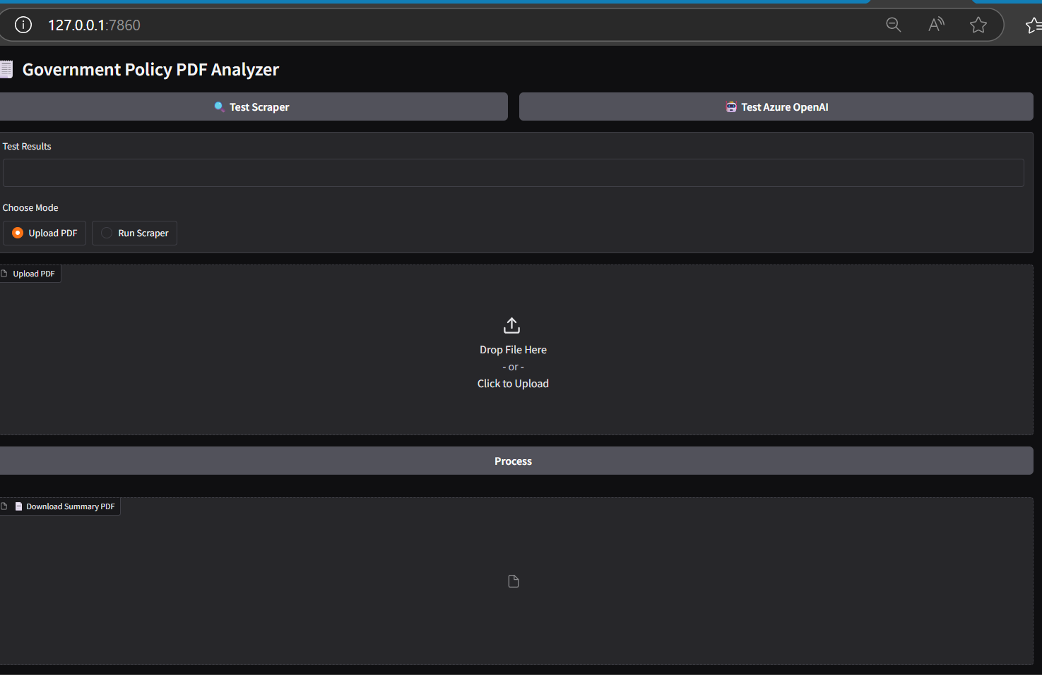
Solution Architecture — Frontend
Gradio UI with mode toggle (Upload/Scrape). Test buttons for Azure and scraper. Display summary and downloadable PDF.

Slide 6
Sample Output Format
Section 4 — Travelling Allowance
This section provides provisions for allowance...
Part A — Applies to Chairperson...
Part B — Applies to family members...

Slide 7
Limitations of the model
Text summaries are not machine-comparable.
Manual comparison between acts is inefficient.
Summarization speed limited by Azure chunking.
PDFs can be summarized with each other, but summarization formats might vary, and accuracy of the comparison might fail.

Slide 8
Proposed Solution
Output as structured JSON or Python classes.
Enables automatic comparison of acts.
Easier legal analytics and change tracking.
Example JSON format:
{ "Section 4": { "title": "Travelling Allowance", ... } }
Example Python Class File format:
class Section4: title = "Travelling Allowance" part_a = "..." part_b = "..."

Slide 9
Business Value and Use Case
Faster understanding of legal documents.
Reduces manual legal effort.
Prepares for scalable legal automation.

Slide 10
Future Scope
Generate .py/.json for each document.
Add comparison tool for different act versions.
UI: Side-by-side view of legal documents.
Can build a model to prompt the user on which existing documents to change to comply with the new rule changes.
Attempt at scaling this to government policies of other countries to efficiently parse legal documents worldwide.

Slide 11


Team
M Barath Vikraman
Hrishikesh Venkatakrishnan
Intern
Intern

