Slide 1

NSF EarthCube’s
GeoCODES
Geoscience Cyberinfrastructure for Open Discovery in the Earth Sciences
Mike Bobak
Notes:
this talk is abt our nsf EC GeoCyberinfra4OpenDiscovery work
From our EarthCube Office work; incl Kenton_M as a PI, and some time from Rob_K, (LisaG) & others.

Slide 2
NSF EarthCube 2012-22
Cyberinfrastructure to integrate Geoscience community efforts
  Integrate data -> info -> knowledge management efforts
  Sharable tools, methods, .. via community involvement
Funded projects include a wide variety of products
  Tools, data, services, apps and other community resources for geoscience researchers
  Such as: Argovis 2.0, Pangeo, Planet Microbe, Sparrow, Macrostrat, StraboSpot, ICEBERG, ASSET, QGreenland, Helioportal, AMGeO, ML4POSE, InGeO, X-DOMES, CHORDS, Seaview, Ocean Protein Portal, Advancing netCDF-CF, Linked Earth, Paleobiology Database, eODP, GeoDeepDive, Data Discovery Studio, Digital Rocks Portal, BALTO, Throughput
The EarthCube Office (earthcube.org/ECO) is a resource to all of these
ECO manages the earthcube.org/geocodes project/resources
Notes:
this nsf program is a long term effort
w/a focus around(integrating)Data2Info2Kn mgt of the outcomes - of it's many funded pprjs
(we are a part of)The EC(program)Office(which)is a resource2all of these(pprjs)
(&we in tech part of)the EC-offic(also)manage the GC effort
GC comes from the NSF geosci program office, called EC, >it’s a long term program (for Geo cyber infra,around data2info2kn mgt) w/many pprjs, that we as part of the ECO aid, & run a hub-pprj called GeoCODES (focused on open-discovery)

Slide 3
What is GeoCODES?
GeoCODES is:
An NSF Earthcube program effort to better enable cross-domain discovery of and access to geoscience data & research tools.
Geoscience Cyberinfrastructure for Open Discovery in the Earth Sciences
GeoCODES is made up of three components:
Metadata standards
  An evolving standard for exposing data called science on schema.org
A set of tools
  to index relevant data from partners within the Council of Data Facilities (CDF) who have adopted science on schema
  plus a prototype portal to query that data & now resources from:
A Resource Registry
  Used to register and discover relevant tools
  Now searchable and linkable via metadata
Notes:
(which helps Enable)x-domain discovery&access to (the)data&tools (from all of those pprjs,&more)
(GC has)3 main components:
Broadening the adoption of(an extension of)the widely used Metadata-standard(Schema.org)
at both a set of Data-Facilities, &in a metadata-catalog(of the other available Resources(that we have worked up)called the RR)
(we have a set of)Tools that crawls all this metadata &a search-engine to make it all - more Findable
GC (x-domain disc&access2geosci data&tools);[G Cyber4OpenDisc inEarthSci] GC focus on metadata standards to make GeoSci data & now tools more findable ;now used by CDF data-facilities &now for other resources as well ;(aided by an ESIP group that we are part of) to be used by schema.org adopters like Google(‘s & our dataset search)

Slide 4
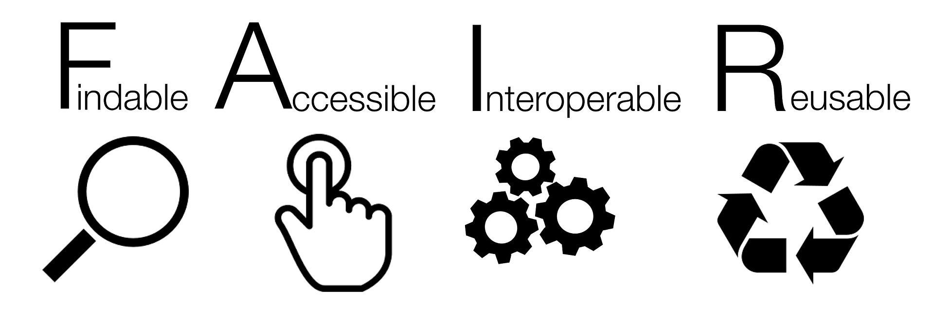

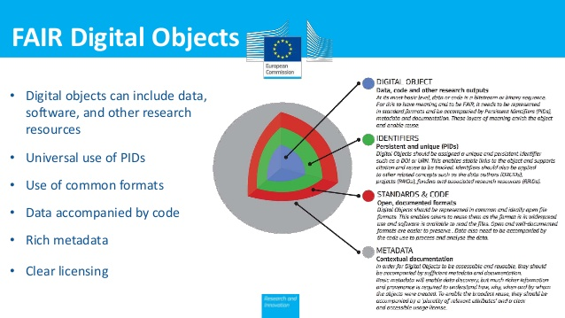
(FAIR) Metadata standards
Notes:
(part of the office also works on)goFAIR.us which(also)helps promote what are called: the FAIR data principles,
(which are mostly around metadata use) to help make Digitaly(IDed)Objects
more FindalbeAccessibleInteroperable+Reusable, using things like PersistentIDs(w/in)Rich metadata
pushing md use2be more FAIR, for the goal of ‘faster time to science’ part of EC-Office is also part of gofair.us /go-fair.org We start w/a focus on Findability of digital assets through standard linked(meta)data, ;which allows for much more (as we get to work our way through the FAIR letters) ;more in FAIR principles link, at bottom of page

Slide 5
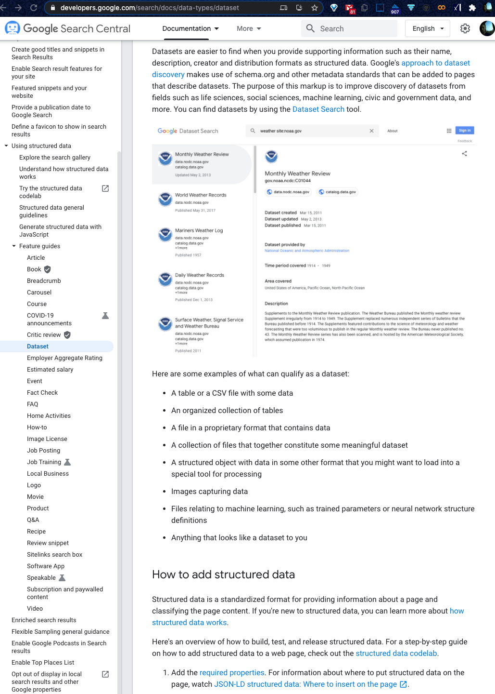
more at:developers.google.com/ search/docs/data-types/dataset
Evolving standard science on schema.org
Used by all search engines, rich snippets
Metadata harvest part of standard crawl
Available to dataset-search if schema:Dataset
Try it datasetsearch.research.google.com
Tools to index and a portal to query that data
We do a focused Geoscience crawl of CDF repos
We have search sites with extended functionality
For finding data, &now Resource Registry software..
Notes:
(as mentioned,our metadata starts w/the widely used)Schema.org [w/extensions,as available]
Schema.org is used by all search engines,(for retrieving Rich Snippets),which u c in everyday(commercial)search
(all this)Metadata is harvested as part of a standard crawl
(&becomes)Available to the dataset-search when it sees so:dataset elt;u can try it&see(more on)it’s gDev page..
(our)Tools are similar, but are more focused,can take(the md)further,&go beyond just data search2incl(other)resources
when schema.org:Dataset found In (regular g) crawl can send ext-schema info to dataset search ;We have a more geo focused crawl & search for any of your resources ;we can also make use of more metadata, in other novel ways as well

Slide 6
/science-on-schema.org/examples/dataset/minimal.jsonld
<script type="application/ld+json">
{
"@context": {
"@vocab": "https://schema.org/"
},
"@type": "Dataset",
"name": "Removal of organic carbon by natural bacterioplankton communities as a function of pCO2 from laboratory experiments between 2012 and 2016",
"description": "This dataset includes results of laboratory experiments which measured dissolved organic carbon (DOC) usage by natural bacteria in seawater at different pCO2 levels. ………....",
"url": "https://www.example-data-repository.org/dataset/472032",
"version": "2013-11-21",
"keywords": ["ocean acidification", "OA", "Dissolved Organic Carbon", "DOC", "bacterioplankton respiration", "pCO2", "carbon dioxide", "elevated pCO2", "oceans"],
"license": "CC-BY-4.0"
} </script>
Evolving standard science on schema.org
Start with schema.org:Dataset
W3C's Data Catalog Vocabulary (DCAT)
Some structured tables via W3C CSVW
Science extensions to schema.org
  github.com/ESIPFed/science-on-schema.org
Can start with minimal json-ld <script>
  en.wikipedia.org/wiki/Linked_data in json
Tools to index and a portal to query that data
We do a focused Geoscience crawl of CDF repos
We make further use of more metadata
Eg. linking data to tools.. from Resource Registry
Notes:
(after finding so:dataset elt)(the gDev page mentions-that it)also uses the overlap w/the DataCatalogVocab:dcat, and can get tables from csvw
(to find out more about the)sci-extensions(that we are also involved in) visit science-on-schema.org
Which has a nice exmpl of a minimal webpage<script> containing Linked(meta)Data-in-json format..
(as mentioned)we have a focused gDS like search that makes further use of more of the metadata&covers a wider array of resources
schema.org is used in regular google search(for rich-snippets), yet data-search incl+sci-ext,DCAT..,here-is example minimal (science on)schema.org jsonLD <script>; which will be crawled by us and others ;if you want to learn how to do this yourselves the related google dev page is a good start, before SoS & json-ld.org as well ; Getting Started : Data Repository - the research data repository
Dataset - the scientific dataset

Slide 7
Access to GeoCODES data/tool search
Present public site:
  geocodes.earthcube.org
POC for using clowder
  earthcube.clowderframework.org
  mbobak-ofc.ncsa.illinois.edu/search.htm
Newer demo with faceted-search:
  alpha.earthcube.org
  mbobak-ofc.ncsa.illinois.edu/landing.html
Notes:
You can try it from the EC-page, or in an instance of our(home-grown)clowder-framework
(&I also have a peek at)some of the new capabilities coming online(in our new alpha site)
instances of the dataset /tools search, that I can give you a quick look at

Slide 8
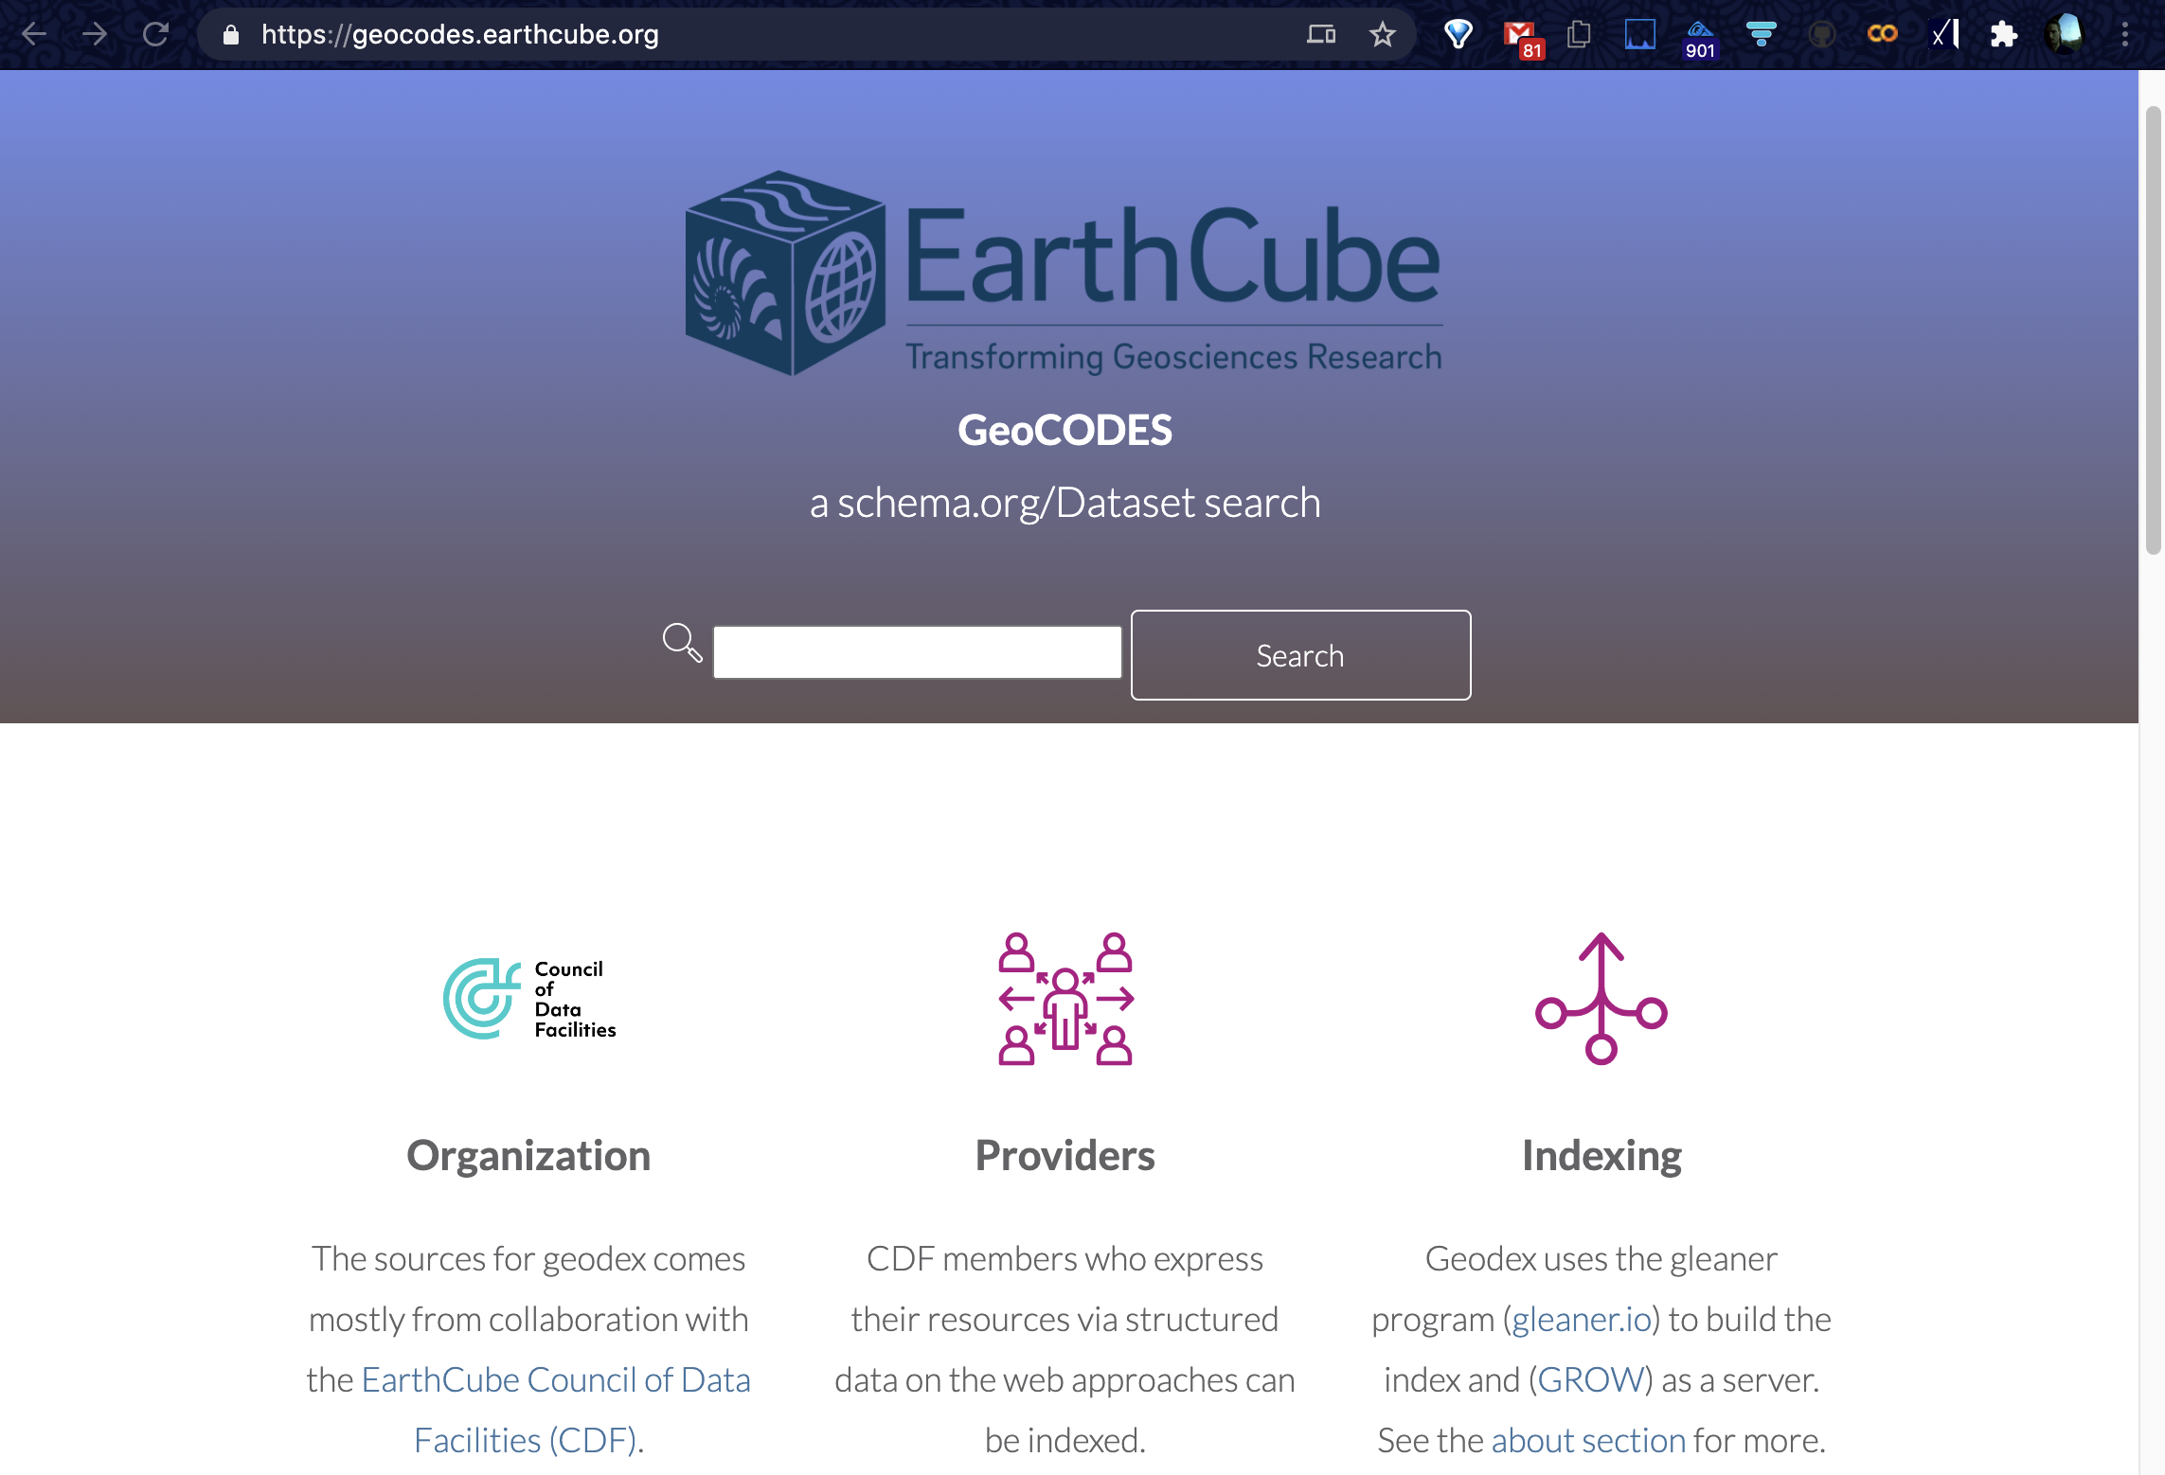
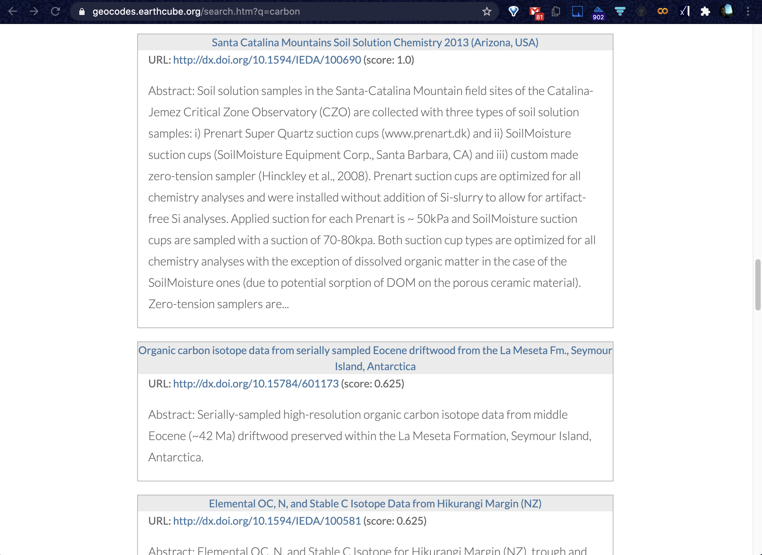
geocodes.earthcube.org /about.html
on the crawl and serving
Results of search: Title, Abstract,
DOI URI to data page at repo
Other versions include a links to full metadata incl. in (a reskinning of clowder to this)
Notes:
(this is the)present search,which has research paper like returns,
w/descriptions(that are)from(the)dataset landing pages;
There are also versions that have the full metadata
incl.1(like this)w/a clowder backend
present search that evolved from the earlier p418 work, simple data only search right now, w/ results that look like a paper’s description, but for each repo’s dataset landing page, that matched the qry ;incl a clowder backed version of this [in tree format]

Slide 9
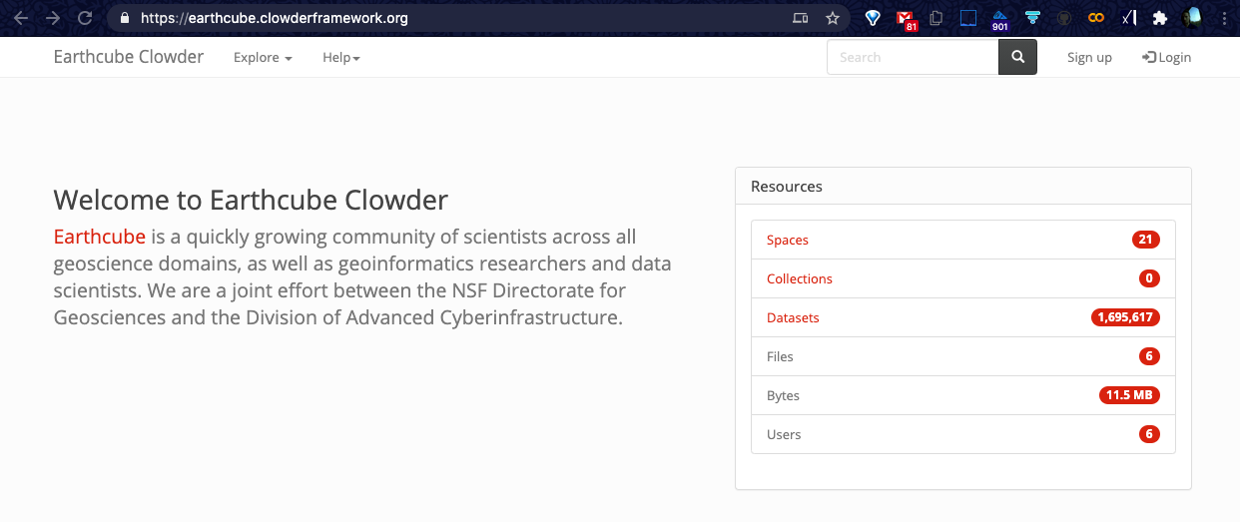
ClowderFramework.org data-facility/repository per space, plus one for Resources/tools..
Notes:
(here is the EC instance. of the)Clowder(data mgt)Framework, that holds(all)the metadata of(the datasets)
(for)each df/repo(in it’s own)'space' plus 1for resources(such as tools)
We do a simpler crawl and assert to a clowder instance, with one space per repository, & the 1st inclusion of the EC-Resource-Registry

Slide 10
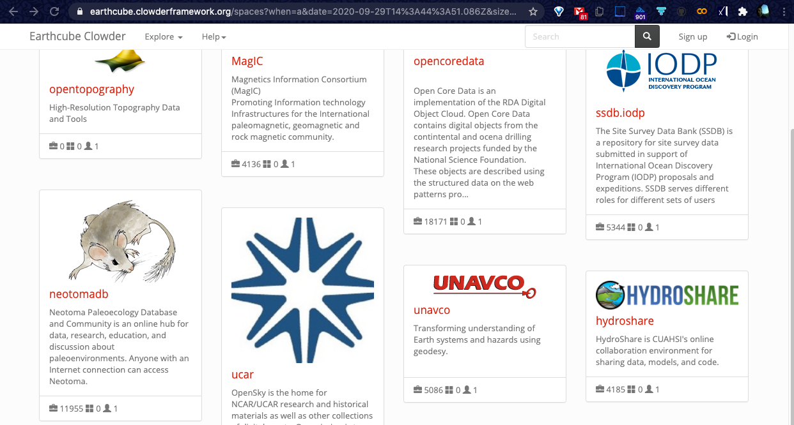
Notes:
(this allows for)browsing of the each df's(sets of)dataset descriptions eg..hs has 4k,..
can browse the repository spaces (one per CDF site) ;eg. 4k datasets in hydroshare ;when you click on it you get the dataset cards

Slide 11
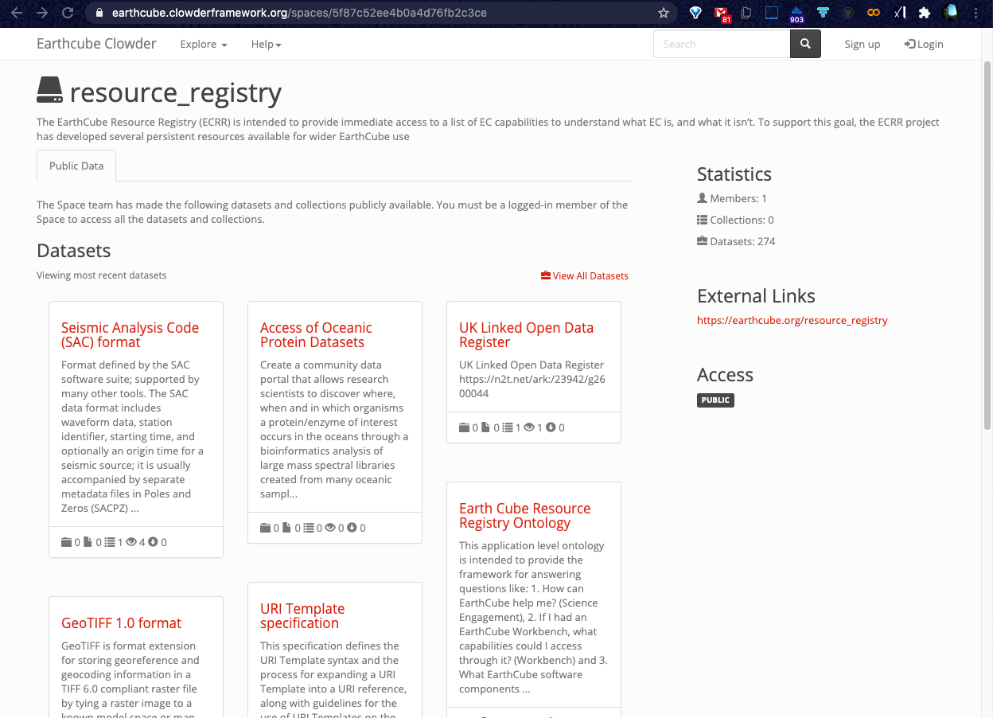
Clowder organization
One space per data-facility
Datasets hold metadata
Also a Resources space:
Allows for
dataset & tool search
metadata/annotation
linking out to get the data
& sometimes (assoc) tool/s
Notes:
(this is the 1st time we incl)our own repository of resource-descriptions along-side those of all the dataset-descriptions,
So they are(both) searchable together
&(also could)allow4linking of resources(2data)in the near future
but in [this example, it is for the newly added resources-registry/repo]
We just saw a clowder space for each CDF data-facility, with searchable metadata for every dataset within them&
here we also include a space for the EarthCube Resource-Registry of software/tools/..,
with a metadata record for each resource, that could be associated/used with the data. 1st time the tools were included alongside the data

Slide 12
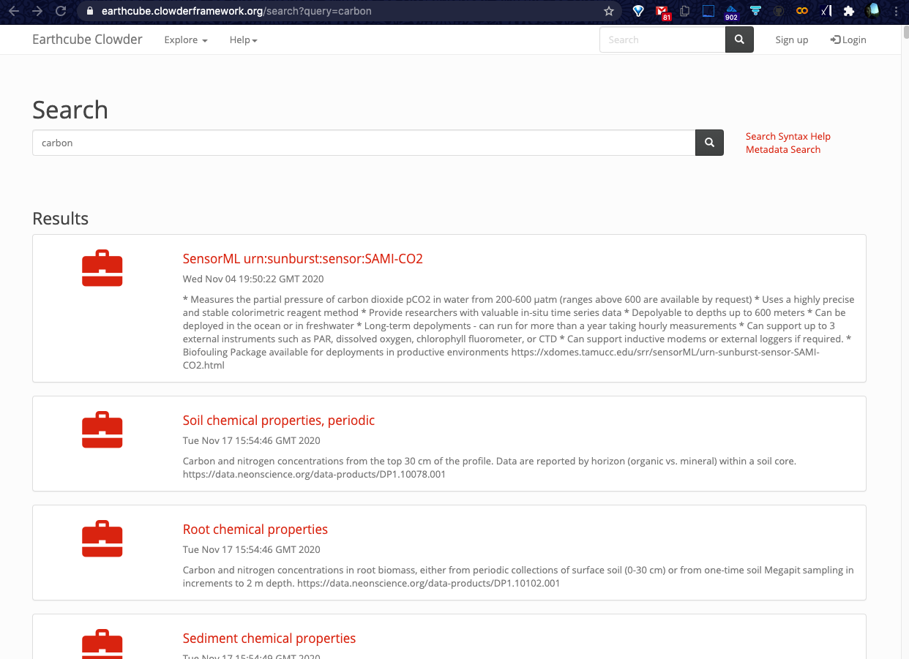
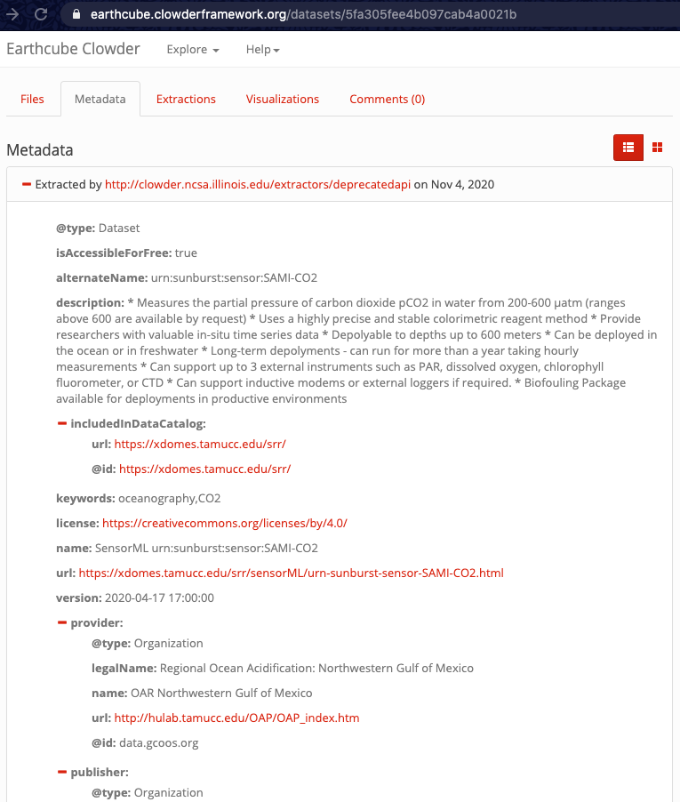
Clowder search results
& a result’s metadata(tab) tree listing
Notes:
(beyond browsing) clowder also has built in search,of these ‘dataset’/resource records &(then)allows4viewing of(each of)their(full)metadata(in a)tree(view) as well,
as linking out to the final-data(or resource) landing pages
search-results page, and it’s link includes a metadata/’details’ tab that shows the full jsonLD that was crawled

Slide 13
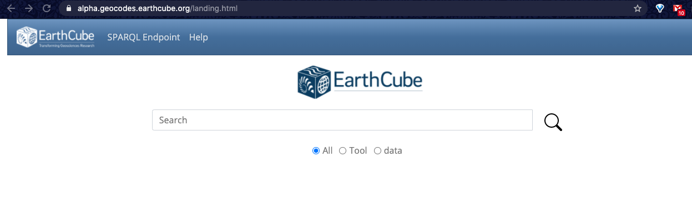
New landing page demo, informed by a NCSA UX study
Notes:
(our latest effort)has been informed by a ncsa UX study, giving a sleeker starting page
Lisa G’s group helped with this study, and we did an implementation from static mockups https://alpha.earthcube.org/example.html & landing.html

Slide 14
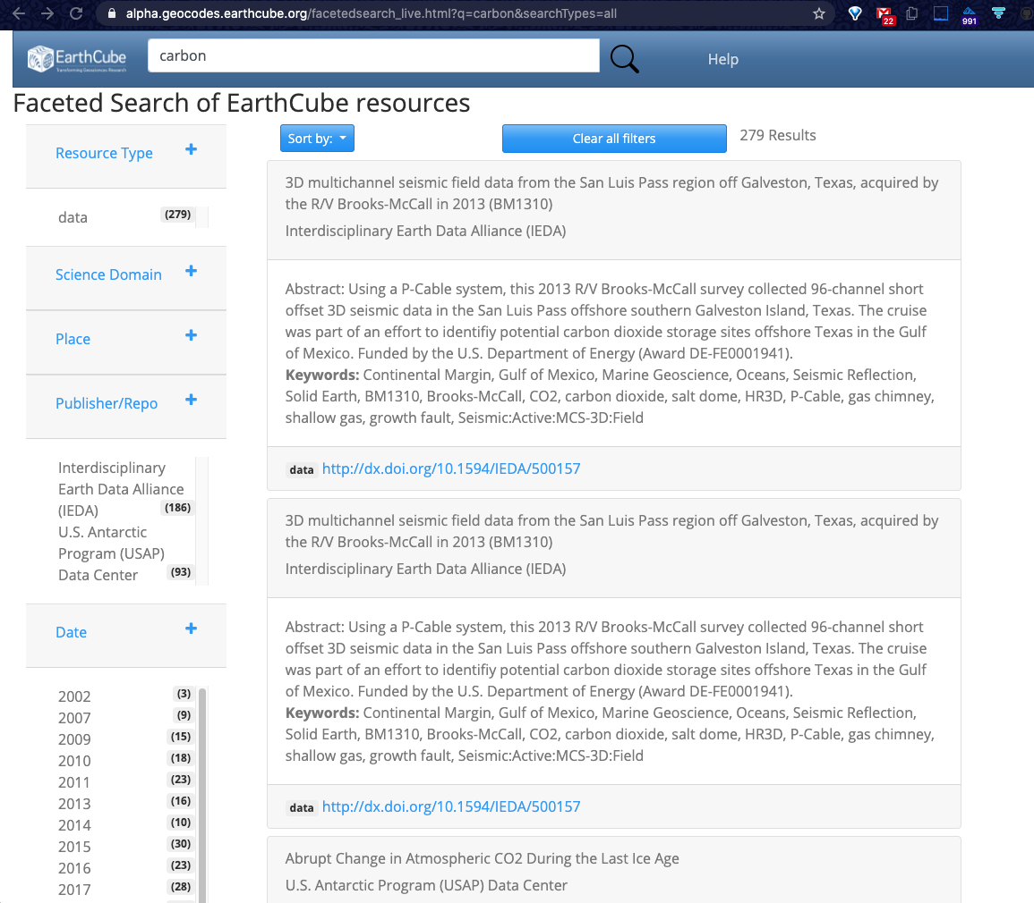
Results filtered by faceted metadata:
Data, Tools, or both
Science Domain
Place (geolocation)
Publisher
Date (of publication)
Notes:
& easier navigation of the results by being able to incl any range of facets on(some of)the returned metadata
facet-widgets allow for [(by)selecting as many of the aggregated values as you wish], & for different sort options ;now w/data & tool can link them

Slide 15
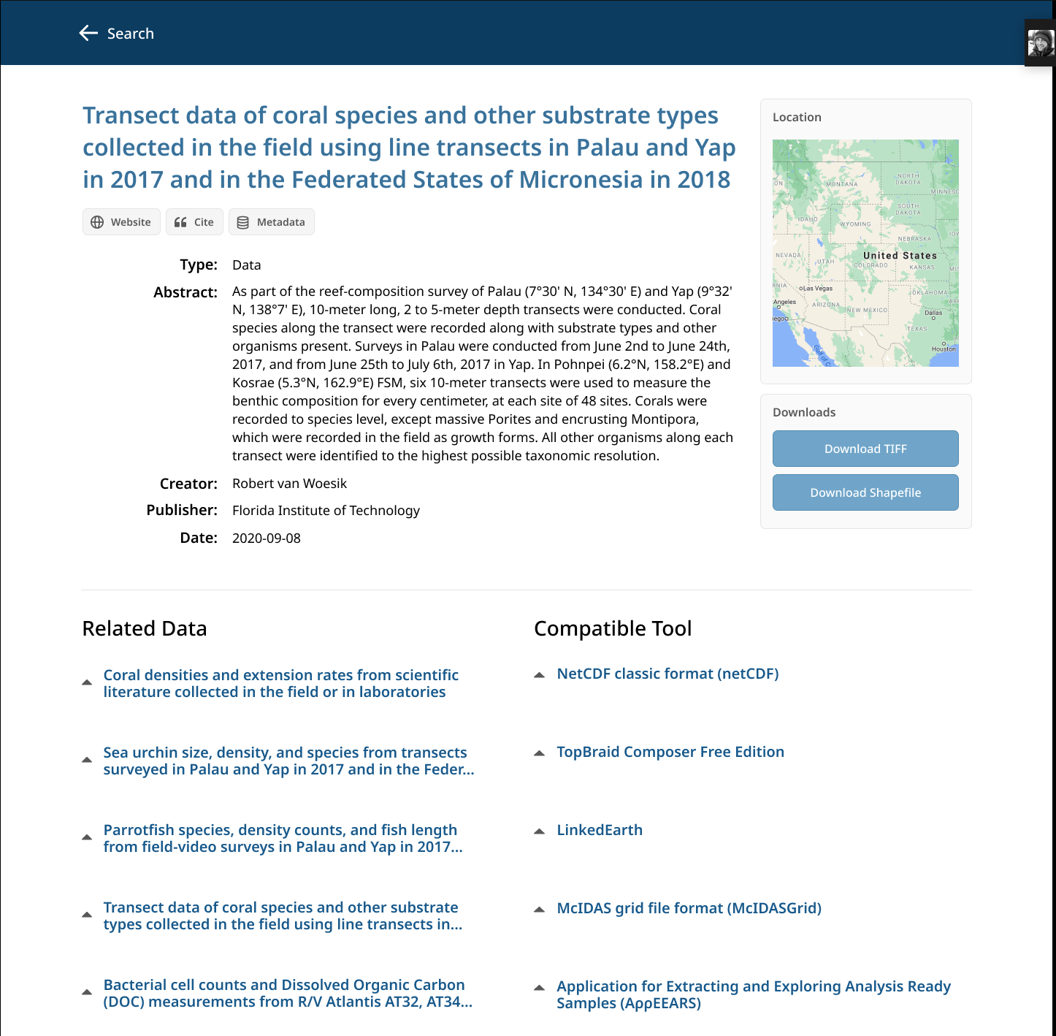
Future work:
Linking data with tools ..
Automatic launching of tools with data
Search on map
Getting these benefits in clowder via:
  triple store sync with clowder
  embedding science on schema
Notes:
Future work(incls)moving into being able to suggest related data and tools(via metadata matching),
&then(aid in it’s access,by)being able to launch a NB|application w/both(the)data&tool(of interest)
We(also)expect to have much of what we have done live-on in clowder as well,
incl.making(even)it's(other)datasets available for crawls by gDS search (via(embedded)SciOnSchema.org<script>s)
future work relating data & tools, possibly launching them together in a NB, & adding map-based view/interaction(bounding-box picking)

Slide 16
Faster time to science
via metadata use
to get more
resources
GeoCODES
Involved with standard metadata adoption
Crawl & Search made easier with more functionality
Now incl Resource-Registry search & linking w/data
Try it at:
https://geocodes.earthcube.org
https://earthcube.clowderframework.org
https://alpha.earthcube.org
Can take questions later: @Mike Bobak
Notes:
This work at promoting metaData adoption, and having tools to make use of it
for Finding data&(possibly re)resources, &then Accessing them
can be tried at these URLs
faster time2sci via FAIR metadata use; so we’ve been focused on it’s adoption, & expanding it’s use beyond that of gDS, incl linking in other resources; try, the public, ncsa-instance, & upcoming new functionality site

Slide 17
extra slides
Notes:
extra slide Older sides with more text /fewer bullets here PID-img-from-paper

Slide 18
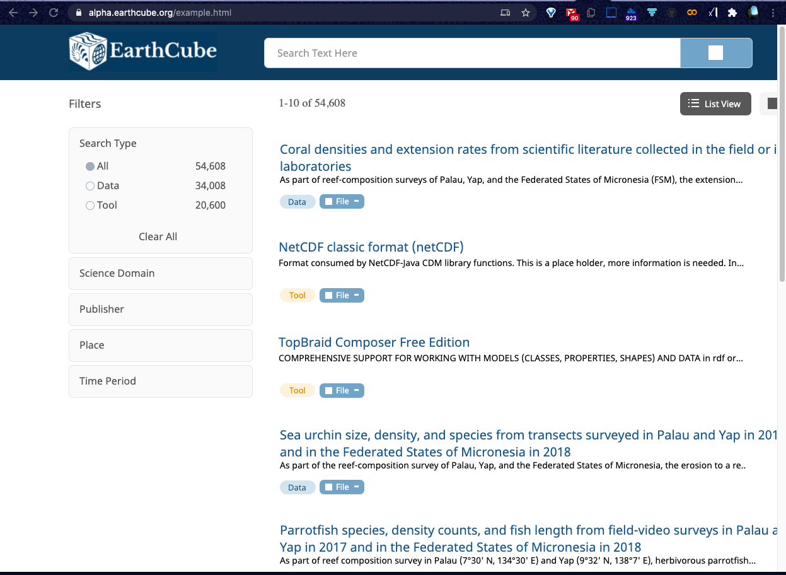

There will be a way to get metadata ‘details’ & upcoming data tool linkages as well.
Also opening of the result’s data & associated tools in a NoteBook is also possible.
Throughput is an EC project that might help us bring in some more of these linkages
Linked-Data is what makes these resources:
Here is the static UX results page, with all the filter-widgets collapsed, and icons to highlight what is data and what is a tool.
Notes:
UX mockup of search results, w/data&tool icons

Slide 19
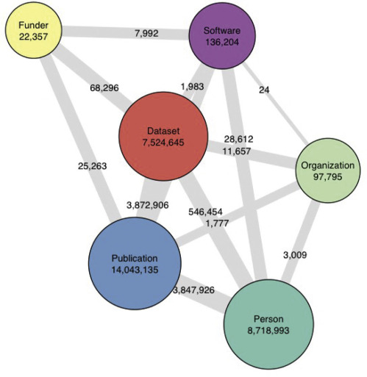
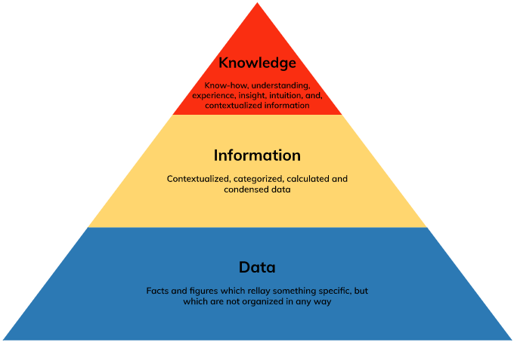
Throughput is an EC project that might help us bring in some more of these linkages
Linked-Data is what makes these resources
data->info->knowledge via
context
Notes:
data->info->kn via context, which can be had by making connections

Slide 20
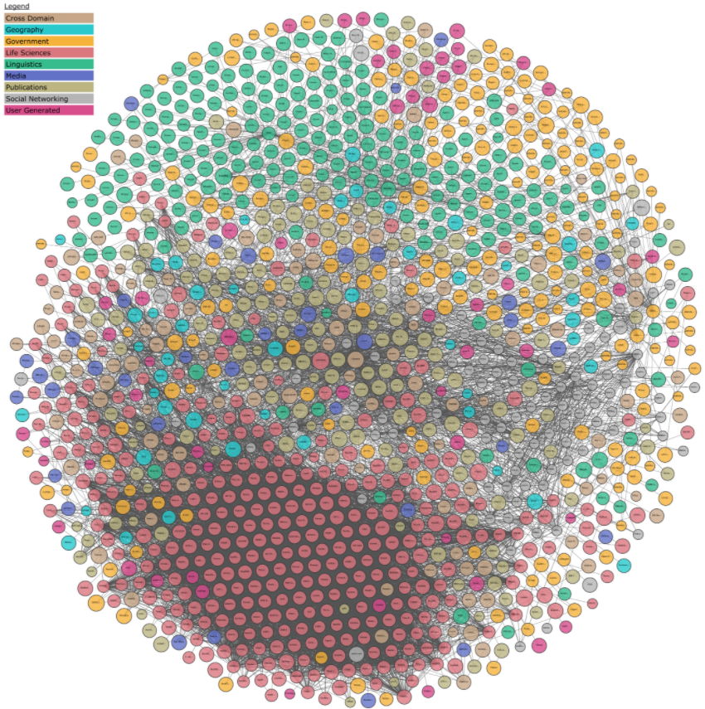
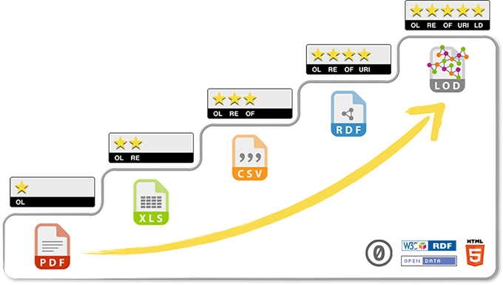
5stardata.info/en last star is linking to the LinkedOpenData cloud lod-cloud.net
Available as: 1: open online, 2: structured, 3: non-proprietary, 4: ref via URIs, 5: link to other
formats
Notes:
5star LOD 1:open-online,2:structured,2:non-prop-formats,4:ref via URIs(RDF),5:link out to rest of LOD cloud

Slide 21
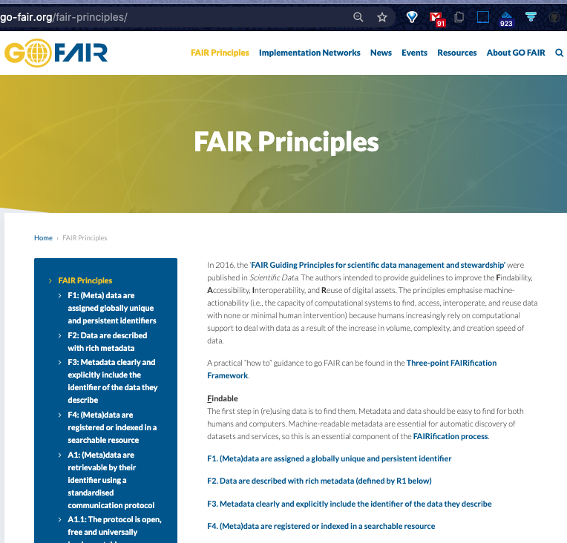
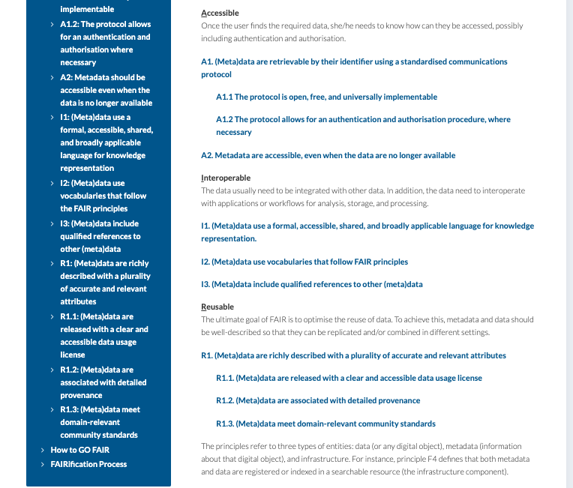
Findable Accessible Interoperable Reusable
Notes:
gDev for start of schema.org for data, SciOnSchema.org to go into a little more depth, &more breadth via FAIR priciples

Slide 22
GeoCODES
Involved with standard metadata adoption
Crawl & Search made easier with more functionality
Now incl Resource-Registry search and linking
Faster time to science
via metadata use
Try it at: to get more
https://geocodes.earthcube.org
https://earthcube.clowderframework.org
https://alpha.geocodes.earthcube.org
Can take questions later: @Mike Bobak resources
Notes:
metadata-standards,crawled for simple and then more interesting search, that can incl metadata linking, eg btwn data tools.
If clowder brings back a SPARQL endpoint for it’s metadata, it can start to use this new work; &w/jsonLD<scripts>inserted in it’s data pages, can get crawled by google & others
So after helping to find the data, we can aid in finding related resources to speed it’s time to use even further.
A lot more can be done by joining up even more http://dbpedia.org/page/Linked_data some via https://throughput-ec.github.io/ ;show links clowder & new search

