Slide 1
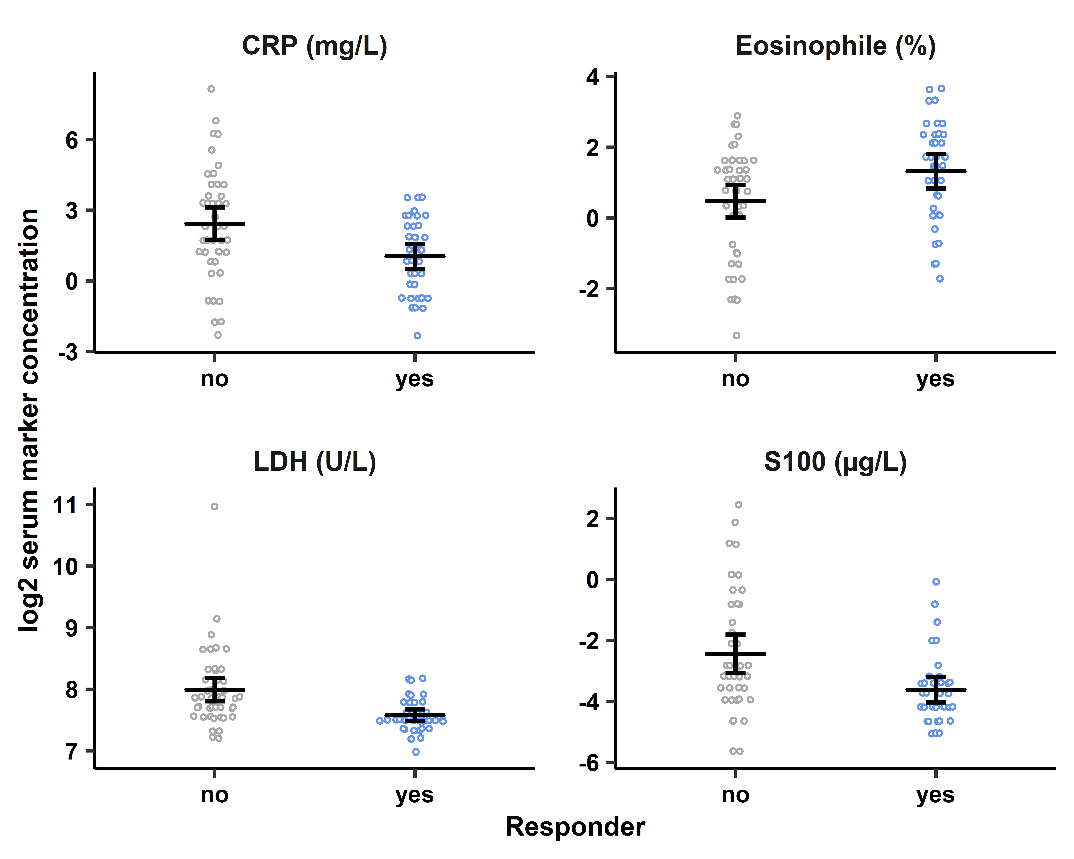
p = 0.002
p = 0.013
p < 0.001
p = 0.002

Slide 2
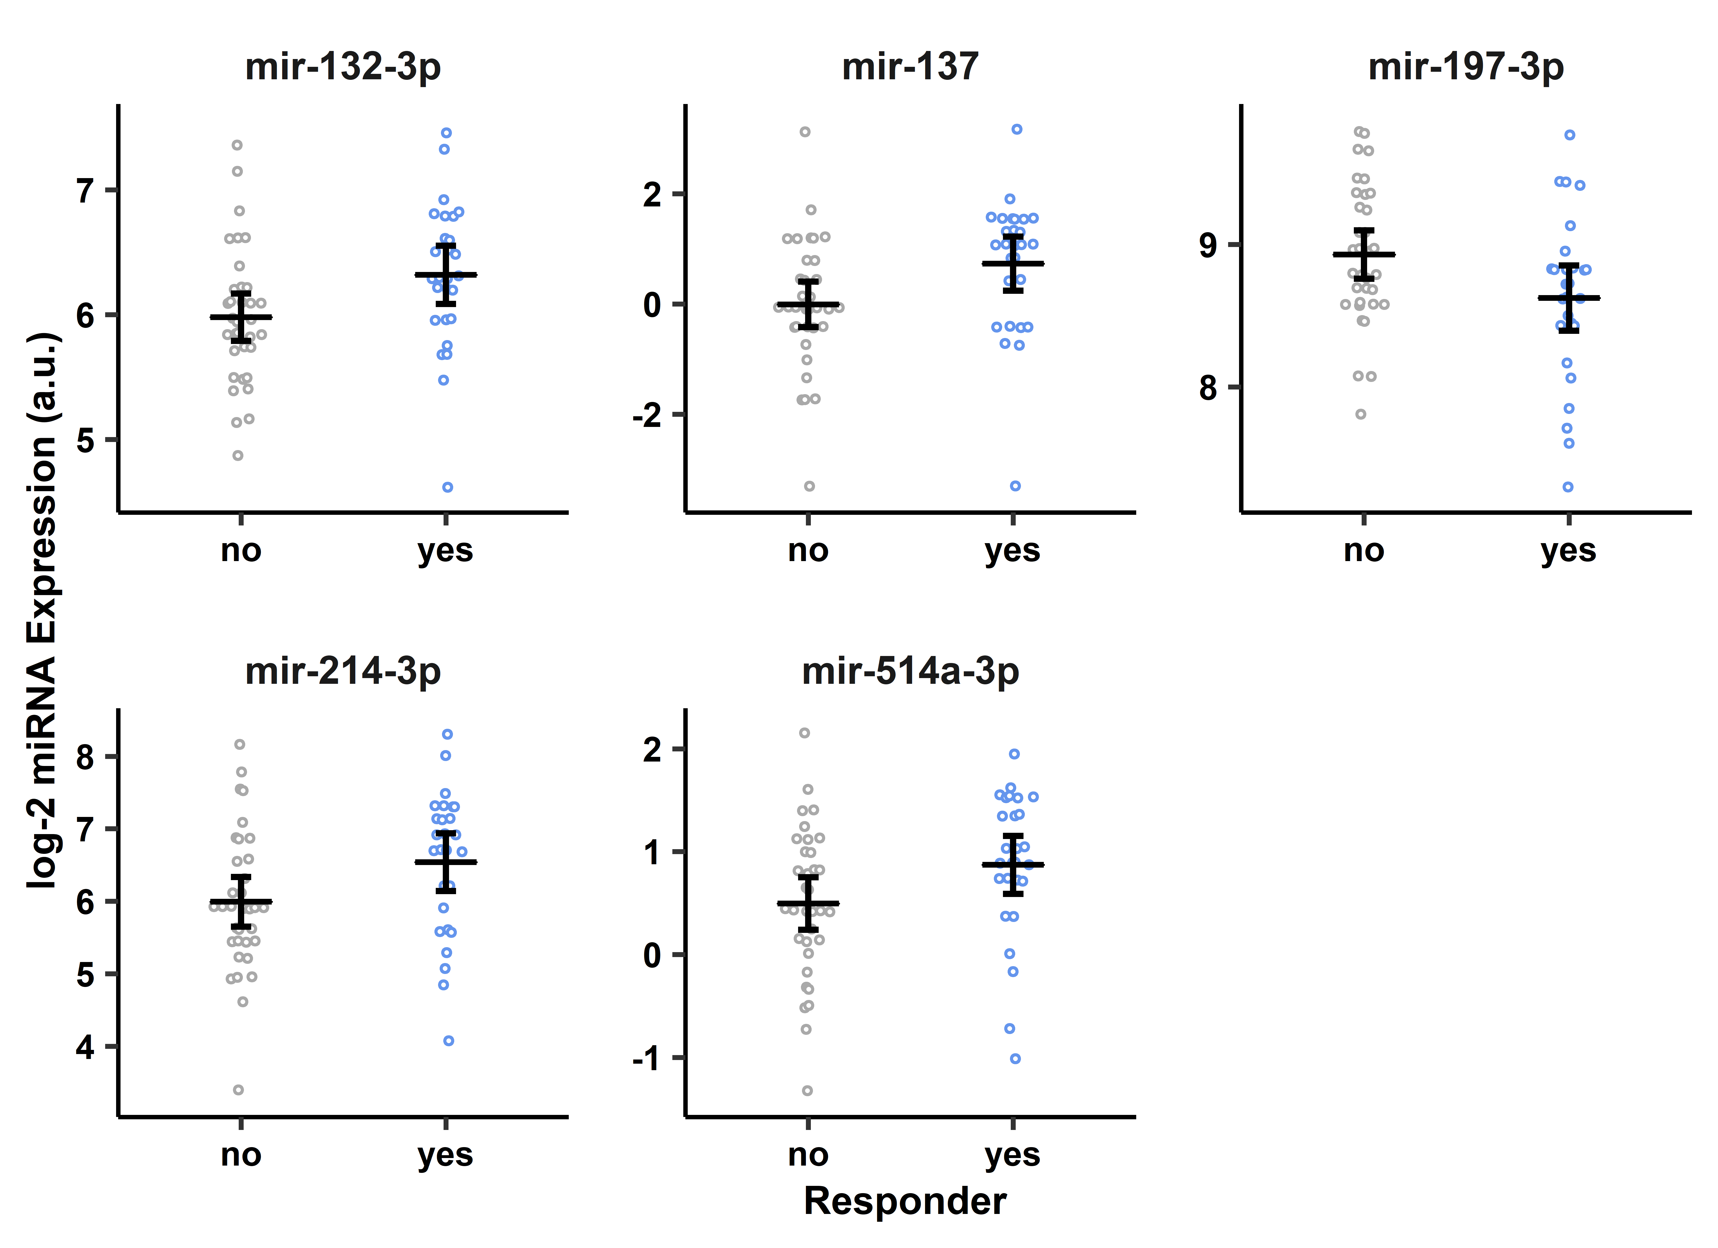
p = 0.025
p = 0.022
p = 0.033
p = 0.038
p = 0.048

Slide 3
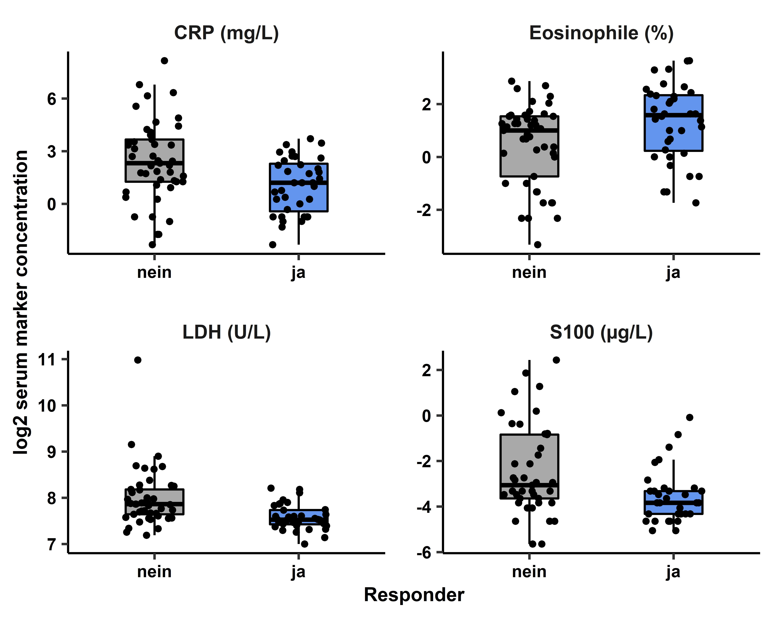
p = 0.002
p = 0.013
p < 0.001
p = 0.002

Slide 4
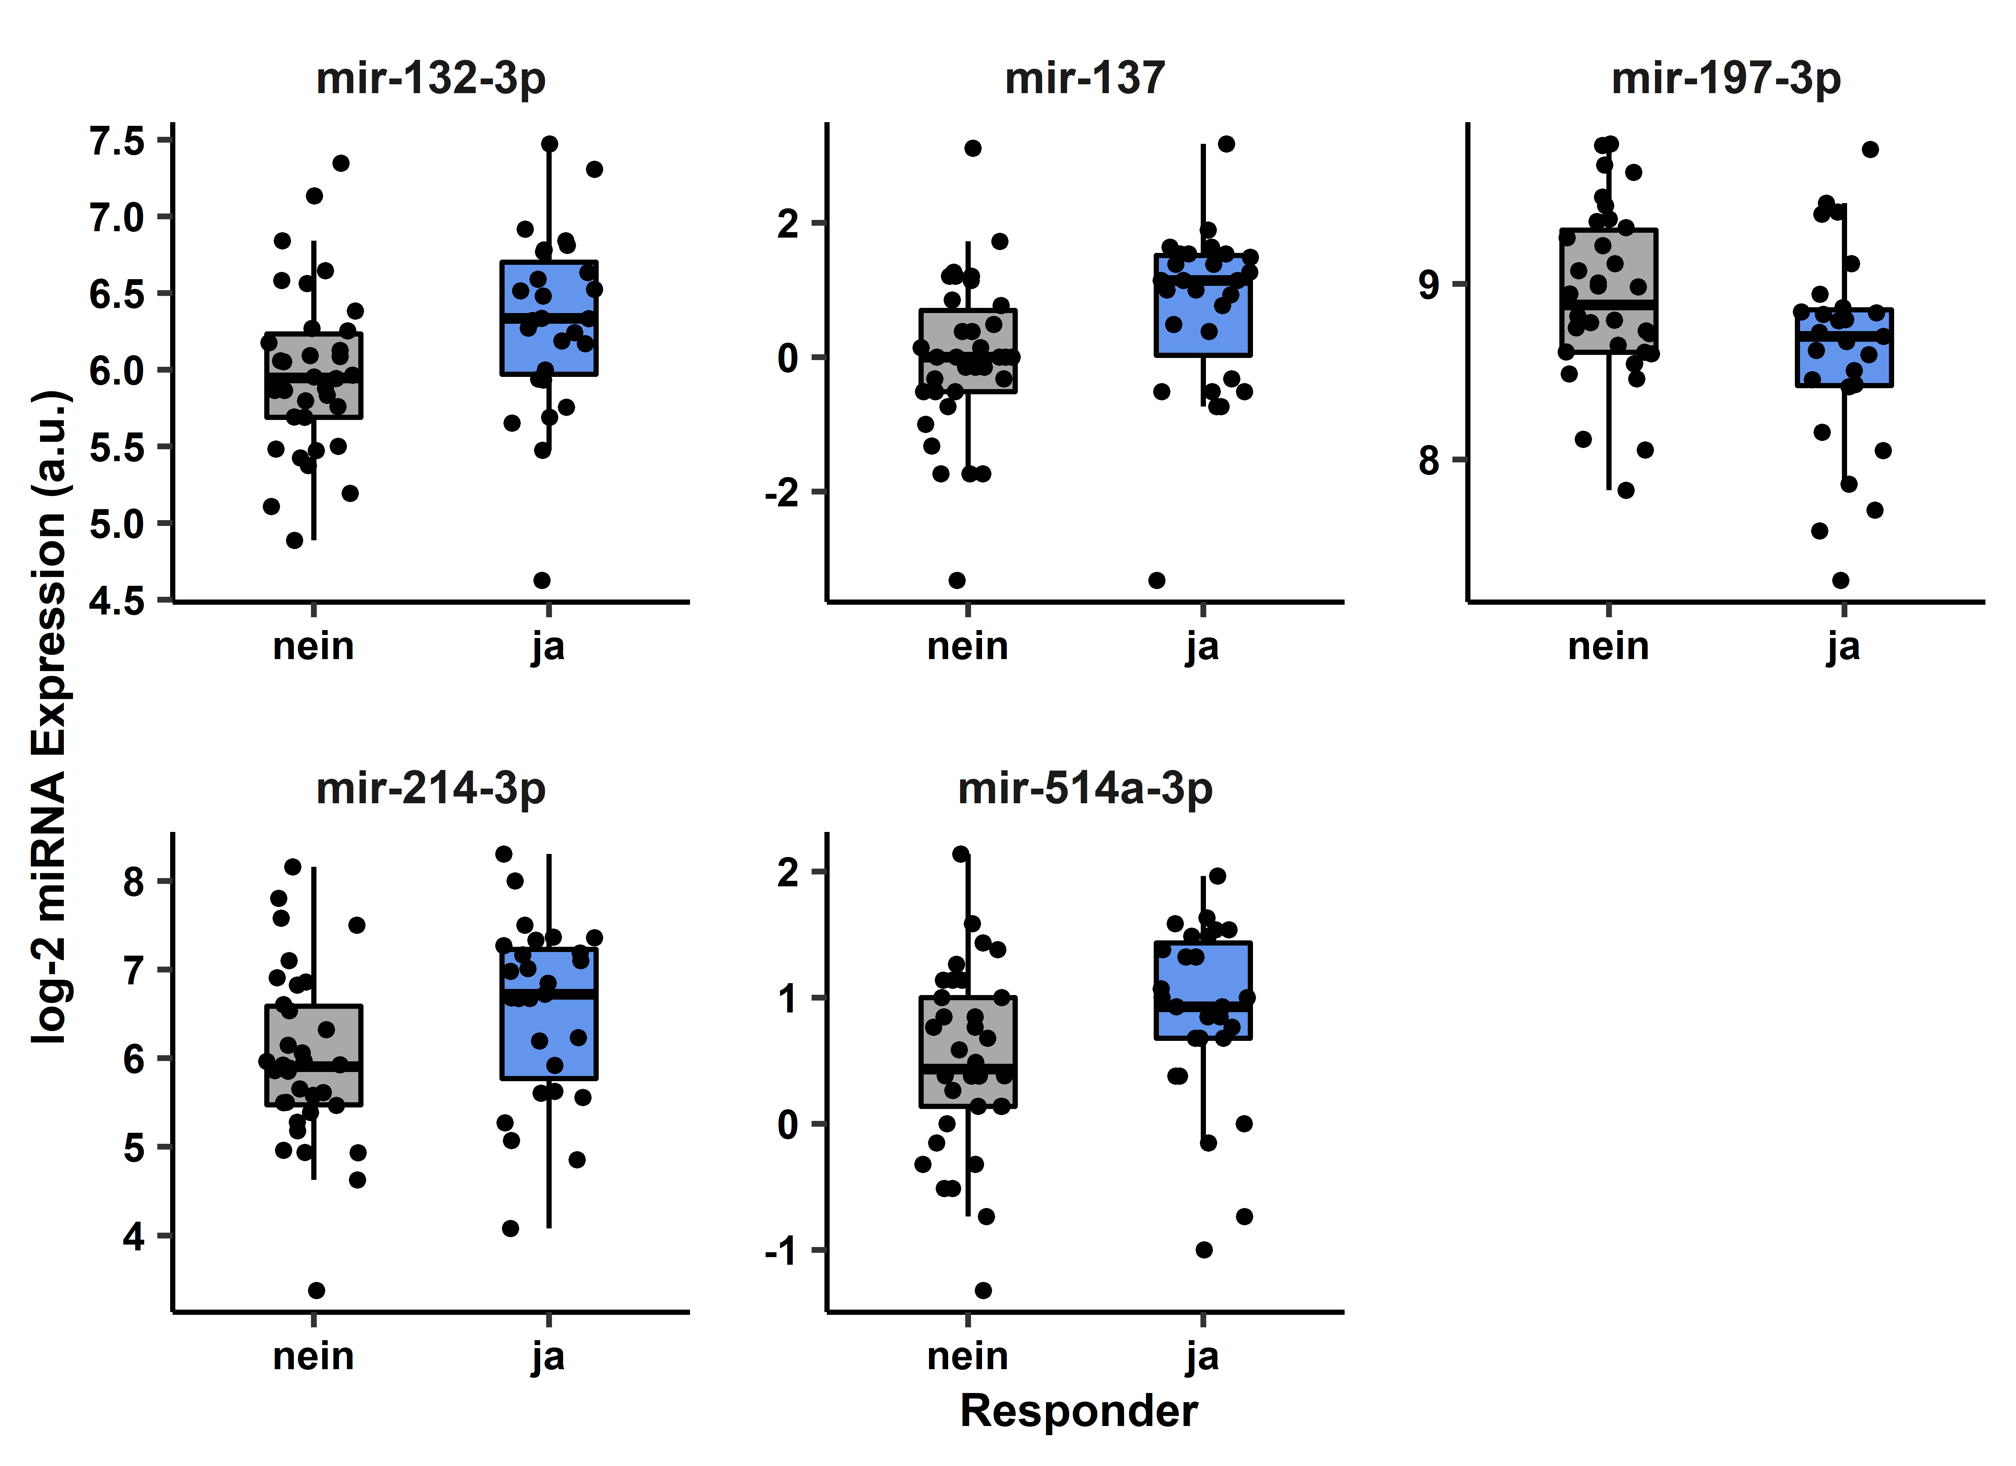
p = 0.025
p = 0.022
p = 0.033
p = 0.038
p = 0.048

