Slide 1
The Dropouts
COVID-19 Detection using X-ray images
Vishal Rishi M.K – 6379592151 Harish Iniyarajan – 9600750441 Bharathi Mozhian M – 9444159358 Janaki Raman – 6379740399

Slide 2
Description of the Project
Problem Statement
Approach to the Solution
Current diagnostic techniques for COVID-19 are quite expensive and take time to produce results, making it difficult to limit the spread of the virus and save lives.
Employ AI to analyze X-ray images of lungs to detect COVID-19 in a cheaper and faster way.
Relevance to the Theme
Techstack Involved
The never ending opportunities offered by AI is utilized to develop a model which helps to detect COVID 19 quicker, cheaper and better.
TensorFlow, Jupyter Python, Scikit-learn, Numpy, Seaborn, Matplotlib, OpenCV, tf-keras-vis

Slide 3
Details of Technology Stack
TensorFlow is an open source library for numerical computation and large-scale machine learning.
TensorFlow
It is an open-source web application that allows one to create and share documents that contain live code, equations, visualizations and narrative text.
Jupyter Python
Scikit-learn is a free software machine learning library for the Python programming language.
Scikit-learn
Tf-keras-vis is a visualization toolkit for debugging tf.keras models in TensorFlow 2.0+.
Tf-keras-vis

Slide 4
Description of the Solution
Step 1
Step 2
AI has the potential to solve problems beyond human expertise. Leverage this to find plausible solutions.
Study relevant literature and analyze existing solutions to tackle the problem by using lung X-ray images.
2021
Step 3
Step 4
Contrive methods to improve generalizability and performance of standard solutions.
Create models using transfer learning, data augmentation, ensemble methods and visualization.

Slide 5
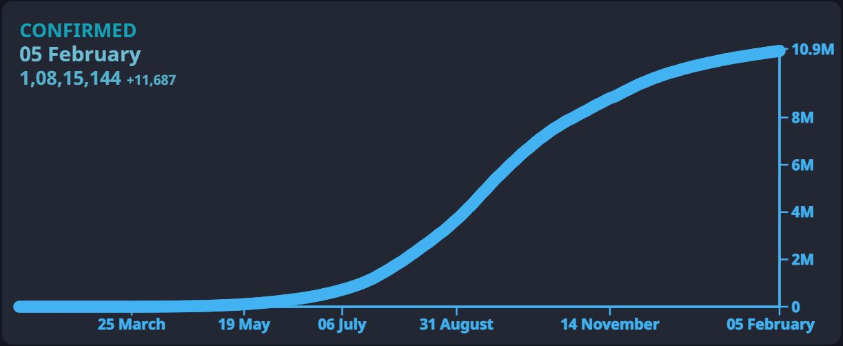
Novelty of the Solution
Providing visualization techniques that improve interpretability thus enabling the medical community to understand the reason behind AI’s decision.
Train, test and compare excellent pre-trained networks and use ensemble methods for robust results.
Explain feature entanglement using auto encoders and PCA. The model captures excellent features that distinguish between the classes.
Our model produced second best accuracy of 94.5% tested on 96 samples in a Kaggle competition. High accuracy with a small dataset speaks volumes about the model’s generalization and performance.
Why the problem you are catering is needed to be solved?
Standard COVID-19 testing procedure takes 2 days to return results.
Analyzing X-ray images by Radiologist to detect COVID-19 requires expertise and is time consuming.
Early detection and isolation of positive COVID-19 cases is vital in containing the spread of the disease.
Confirmed COVID-19 cases in India as of February 5, 2021.

Slide 6
Growth Plan of the Product
10%
Obtain dataset from Kaggle containing around 200 lung X-ray images, split them into train-test datasets and employ data augmentation.
Checkpoint 1
25%
Use several pre-trained networks and test them on the dataset with both feature extraction and fine tuning techniques.
Checkpoint 2
50%
Use Saliency maps, feature activation, GradCAMs and other visualization techniques for better interpretation of the model.
Checkpoint 3
80%
Create ensemble models and evaluate every model using several metrics and nominate the best model.
Checkpoint 4

Slide 7
Business Aspects of the Hack
01
Market Impact
Our project provides a cost and time effective, high accuacy method for COVID-19 detection with a low initial capital.
Target Consumers
02
Doctors and medical community to detect COVID-19.
03
Financial Sustainability
Typical financial model for creation and maintenance of web server is required. Additional costs for obtaining X-ray images maybe incurred.
Product > Project
04
Deploying our algorithm as a web-app would convert our project to a product.

Slide 8

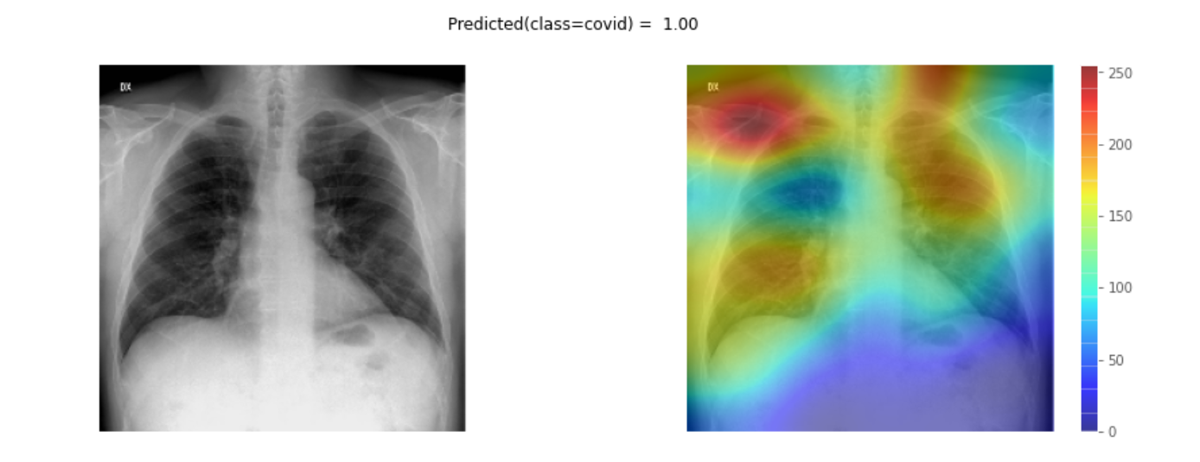
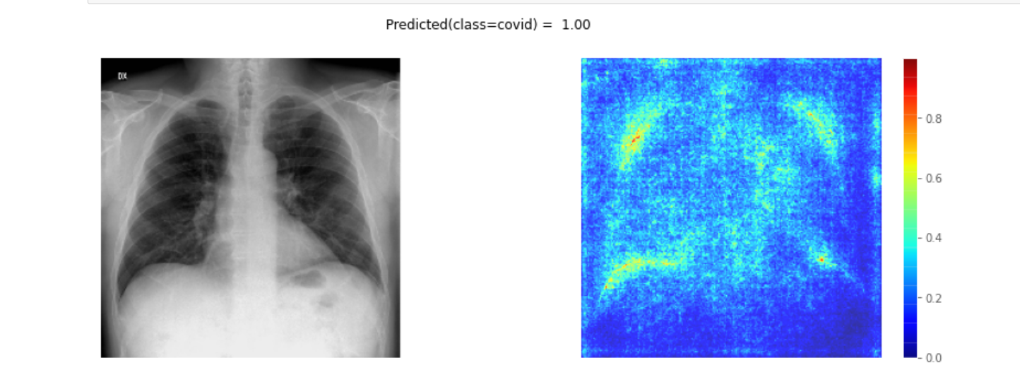
Working Prototype
GradCAM
Deep Patterns
Saliency Maps

Slide 9
Learning Curve
What have you learnt by doing this project?
04
01
Realization
We realized how powerful AI actually is and exploited it to our needs. We also realized how important early detection of COVID-19 is.
03
02
Tackled data shortage
02
We learnt to use data augmentation to tackle data shortage. With only 210 images initially, we increased the generalizability.
01
03
Performance enhancement
We learnt that ensemble models could potentially perform better than individal models and leveraged it.
04
3C
In an online world, we learnt to Communicate, Collaborate and Critically think in an effective manner.

Slide 10
About Team
01
02
Vishal Rishi M.K
Janaki Raman
Team Lead
Team Member
03
04
Bharathi Mozhian M
Harish Iniyarajan
Team Member
Team Member

