Slide 1

AWS AUTOMATION USING BOTO3 How To Describe Key Pair For AWS Ec2 Instance Using Boto3 Python Tutorial :35

Slide 2
Pre-requisites
pip install boto3
pip install awscli

Slide 3
Create IAM user
Nagivate to aws console
Search for iam service
Create new user
Give programmatic access
Add to administrator policy
Save access id and secret key

Slide 4
Configure awscli
aws configure
Enter access id , secret key,region, outfput type

Slide 5
What is key pair
A key pair, consisting of a private key and a public key, is a set of security credentials that you use to prove your identity when connecting to an instance. Amazon EC2 stores the public key, and you store the private key. You use the private key, instead of a password, to securely access your instances. Anyone who possesses your private keys can connect to your instances, so it's important that you store your private keys in a secure place.
https://docs.aws.amazon.com/AWSEC2/latest/UserGuide/ec2-key-pairs.html

Slide 6
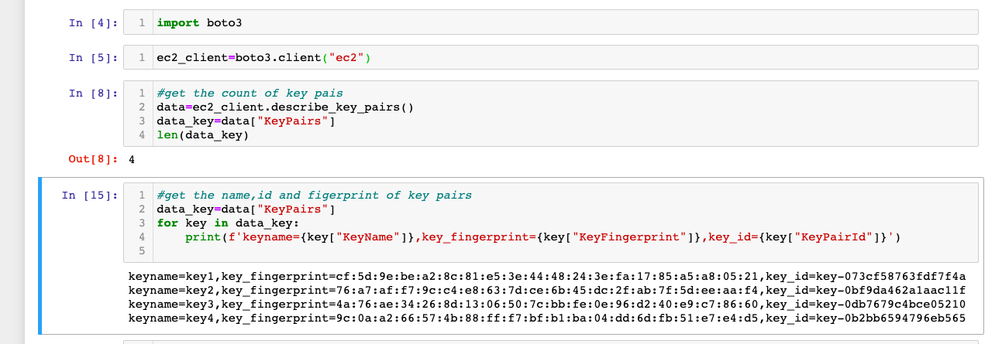
How To Describe Key Pair For AWS Ec2 Instance

