Slide 1
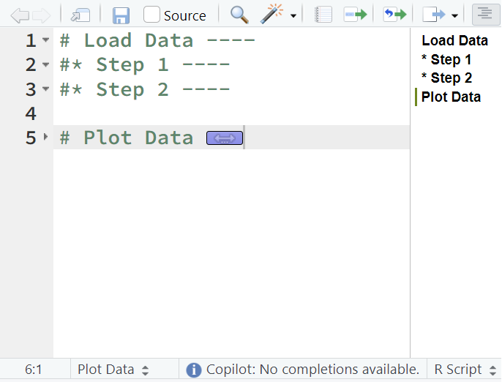
code folding
code
outline
code
navigation

