Slide 1



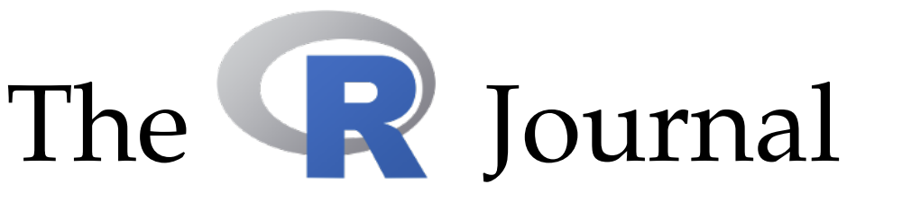
The R Foundation
…supports the
useR! conference
…provides the Comprehensive
R Network (CRAN)
…publishes the R Journal

