Slide 1

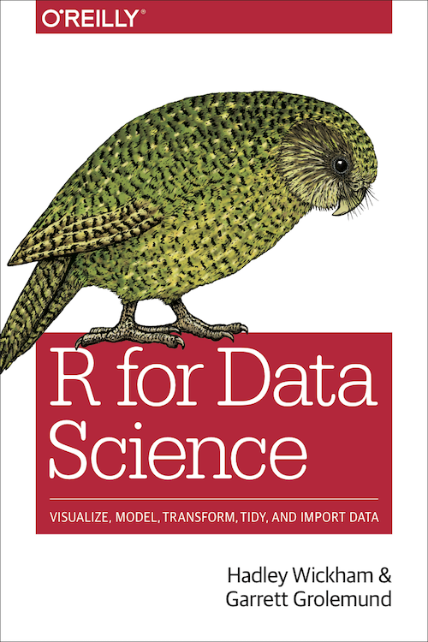


…provides free resources
and materials for R
…contributes to various
R packages and projects
…develops the RStudio IDE

