Slide 1
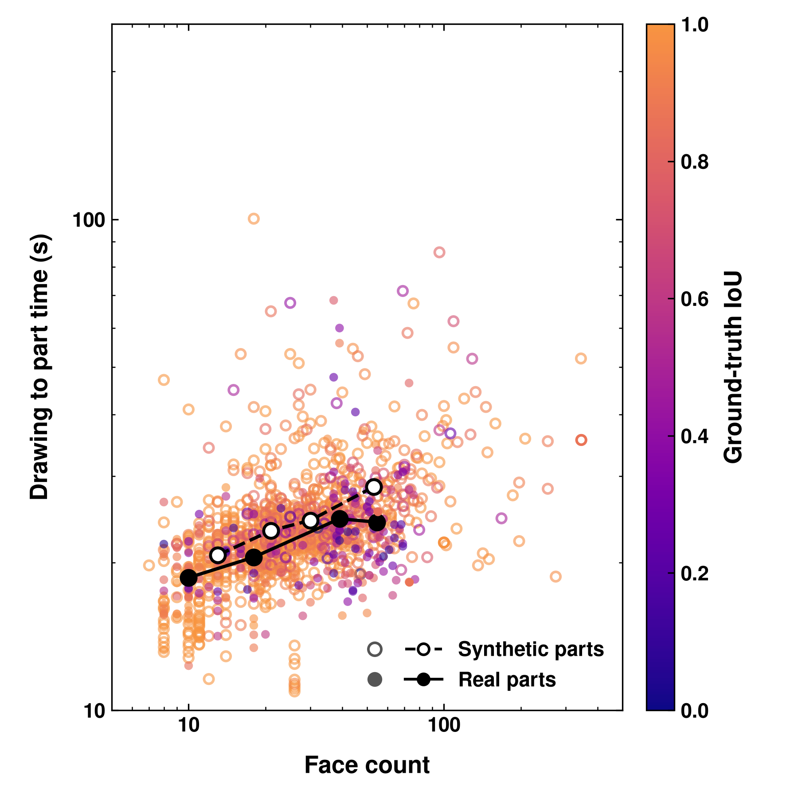
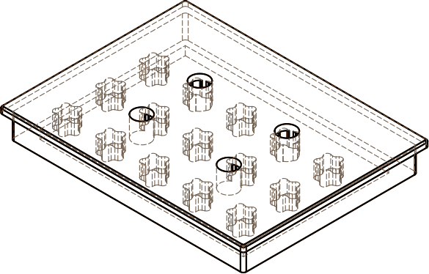
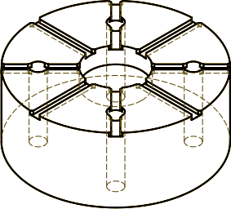
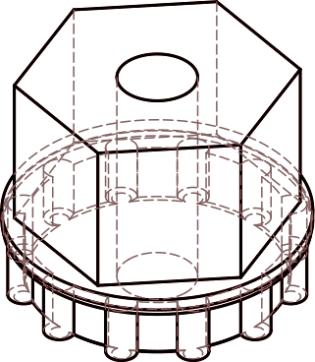
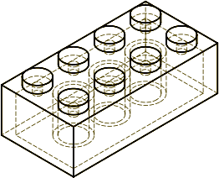
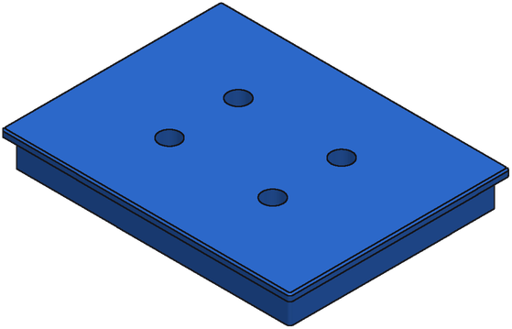
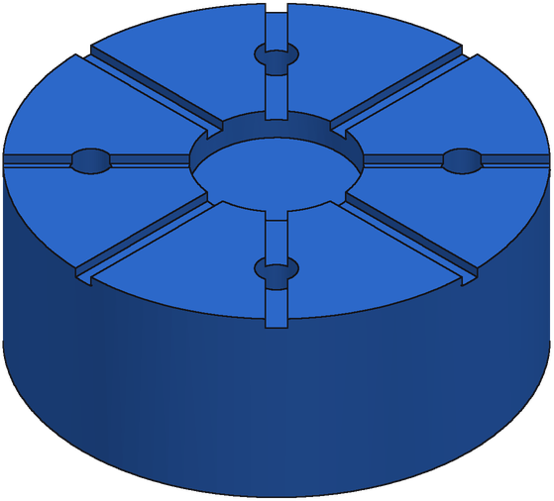
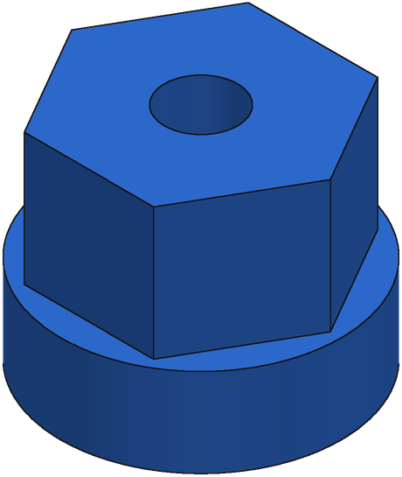
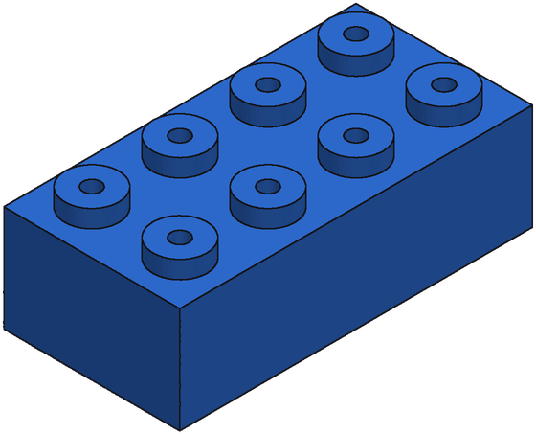
A
B
C
D
A
D
B
C
Notes:
A: 47adc310-e94b-4f63-6f3f-66e84b834f1a — 345 faces, 36 s, IoU 0.87
B: 3cc5a2b0-7892-9964-3d57-a20f1f78ba81 — 100 faces, 22 s, IoU 0.99
C: A_00438866_13481f4ab00aa70d0406f5b3_step_000_x — 73 faces, 18 s, IoU 0.87
D: A_00437468_20ac46b0dd8c5bf01593bd5d_step_006_x — 55 faces, 25 s, IoU 0.85

