Slide 1
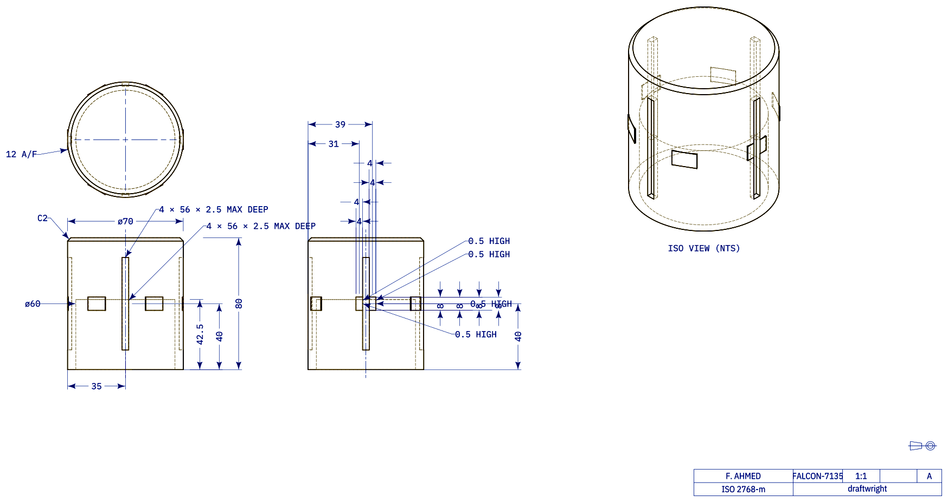
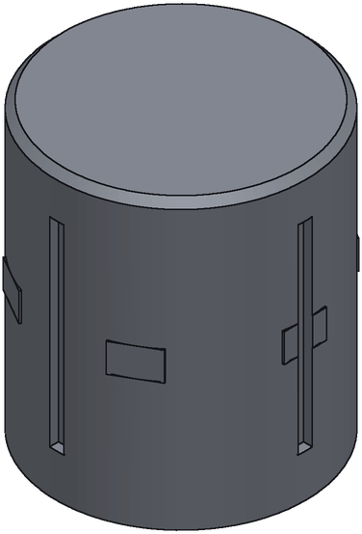
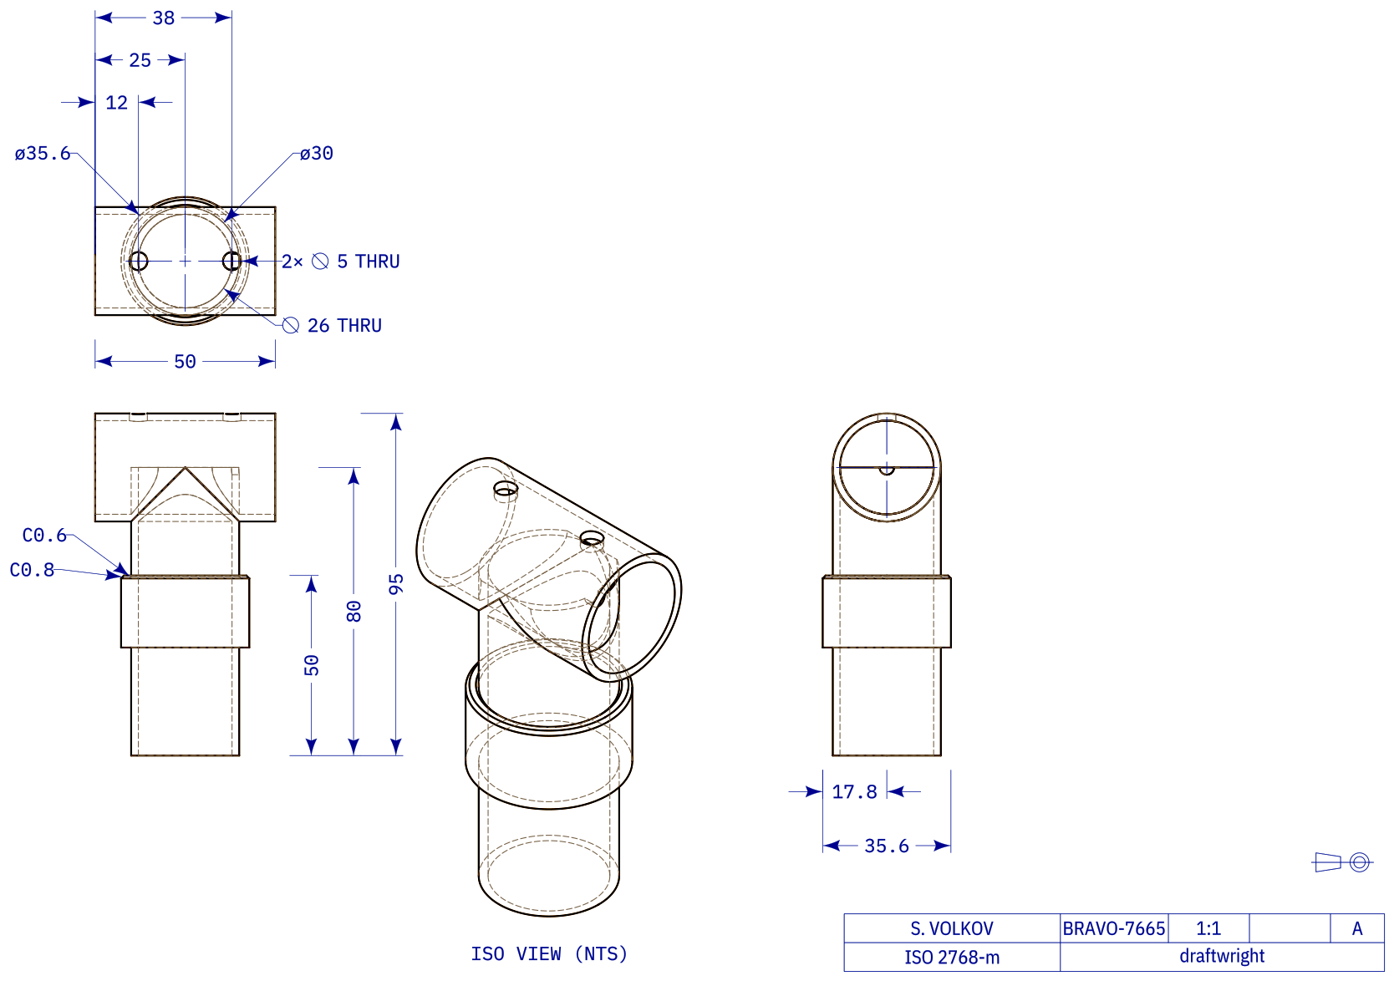
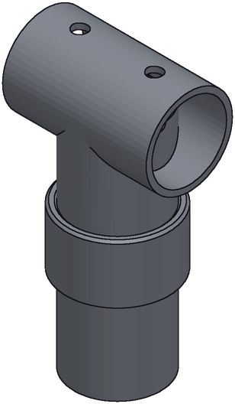
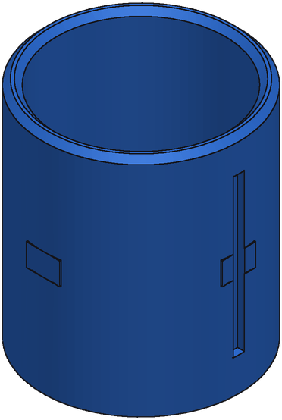
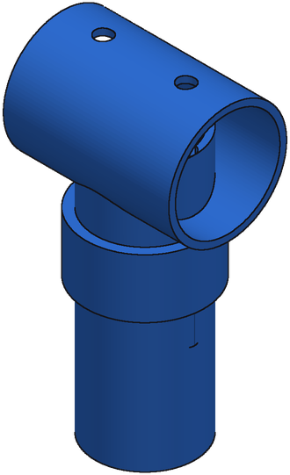
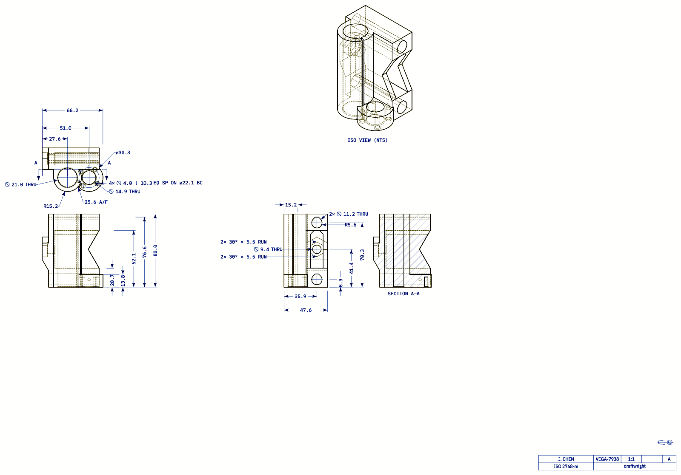
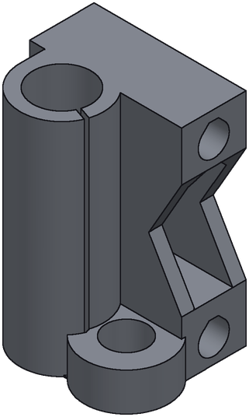
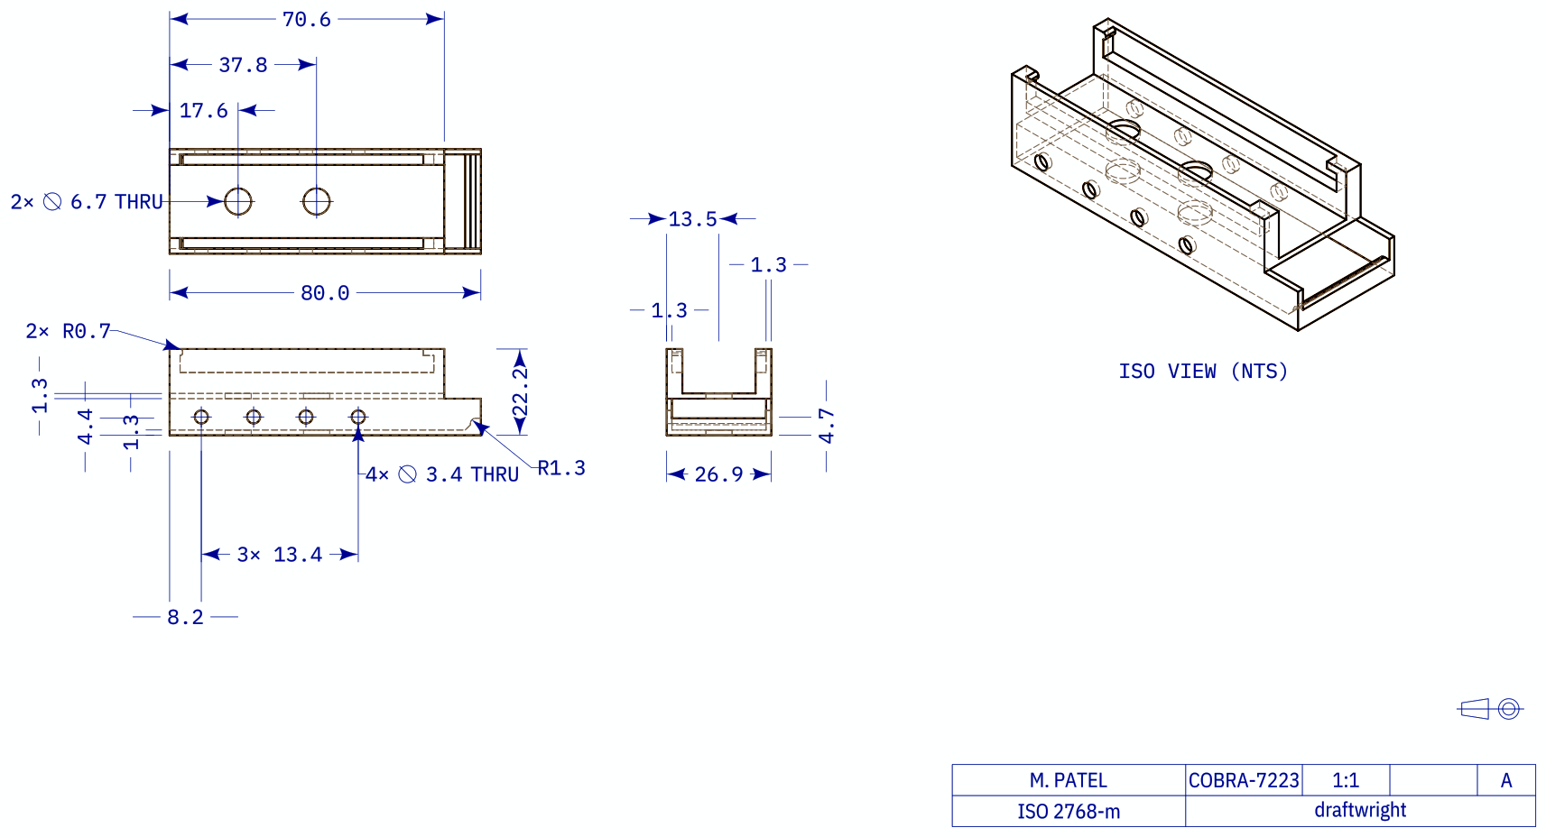
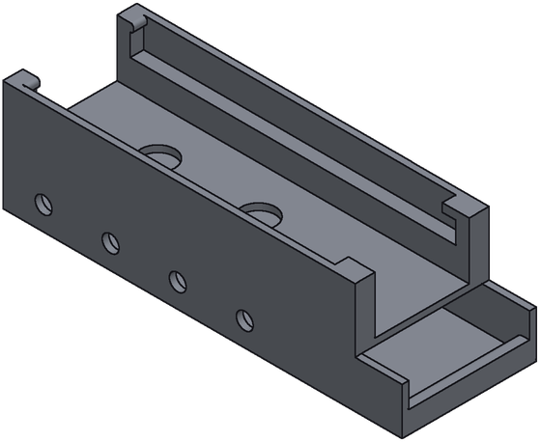
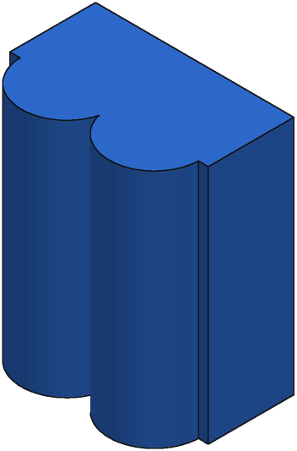
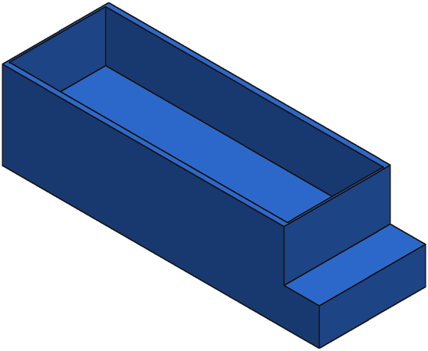
Offset lowers IoU
Offset lowers IoU
IoU 0.42
IoU 0.42
Missing features
Missing features
IoU 0.34
IoU 0.26
Ground truth
Generation
Notes:
Offset lowers IoU: option 36, 0580ef4e-edaa-7eaa-0a10-6105fd6d8ad0, Synthetic parts, 70 faces, IoU 0.421
Offset lowers IoU: option 42, 4ae465ca-2dca-30ef-d26b-ddd501e272bf, Synthetic parts, 25 faces, IoU 0.415
Missing features: option 2, A_00437190_5875024f0dbf5317c8fd357d_step_002_x, Real parts, 69 faces, IoU 0.339
Missing features: option 17, A_00425573_8f6f3508eb000658525e42e6_step_000_x, Real parts, 51 faces, IoU 0.259
SFT + GRPO without repair, bf16 run (21 Oct). Renders at the drawing's isometric camera; ground truth and generation share one scale.

