Slide 1
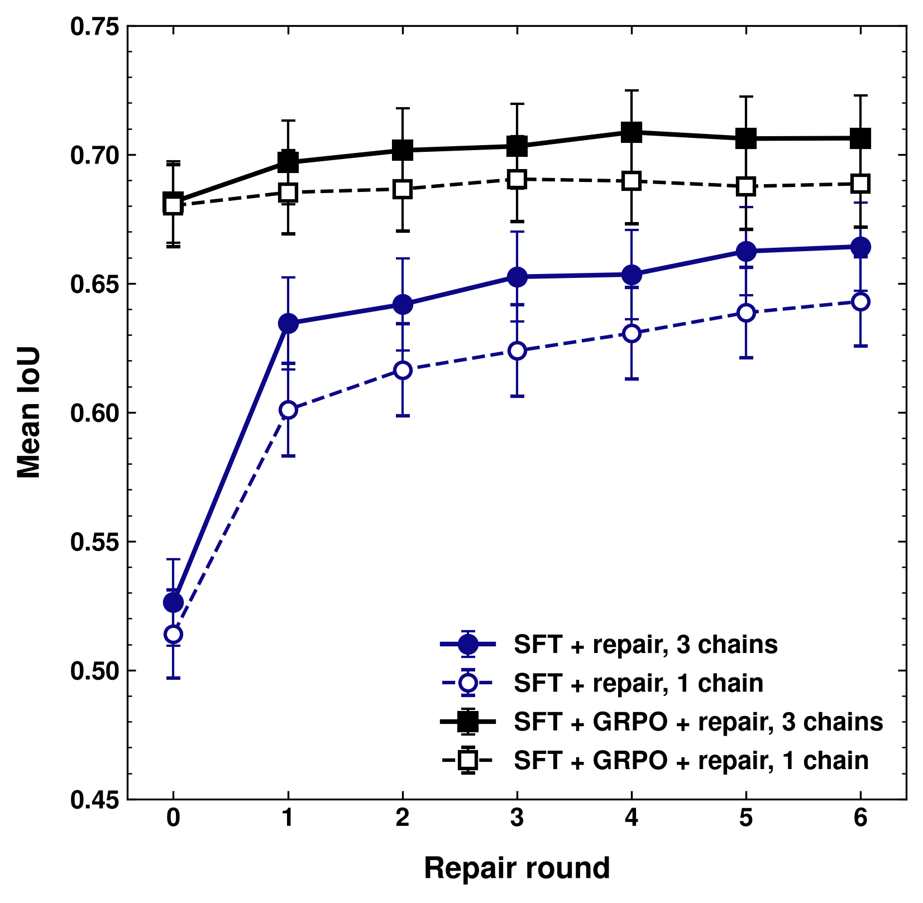
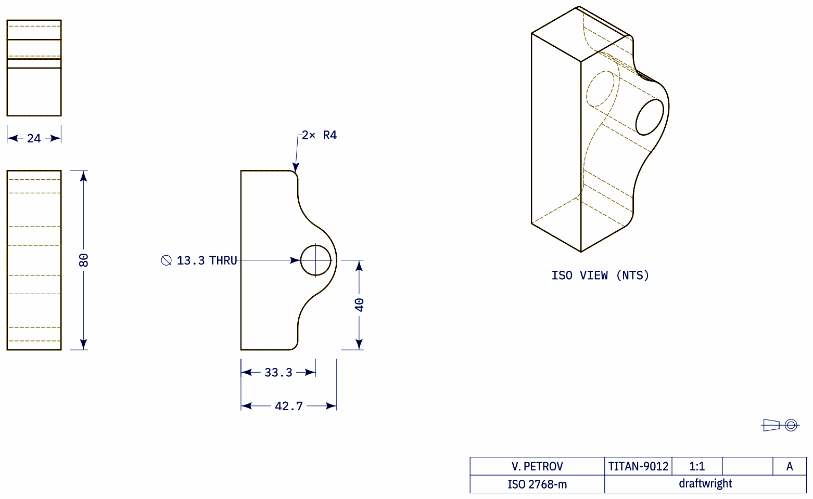
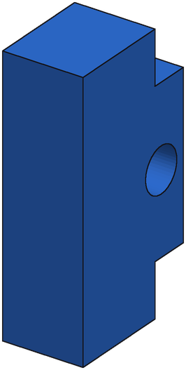
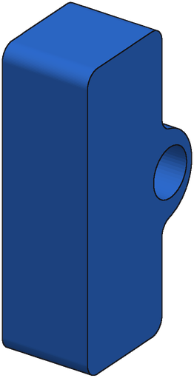
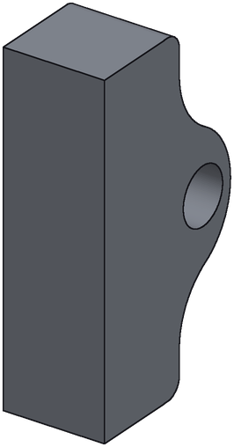
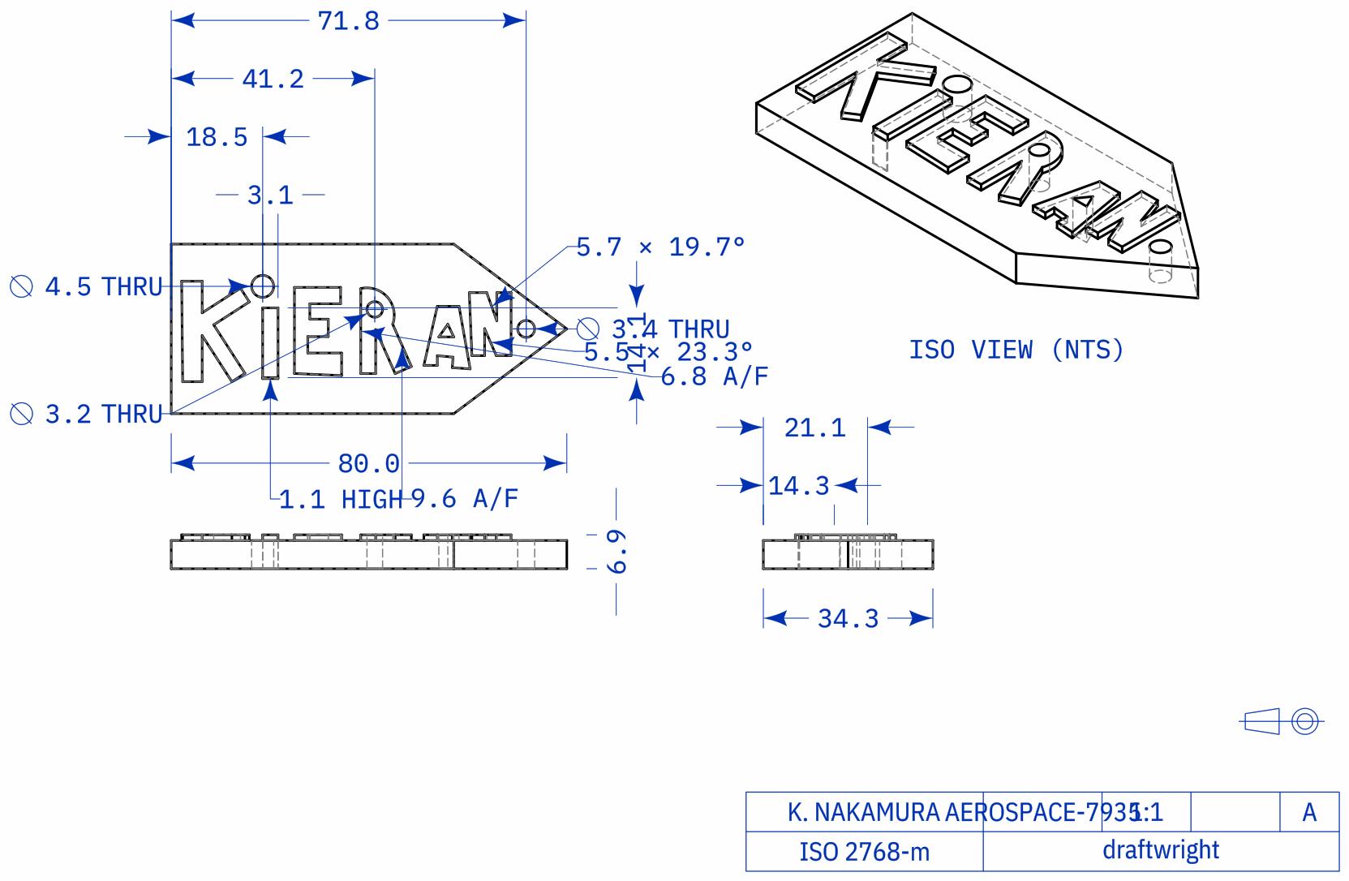
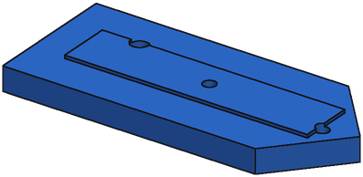
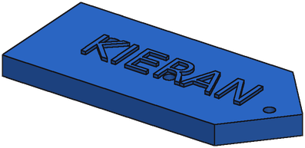
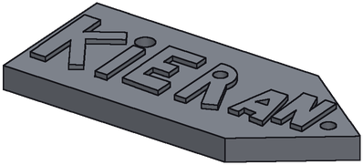
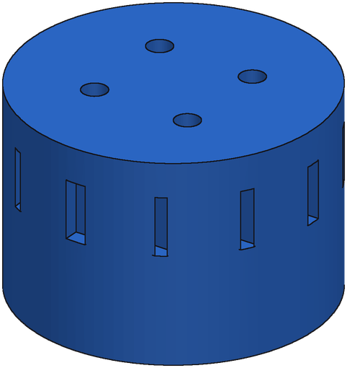
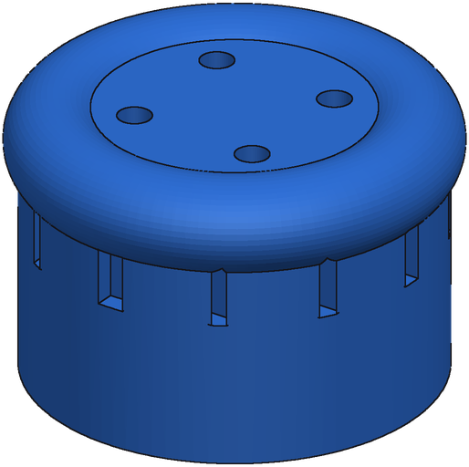
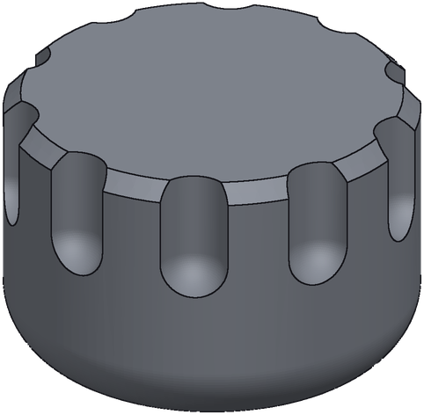
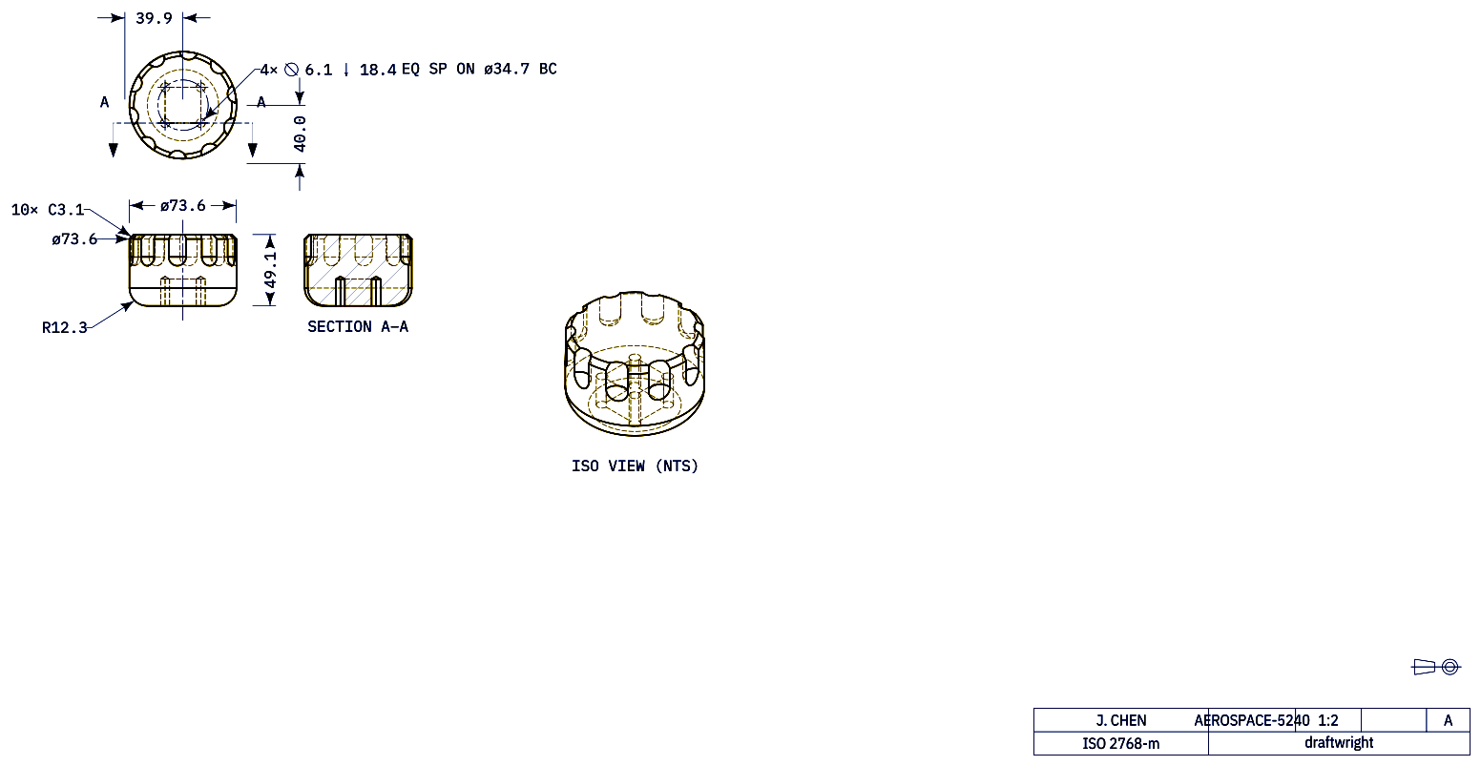
SFT + GRPO Replaces Repair Compute
Drawing
SFT + GRPO
After repair
Ground truth
75th percentile: +0.056
IoU 0.83
IoU 0.88
Median: +0.002
IoU 0.85
IoU 0.86
10th percentile: −0.074
IoU 0.85
IoU 0.77
280 held-out real parts. SFT + GRPO with no repair (0.682) matches SFT alone after 6 repair rounds (0.664); repair on SFT + GRPO adds +0.025 on average. Examples: representative parts by per-part repair gain.
Notes:
Both curves: 3 rp3 repair chains x 6 rounds x 16 repairs, render-compare gate (margin 0.1), served pick = chain with the best render-compare score; mean IoU vs ground truth of the served program after each round, SEM whiskers. SFT = e55, K=8, starts = top-3 distinct by consistency vote (12 Oct run). GRPO = rft2_rl_s60, K=8, starts = top-3 distinct by verifier + render-compare (20 Oct serv-05 run). Paired, 280 parts: GRPO round 0 - SFT round 6 = +0.017 [-0.004, +0.039] (tie); GRPO round 6 - SFT round 6 = +0.042 [+0.020, +0.064]; SFT gains +0.138 from repair, GRPO +0.025 [+0.008, +0.041]. GRPO no repair ~26 s per drawing vs ~294 s with repair.

Slide 2
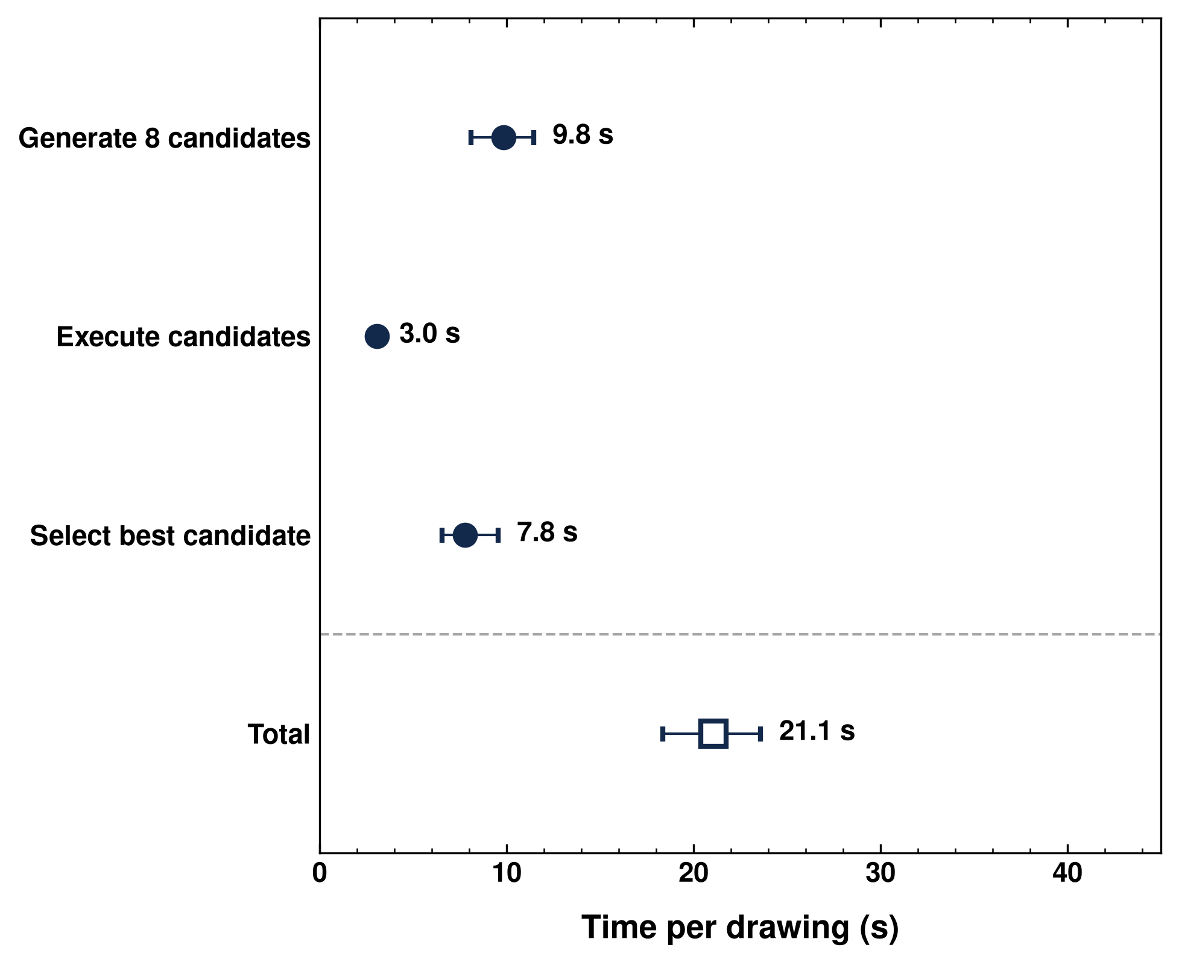
SFT + GRPO Pipeline: Time per Drawing
Stage | Time (s), mean ± std
Generate 8 candidates | 9.9 ± 2.9
Execute candidates | 3.2 ± 0.5
Select best candidate (render-compare) | 8.9 ± 4.8
Pipeline total (no repair) | 22.0 ± 6.4
Mean IoU | 0.677
Optional: repair (3 chains × 6 rounds) | 267.9 ± 142.9
Total with repair | 294.3 ± 145.2
Mean IoU, before → after repair | 0.680 → 0.706
280 held-out real parts (bench B); one model in bf16, a copy on each of 8 H200s, 8 drawings in flight. Repair rows (grey): separate run with repair; it adds ~+0.025 IoU for ~10× the time.
Notes:
Generate = 1 greedy + 7 sampled candidates (T 0.7, thinking, 2,400 tokens) from the SFT + GRPO model, bf16, one copy per H200 (vLLM data parallel 8, 21 Oct, wpk-serv-05); execute = build123d -> STEP + STL; select = render each executing candidate as a drawing and pick the best render-compare match (no verifier: offline it ties verifier + render-compare, +0.002 on bench B and synthetic). Chart = median with interquartile whiskers. Repair rows come from the 20 Oct run with repair (3 rp3 chains x 6 rounds, verifier + render-compare starts, 6 drawings in flight): total with repair 294.3 ± 145.2 s, IoU 0.680 -> 0.706.

Slide 3
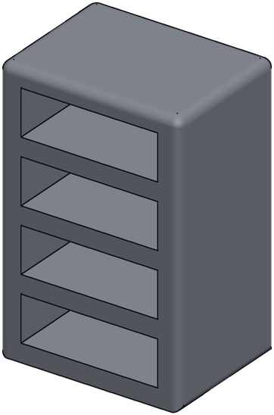
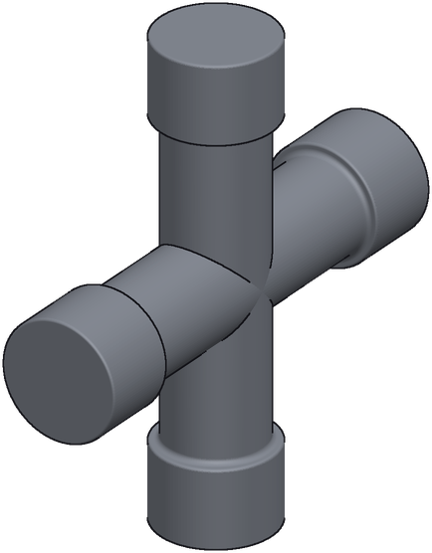
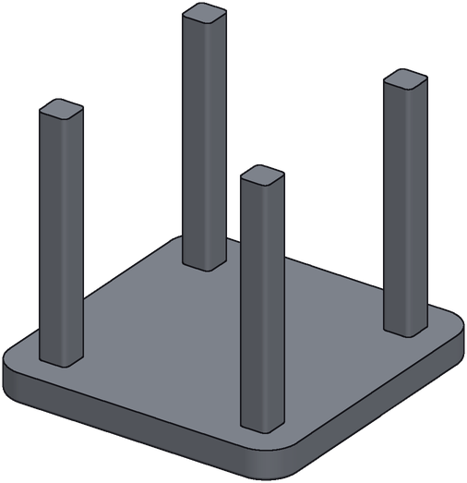
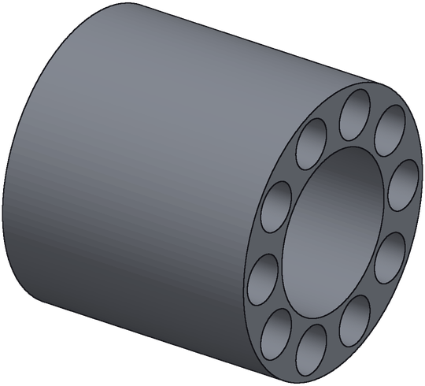
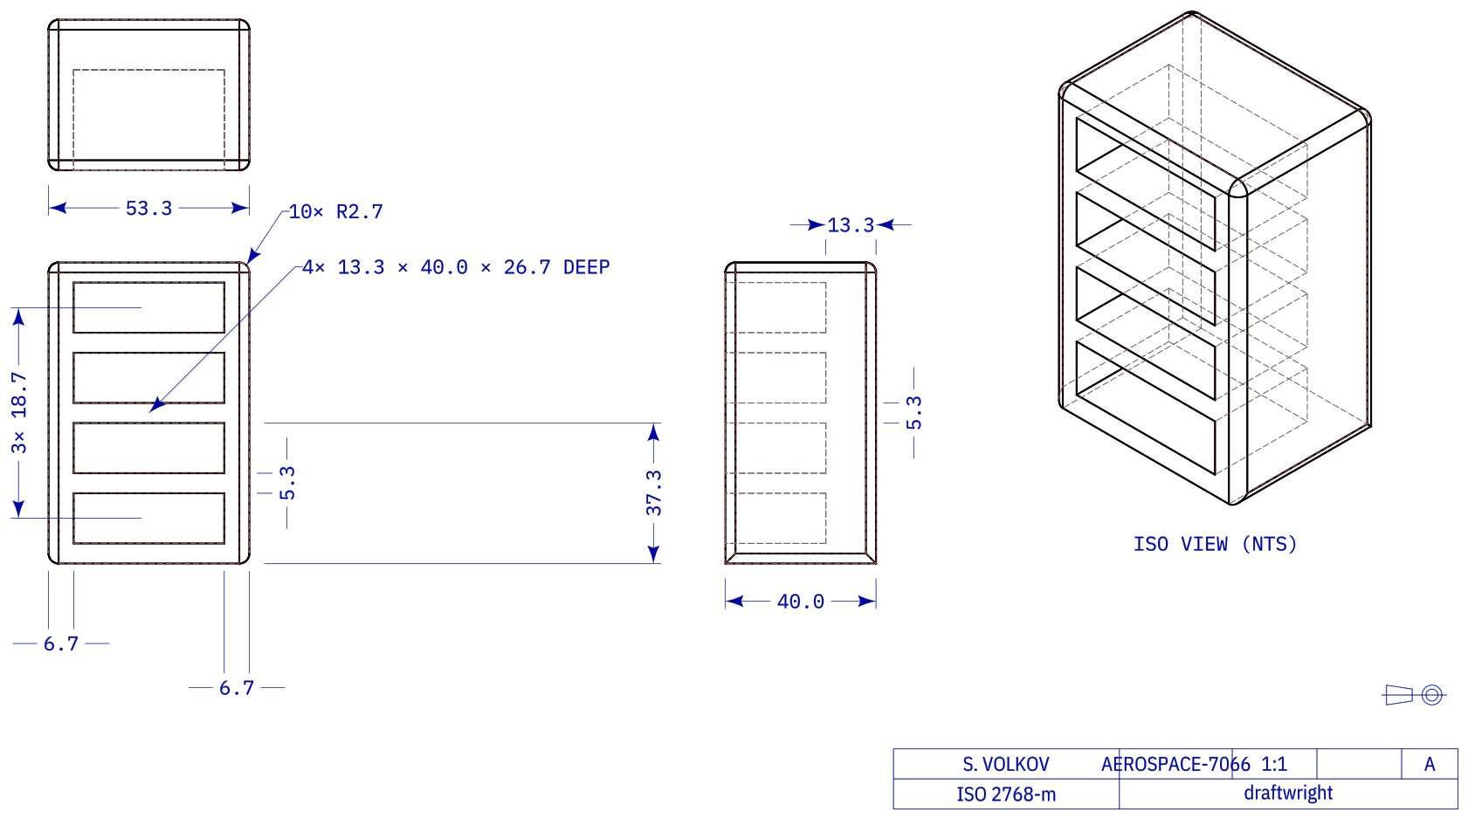
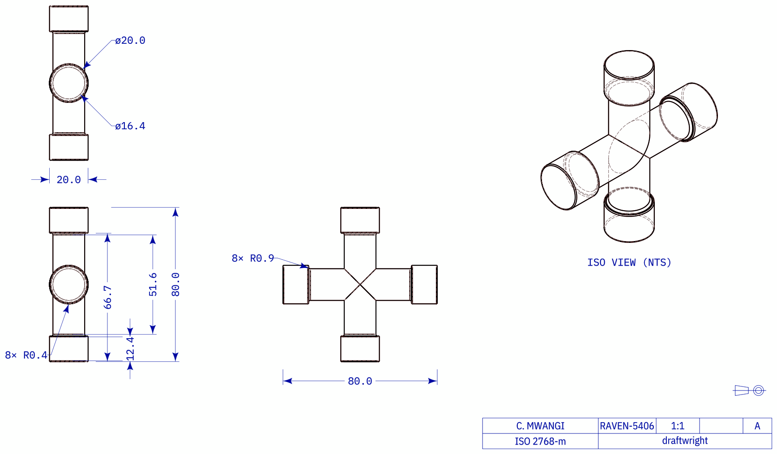
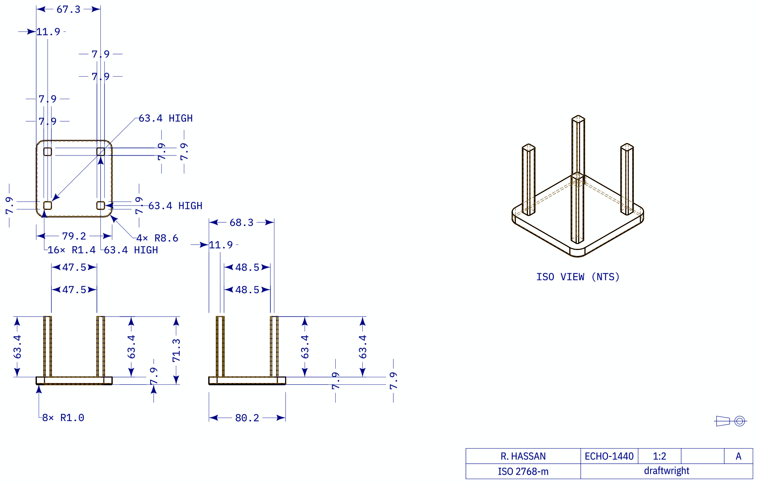
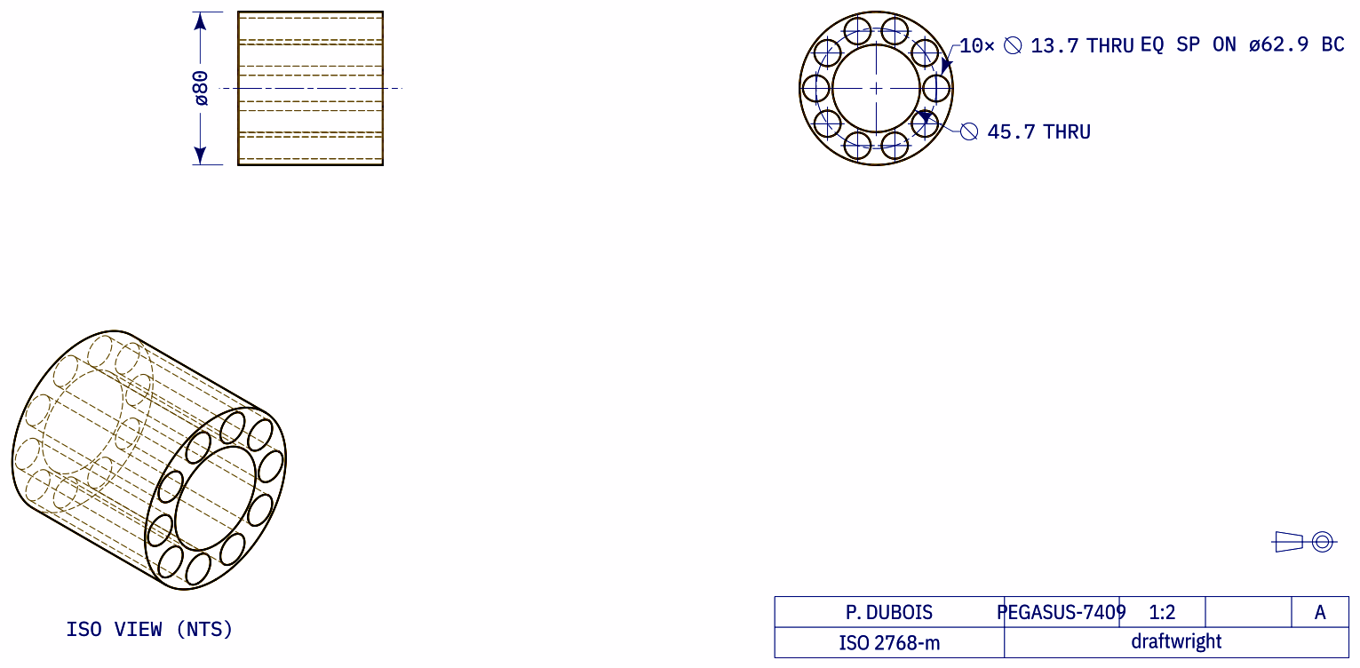
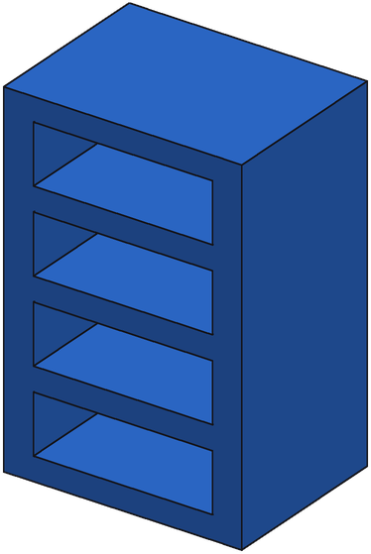
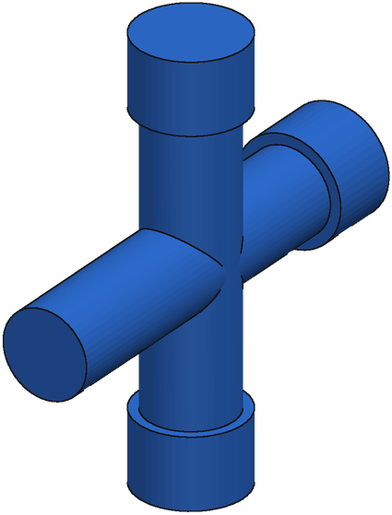
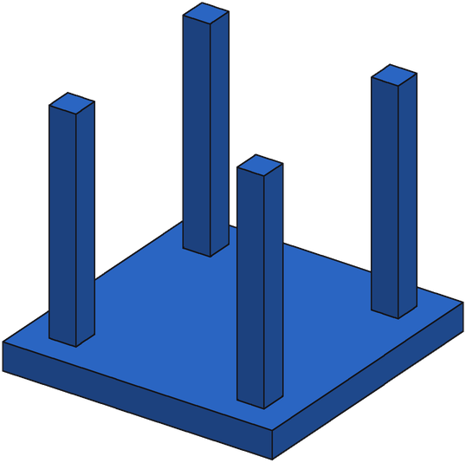
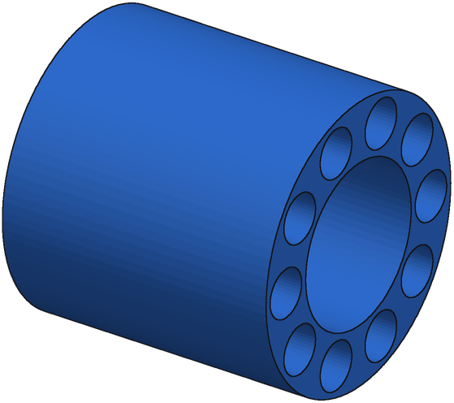
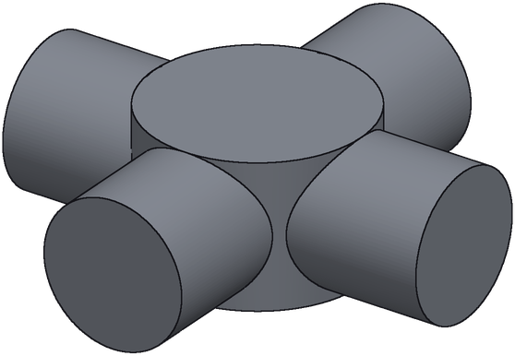
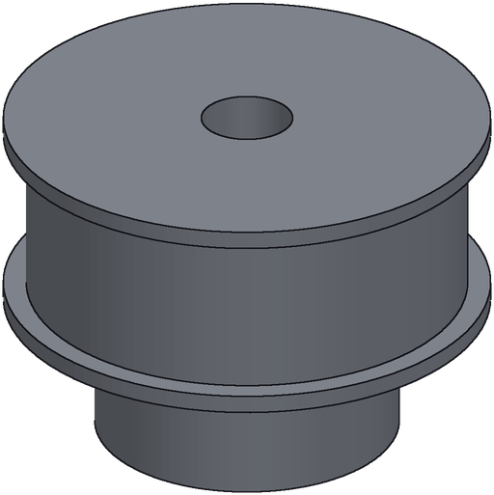
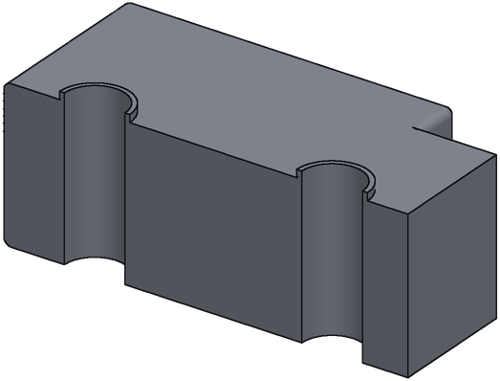
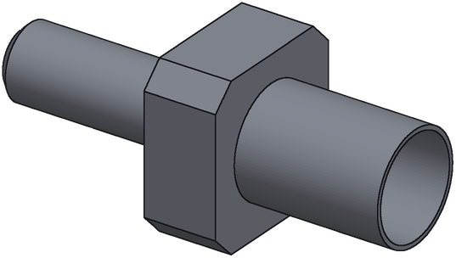
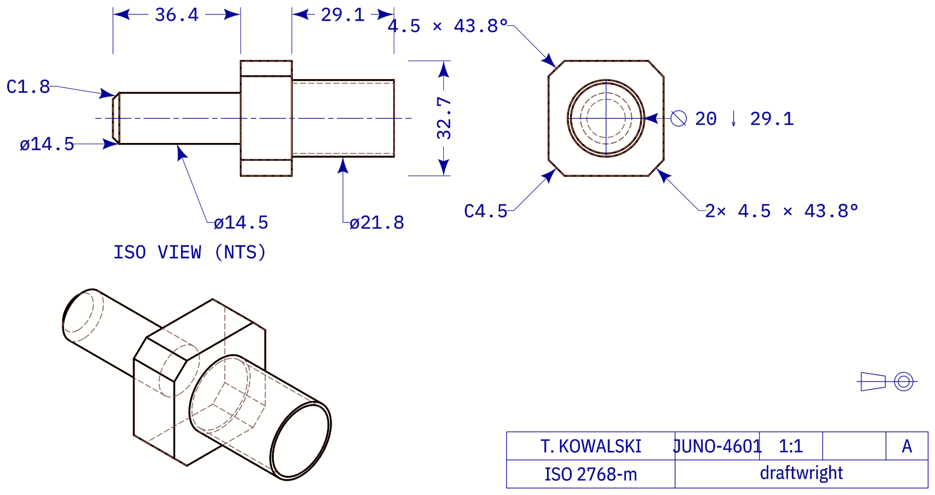
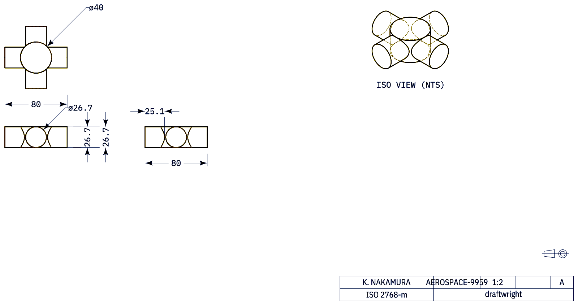
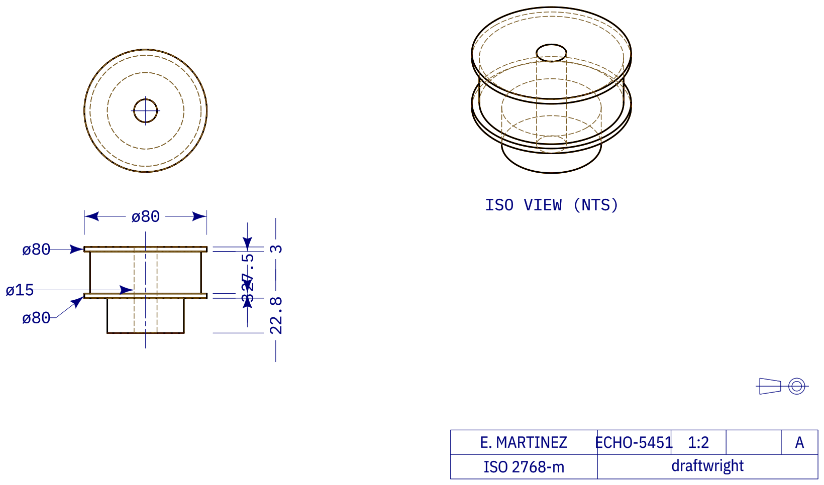
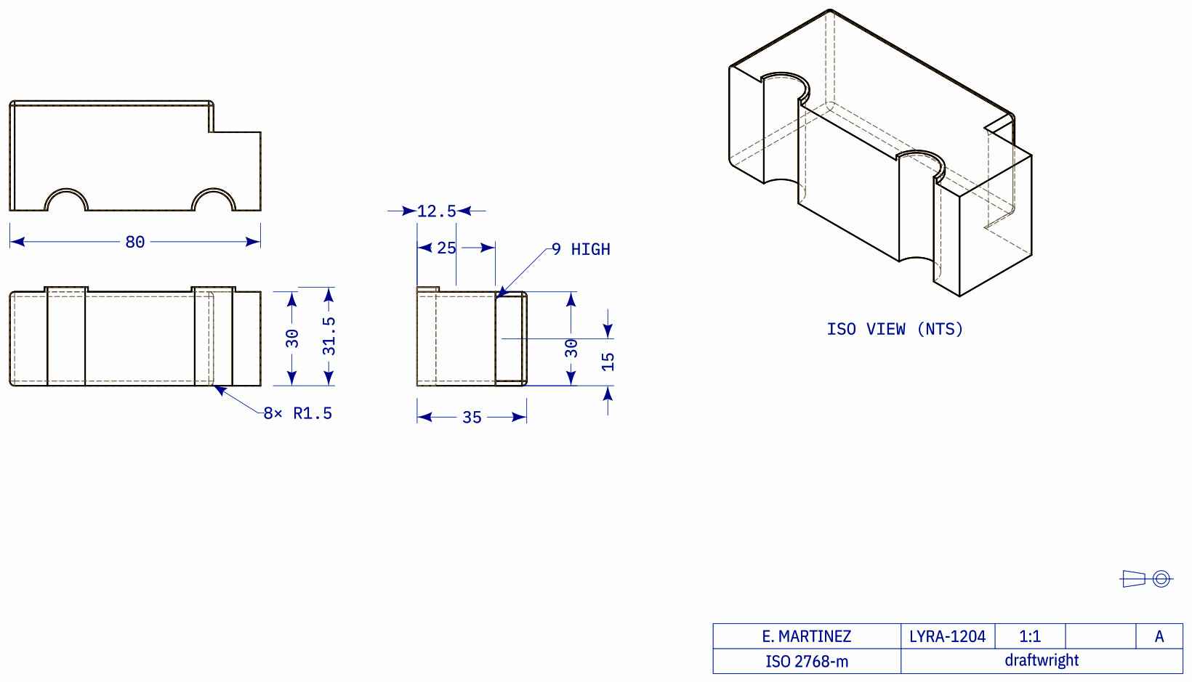
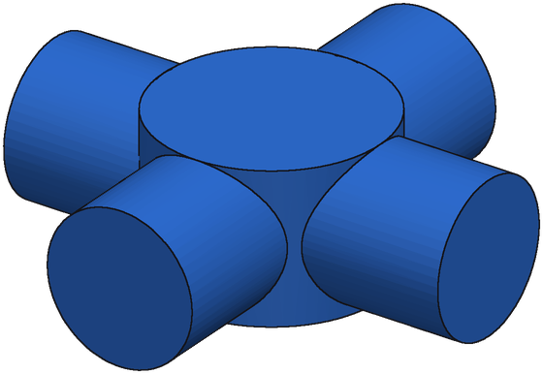
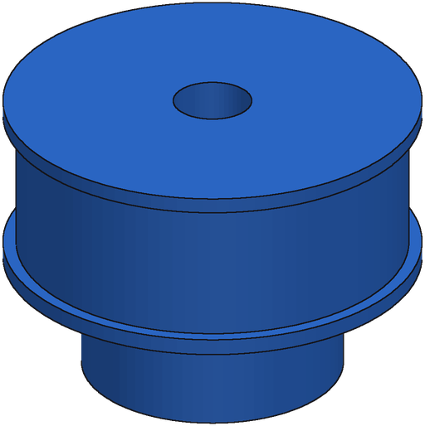
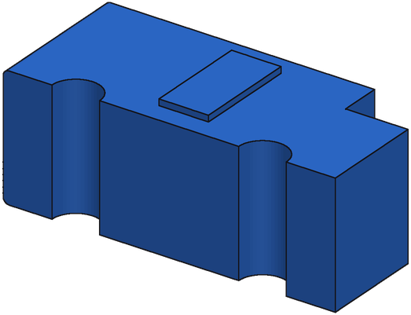
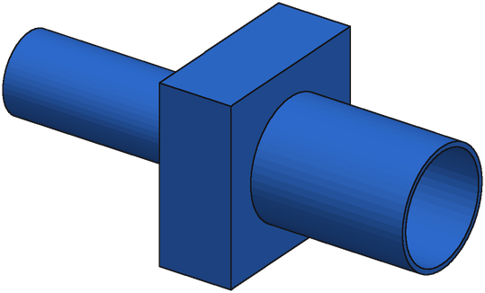
SFT + GRPO Reconstructions
Ground truth
SFT + GRPO
Shelving unit
Cross pipe fitting
Plate with four posts
Bored cylinder, hole ring
IoU 0.988
IoU 0.939
IoU 0.977
IoU 0.938
Shaft with square boss
Four-way hub
Flanged pulley
Slotted block
IoU 0.934
IoU 0.998
IoU 0.951
IoU 0.978
Held-out real parts (bench B). SFT + GRPO, 8 candidates, best one picked without labels; no repair (~26 s per drawing).

Slide 4
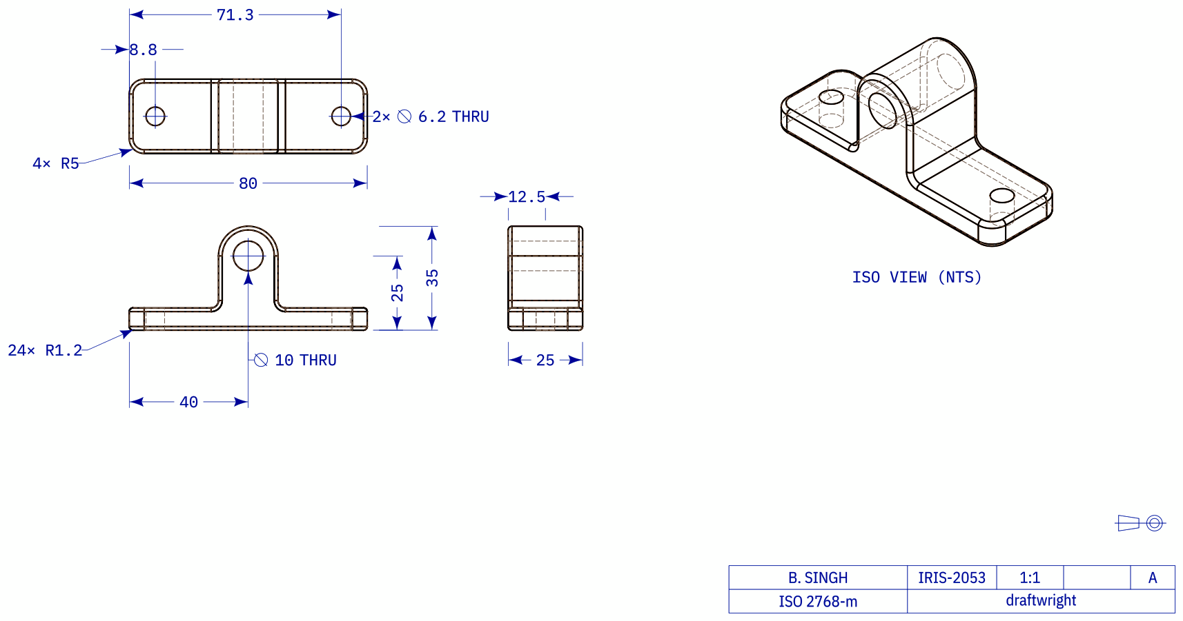
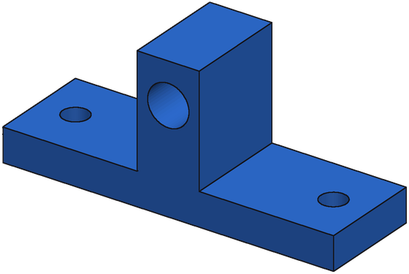
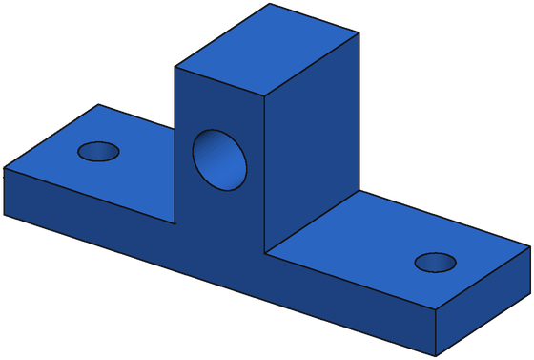
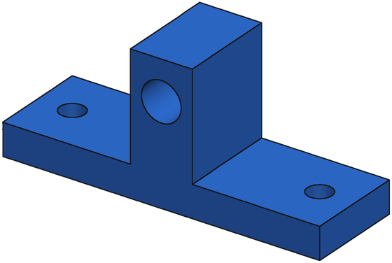
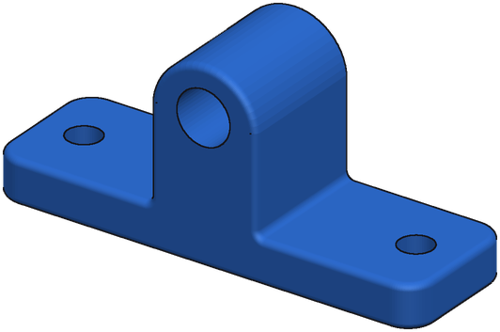
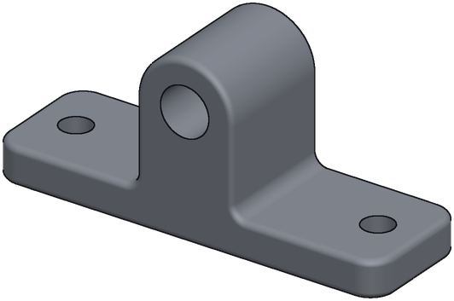
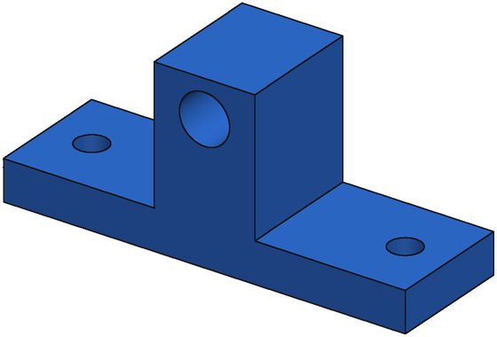

One Drawing Through the Pipeline
Generate 10 s · Execute 4 s · Select 11 s · Repair 333 s · total 359 s
1. Eight candidates
2. Repair (served chain)
IoU 0.85
IoU 0.82
IoU 0.85
IoU 0.86
Input drawing
Start
IoU 0.82
Round 2
IoU 0.95
Ground truth
IoU 0.88
IoU 0.85
IoU 0.85
IoU 0.85
outlined = 3 repair starts
Bench-B part. Candidates are ranked by the verifier + render-compare score (no ground truth); IoU shown for reference.

Slide 5
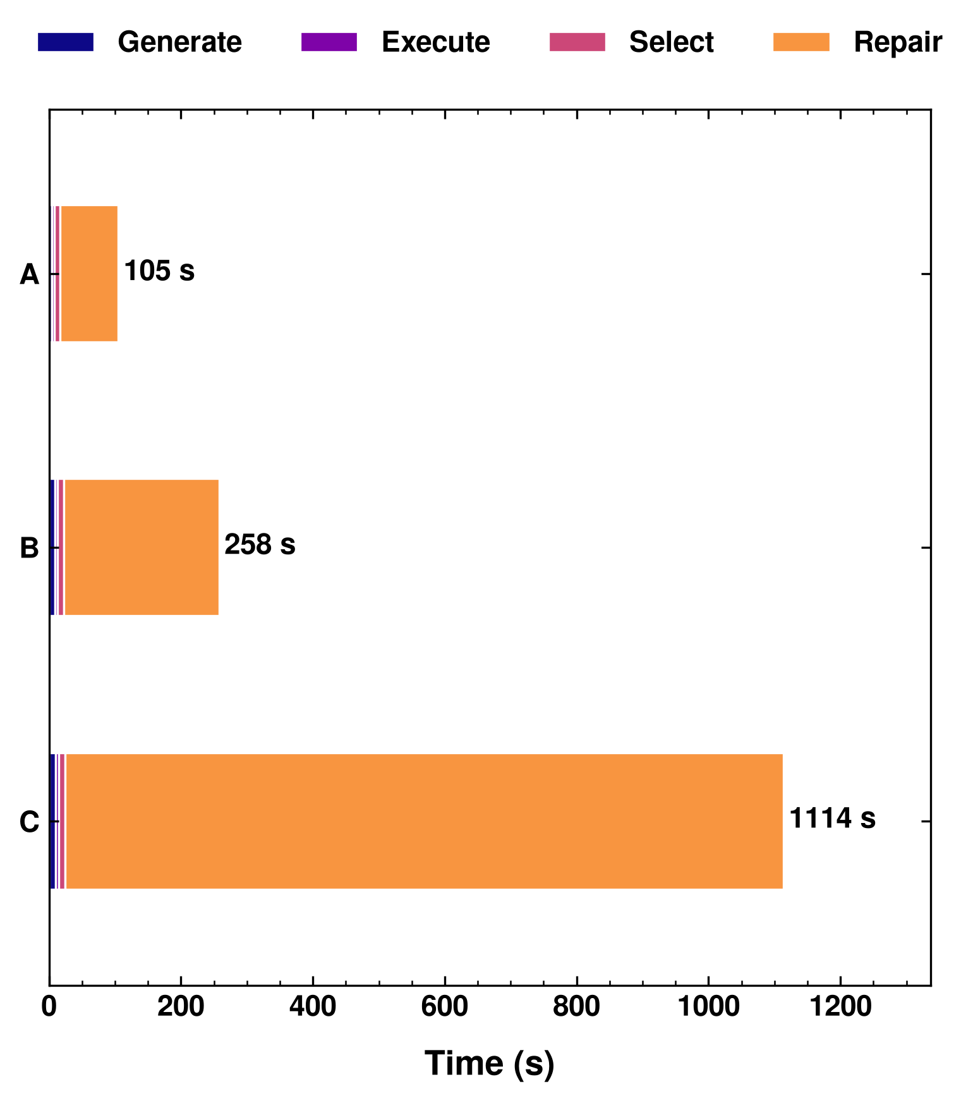
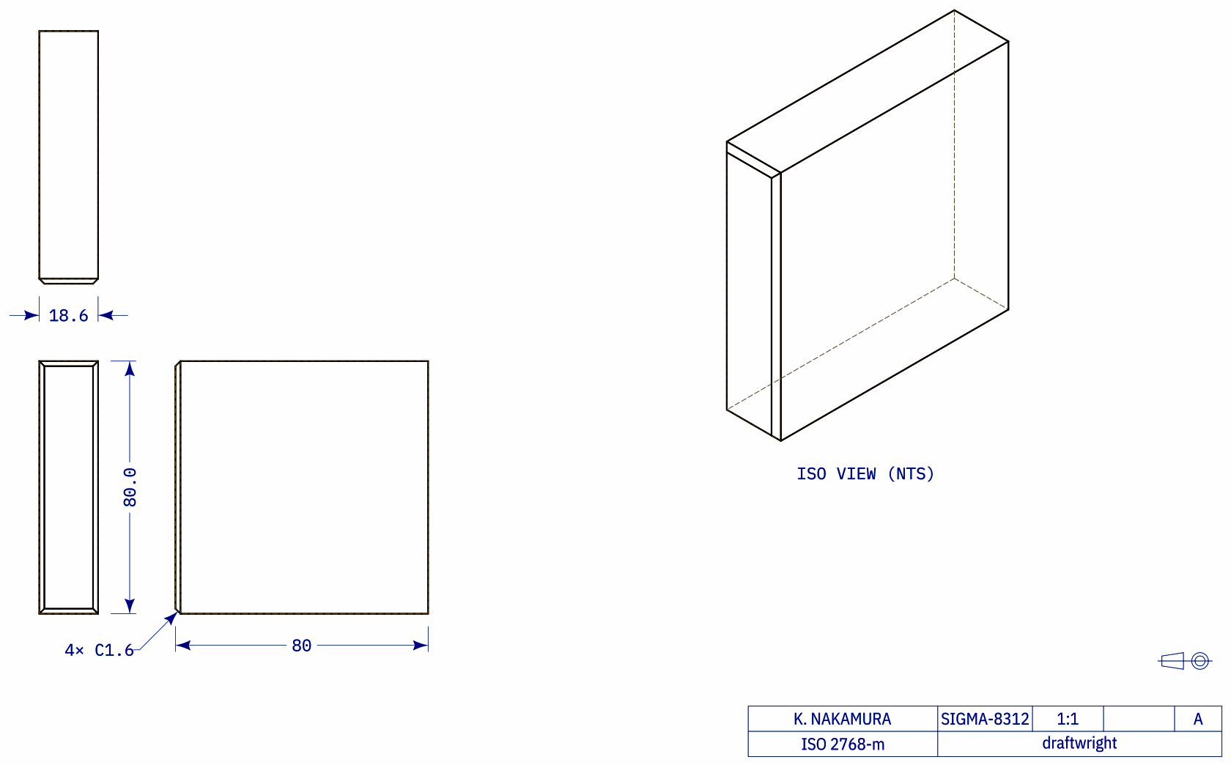
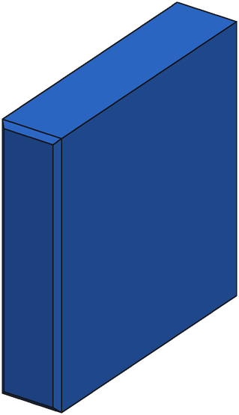
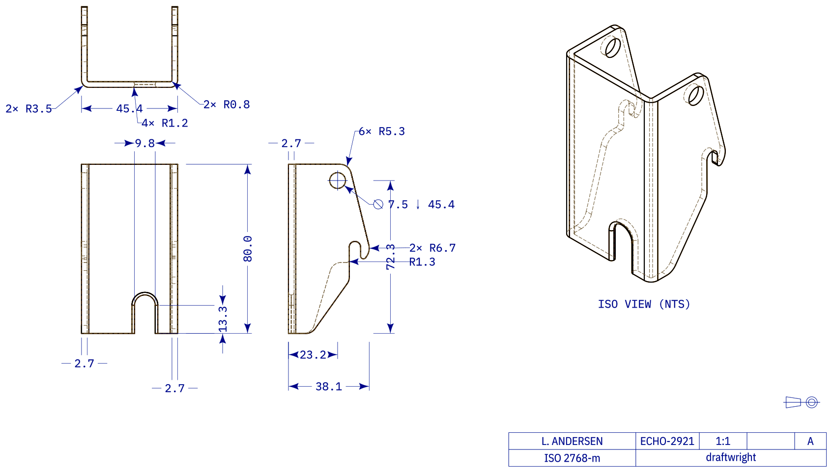
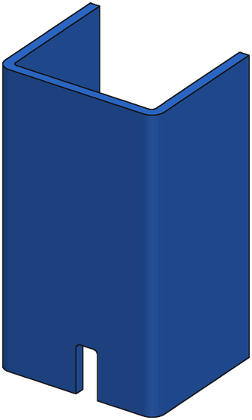


Where the Time Goes
A
105 s
repair 84% of time
IoU 1.00 → 1.00
B
258 s
repair 91% of time
IoU 0.75 → 0.77
C
1114 s
repair 98% of time
IoU 0.74 → 0.97

Slide 6

Part Complexity vs Pipeline Time
A
B
C
105 s
258 s
1114 s
Called-out parts are separate images: move, resize or delete them as needed.

Slide 7













Part Complexity, Time and Accuracy
Drawing
SFT + GRPO
Ground truth
A
345 faces · 36 s · IoU 0.87
B
255 faces · 35 s · IoU 0.89
C
109 faces · 62 s · IoU 0.70
D
37 faces · 68 s · IoU 0.74
Notes:
SFT + GRPO without repair: 8 candidates -> execute -> render-compare pick (no verifier: offline it ties verifier + render-compare, +0.002 on bench B and synthetic). bf16, one copy per H200 (vLLM data parallel 8, wpk-serv-05, 21 Oct), 8 drawings in flight. Time = generate + execute + select per drawing; IoU = ground truth vs the served pick. Squares = bench B (280 real), circles = synthetic pool (1,027). Left out: 7 synthetic parts above 150 s (193-315 s), render-compare timeouts (300 s cap on one candidate's drawing render). Renders at the drawing's isometric camera. A: 47adc310-e94b-4f63-6f3f-66e84b834f1a; B: 533abec2-4fd4-5a40-a13d-b433aa8cab0e; C: 938a49c0-9465-9f43-2866-78f160c971b2; D: A_00435481_238d07e52f28263bd5d645f4_step_000_x

